Slide 1
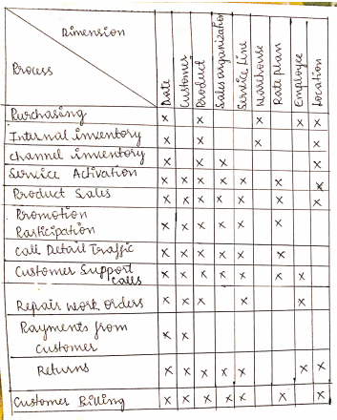
1. First construct a Data Warehouse Bus Matrix to identify the company's business processes and any likely Data Marts.

Slide 2
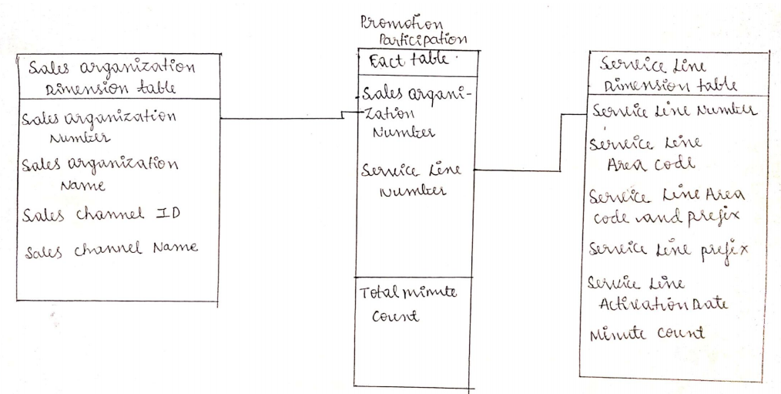
2. Design the star schema/Snowflake for any Data Marts you have identified, ensuring your Dimensions are conformed, primary and foreign keys are clearly labeled, and that your attributes are named using verbose textual descriptions.

Slide 3
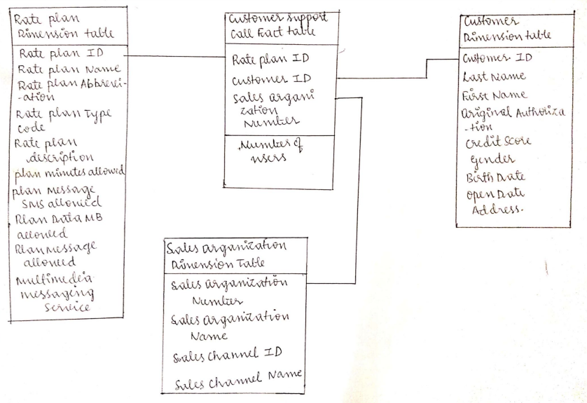

Slide 4
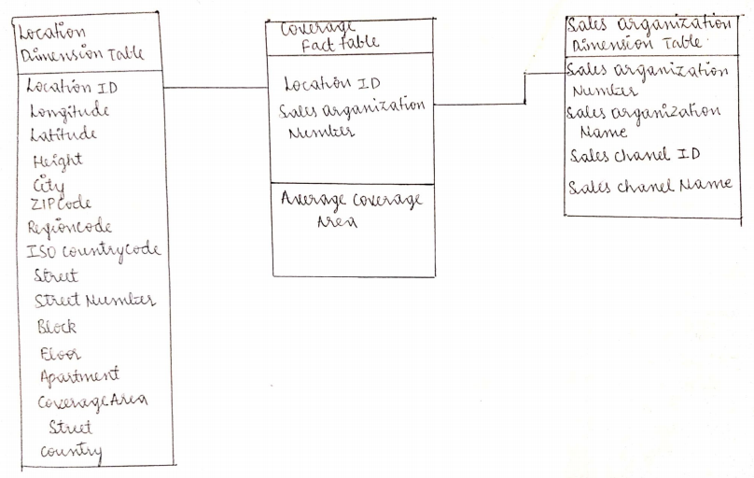

Slide 5
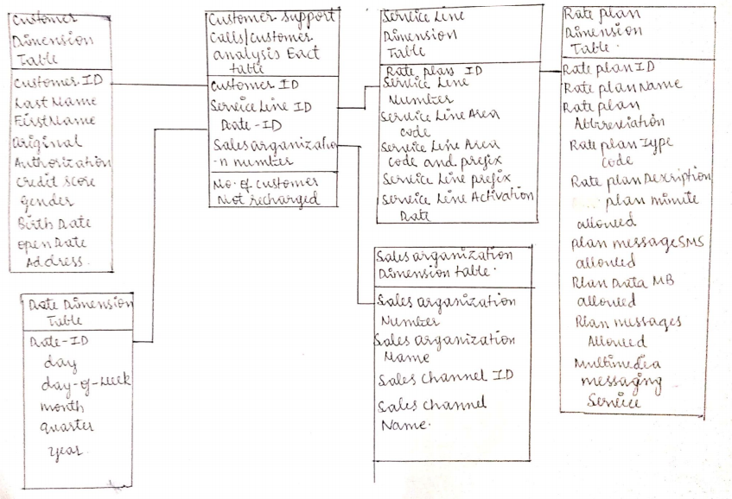

Slide 6
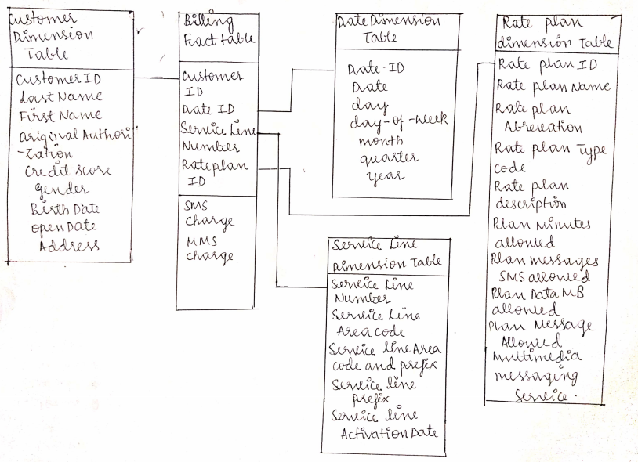

Slide 7
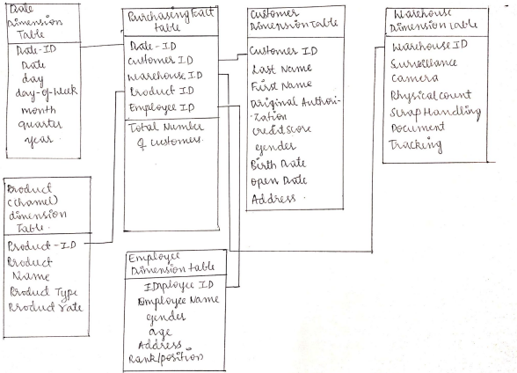

Slide 8
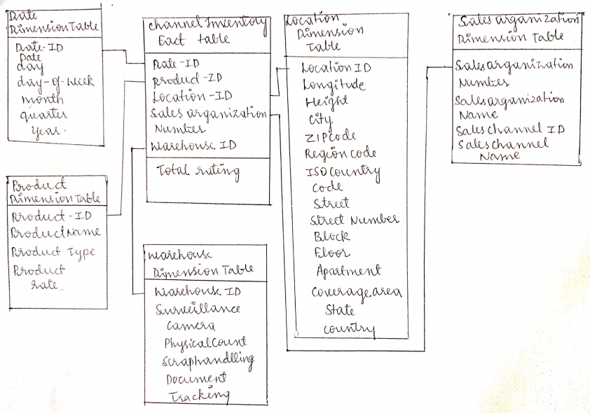

Slide 9
3. Create the following table with a row for each fact table in your design, indicating the granularity of each fact and a brief justification for choosing that granularity
Fact Table Name | Fact Granularity | Fact Table Type | Brief Justification
Promotion Participation | Total minute count -> Low granularity | Additive | Measure is the sum of the minute count present in the service line dimension table
Customer Support call | Number of users -> Low level | Semi Additive | Any of the dimension present
Coverage | Average coverage area | Additive | Coverage are is summed up through all of the dimensions in the fact table

Slide 10
Customer support calla/ Customer analysis | Number of customers not recharged -> High granularity | Non Additive | Here we are counting the number of customers and not adding
Purchasing | Total number of customers | Non Additive | Here we are counting the customers who are purchasing the particular channel
Channel Inventory | Total rating | Additive | Here we are adding the rating of the particular product

Slide 11
Billing | SMS charge -> High granularity MMS charge -> High granularity | Semi Additive | Rate plan can be summed up Date cann’t be summed.

Slide 12
4. Create the following table with a row for each dimension table in your design, giving a brief justification for choosing that dimension, and indicating any attribute hierarchies that exist within the dimension.
Dimension Table Name | Brief Justification | Attribute Hierarchy
Date | We want Date dimension table in Billing to track how many SMS ,MMS have delivered or received at that particular date. In Customer support calls/Customer analysis the date is used to detect whether the warranty of the customer has been expired based on the date on which customer had recharged a particular data plan rate previously. | Date -> Day -> Day_of_weak -> Month -> Quarter -> Year

Slide 13
Customer | Information regarding the customers are stored in this table according to heirarchy. | Customer_ID -> Last_Name -> First_Name -> Original Authorization Credit Score -> Gender -> Birth Date -> Open Date -> Address
Product | Information regarding the various channels , and their Models are stored in this table it is used in the channel inventory and purchasing process. | Product ID - > Product Name - > Model ID -> Variant ID
Sales Organization | Each service line is sold in a unique organization and a unique sales channel. Sales Organization includes various organizations names for example like Airtel,Idea,starplus etc. Their id and name. | Sales Organization Number - > Sales Organization Name - > Sales Channel ID – > Sales Channel Name

Slide 14
Service Line | A phone number can also be considered as a service line. A wireless telecommunication company has millions of service lines. Each service line is associated to a customer. | Service Line Number - > Service Line Area Code - > Service Line Prefix -> Service Line Activation Date -> Minute Count
Warehouse | Warehouse stores the information from multiple sources. Warehouse stores internal information about the security, profit and loss , and about documents | Warehouse ID -> Surveillance Camera -> Physical Count -> Scrap Handling ->Document -> Tracking
Rate Plan | For each service line or phone number there is a single rate plan associated, but rate plan can evolve in time, as the customer’s requirements and usage habits evolve. | Rate Plan Name -> Rate plan Abbreviation -> Rate Plan Code -> Rate Plan Description -> Plan Message SMS Allowed -> Plan Data MB Allowed -> Plan Messages MMS Allowed -> Night weekend Minutes Allowed

Slide 15
Employee | Employee plays major role in sales organization. This dimension table contains detail about the employee. | Employee ID -> Employee Name -> gender -> age -> Addresses -> Rank/Position
Location | Location is useful in tracking the service line of sales organization. To give the service to customer location is important so it also plays an major role. | Location ID - > Longitude -> Latitude - > Height - > City > ZIP code - > Region Code - > ISO Country Code - > Street - > Street Number - > Block - > Floor > Apartment -> Coverage Area - > State - > Country

Slide 16
5. List down at least 10 business questions (Analytical queries ) that will be posed on the designed data warehouse
Process : Promotion participation.
Providing songs for the users as ringtone for particular organization. Owner of the song should pay for the organization.
Query : Find the sales organization number, sales organization name, whose total minute count is greater than 10,00,000 per day.
Process: Customer support call.
For other organization to give the same type of plan or more attractive for healthy competition.
Query : Find the rate plan code, rate plan description, rate plan name, abbreviation, plan minutes allowed, Plan messages SMS allowed, plan data MB allowed, plan message MMS allowed.
Rank based on the highest number of users , all the rate plans of particular organizations.
3. Process : Service Activation
To find average coverage area of particular organization.
Query : Find the average coverage area with respect to sales organization and location(longitude, latitude, Street, country).

Slide 17
4. Process : Customer support call
Listing the customers who have not reached.
Query : Find the total number of customer who have not recharged and list them with respect to the sales organization Number.
5. Process : Customer Analysis.
Top n customers based on rate plan of particular organization. Used by digital marketers. To find the loyal customers.
Query : Determine the top 10 customers of sales organization based on the days they have started using.
6. Process : Customer billing
Query : Find the Customer Name,MMS charge,SMS charge ,Original Authorization, Credit score whose “service line prefix= 91”,and rate plan minutes allowed is 2000 sec.
7. Process : Purchasing
Total number of customers purchased a particular channel. Top n channels purchased by customers. Least n channels purchased by customer. To convert black money to white money.
Query : Determine the top 10 product names based on the number of customers.

Slide 18
8. Process : Warehouse
Surveillance Camera : It provides a video record of all the activity that occurs in the warehouse and on the production line. Security camera allows the management to catch employees engaging in unethical behavior.
Query : Find the surveillance Camera, Document with respect to Product Name, Product Type.
9. Process : Internal inventory
Physical count : Companies conduct physical inventory count periodically and compare the inventory counted to the inventory recorded in the system. This allows the company to identify any discrepancies.
Query : Find the physical Count, Employee name with respect to the product name, product type.
10. Process: Channel inventory
Demand: To find the ratings of the sales organizations.
Query : Find the total rating with respect to the product name, Iso country code.

Slide 19
6. Identify which fields from your facts/dimensions are required to answer each of the above business questions
Query Number | Facts / dimension | Fields
1 | Sales organization Dimension table | Sales organization number Sales organization Name
1 | Promotion Participation Fact table | 1. Total minute count
1 | Service Line Dimension table | 1. Minute Count
2 | Rate plan dimension table | Rate plan Name Rate plan Abbreviation Rate plan type code

Slide 20
2 | Rate plan dimension table. | 4. Rate plan description Plan minutes allowed Plan message SMS allowed Plan Data MB allowed Multimedia
2 | Customer Support call fact table | 1. Number of users
3 | Coverage fact table | 1. Average Coverage
3 | Sales Organization Dimension table | 1. Sales organization Name
3 | Location dimension table | Longitude Latitude Street Country

Slide 21
4 | Customer Support Call Fact table | 1. Number of customers recharged
4 | Rate plan dimension table | 1.Rate plan
4 | Sales organization dimension table | 1.Sales organization Number
5 | Customer dimension table | Last name First name Original Authorization credit score
5 | Date dimension table | Day Day of the week Month Quarter Year

Slide 22
6 | Billing fact table | SMS charge MMS charge
6 | Rate plan dimension table | 1. Plan minutes allowed
6
7 | Product dimension table | 1. Product Name
7 | Purchasing fact table | 1. Total number of customers
7 | Customer dimension table | 1. Customer ID
8 | Warehouse dimension table | Surveillance Camera Document
8 | Product dimension table | Product Name Product type

Slide 23
9 | Warehouse dimensional table | 1. Physical count
9 | Employee dimensional table | 1. Employee Name
9 | Product dimensional table | Product Name Product Type
10 | Channel Inventory fact table | 1. Total rating
10 | Product dimensional table | Product Name Product Type
10 | Location dimensional table | ISO country code

Slide 24
7. What specific OLAP operations (roll-up, drill down, etc.,) should one perform in order to give solution to above business questions
Query 1
1. Roll up on the sales organizations from sales organization number to sales organization name.
2. Roll up on the service line from service line number to minute count.
3. Total minute count is measure.
Query 2
1. Roll up on the Rate plan from Rate plan ID to Rate plan Type Code.
2. Roll up on the Rate plan from Rate plan type code to Rate plan description.
3. Drill down on the Rate plan from Rate plan description to rate plan name.
4. Roll up on the Rate plan from Rate plan name to Rate plan abbreviation.
5. Roll up on the Rate plan from Rate plan abbreviation to plan minutes allowed.

Slide 25
6. Roll up on Rate plan from plan minutes allowed to plan messages SMS allowed.
7. Roll up on Rate plan from plan messages SMS allowed to plan data MB allowed.
8. Roll up on Rate plan from plan data MB allowed to plan message MMS allowed.
9. Slice on sales organization with sales “ organization Name= Airtel”.
Query 3
1. Roll up on the Location from Location Id to longitude.
2. Roll up on the Location from Longitude to latitude.
3. Roll up on the Location from latitude to street.
4. Roll up on the location from street to country.
5. Average Roll up on the sales organization from sales organization number to sales organization name.
6. Average coverage Area is measure.
Query 4
1. Roll up on customers from Cutsomer Id to last name.
2. Roll up on sales organization from sales organization number to sales organization name.
3. Roll up on Rate plan from Rate plan ID to Rate plan Name.

Slide 26
Query 5
1. Roll up on the Sales organization from sales organization number to sales organization name.
2. Roll up on Date from Date ID to year Subtract from current year rank in descending order them and select top 10.
Query 6
1. Roll up on customer from customer id to last name.
2. Roll up on customer from last name to first name.
3. Roll up on customer from first name to original authorizationn credit score.
4. Roll up on service line from service line number to service line prefix.
5. Roll up on Rate plan from Rate plan Id Rate plan name.
6. Dice on service line and Rate plan with “service line number=91”
and “ Rate plan minutes =2000 sec”.

Slide 27
Query 7
1. Roll up on customer from customer ID to customer ID.
2. Roll up on product from product ID to Product name.
3. count the number of customers based on the product name.
4. Total number of customers is a measure.
Query 8
1. Roll up on warehouse from warehouse Id to surveillance camera.
2. Roll up on warehouse from surveillance camera to document.
3. Roll up on product from product ID to product name.
4. Roll up on product from product ID to product type.
5. slice on product with “ product name= star network” and “product type=telivision”.
Query 9
1. Roll up on warehouse from warehouse ID to surveillance.
2. Roll up on warehouse from warehouse ID to physical count.
3. Roll up on employee from employee ID to employee name.
4. Roll up on product from product ID to product name.
5. Roll up on Product from product name to product type.
6. slice on product with “ product name= star network” and “product type=telivision”.

Slide 28
Query 10
1. Roll up on Location from Location ID to ISO country.
2.Roll up on Product from Product ID to Product name.
3. Dice on location and product with “ISO country =91 “
And “Product name=star”.

Slide 29
References
To find the difference between the two dates. -> https://stackoverflow.com/questions/17833176/postgresql-days-months-years-between-two-dates
Attributes for payments from customer -> https://www.nfon.com/en/service/knowledge-base/knowledge-base-detail/call-profile/
Additive and Non additive -> https://www.folkstalk.com/2010/01/types-of-facts.html
Sales and distribution of vodafone -> https://www.scribd.com/doc/43142911/Sales-and-Distribution-of-Vodafone
Sales Organization --> https://www.slideshare.net/vikram055/sales-organisation
Business intelegence for telecommunication -----https://www.slideshare.net/ArchitMehrotra/presentation-on-use-of-bi-in-telecommunications-industry

Slide 30
Telecommunication Products(eztalks) --->
https://www.eztalks.com/telecommuting/telecommunication-and-telecommunication-products-and-solutions.html
Types of Data Warehouse architecture/methodologies ---->
https://www.google.com/search?q=how+to+construct+bus+matrix+for+a+datawarehouse&oq=how+to+construct+bus+matrix+for+a+datawarehouse&aqs=chrome..69i57.20701j0j8&sourceid=chrome&ie=UTF-8#kpvalbx=1
About Credit Score ---> https://www.bankbazaar.com/credit-score.html

