Slide 1








Understanding ETL & Orchestration Tools: Pentaho vs Apache Airflow vs Dagster
Pentaho
Apache Airflow
Dagster
GUI-based ETL (drag-and-drop)
Workflow orchestration using DAGs (Python)
Modern data orchestration with strong data validation

Slide 2
Pentaho
Pentaho Data Integration(PDI)- uses a workflow metaphor as building blocks for transforming your data and other tasks. Workflows are built using steps or entries as you create transformations and jobs. Each step or entry is joined by a hop which passes the flow of data from one item to the next.
How PDI Works?
Source: Where data comes from
Transformation: How data is processed
Target: Where data is finally stored
➡CSV File → ⚙Transformation → 🗄 Database
Spoon is the design tool in Pentaho that allows users to create, edit, and execute ETL pipelines using a graphical interface.
Source
Transformation
Target

Slide 3
What is a Transformation?
A transformation in Pentaho Data Integration (PDI) represents a data flow made up of a network of logical tasks called steps. It defines how data moves from a source to a destination while undergoing different processing operations. In simple terms, transformations describe what happens to the data.
A transformation can perform tasks such as reading data from a flat file, filtering records, sorting data, and loading it into a relational database table.
If an error occurs during processing, instead of discarding the data using a Dummy step, the data can be logged back into a database table. This shows that transformations can also handle error management and logging. Technically, a transformation is a directed graph that represents the flow of data between different processing steps.
All transformation files are saved with the .ktr file extension.
The two main components of a transformation
Steps
Hops

Slide 4


Steps (Core Processing Units):
Steps are the building blocks of a transformation. Each step is designed to perform one specific task, such as:
Reading data from a text or flat file
Filtering rows
Sorting data
Writing data to a database
predefined steps:Input, Output, and Scripting.
Hops (Data Flow Connectors):
Hops are the connections between steps and act as data pathways. They allow both data and schema metadata to pass from one step to another. In Spoon, hops are represented as arrows that show the direction of data flow.

Slide 5
What is a Job?
A Job in Pentaho Data Integration is used to control and coordinate ETL workflows. While transformations focus on data flow, jobs focus on process flow and execution order.
The main building blocks of a job are Job Entries. Each job entry performs one specific task. The same job entry can be reused multiple times in a job with different configurations.
Jobs use Job Hops to control execution order and decision-making. Job hops do not carry data—they only decide what runs next, based on success or failure of the previous job entry.
Jobs are saved with the .kjb file extension.

Slide 6
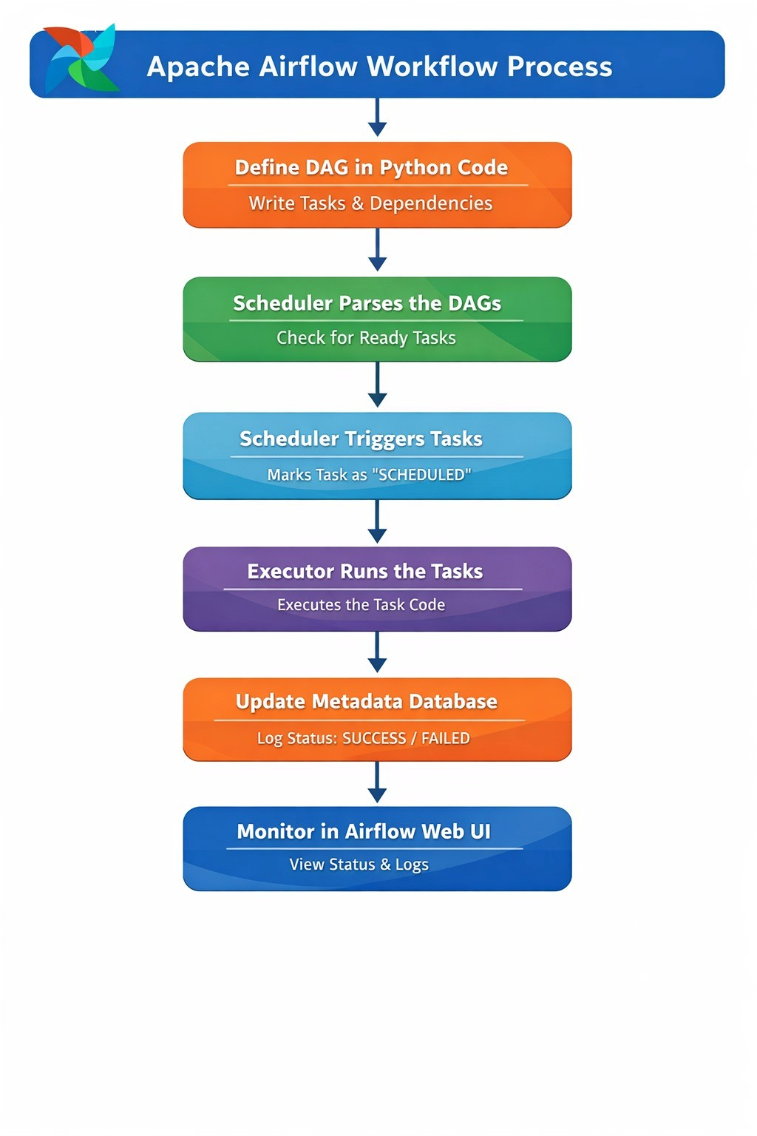
Apache Airflow
Apache Airflow is a workflow orchestration platform that allows you to define, schedule, and monitor complex data pipelines as code. Instead of using UI-based workflow builders, Airflow uses Python to define Directed Acyclic Graphs (DAGs) representing your workflows.

Slide 7
What is a DAG?
A DAG (Directed Acyclic Graph) is the fundamental unit in Airflow. It represents:
Directed: Tasks execute in specific direction (flow from A → B → C)
Acyclic: No circular dependencies allowed (prevents infinite loops)
Graph: Visual representation of tasks and relationships
Dag is a collection of tasks organized in a way that reflects their relationships and dependencies. It’s like a roadmap for your workflow, showing how each task connects to the others.
What is Task?
Task: a node in the dag represents a task.which are units of work in the airflow. each task can be an operator,sensor,or a hook.
how to define dag:
1.import modules
2. define default arguments
3. initiate the dag
4. define task
5. define dependencies

Slide 8
How Airflow Works?
Task-1
Task-2
Task-3
Example:
Extract script
Transform script
Load script

Slide 9
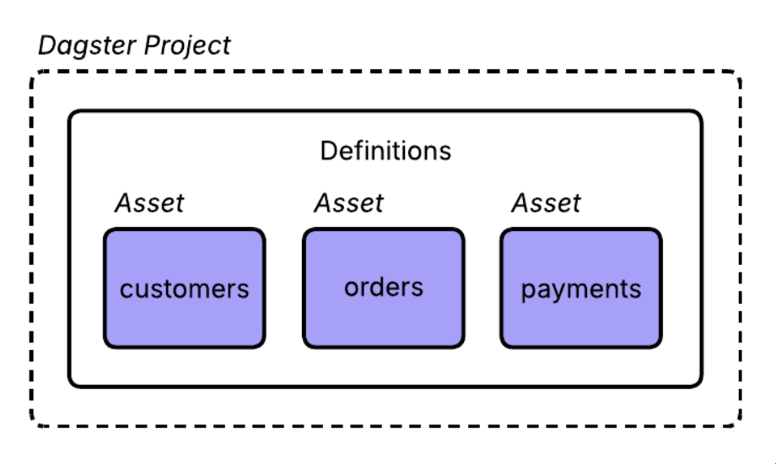
Dagster
What is Dagster?
Dagster is a modern data orchestration tool
It helps build, run, and monitor data pipelines
Key Building Blocks in Dagster
Assets ,Ops,Jobs,Runs
Assets:
Software-defined assets are the primary building blocks in Dagster. They represent the underlying entities in our pipelines, such as database tables, machine learning models, or AI processes. Together, these assets form the data platform.
All Dagster objects, such as assets, are added to the Definitions object that was created when you initialized your project.

Slide 10
Ops:
Ops are the core unit of computation in Dagster.
An individual op should perform relatively simple tasks, such as:
Deriving a dataset from other datasets
Executing a database query
Initiating a Spark job in a remote cluster
Querying an API and storing the result in a data warehouse
Sending an email or Slack message
Jobs:
Jobs are the main unit of execution and monitoring in Dagster. They allow you to execute a portion of a graph of asset definitions or ops based on a schedule or an external trigger.
When a job begins, it kicks off a run. A run is a single execution of a job in Dagster. Runs can be launched and viewed in the Dagster UI.
There are Two different jobs:
Asset jobs
Op jobs

Slide 11
Asset jobs:
An asset job is a type of job that targets a selection of assets and can be launched:
Manually from the Dagster UI
At fixed intervals, by schedules
When external changes occur, using sensors
To create an asset job, use the define_asset_job method. An asset-based job is based on the assets the job targets and their dependencies.
Op jobs:
An op job executes a graph of ops.
Op jobs can be launched in a few different ways:
Manually from the Dagster UI
At fixed intervals, by schedules
When external changes occur, using sensors
The simplest way to create an op job is to use the @dg.jobdecorator.

Slide 12
Dagster Flow
Asset-A
Asset-B
Asset-C
Example:
Raw data asset
Cleaned data asset
Aggregated data asset

Slide 13
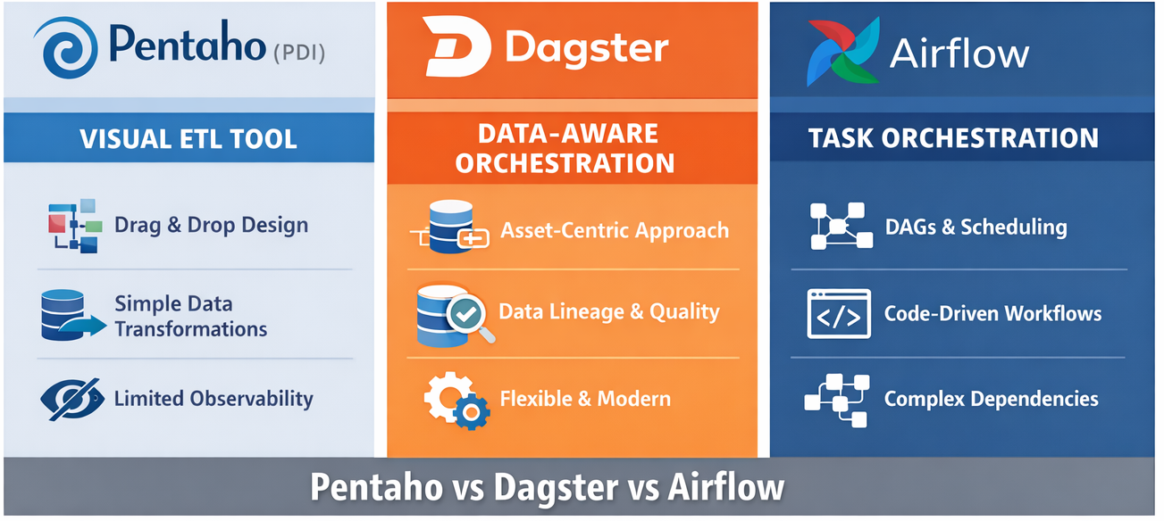
🔹 How Dagster, Airflow, and Pentaho Differ
Pentaho is like a visual ETL tool
→ You see data moving from files to databases using drag-and-drop.
→ Best when you want quick, simple data transformations without much coding.
Airflow is like a task scheduler
→ It focuses on what task runs first and what runs next.
→ Great for managing complex workflows, but it doesn’t deeply understand the data itself.
Dagster is like a data-aware orchestrator
→ It focuses on what data exists, how it’s created, and whether it’s fresh.
→ Helps teams understand, debug, and trust their data pipelines.

Slide 14
THANK YOU

