Slide 1
Presentation on
Git & GitHub

Slide 2
1. What problem Git actually solves
Before Git, developers used to:
Copy folders like project_final, project_final_v2
Share code through pen drives or email
Accidentally overwrite each other’s work
Lose old working code
Git solves all of this by tracking every change and keeping a complete history of the project.

Slide 3
2. What is Version Control
Version Control is a system that:
Tracks who changed what
Tracks when the change happened
Allows going back to any previous version
Helps multiple people work on the same project safely
What is Git:
Git is a distributed version control system that runs locally on our computer and does not require an internet connection to work. It keeps the complete history of a project, and every developer has a full copy of the code along with its past versions.

Slide 4
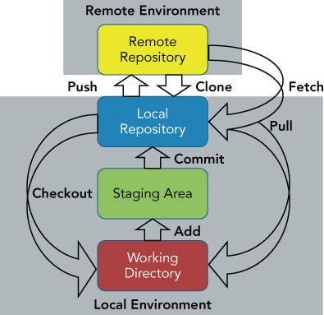

Slide 5

GIT Commands
git init
Creates a new Git repository
Starts version tracking
Use case-When starting a new project.
git status
Shows current file state
Tells what is staged, modified, or untracked
Use case-Before committing, to avoid mistakes.
git add
Moves changes to staging area
Use case-Select only required files for commit.
git commit
Saves changes permanently
Adds a message for clarity
Use case-Each commit represents a logical change.

Slide 6

What is GitHub?
A cloud platform to host Git repositories.
Used for collaboration
👉 Git = tool
👉 GitHub = platform
Why GitHub is Needed?
GitHub provides:
Remote backup
Team collaboration
Code review system
Issue tracking
Real-world use case:
Teams working from different locations.

Slide 7
Other Tools Like GitHub
GitLab
Built-in CI/CD
Preferred in DevOps projects
Type: Git repository + DevOps platform
Bitbucket
Integrates with Jira
Enterprise-focused
Type: Git repository (Atlassian ecosystem)
Azure Repos
Microsoft ecosystem
Used in corporate environments
Type: Git repository (Microsoft ecosystem)
SourceForge
Older platform
Open-source hosting
Type: Open-source hosting platform

Slide 8
Thank you!

