Slide 1
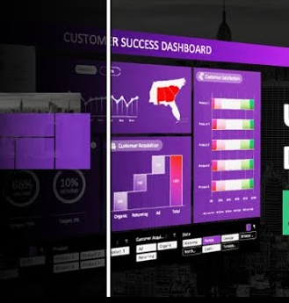

CUSTOMER SUCCESS dashboard in Microsoft excel Introduction to Data Management (INT-217)
Presented by:
TIPPIREDDY SINDHU (Btech. Cse)
11804718
Km070

Slide 2
What is Data & Database ?
In simple words,
Data is a collection of a distinct small unit of information. It can be used in a variety of forms like text, numbers, media, bytes, etc. it can be stored in pieces of paper or electronic memory, etc.
A database is an organized collection of data, so that it can be easily accessed and managed.
You can organize data into tables, rows, columns, and index it to make it easier to find relevant information.

Slide 3
What is Data Management ?
Data management is the practice of collecting, keeping, and using data securely, efficiently, and cost-effectively. The goal of data management is to help people, organizations, and connected things optimize the use of data within the bounds of policy and regulation so that they can make decisions and take actions that maximize the benefit to the organization

Slide 4




Why is Data Management Important ?
Minimized Errors
Efficiency Improvements
Data Quality Improvement
Protection From Data Related Problems and Risks:

Slide 5
Introduction to Excel.
Excel is a handy software that can be used to store and organize many data sets. Using its features and formulas, you can also use the tool to make sense of your data. For example, you could use a spreadsheet to track data and automatically see sums averages and totals.
One of the main advantages of MS excel is that it facilitates smooth and easy data entry.
Compared to any other data entry and analyzing tools, MS Excel offers features like Ribbon interface, a set of commands used to perform various operations.

Slide 6
What is an Excel Dashboard ?
Excel dashboards make it easy to perform quick overviews of data reports rather than going through large volumes of data. Overviews help in making quick and urgent decisions since one can skim through a lot of information at once and within a short time.
The dashboards help in tracking Key Performance Indicators (KPIs) with ease, which helps organizations track the progress on their targets.

Slide 7
Introduction
A sales report is a summary of all sales activity that occurs over a specific period of time.
They give a snapshot of the company’s exercise at a specific moment in time to assess the situation and determine the best decision to make and the type of action to undertake. These reports help in finding potential new market opportunities where they could improve monthly the results by using modern sales reporting software.

Slide 8
Objectives Of Dashboard
✓ To analyze the Sales Trend based on total revenue
✓ To analyze region wise sales.
✓ To compare sales by employees year wise.
✓ To analyze item wise returns.
✓ To analyze contribution of customers.
✓ To create a dynamic and highly responsive Dashboard.

Slide 9
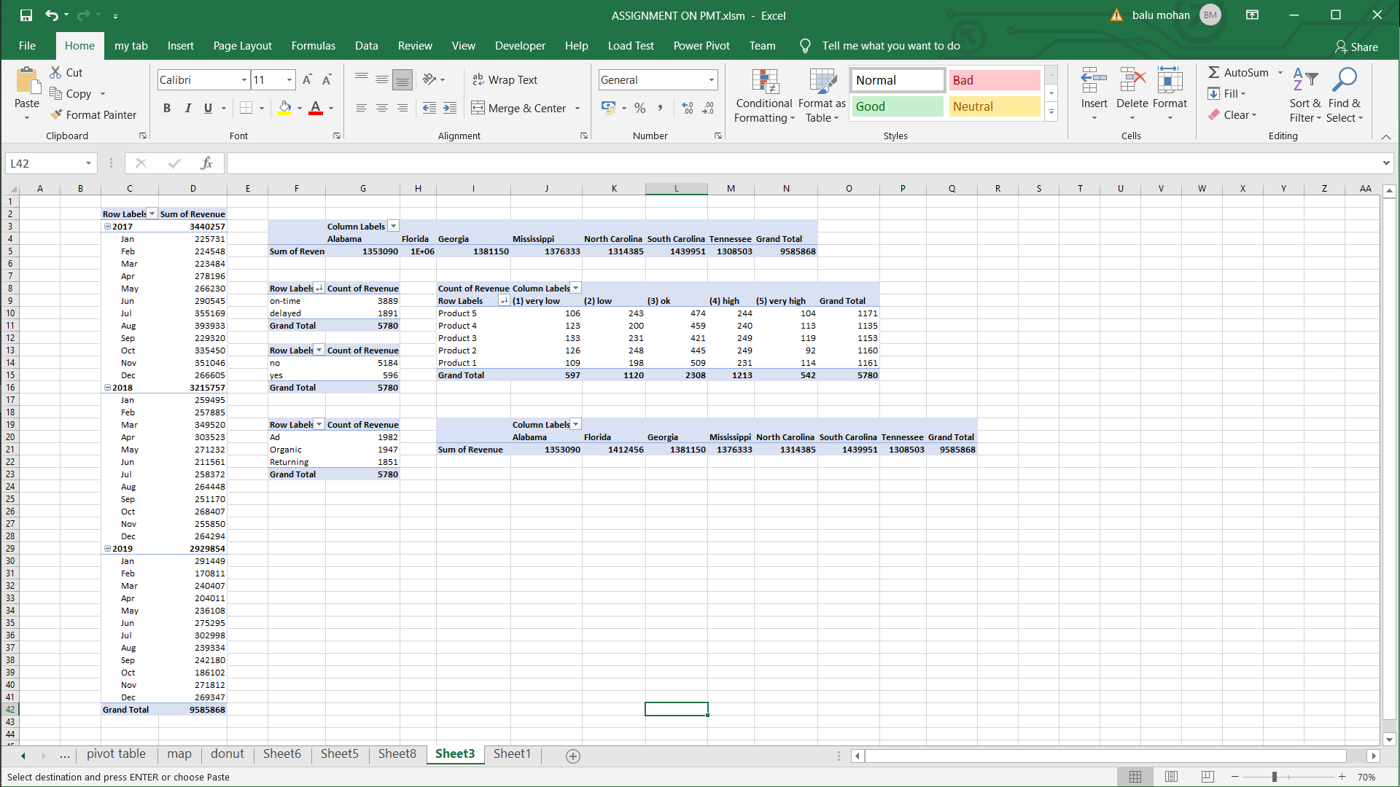
Specific Requirements
Pivot Tables:
A Pivot Table is used to summarise, sort, reorganise, group, count, total or average data stored in a table.

Slide 10
Pivot Charts
A Pivot chart shows the data series, categories, and chart axes the same way a standard chart does. Additionally, it also gives you interactive filtering controls right on the chart so that you can quickly analyze a subset of your data.

Slide 11
Types Of Pivot Charts Used :
Map Chart
Bar Graph
Line Chart
waterfall chart
Doughnut
Chart

Slide 12
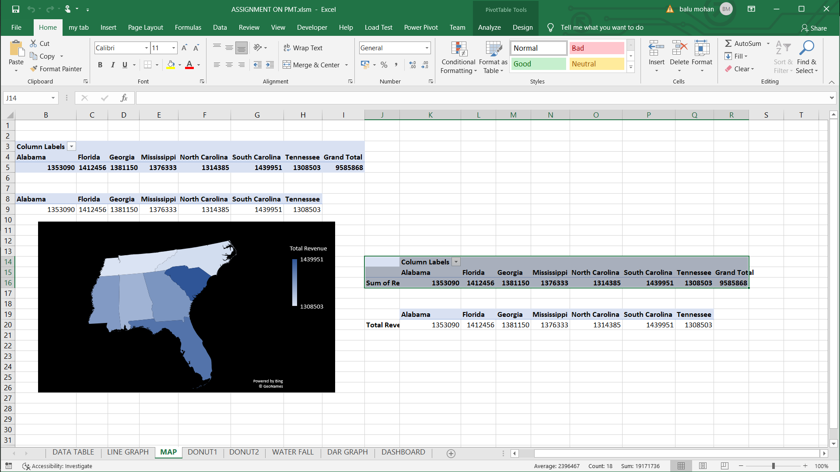
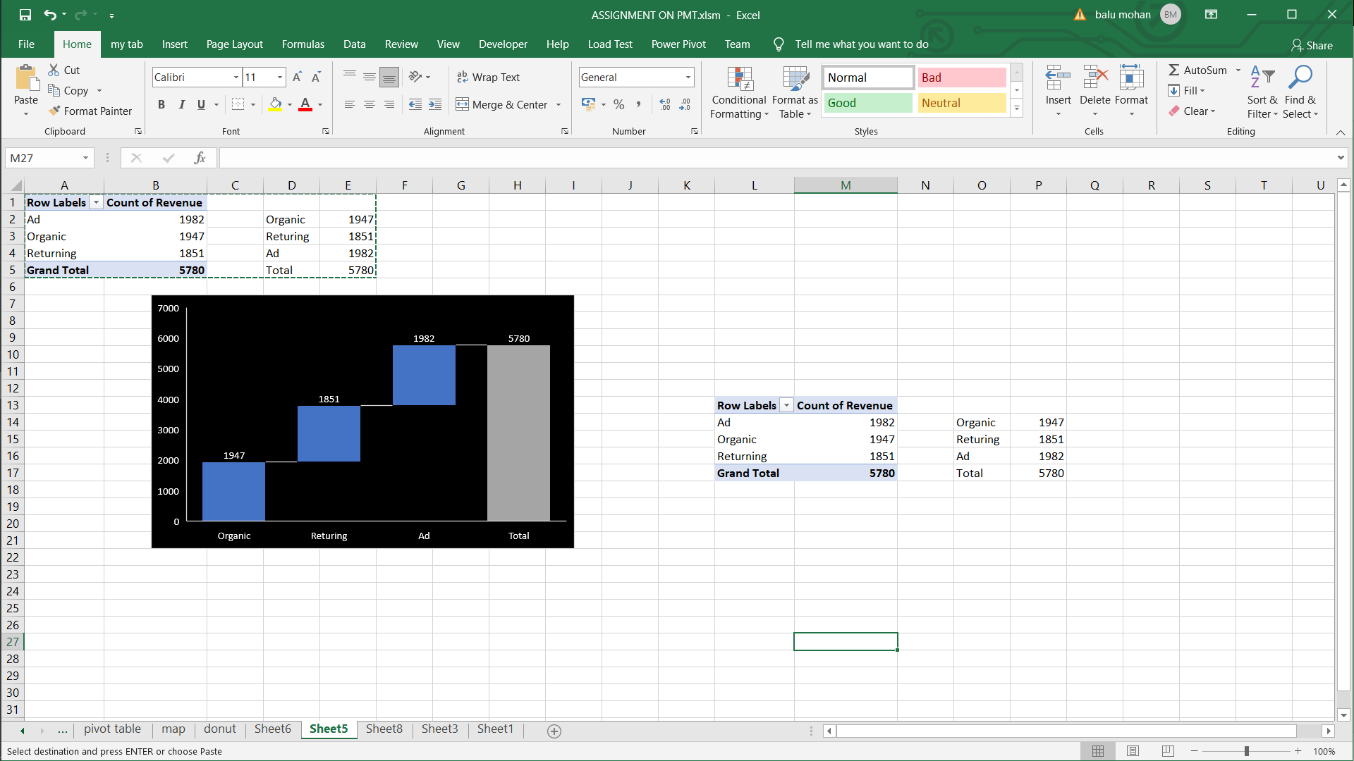
PIVOT Charts Structures

Slide 13
Thank You !!

