Slide 1
AI Echo: Your Smartest Conversational Partner
Sentiment Analysis from ChatGPT User Reviews
Using NLP, Machine Learning & Streamlit
Presented by :Sindhuja Seenivasan

Slide 2
Business Problem
Understanding user sentiment from ChatGPT reviews is crucial for:
- Identifying product pain points
- Improving user experience
- Informing AI development teams
However, manual analysis is time-consuming and inconsistent.

Slide 3
Use Cases
Product teams analyzing feedback trends
UX researchers assessing interaction quality
Moderators detecting negative or abusive reviews
Executives gaining sentiment-driven insights

Slide 4
Proposed Solution
AI Echo is a Streamlit-based app that:
Accepts ChatGPT review text
Performs sentiment analysis (Positive/Neutral/Negative)
Provides exploratory data insights (EDA)
Shows trend patterns and keyword analysis
Uses ML models for accurate prediction

Slide 5
Dataset Used
Data Source: Scraped ChatGPT user reviews
Fields: Review text, rating, sentiment, date, version, platform, location
Preprocessing: cleaning, labeling, TF-IDF vectorization
Balanced dataset with resampling techniques

Slide 6
Exploratory Data Analysis (EDA)
Sentiment distribution (Positive > Negative > Neutral)
Trend over time shows spikes after version updates
Verified users show more positive reviews
Longer reviews often reflect stronger (positive or negative) sentiments
Web users gave more neutral feedback vs mobile users
Top negative feedback themes: hallucination, delay, inaccuracy

Slide 7
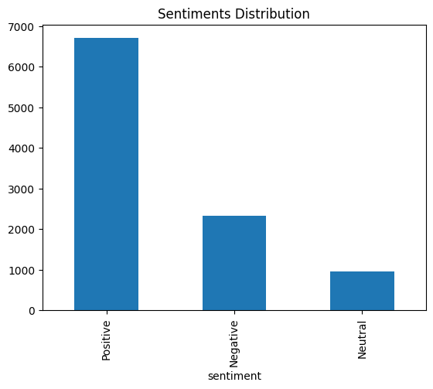
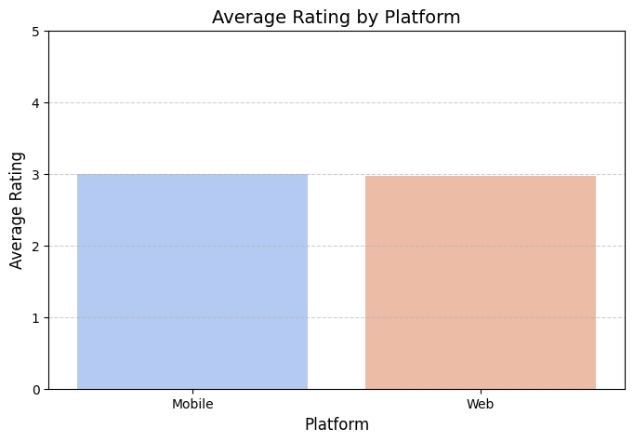
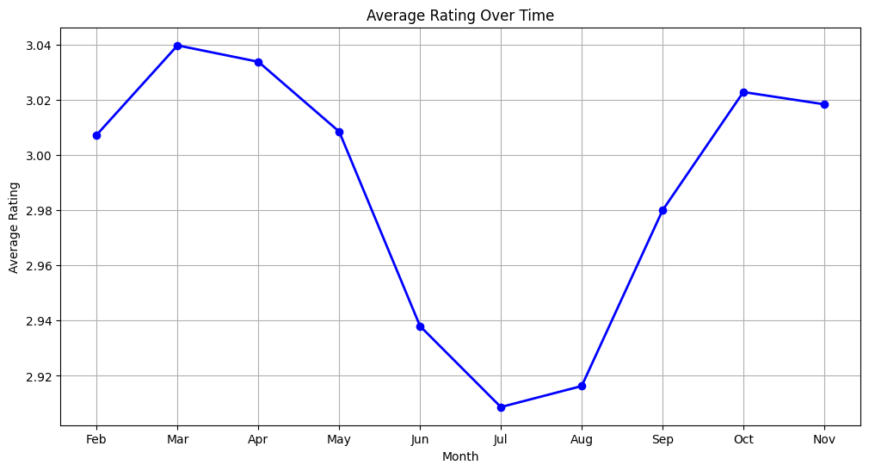
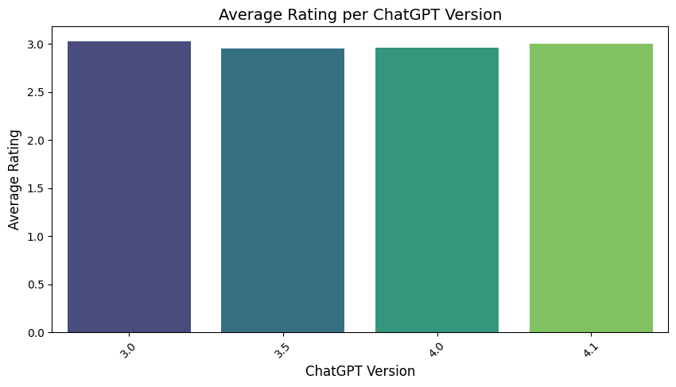

Slide 8
Models Used
TF-IDF Vectorizer for feature extraction
Classical ML models:
• Logistic Regression
• Random Forest
• SVM with class weight
Deep Learning:
• RNN
• LSTM
Evaluated using KFold cross-validation

Slide 9
Model Performance
Accuracy: up to 88% (SVM )
ROC-AUC Score: 0.95 (SVM)
Precision/Recall balanced across classes
SVM chosen for deployment due to speed + accuracy
Evaluation visualizations include confusion matrix, ROC curve, wordcloud

Slide 10
Recommendations
Integrate AI Echo into product feedback systems
Use feedback trends to prioritize updates
Extend app to support multi-language sentiment
Retrain models quarterly with new data
Expand for audio or video review analysis

Slide 11
Conclusion
AI Echo demonstrates the power of NLP and Machine Learning
in extracting meaningful insights from user reviews.
The project successfully classifies user sentiments into Positive,
Negative, and Neutral with high accuracy using optimized models.
Extensive EDA helped uncover patterns based on platform usage,
verification status, review length, version type, and geography.
These insights can drive better product improvements, user
experience strategies, and support personalization.

