Slide 1
Life Expectancy Analysis
Trends, Influences, and Insights
Presented by: Sindhuja Seenivasan

Slide 2
Introduction
Life expectancy refers to the average number of years a person is expected to live.
It is a key indicator of population health and development.
Understanding life expectancy helps governments plan healthcare, education, and economic policies.

Slide 3
Objectives
Analyze global and regional trends in life expectancy.
Identify factors that influence life expectancy.
Explore disparities based on gender, income, and geography.

Slide 4
Data Overview
Dataset contains life expectancy information across countries and years.
Key variables: Country, Year, Life Expectancy, GDP per capita, Health Expenditure, Education.
Data sources include WHO, World Bank, and other global organizations.

Slide 5
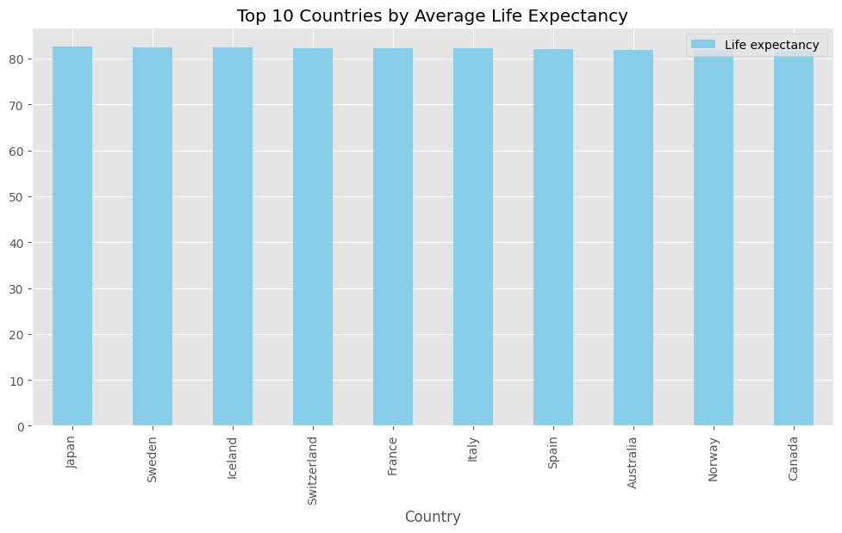
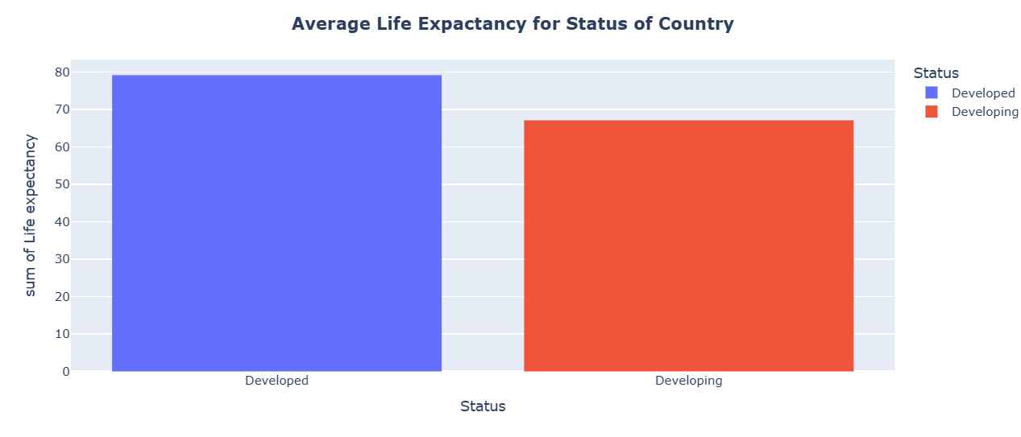
Key insights

Slide 6
Regional Differences
Japan has the Highest average life expectancy; Africa and Seria the lowest.
Regions affected by conflict, poor healthcare, or poverty show slower progress.
Public health initiatives have led to sharp improvements in some regions.

Slide 7
Key Influencing Factors
Economic: Higher GDP per capita often leads to better healthcare access.
Health: Immunization, clean water, and nutrition improve longevity.
Education: Higher literacy and education levels correlate with longer lives.
Social Conditions: Urbanization and sanitation impact public health.

Slide 8
Correlation Insights
Strong positive correlation between income level and life expectancy.
Health expenditure per capita is another strong predictor.
Education and sanitation also play critical roles.

Slide 9
Summary of Findings
Global life expectancy is improving, but inequality remains.
Economic and healthcare investment are key drivers.
Gender and region-based disparities highlight the need for targeted policies.

Slide 10
Recommendations
Invest in primary healthcare infrastructure.
Promote education, especially for girls and rural populations.
Encourage public health campaigns on lifestyle diseases.
Address social and economic inequalities.

Slide 11
Conclusion
Life expectancy is a critical measure of human development.
Data shows positive trends but also reveals persistent challenges.
Data-driven policy decisions can improve health outcomes for all.

Slide 12
References
World Health Organization (WHO)
World Bank Open Data
United Nations Development Programme (UNDP)
Kaggle: Life Expectancy Dataset

Slide 13
Questions & Answers
Thank you!
Questions or comments?

