Slide 1
TCS Stock Price Forecasting (2002–2016)
Trends, Influences, and Insights
Presented by: Sindhuja Seenivasan

Slide 2
Business Problem Statement
Problem:
Investors seek reliable short-term forecasts of TCS stock prices.
Business Challenge:
- Volatility
- Outdated heuristics
- Need for data-driven predictions

Slide 3
Current Solution
- Manual tools: Moving averages, news-based trading
- Limitations:
- Low accuracy
- No automation
- No learning from history

Slide 4
Proposed Solution
Use ML models on historical data
Apply Linear Regression to predict 'Close' price
Evaluate and compare with Ensemble methods, LSTM

Slide 5
Dataset Overview
- Source: Kaggle
- Date Range: Jan 2002 – Dec 2016
- ~3,500+ rows
Features:
Date, Open, High, Low, Close, Last, Trade Quantity, Turnover
Target: Close

Slide 6
Data Preprocessing
- Date to datetime
- Null value removal
- Lag features (e.g., prev_close)
- Min-Max scaling
- 80/20 train-test split

Slide 7
Models Evaluated
Linear Regression (Best)
Random Forest
Bagging Classifier
LSTM

Slide 8
Best Performing Model – Linear Regression
Strong linear trends
Low error, high R²
Simple, fast, explainable
Best tracking on test set

Slide 9
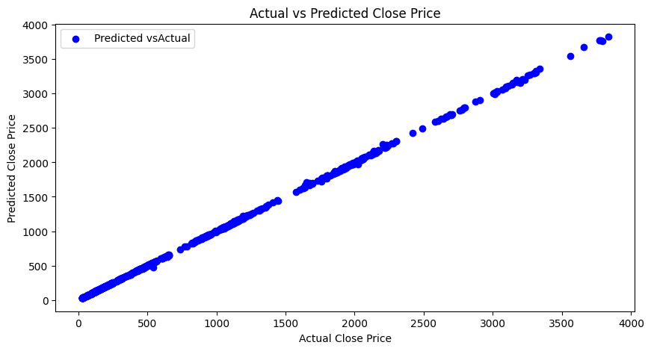
Model Output Visualization
Include line plot:
Actual vs Predicted (Test data)

Slide 10
Business Impact
Better timing for trades
Enhanced analysis
Forecast stock-based compensation

Slide 11
Conclusion
Linear Regression was best
Simple models = powerful with clean data
Future Work:
Sentiment analysis
Ensemble models
Sector index modeling

Slide 12
Q&A
Thank you!
Any questions?

