Slide 1

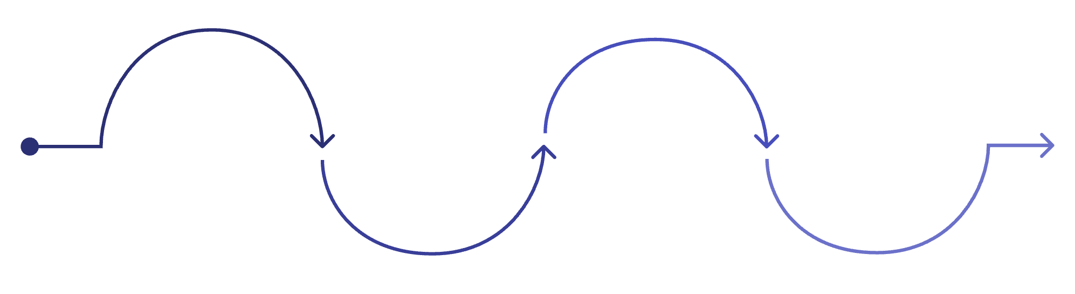
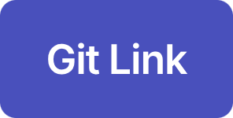
The consultation is not the end of the journey
A patient gets a teleconsultation with a doctor, but that’s just the start. They still need to collect medicines, get tests done, and come back for follow-up. Some fall out at different points along the way.
The hard part isn’t the consultation itself. It’s making sure patients actually complete everything that comes after.
Teleconsultation
Medicine Collection
Required Test
Review Visit
Patient must obtain prescribed meds
Lab or diagnostic tests needed
Follow-up to assess treatment
Completed remotely with doctor
By team Yappers

Slide 2
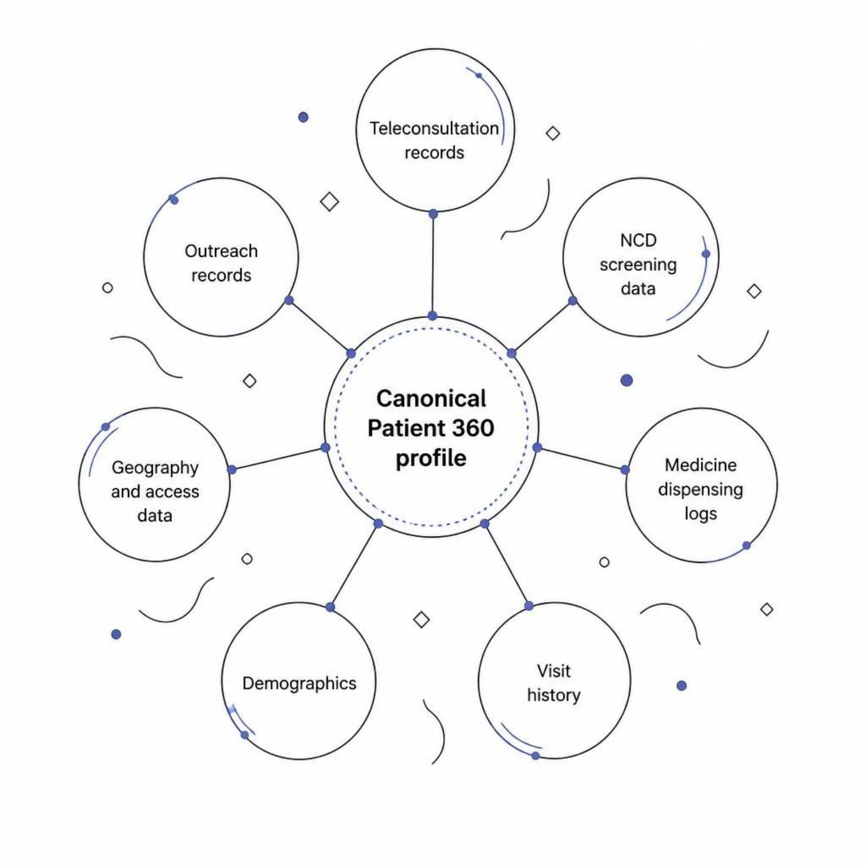
The patient exists across multiple systems
Patient records are scattered across different systems — different IDs, different formats, incomplete pictures. But before we can predict anything, we need to figure out which records belong to the same person.
Record Linkage
We link records across systems using name, phone, demographics, and geography — with fuzzy matching where required.
Same person, different IDs in different systems. That's why we built the Patient 360 — to see the whole picture.

Slide 3

Dropout is not one event
We could build a simple dropout classifier. But that just tells you who's at risk, not what to actually do about it. Knowing where the care journey is likely to break — that's what actually helps.
Generic Model
Our Approach
Patient
Patient
→ Dropout / No Dropout
→ Dropout risk + Likely failure stage
Just a yes/no. Doesn't tell you where to step in.
But if you know whether it's the medicine, the test, or the follow-up visit — then you know what to do.
Medicine
Test
Review
Patient does not collect prescribed medicines.
Patient does not complete a required diagnostic test.
Patient does not return for scheduled follow-up.

Slide 4


Why stage-aware ML?
We looked at three options. The question was: how simple, how smart, and how usable for actual health workers?
Simple Dropout Classifier
Sequence / Transformer Model
Stage-Aware Tabular ML ✓ Chosen
Pros: Simple, interpretable
Limitation: Doesn't tell you where to step in — just says someone's at risk.
Pros: Models longitudinal patient events
Limitation: Gets complicated fast, hard to explain with our dataset size, and health workers won't understand what it's doing.
Pros: Captures patient history, identifies failure stage, easier to validate and explain, practical for deployment.
We went with the middle option. Smart enough to understand the care journey, but not so complex that it breaks down in the field.

Slide 5




What the model knows at prediction time
We make the prediction right after the consultation, before anything else happens. The model uses four types of information:
Patient
Previous Behavior
Age, gender, vulnerability status, NCD history
Past visits, medicine pickup patterns, missed follow-ups
Access
Current Consultation
Location, distance to facility, connectivity when available
Diagnosis, prescribed medicines, needed tests, review schedule
From those four things, the model outputs two things: how likely the patient is to drop out, and where we think they'll get stuck.

Slide 6
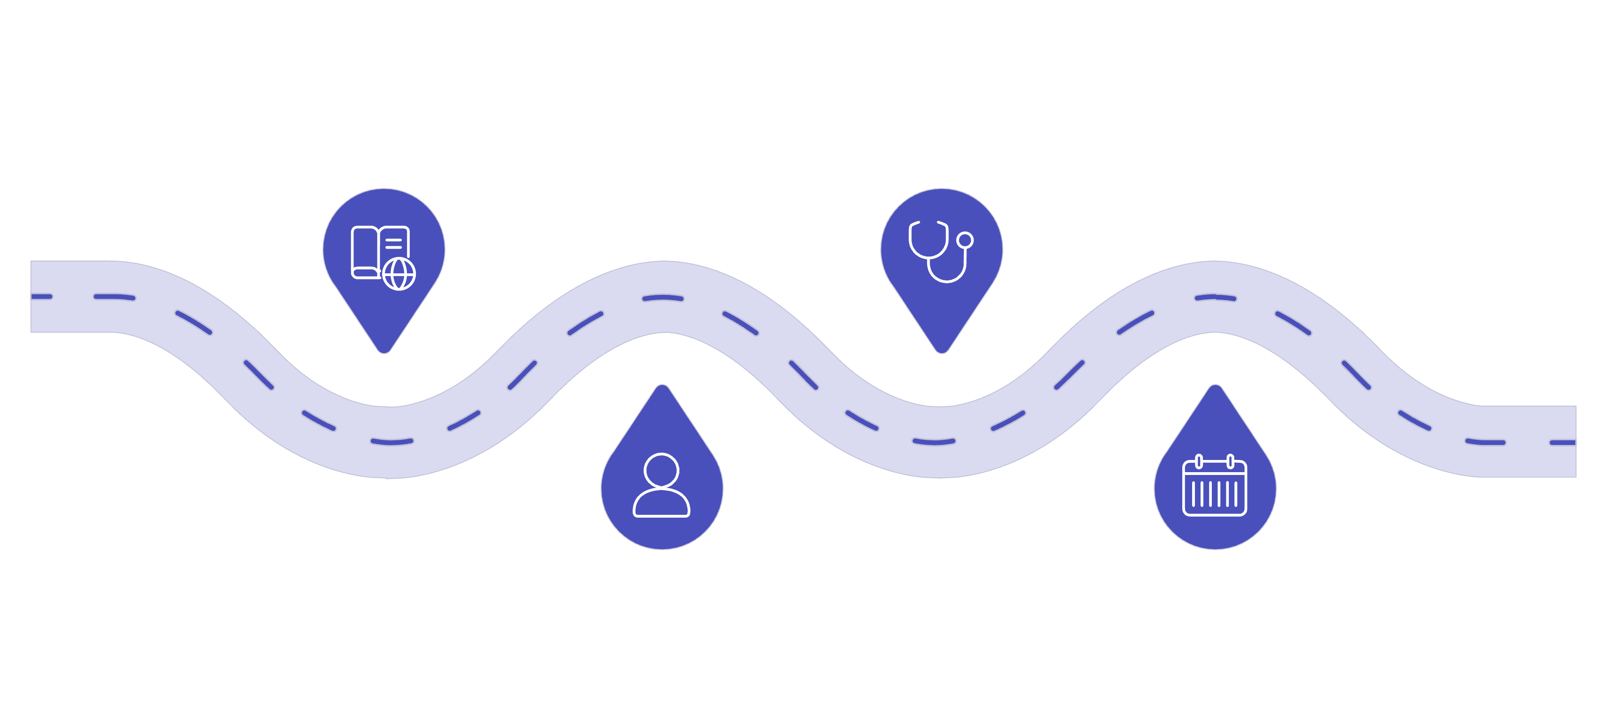
We predict the future without using the future
This is the rule we built everything around: the model can't use information from after the consultation it's trying to predict.
Current consultation
Previous visits
Past encounter records
Consultation at prediction point
Patient profile
Future events
Demographics and history
Not used as model inputs
The rule in practice
Temporal leakage is easy to miss. But it's a killer — your model looks great in testing, then fails the moment you deploy it.
Consultation: July 10
Medicine pickup: July 12
We can't use the July 12 event to predict what happened on July 10. That would be cheating. And a model that cheats on training data falls apart when you actually use it.

Slide 7
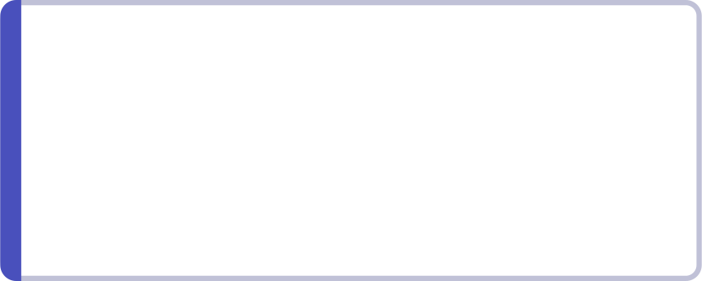

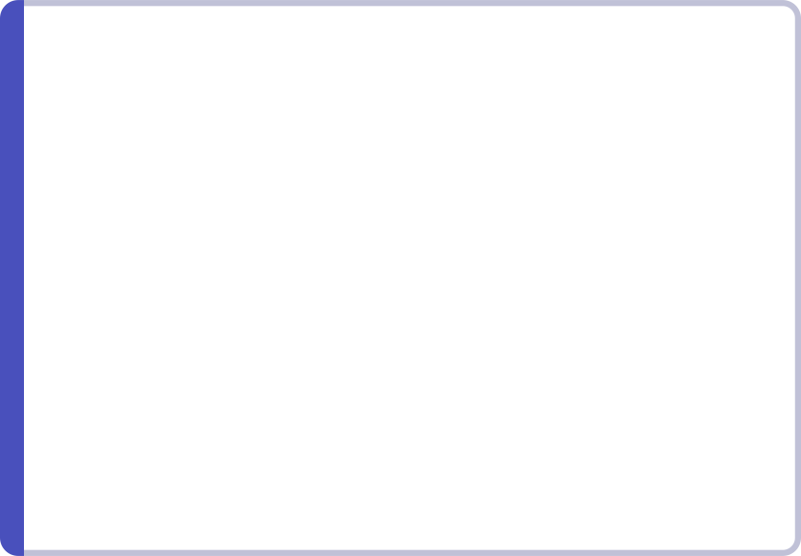

We don't give the health worker another probability
The model isn't here to give health workers another number to think about. Every prediction comes with a concrete next step.
Example: Patient P003721
Stage → Action Mapping
Medicine risk
Dropout Risk
Likely Stage
Check if they can get to the pharmacy, help with transport if that's the problem.
High
Medicine collection
Test risk
Why
Action
Help schedule or accompany patient for test completion
They've missed pickups before, and getting to the facility is hard.
Call the patient, check if they can get to the pharmacy, help arrange transport if needed.
Review risk
Send reminder + assist with review scheduling
The model is a tool for the health worker, not a replacement for their judgment.

Slide 8
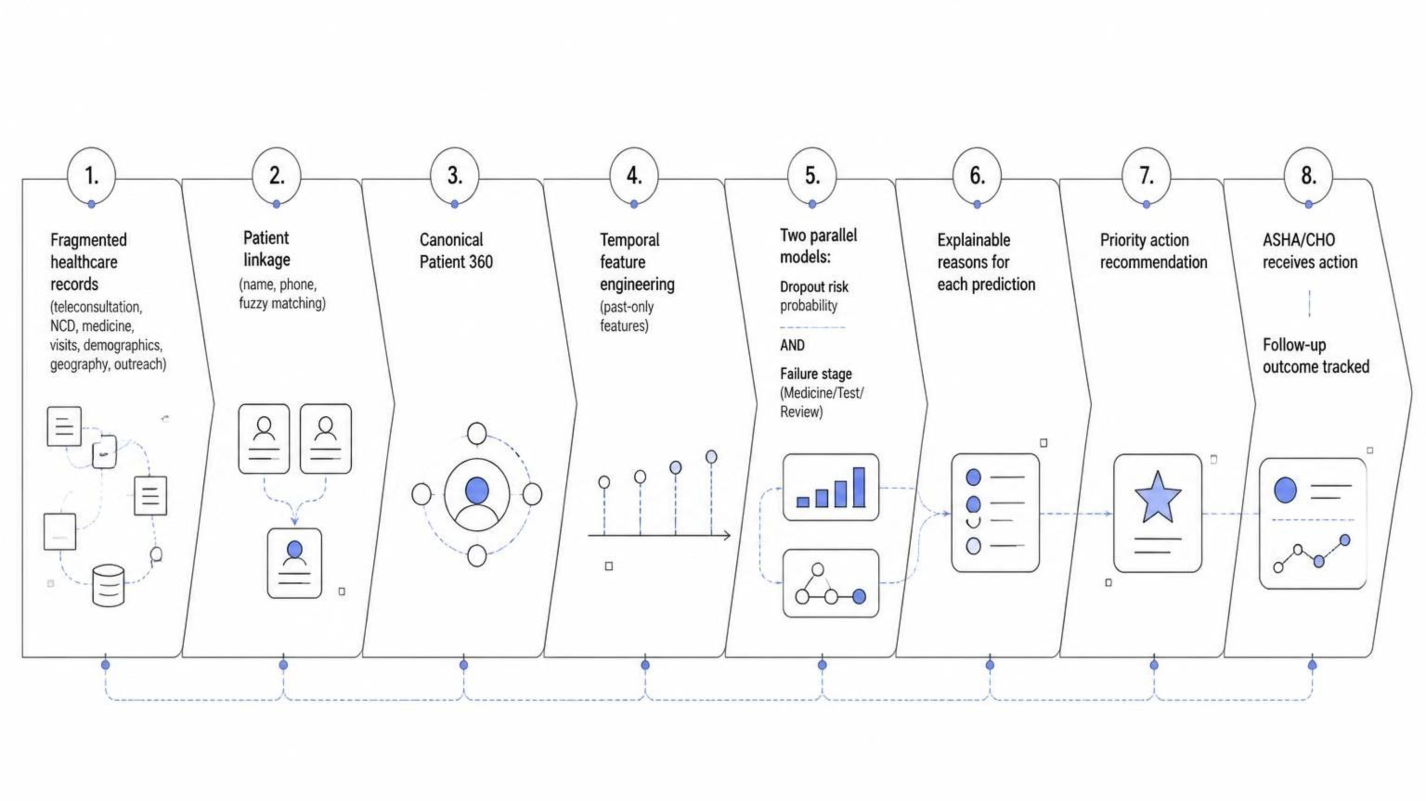
From fragmented records to follow-up assurance
This is how it all fits together — from messy data to an actual action the health worker can take. And every step is traceable, so if something seems off, you can follow it back to the source.
If a prediction doesn't look right, you can trace it back through the whole chain to see where it came from.

Slide 9

Does the model actually help?
We're looking at three things — not just whether the model is accurate, but whether it actually works in the real world.
Predictive Performance
Temporal Validation Strategy
ROC-AUC, PR-AUC
Precision, Recall, F1
Train
Earlier development data
Stage Prediction
Macro-F1 across stages
Per-stage performance
Confusion matrix
Validate
Later development data
Evaluate
Operational Usefulness
Future evaluation cohort
How many of the patients we flag as highest-risk actually do drop out
Whether the predictions are reliable, and how many patients we'd actually need to follow up with
We're not showing numbers here — those will come from the actual evaluation. But this is how we'll measure whether it works.

Slide 10





Predict the risk. Find the break. Act early.
We're not just flagging who might drop out. We're identifying where the care journey is likely to break, and turning that into something the health worker can actually act on.
Link
Predict
Identify Stage
Act
Measure
Uses fragmented data
Respects rural constraints
Interpretable by design
Prediction → Action
Evaluable in deployment
From the consultation to care that actually gets completed.

