Slide 1

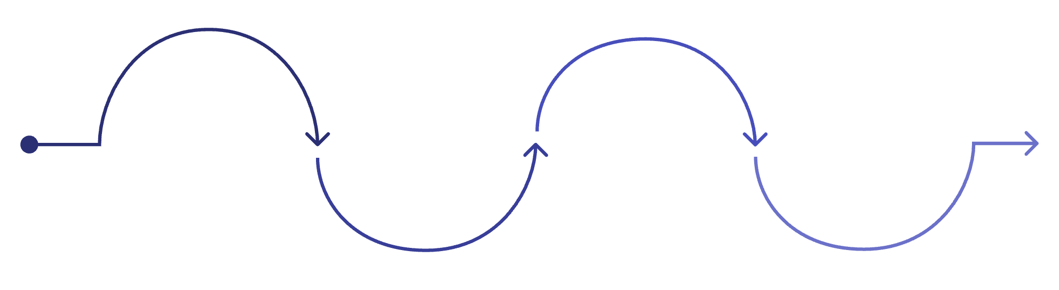
The consultation is not the end of the journey
A teleconsultation connects a rural patient with a doctor — but care continues long after the call ends. Patients must collect medicines, complete tests, and return for review. Some fall out at different points along the way.
The real challenge is not completing the consultation — it is completing the care journey.
Teleconsultation
Medicine Collection
Required Test
Review Visit
Patient must obtain prescribed meds
Lab or diagnostic tests needed
Follow-up to assess treatment
Completed remotely with doctor

Slide 2
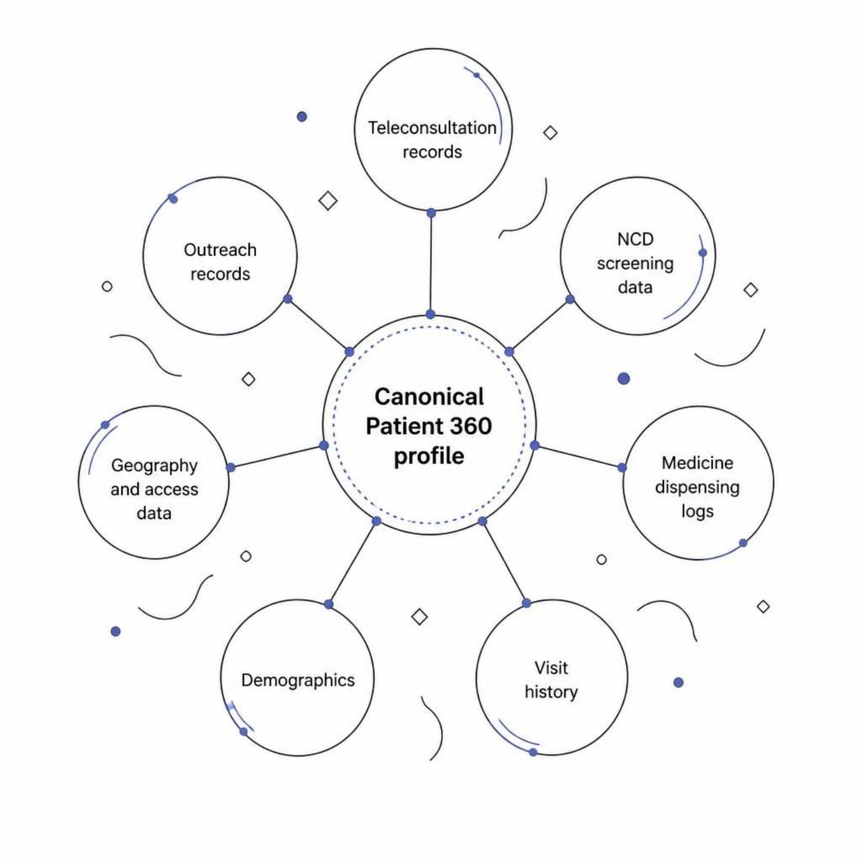
The patient exists across multiple systems
We noticed that patient records are scattered across different systems — different IDs, different formats, incomplete pictures. Before predicting risk, we first need to know that the records belong to the same person.
Record Linkage
We link records across systems using name, phone, demographics, and geography — with fuzzy matching where required.
Different records → different IDs → incomplete patient picture. The Patient 360 is our foundation.

Slide 3

Dropout is not one event
We considered a simple dropout classifier. But a single score tells us who to worry about — not what to do next. The stage of likely failure is what makes the prediction actionable.
Generic Model
Our Approach
Patient
Patient
→ Dropout / No Dropout
→ Dropout risk + Likely failure stage
One score. No guidance on where or why.
Medicine, Test, or Review — each triggers a different action.
Medicine
Test
Review
Patient does not collect prescribed medicines.
Patient does not complete a required diagnostic test.
Patient does not return for scheduled follow-up.

Slide 4


Why stage-aware ML?
We considered three approaches. The trade-off was between simplicity, intelligence, and practicality for frontline use.
Simple Dropout Classifier
Sequence / Transformer Model
Stage-Aware Tabular ML ✓ Chosen
Pros: Simple, interpretable
Limitation: Doesn't identify the intervention point — just flags risk without direction.
Pros: Models longitudinal patient events
Limitation: More complex, harder to justify with ~5,000 patients, less transparent for frontline workers.
Pros: Captures patient history, identifies failure stage, easier to validate and explain, practical for deployment.
We chose the middle ground: enough intelligence to understand the care journey, without unnecessary complexity.

Slide 5




What the model knows at prediction time
Prediction happens immediately after consultation — before any follow-up events occur. The model draws on four feature groups:
Patient
Previous Behavior
Age, gender, vulnerability status, NCD history
Prior visits, medicine collection patterns, missed follow-ups
Access
Current Consultation
Geography, distance to facility, connectivity where available
Diagnosis, prescribed medicines, required tests, review schedule
Features feed two outputs: a dropout risk probability and a likely failure stage (Medicine / Test / Review).

Slide 6
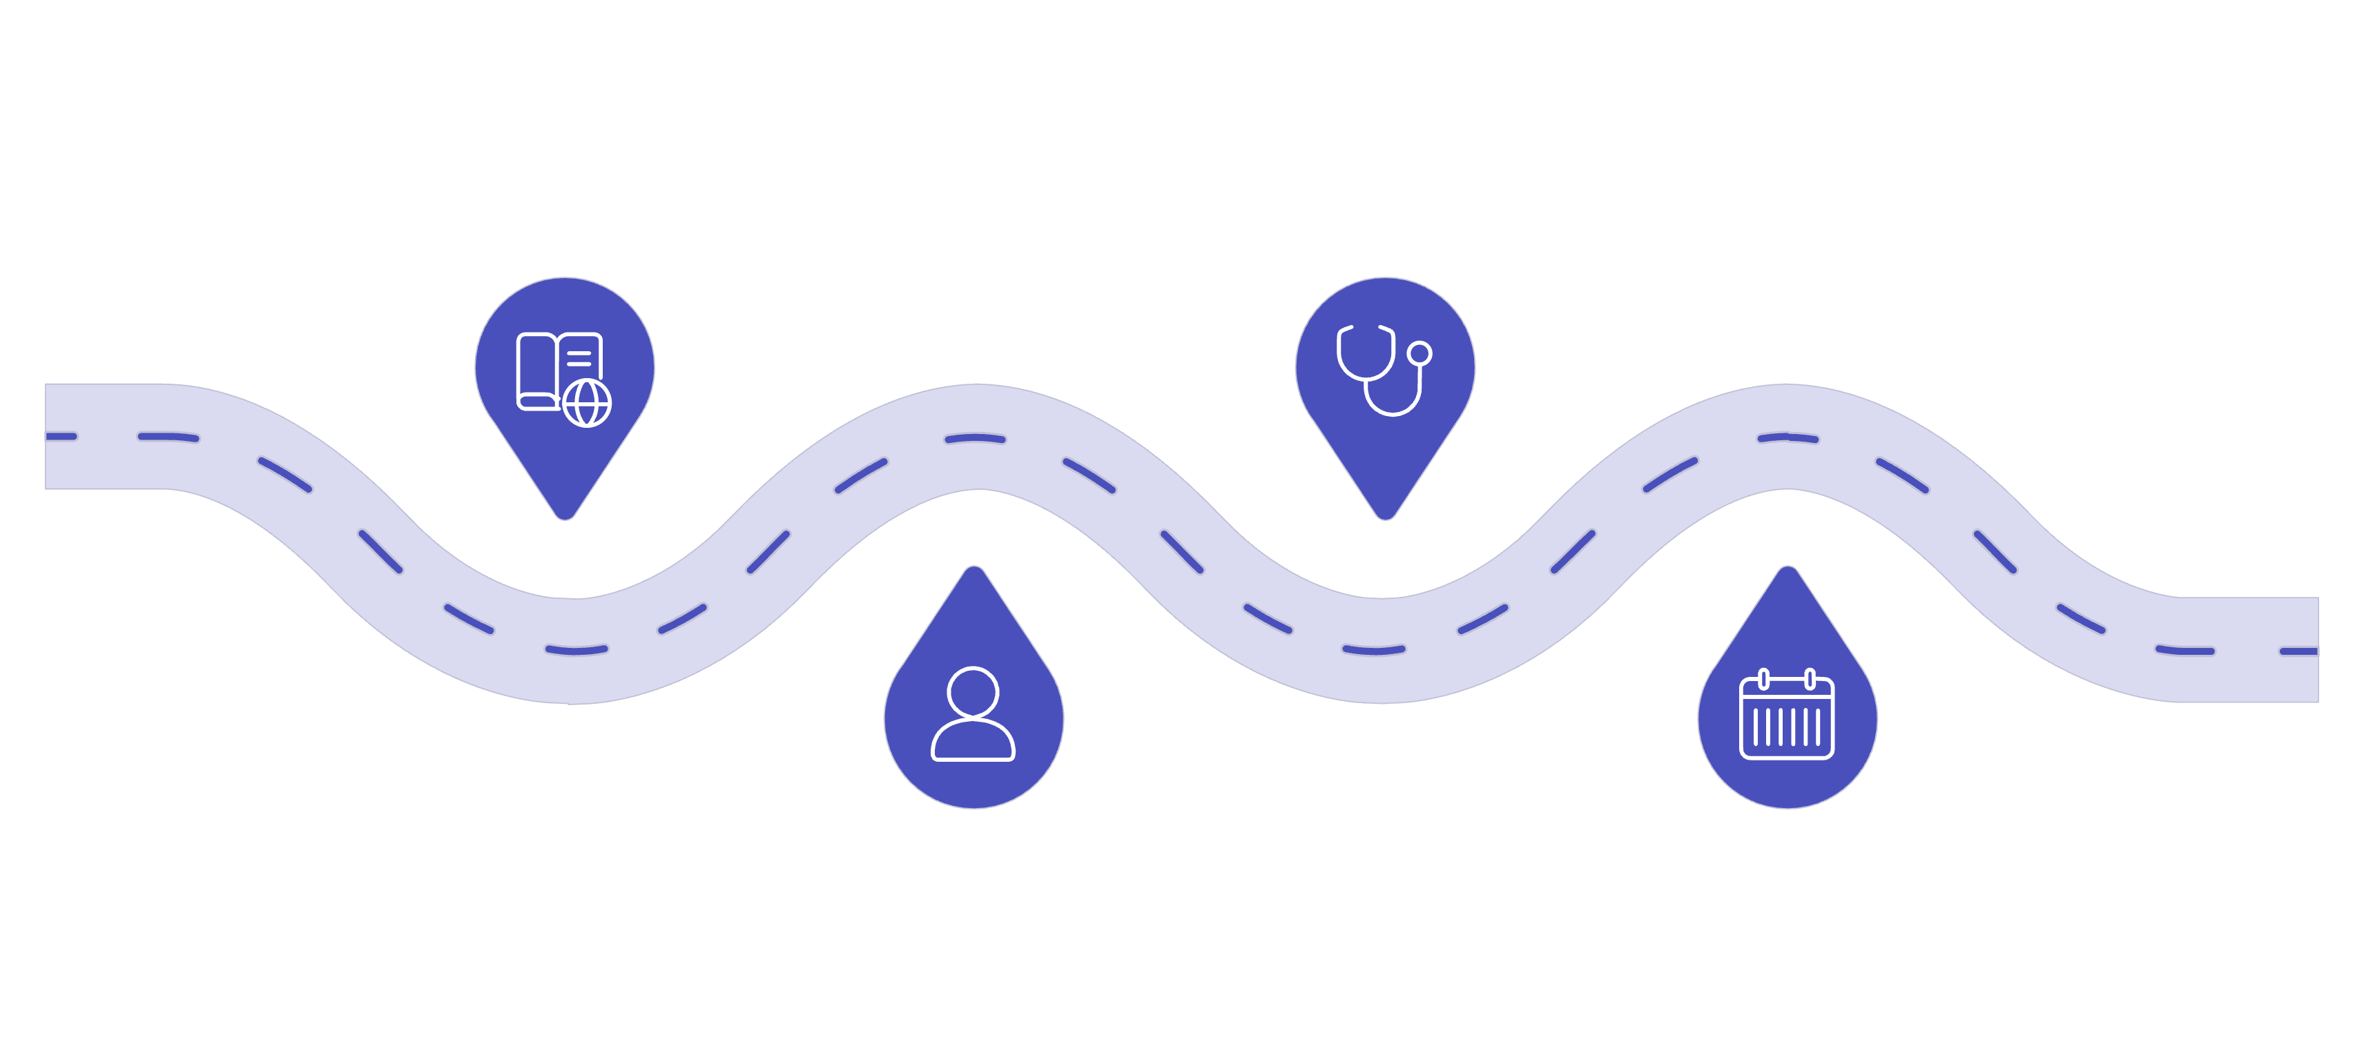
We predict the future without using the future
This is our most important design rule. The model must not see events that happen after the consultation it's predicting for.
Current consultation
Previous visits
Past encounter records
Consultation at prediction point
Patient profile
Future events
Demographics and history
Not used as model inputs
The rule in practice
Temporal leakage is a common ML mistake. We designed around it deliberately — because a model that cheats on training data fails in the field.
Consultation: July 10
Medicine pickup: July 12
The July 12 event cannot be used to predict the July 10 outcome. This prevents temporal leakage and makes the model usable in real deployment.

Slide 7
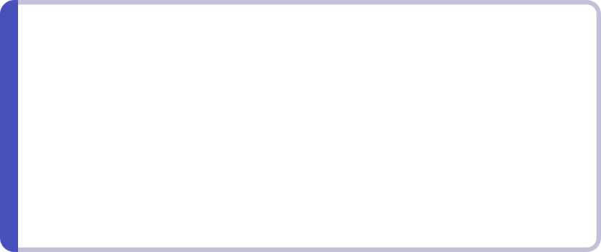

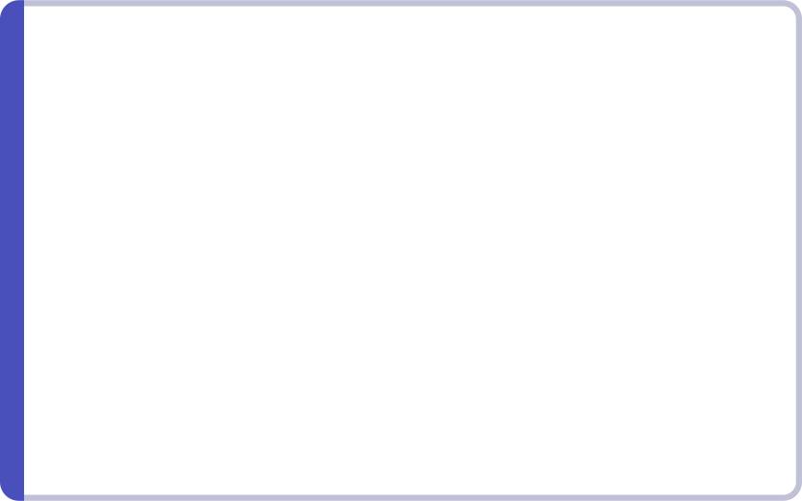

We don't give the health worker another probability
The model's job is to support the ASHA/CHO — not add to their cognitive load. Every prediction comes with a recommended next step.
Example: Patient P003721
Stage → Action Mapping
Medicine risk
Dropout Risk
Likely Stage
Confirm pickup availability, arrange transport if needed
High
Medicine collection
Test risk
Why
Action
Help schedule or accompany patient for test completion
Previous low pickup history + access difficulty
Contact patient → confirm availability → facilitate pickup
Review risk
Send reminder + assist with review scheduling
The model supports the health worker. It does not replace clinical judgment.

Slide 8
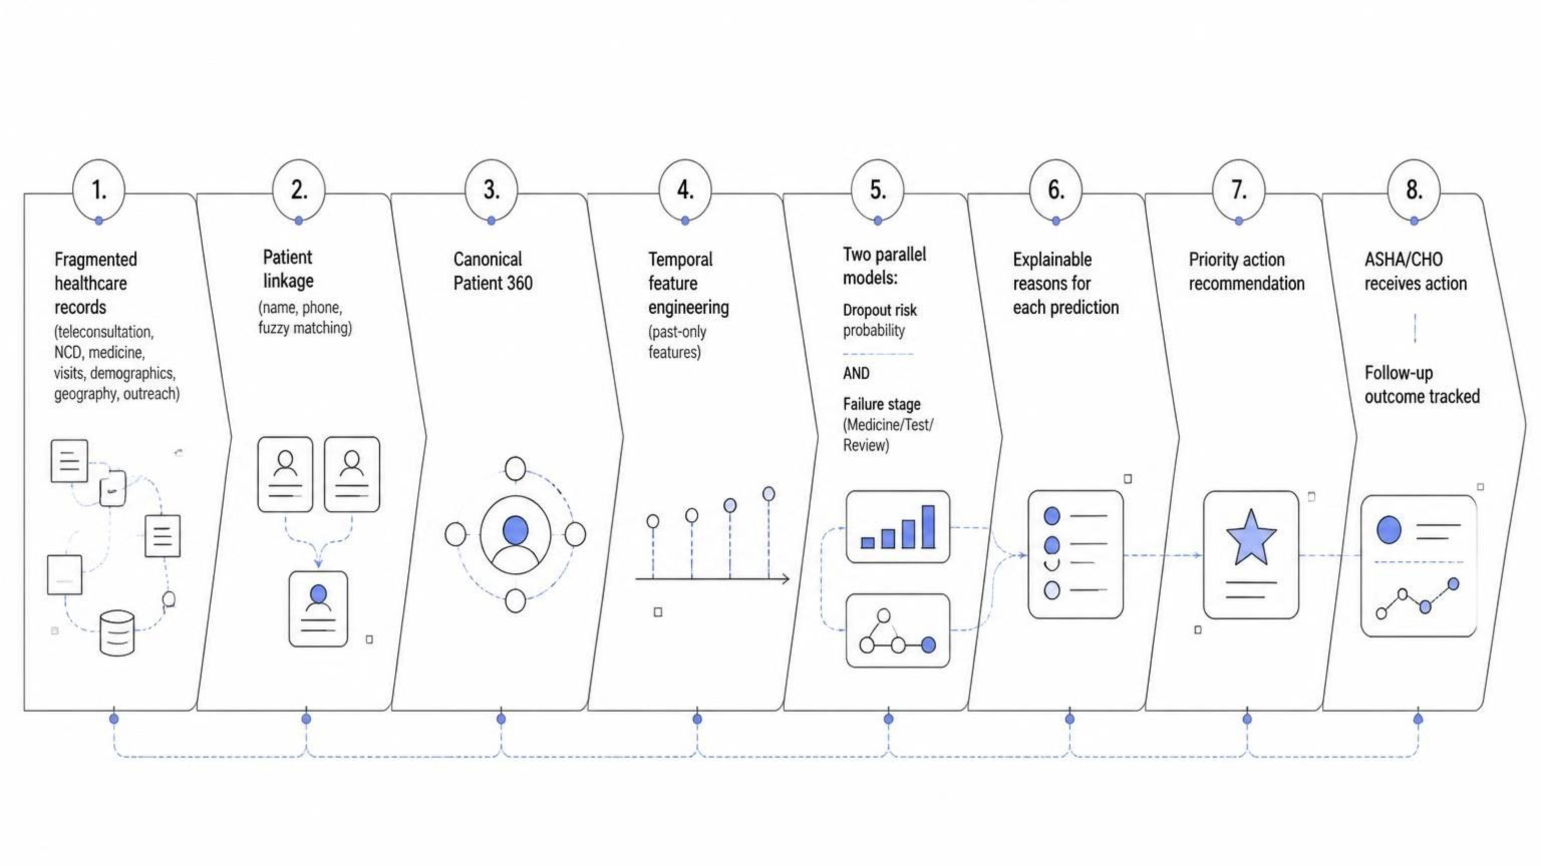
From fragmented records to follow-up assurance
This is the complete pipeline — from raw, scattered data to a practical action for the health worker. Every step is designed to be auditable and explainable.
Each stage in the pipeline is traceable. If a prediction seems off, a health worker or supervisor can follow the chain back to the source data.

Slide 9

Does the model actually help?
We evaluate across three dimensions — not just accuracy, but whether the model is useful in practice.
Predictive Performance
Temporal Validation Strategy
ROC-AUC, PR-AUC
Precision, Recall, F1
Train
Earlier development data
Stage Prediction
Macro-F1 across stages
Per-stage performance
Confusion matrix
Validate
Later development data
Evaluate
Operational Usefulness
Future evaluation cohort
Recall among top 10% and 20% highest-risk patients
Calibration and outreach workload
We do not report results here. Actual metrics depend on the evaluation dataset and must be filled in after testing.

Slide 10





Predict the risk. Find the break. Act early.
We don't just predict who may drop out. We predict where the care journey is likely to break — and turn that prediction into a practical next step for the health worker.
Link
Predict
Identify Stage
Act
Measure
Uses fragmented data
Respects rural constraints
Interpretable by design
Prediction → Action
Evaluable in deployment
From teleconsultation to completed care.

