Slide 1

Health Insurance Analysis and Prediction
Aiswarya Sriram(as14988)
Reuben Cherian(rc4610)
Sindhu Bhoopalam Dinesh(sb8019)

Slide 2
Introduction
We used the Health Insurance Marketplace Public Use Files.
Contains information related to health and dental plans offered in the US Health MarketPlace.
We wanted to analyze medical insurance data of different states, age groups, and insurance providers.
This can provide us with indicators that help people make informed decisions to choose an optimal insurance plan.
Dataset size - 3.4 GB (3 years)
Why Big Data?
As the number of years increase, the scale of the data increases
To perform analysis with machine learning, with larger number of features, we would need Big Data infrastructure

Slide 3
Objective
Our objective is to analyse medical insurance plan parameters to observe -
1. How plan rates affect people from different states
2. Analysis of plan benefits across the states
3. Effect of health habits and age of a person on the plan rates
4. Distribution of plan rates across the insurance issuers
5. Predict plan rates using applicable features.

Slide 4
Architecture
Docker
all-spark-notebook
PySpark
seaborn
matplotlib
pyspark.sql
pyspark.ml
plotly
Notes:
To perform scalable analytics and machine learning we use pyspark as well as other visualization libraries like plotly here and all of this is bundled into a deployable docker container.

Slide 5
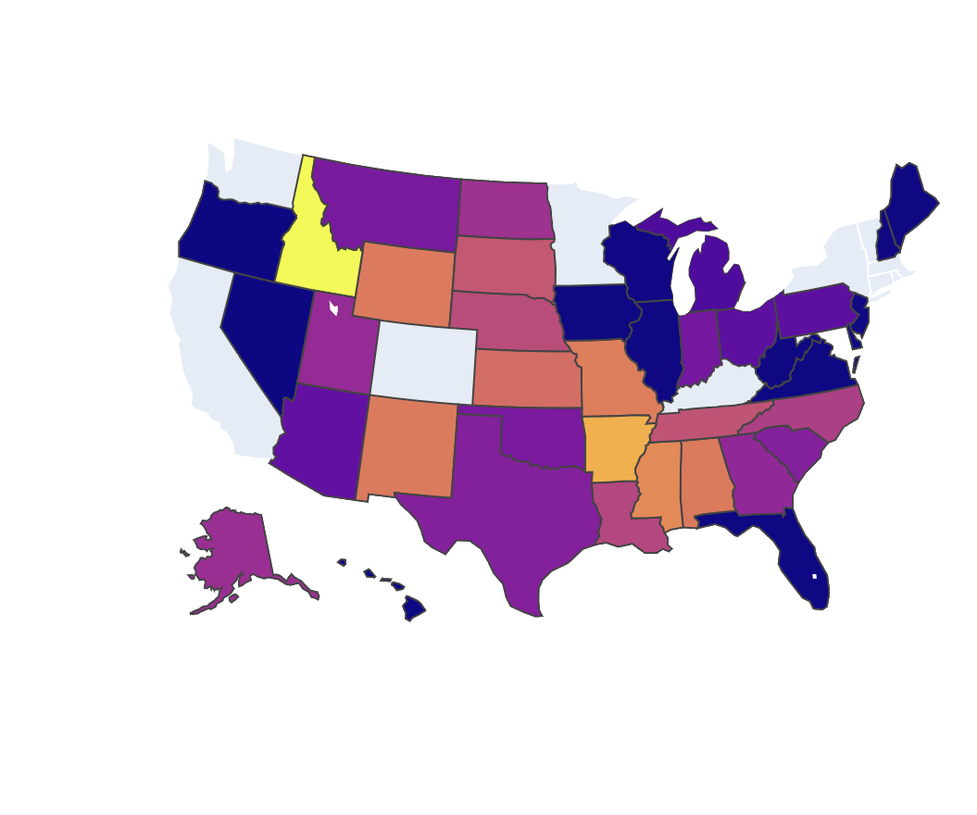
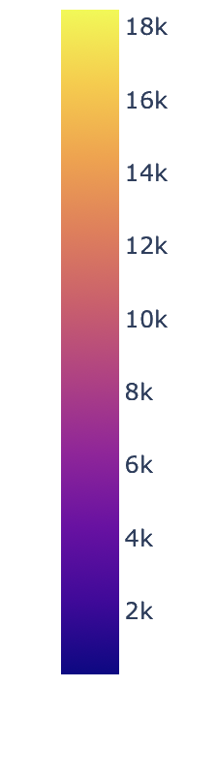
Part I - Rate vs State Analysis
A user or an insurance company may want to know how the overall rates for an insurance plan varies across states.
Why?
Informs user whether living in a particular state has an effect on cost of their insurance plan.
The insights obtained can help insurance companies structure new insurance plans.
Visualized average insurance rate for a particular state so insurance companies can better understand their user base.
Annual Individual insurance rate
Conclusion - There is no clear dependence between an individual's insurance plan rate and the state that the individual is from (there was a low correlation ratio - 0.0032).
Notes:
To solve the problem of understanding how residence in a particular state affects your insurance plan we visualized and calculated their dependence. This mainly helps because one it tells users how or even if the state they’re from affects their insurance plan and two it helps insurance companies understand this bias when they’re structuring new insurance plans. This analysis for comparing the categorical data (state) with the numerical data (individual rate) was done by comparing the intra categorical dispersion and overall dispersion in other words with correlation ratio. We have also visualized the average insurance rate for all the states as you can see from the slide.

Slide 6
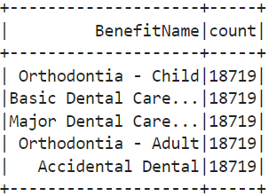
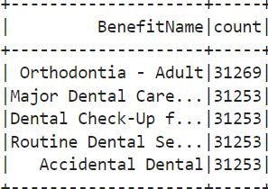
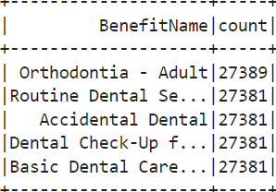
Part II - Analysis of Plan Benefits
Plan Benefits across the Years -
Top 5 benefits in each of the years 2014, 2015, 2016 -
2014
2015
2016
Conclusion:
For most of the states, the maximum used benefit is related to dental care/Orthodontia
Thus dental care is the most sought after benefit
Insurance providers can use this info and design their plans accordingly

Slide 7
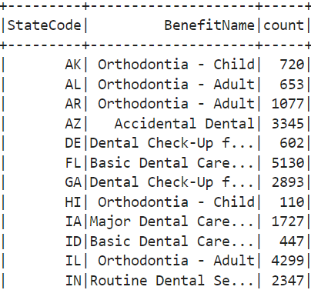
Most availed Plan Benefit per State
Find distinct states
Preprocess state codes to remove junk values
Group by state code, benefit name and find the benefit counts
Use the window function to find the top benefit used in each state
We can get an idea of which healthcare service is most needed in each state from this.

Slide 8
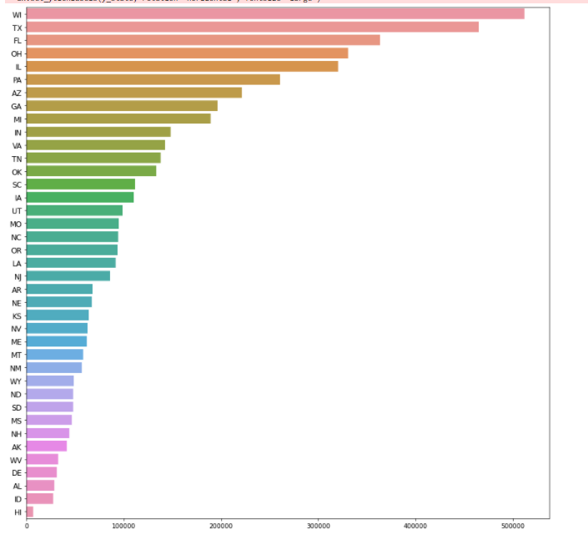
Plan Benefits across States
Group by StateCode
Find the total number of benefits associated with each state.
State code - x axis, no of benefits- y axis
Conclusion:
We can see that state WI(Wisconsin) is using maximum number of benefits, followed by TX(Texas)
The state using least number of benefits is Hawaii
This means that insurance providers are offering a wider range of benefits in the top states

Slide 9
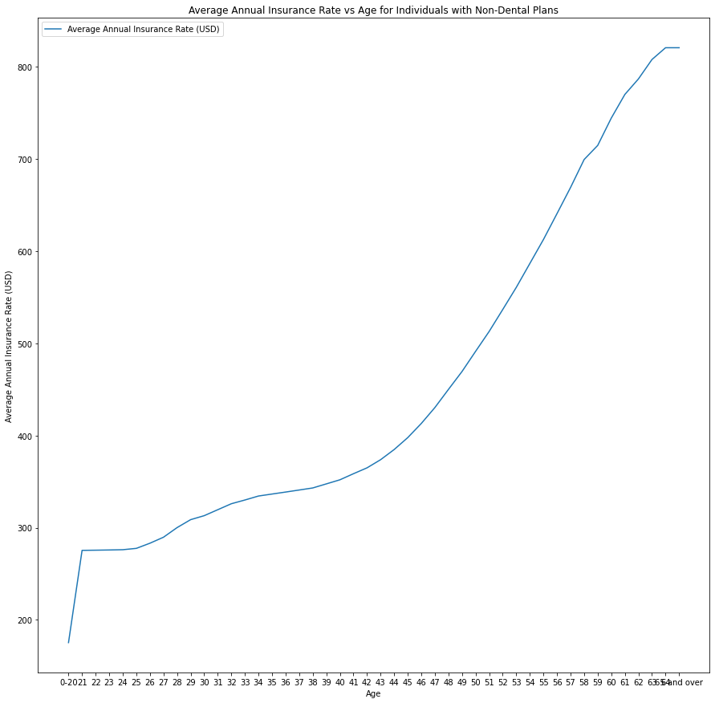
Part III - Effect of Age on Plan rates
Comparing the average plan rate with age for non-dental plan, the average increase with age.
Correlation is - 0.7599
Conclusion: Age and Plan rates are strongly dependent.
Insurance users can keep this in mind while setting aside money for an insurance plan.

Slide 10
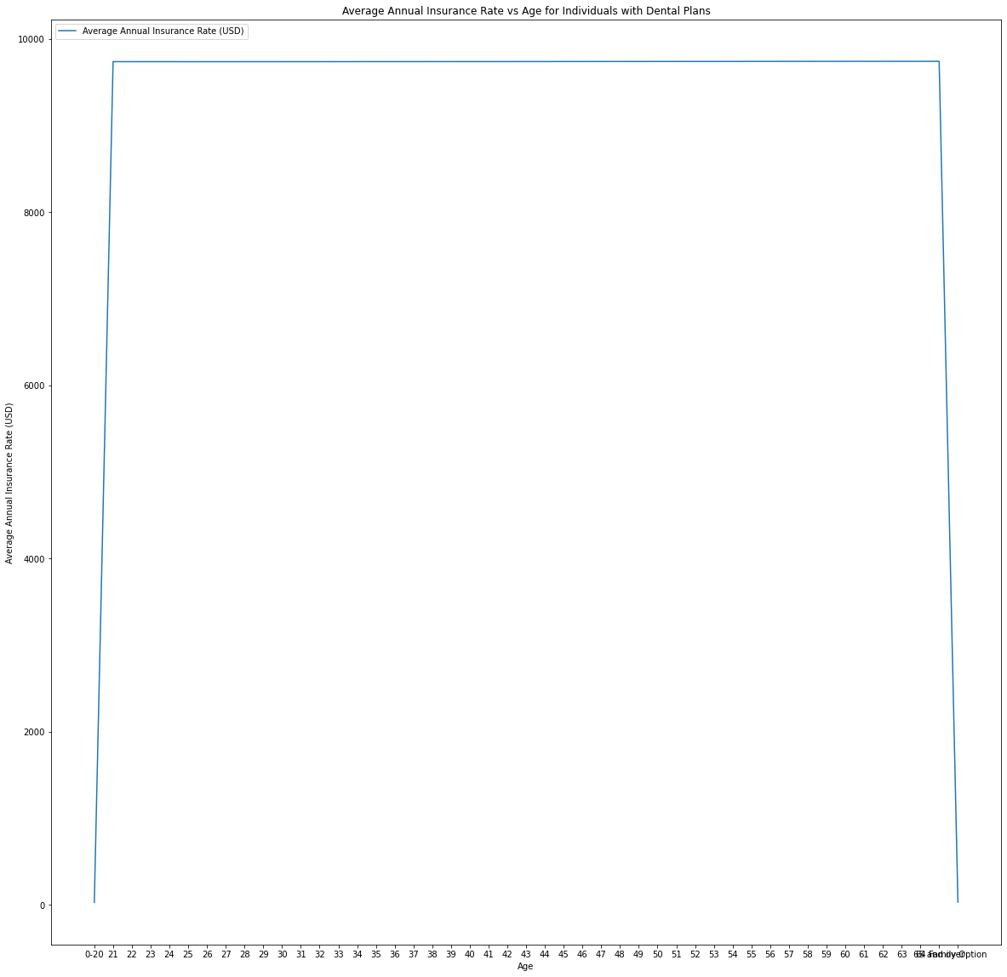
Comparing the average plan rate with age for dental plan, the average increase with age.
Correlation is - 0.0037
Conclusion: Age and Dental Plan rates don’t seem to be dependent.
Also, the dental insurance plan rates are relatively higher. Thus dental insurance is sought after, irrespective of the age.

Slide 11
Part III - Effect of Health Habits on Plan Rates
Some plan users have particular tobacco preferences and some have no preference.
Considering the Individual Tobacco Rate for users with tobacco preference, the correlation between Individual Tobacco Rate and Plan Rates is 0.9737 with the plan rates increasing as tobacco rates increase.
Conclusion: Insurance providers could look to make more affordable plans for Tobacco users.

Slide 12
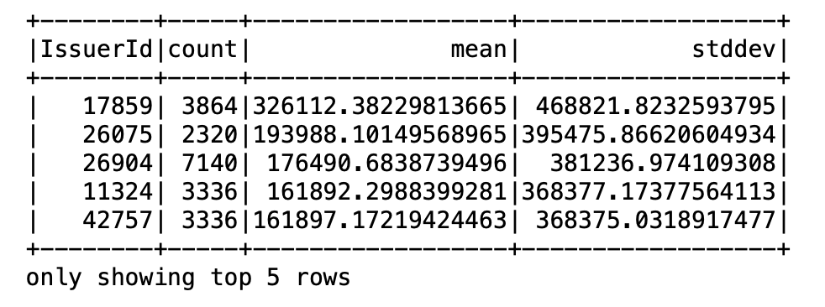
Part IV - Distribution of Rates across Issuers
Analysing how the individual rates are distributed across each of the issuers tells us how diverse an issuers portfolio is.
Calculating the mean, standard deviation and the count of individual rates for each issuer can tell us how the rate is distributed among these issuers.
Conclusion -
Displayed the final issuers which have the highest standard deviation since they have the most diverse portfolio.
Notes:
Different issuers have different portfolios and as a consumer understanding how individual rate is distributed across issuers can be a useful metric to understand which issuer group you want to be a part of. Over here you can see the issuers with the highest standard deviation from the mean giving you a good idea of the issuers with the most diverse portfolios.

Slide 13
Part V - Predicting Individual Insurance Rate
Create a linear regression model to predict individual Rate
Features (predictor variables) - Age, Individual Tobacco rate
Criterion variable - Individual Insurance Rate
Pyspark ML features - Vector Assembler, Pipeline
Train, test split of 70-30
R2 value - 0.94 Accuracy - 94.95%
Notes:
Individual Tobacco Rate is the rate of tobacco consumption.

Slide 14
Overall Conclusions
No clear dependence between an individual's insurance plan rate and the state that the individual is from
The most common benefit used in every state is related to dental care - useful for insurance providers - lets them know they should invest in dental care options.
There is a good correlation between:
age and Individual rate
Individual Tobacco Rate and Individual Rate
Our linear regression model to predict Individual Insurance plan rates has an R2 value of 0.94 (94% accuracy)

Slide 15
Future Work
Analyze correlation between other variables to determine the best features to use to predict insurance rates more reliably.
Use new features to build a recommendation system for the user.

