Slide 1
AI-Based tool for preliminary diagnosis of Dermatological manifestations.
CSE7101- Capstone Project
Review-2
Team Number: ISE_40
Roll Number | Student Name
20221ISE0162 | Sindhu L Y
20221ISE0171 | Anusha M S
20231ISE3001 | Kumar G K
Under the Supervision of,
Ms. Babitha S
Associate Professor
School of Computer Science and Engineering
Presidency University
Name of the Program: Capstone Project
Name of the HoD: Dr. Zafar Ali Khan N
Name of the Program Project Coordinator: Ms.Suma N G
Name of the School Project Coordinators: Dr. Sampath A K , Dr. Geetha A

Slide 2
Content
Abstract
Literature Survey
Objectives
Existing Methods and Drawbacks
Proposed Method and Feasibility Study
Architecture Diagram
Modules
References

Slide 3
Problem Statement Number : PSCS_49
Organization: Ministry of AYUSH
Category : Software
Abstract :
Artificial Intelligence (AI) has significantly advanced the field of medical imaging, particularly in dermatology. Skin conditions often present diagnostic challenges due to their wide variability and similarity across different diseases. Limited access to dermatologists, especially in low-resource regions, further complicates timely diagnosis. This paper reviews state-of-the-art AI-based diagnostic tools in dermatology, including convolutional neural networks (CNNs), foundation models, and multimodal vision-language systems. The study also highlights challenges such as dataset bias, regulatory hurdles, and explainability. Finally, a framework for AI-based preliminary diagnosis is proposed, emphasizing integration with tele-dermatology and mobile platforms to improve accessibility and early detection.

Slide 4
Content
Literature Survey:
Several studies have applied AI in dermatology:
- Esteva et al. (2017) achieved dermatologist-level accuracy in skin cancer classification using CNNs.
- DermX and DermX+ (2022) provided explainable CNN frameworks, reaching F1 scores close to dermatologists.
- DermNIO (2025) foundation model trained on 432,776 images achieved 95.79% accuracy, outperforming clinicians.
- VL-MedGuide (2025) combined vision-language learning, offering rationalized outputs and explainability.
- Tibot AI Tool (India, 2020) showed ~85% top-3 accuracy across common dermatoses.
- Teledermatology studies demonstrated AI assistance improved agreement between primary care providers and dermatologists.
While promising, these methods face challenges of dataset bias, lack of external validation, and limited representation of darker skin tones.

Slide 5
Content
Objectives :
To design an AI-based tool capable of preliminary diagnosis of dermatological manifestations.
To integrate multimodal inputs such as images, metadata, and clinical descriptions for improved accuracy.
To implement explainable AI methods for transparency and trust.
To address dataset bias and fairness by incorporating diverse datasets.
To explore mobile/tele-dermatology deployment for accessibility in resource-limited regions.
.

Slide 6
Existing Methods and Drawbacks
Image-only CNNs often fail to generalize across diverse skin tones and rare diseases.
Lack of explainability reduces clinician trust in AI predictions.
Many tools are evaluated only on benchmark datasets without clinical validation.
Fairness issues exist due to dataset imbalance toward lighter skin tones.
Existing commercial tools provide reasonable accuracy but lack transparency and broad validation.

Slide 7
Proposed Method and Feasibility Study
We propose a hybrid multimodal AI framework combining dermoscopic images, patient metadata, and clinical text. The architecture uses a CNN-Transformer hybrid backbone for feature extraction, fused with metadata through cross-attention layers. Explainability is achieved using Grad-CAM visualizations and concept-based reasoning. The feasibility study involves training on HAM10000, ISIC archives, and Fitzpatrick17k datasets. Performance will be benchmarked against dermatologists’ accuracy, with additional evaluation of fairness across skin tones and calibration for triage decisions.

Slide 8
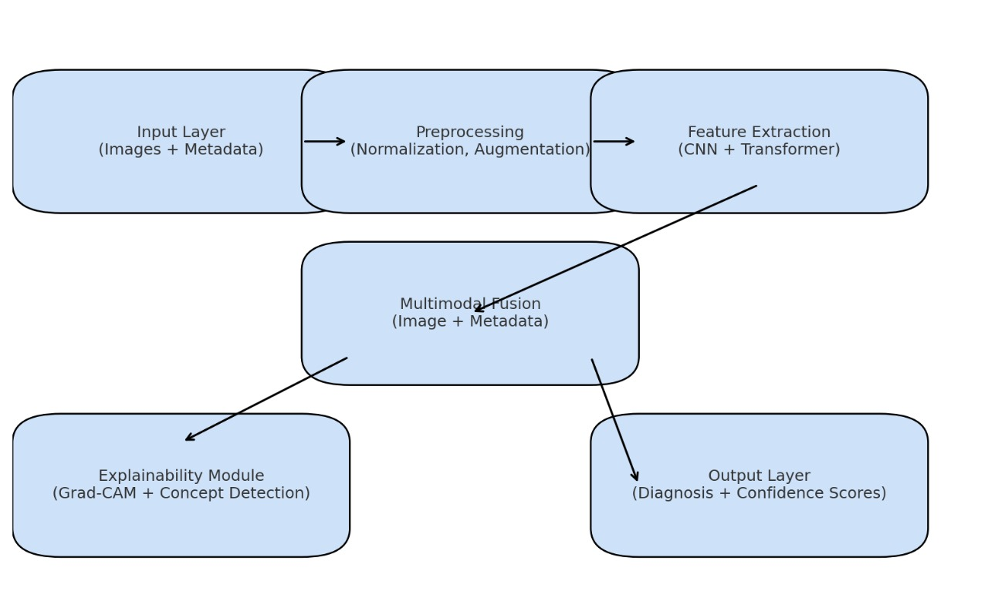
Architecture Diagram

Slide 9
Modules
The system is divided into the following modules :
- Data Collection and Preprocessing Module
- Feature Extraction Module
- Multimodal Fusion Module
- Explainability and Visualization Module
- Diagnosis and Decision Support Module
- Mobile/Tele-dermatology Deployment Module

Slide 10
References (IEEE Paper format)
[1] A. Esteva et al., 'Dermatologist-level classification of skin cancer with deep neural networks,' Nature, 2017.
[2] R. Jalaboi et al., 'DermX and DermX+: Explainable CNNs for Dermatology,' arXiv, 2022.
[3] J. Xu et al., 'DermNIO: A Foundation Model for Dermatology,' arXiv, 2025.
[4] K. Yu et al., 'VL-MedGuide: Vision-Language Diagnosis,' arXiv, 2025.
[5] A. Gupta et al., 'Assessment of Tibot: AI Tool for Skin Diagnosis,' Indian Dermatology Online Journal, 2020.
[6] J. Han et al., 'AI Assistance in Teledermatology,' JAMA Dermatology, 2021.
[7] P. Tschandl et al., 'The HAM10000 dataset: Multi-source dermatoscopic images for AI research,' Scientific Data, 2018.
[8] T. Brinker et al., 'Skin cancer classification and dermatologist-level performance of deep learning,' The Lancet Oncology, 2019.
[9] E. Fujisawa et al., 'Deep-learning based, computer-aided classifier developed with a small dataset of rare skin diseases,' British Journal of Dermatology, 2019.
[10] M. Tschandl et al., 'Expert-level diagnosis of nonpigmented skin cancer by combined convolutional neural networks,' JAMA Dermatology, 2019.

Slide 11


