Slide 1

PROJECT PRESENTATION ON “VOIZFONICA TELECOM”

Slide 2

Agenda:
ABOUT COMPANY
CHALLENGES
PROPOSALS
SPECIFICATIONS
ARCHITECTURE
DASHBOARD
OVERVIEW
USER INTERFACE
DATABASE DESIGN
CONCLUSION

Slide 3
About Us:
VOIZFONICA is mobile network operator and telephone company.
It aims in making long distance communication easy for people.
There are 3 products of company like prepaid, postpaid and dongle.
VoizFonica business is very technology dependent as company acts as a network service provider (NSP) in mobile.

Slide 4
Challenges:
In current system we are not able to handle the customer because manual legacy system is being used.
Migration of customer from postpaid to prepaid.
Mobile Number Portability.

Slide 5
Achieved Goals:
We have implemented a complete Automated System for better customer experience.
Bill generation and sending to customer via Email has been implemented.
Now Customer can contact us easily and query can be resolved smoothly.

Slide 6
Specifications:
Software
Hardware
Language-Python, HTML5, CSS
Database-MongoDB Atlas.
Testing tool-Postman
Operating system windows 7 or above.
Backend framework- Django.
Frontend Framework - Bootstrap.
RAM-4GB or above.
Processor Intel core i3/i5/i7.
CPU clock rate-2.0 GHz.
SSD-10GB free space.

Slide 7
Architecture:
USER
USER
INTERFACE
SERVICE
PROVIDER
SERVICES
&
OFFERS
BACKEND
&
DATABASE

Slide 8
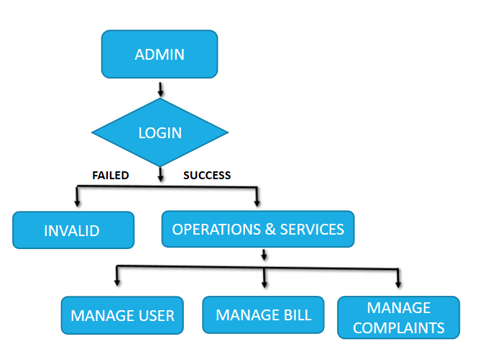
ADMIN MODULE WORK FLOW:

Slide 9
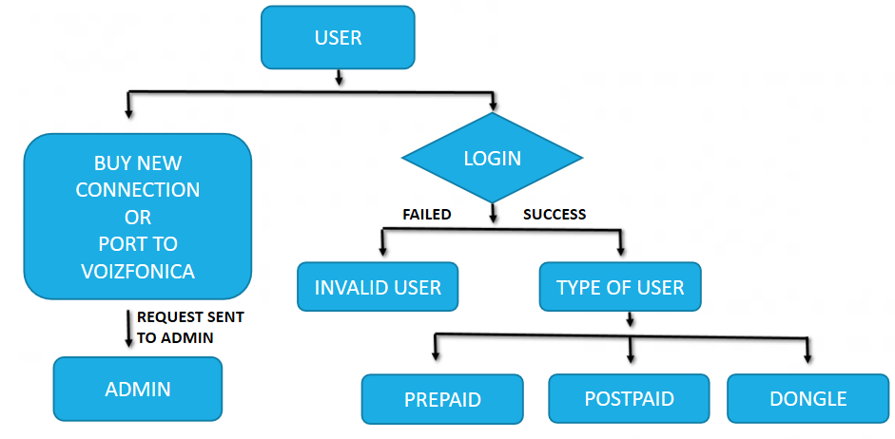
CUSTOMER MODULE WORK FLOW:

Slide 10
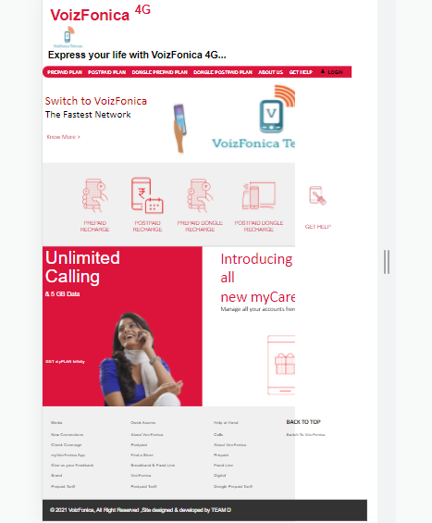
HOMEPAGE
This is how our home page looks which contains the following services:
*Prepaid
*Postpaid
*Dongle Prepaid
*Dongle postpaid
*About us
*Get Help
*Login

Slide 11
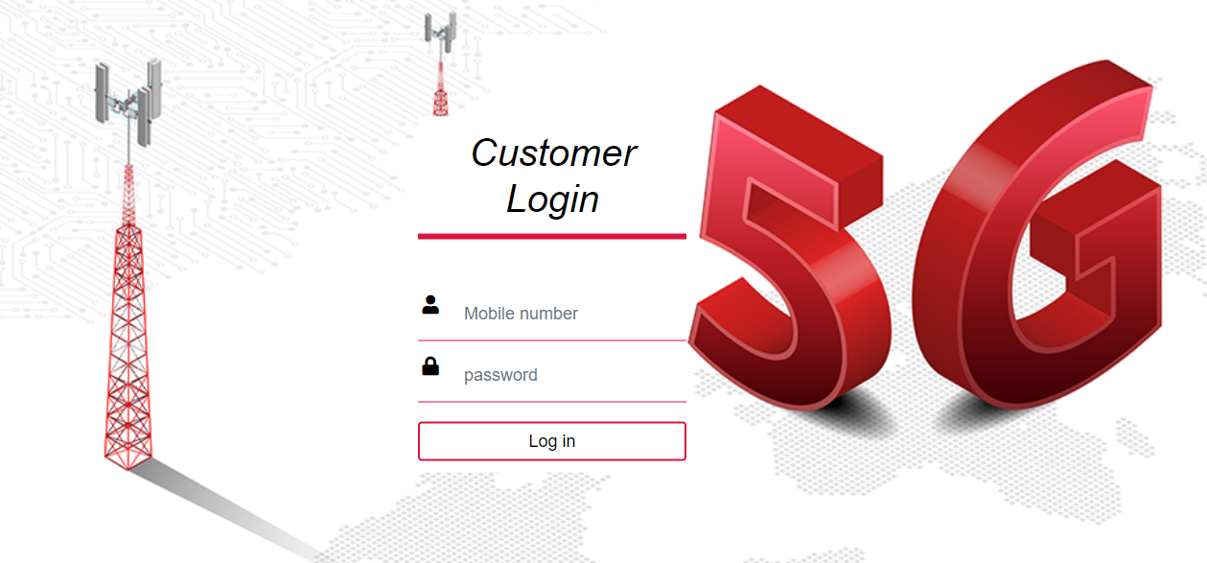
Customer Login:
-If the user is already registered he/she can access all our services.
-If the user is new then he/she can contact the service provider for more information and guidance.

Slide 12
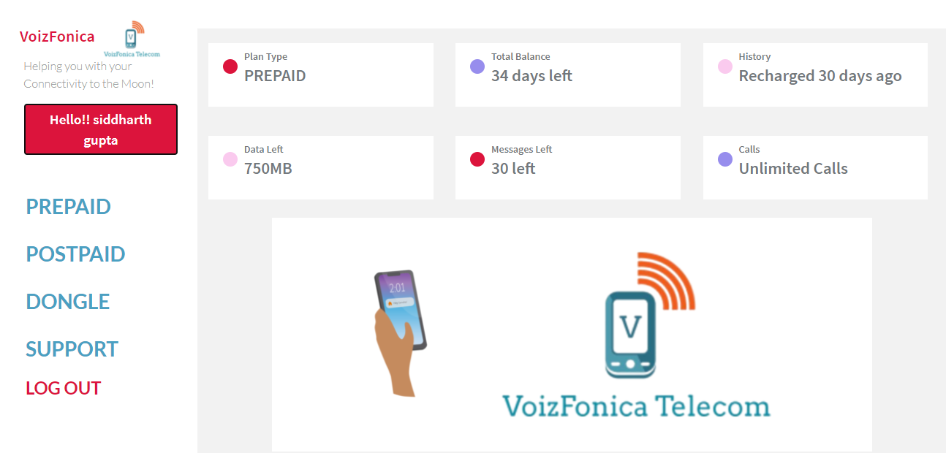
DASHBOARD (AFTER LOGIN):
When the user clicks on login he/she will be directed to the user dashboard.
-In the user dashboard the user can see the services like:
*Prepaid
*Postpaid
*Dongle
*Support
*Logout
-We have given an option where the user can see his/her plan type, total bill balance, plan history, data left, messages left and calls.

Slide 13
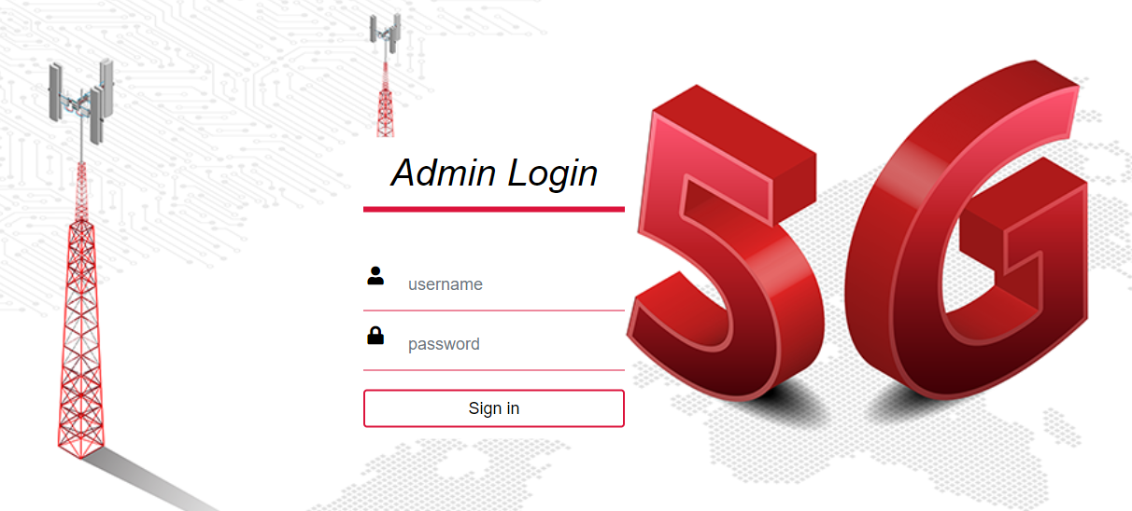
ADMIN LOGIN

Slide 14
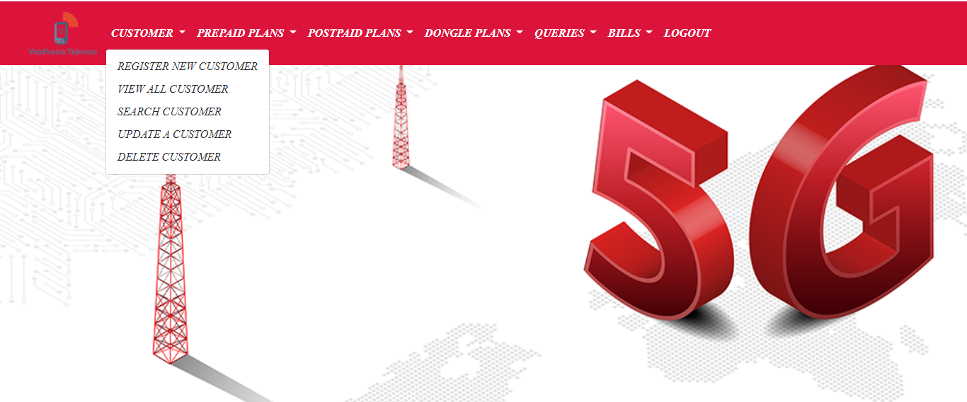
ADMIN PAGE
This is how our admin page looks like, it contains the following services for managing customers-
*Customer
*Prepaid
*Postpaid
*Dongle
*Queries
*Bills
*Logout

Slide 15

OUR WORK EXPERIENCE
Rakesh R
It was good experience to work in a group . Got to know that anything can be done with a good team work and ofcourse I have learnt many new things by working on this project.
Sindhu Barathi A
I learned so many new technologies which would be very helpful to build my future.And it was a pleasure working as team
Kanchana Goudar
I worked with a good team. Learned so many new things and experienced that the team work gives good results
Tamilarasi.K
I learned how to work as a team and its was fun and learned lots of new things.

Slide 16
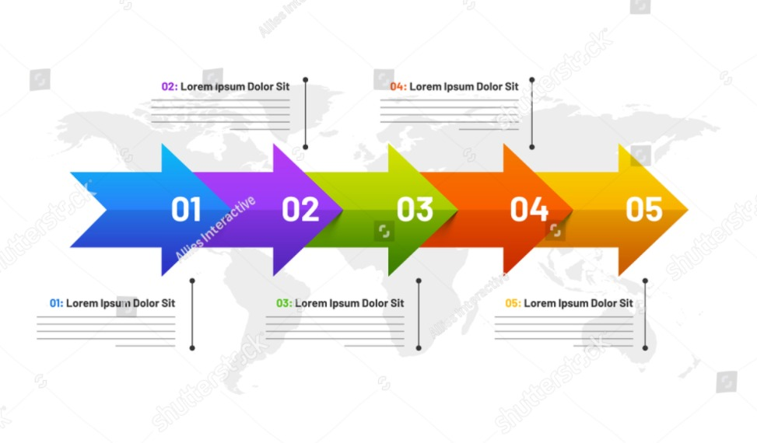
OUR WORK EXPERIENCE
Siddharth Gupta
With this project, I came to know how to handle the team .
Rakesh R
It was good experience to work in a group . Got to know that anything can be done with a good team work and ofcourse I have learnt many new things by working on this project.
Kanchana Goudar
I worked with a good team. Learned so many new things and experienced that the team work gives good results
Sindhu Barathi A
I learned so many new technologies which would be very helpful to build my future.And it was a pleasure working as team.
Tamilarasi.K
I learned how to work as a team and its was fun and learned lots of new things.

Slide 17
Conclusion:
VoizFonica is a company that is aware of the new challenges posed by today’s society. This is why the company offer the means to facilitate communication between people, providing them with the most secure and state of the art technology in order for them to live better, and for them to achieve whatever they resolve.

Slide 18
