Slide 1

PROJECT PRESENTATION ON “VOIZFONICA TELECOM”

Slide 2

Agenda:
ABOUT COMPANY
CHALLENGES
PROPOSALS
SPECIFICATIONS
ARCHITECTURE
DASHBOARD
OVERVIEW
USER INTERFACE
DATABASE DESIGN
CONCLUSION

Slide 3
About Us:
VOIZFONICA is mobile network operator and telephone company.
It aims in making long distance communication easy for people.
There are 3 products of company like prepaid, postpaid and dongle.
VoizFonica business is very technology dependent as company acts as a network service provider (NSP) in mobile.

Slide 4
Challenges:
In current system we are not able to handle the customer because manual legacy system is being used.
Migration of customer from postpaid to prepaid.
Mobile Number Portability.

Slide 5
Achieved Goals:
We have implemented a complete Automated System for better customer experience.
Bill generation and sending to customer via Email has been implemented.
Now Customer can contact us easily and query can be resolved smoothly.

Slide 6
Specifications:
Software
Hardware
Language-Python, HTML5, CSS
Database-MongoDB Atlas.
Testing tool-Postman
Operating system windows 7 or above.
Backend framework- Django.
Frontend Framework - Bootstrap.
RAM-4GB or above.
Processor Intel core i3/i5/i7.
CPU clock rate-2.0 GHz.
SSD-10GB free space.

Slide 7
Architecture:
USER
USER
INTERFACE
SERVICE
PROVIDER
SERVICES
&
OFFERS
BACKEND
&
DATABASE

Slide 8
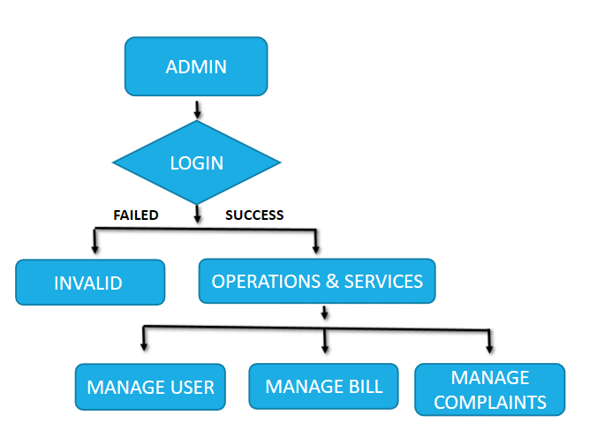
ADMIN MODULE WORK FLOW:

Slide 9
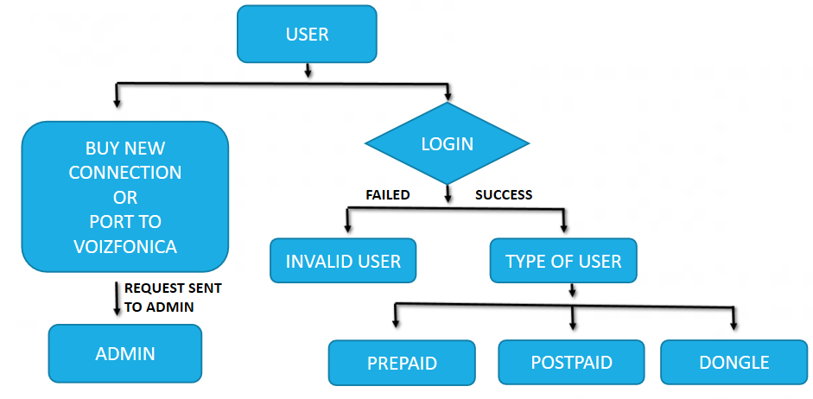
CUSTOMER MODULE WORK FLOW:

Slide 10
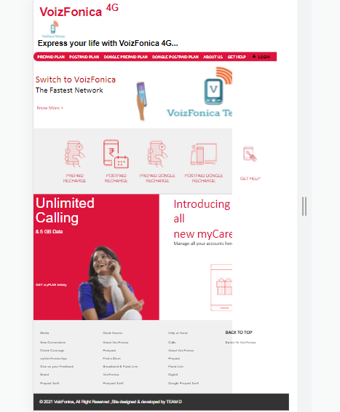
HOMEPAGE
This is how our home page looks which contains the following services:
*Prepaid
*Postpaid
*Dongle Prepaid
*Dongle postpaid
*About us
*Get Help
*Login

Slide 11
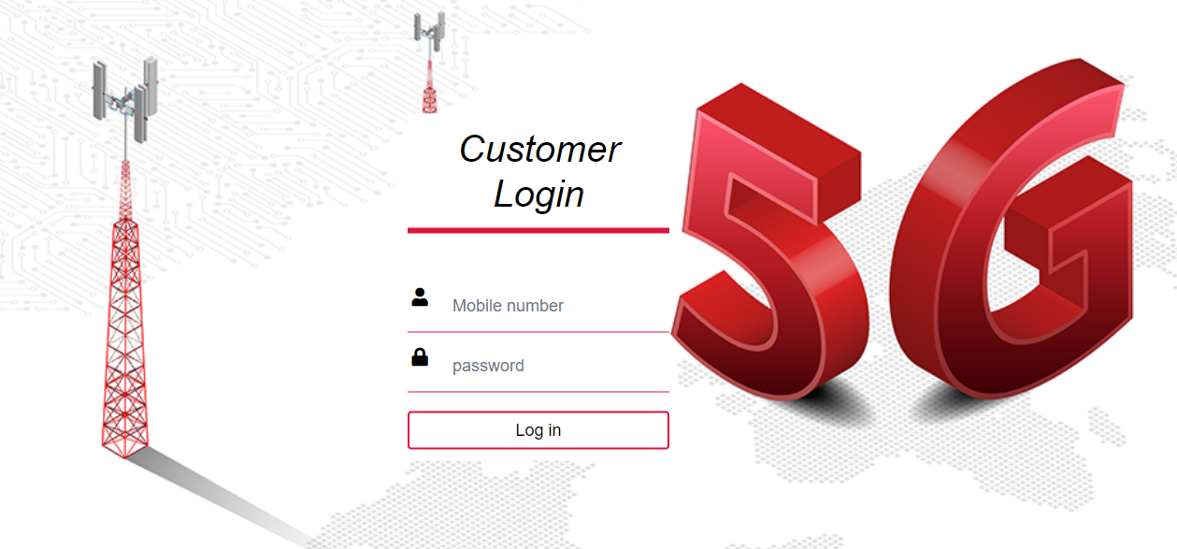
Customer Login:
-If the user is already registered he/she can access all our services.
-If the user is new then he/she can contact the service provider for more information and guidance.

Slide 12
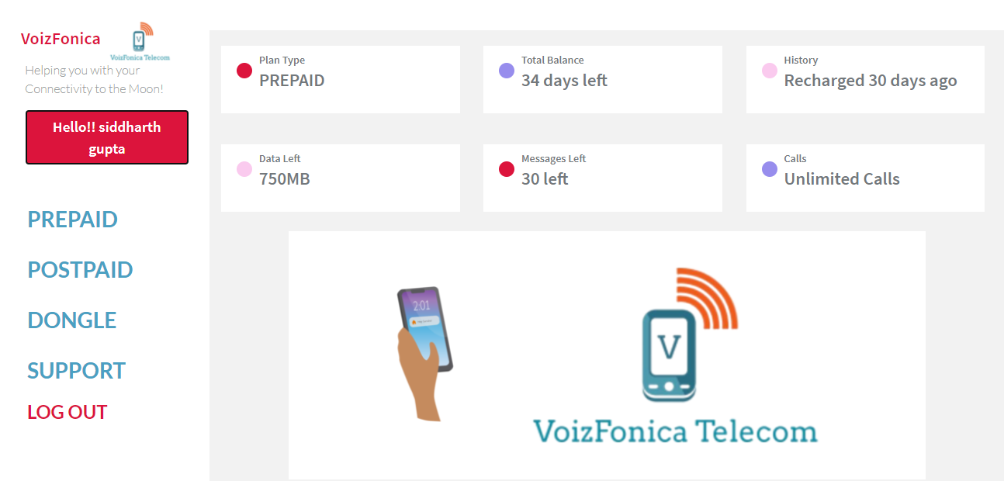
DASHBOARD (AFTER LOGIN):
When the user clicks on login he/she will be directed to the user dashboard.
-In the user dashboard the user can see the services like:
*Prepaid
*Postpaid
*Dongle
*Support
*Logout
-We have given an option where the user can see his/her plan type, total bill balance, plan history, data left, messages left and calls.

Slide 13
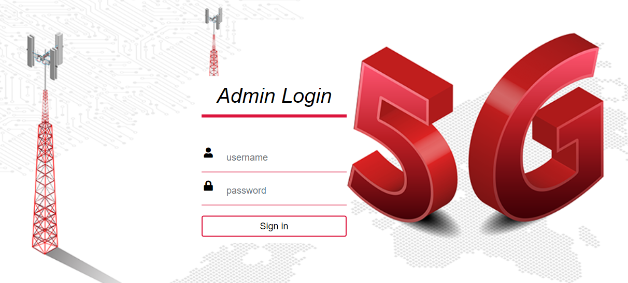
ADMIN LOGIN

Slide 14
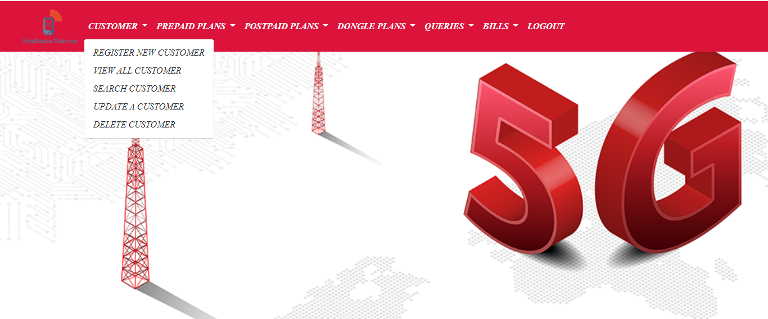
ADMIN PAGE
This is how our admin page looks like, it contains the following services for managing customers-
*Customer
*Prepaid
*Postpaid
*Dongle
*Queries
*Bills
*Logout

Slide 15
Conclusion:
VoizFonica is a company that is aware of the new challenges posed by today’s society. This is why the company offer the means to facilitate communication between people, providing them with the most secure and state of the art technology in order for them to live better, and for them to achieve whatever they resolve.

Slide 16


