Slide 1
ARTIFICIAL NEURAL NETWORK
HAND WRITTEN DIGIT RECOGNITION
SINDHU KALEESWARAN-RA2011026010082
APARNA SURESH-RA2011026010099
CHEREDDY SOWMYA SRI-RA2011026010113

Slide 2
Title:
Hand Written Digit Recognition

Slide 3
Problem Statement:
Implementation of neural network to recognize the hand-written digits from 0-9.

Slide 4
Data set: Each training example is a 20-pixel x 20-pixel grayscale image of the digit. Each pixel is represented by a floating-point number indicating the grayscale intensity at that location. The 20 by 20 grid of pixels is “unrolled” into a 400-dimensional vector. Each training examples becomes a single row in our data matrix X. This gives us a 5000 x 400 matrix X where every row is a training example of a handwritten digit image.

Slide 5
Structure: Layer-1(input layer)comprises of 25 units. Layer-2(hidden layer)comprises of 15 units. Layer-3(output layer)comprises of 10 units. Layer-1 and Layer-2 are implemented using Relu activation. Layer-3 is implemented using Linear activation.

Slide 6
Implementation: This model is implemented using Tensorflow implementation.Tensorflow models are built layer by layer. We specify a layer's output dimensions and this determines the next layer's input dimension.

Slide 7
Code Snippet: import numpy as np import tensorflow as tf (X_train,Y_train),(X_test,Y_test)=keras.datasets.mnist.load_data() from tensorflow.keras.models import Sequential from tensorflow.keras.layersimport Dense from tensorflow.keras.activations import linear, relu, sigmoid%matplotlib widget import matplotlib.pyplot as pltplt.style.use('./deeplearning.mplstyle’) import logging logging.getLogger("tensorflow").setLevel(logging.ERROR)tf.autograph.set_verbosity(0) from public_tests import * from autils import *from lab_utils_softmax import plt_softmaxnp.set_printoptions(precision=2) plt_act_trio()

Slide 8
def my_softmax(z): N = len(z) a = np.zeros(N) ez_sum = 0 for k in range(N): ez_sum += np.exp(z[k]) for j in range(N): a[j] = np.exp(z[j])/ez_sum return(a) z = np.array([1., 2., 3., 4.]) a = my_softmax(z) atf = tf.nn.softmax(z) print(f"my_softmax(z): {a}") print(f"tensorflow softmax(z): {atf}“) test_my_softmax(my_softmax) plt.close("all")plt_softmax(my_softmax # load dataset X, y = (X_train,Y_train),(X_test,Y_test)=keras.datasets.mnist.load_data()

Slide 9
m, n = X.shape fig, axes = plt.subplots(8,8, figsize=(5,5)) fig.tight_layout(pad=0.13,rect=[0, 0.03, 1, 0.91]) #[left, bottom, right, top] widgvis(fig) for i,ax in enumerate(axes.flat): random_index = np.random.randint(m) X_random_reshaped = X[random_index].reshape((20,20)).T ax.imshow(X_random_reshaped, cmap='gray') ax.set_title(y[random_index,0]) ax.set_axis_off() fig.suptitle("Label, image", fontsize=14) tf.random.set_seed(1234) # for consistent results

Slide 10
model = Sequential( [ tf.keras.Input(shape=(400,)), Dense(25, activation='relu', name = "L1"), Dense(15, activation='relu', name = "L2"), Dense(10, activation='linear', name = "L3"), ], name = "my_model" ) test_model(model, 10, 400) [layer1, layer2, layer3] = model.layers W1,b1 = layer1.get_weights() W2,b2 = layer2.get_weights() W3,b3 = layer3.get_weights() print(f"W1 shape = {W1.shape}, b1 shape = {b1.shape}") print(f"W2 shape = {W2.shape}, b2 shape = {b2.shape}") print(f"W3 shape = {W3.shape}, b3 shape = {b3.shape}")

Slide 11
model.compile( loss=tf.keras.losses.SparseCategoricalCrossentropy(from_logits=True), optimizer=tf.keras.optimizers.Adam(learning_rate=0.001), metrics = ['accuracy’]) history=model.fit( X,y, epochs=10, batch_size=10) plot_loss_tf(history) history.history.keys() plt.plot(history.history['accuracy’]) plt.legend(['loss','accuarcy’]) plt.ylabel('loss/accuracy') image_of_two = X[1015] display_digit(image_of_two) prediction = model.predict(image_of_two.reshape(1,400)) print(f" predicting a Two: \n{prediction}") print(f" Largest Prediction index: {np.argmax(prediction)}") prediction_p = tf.nn.softmax(prediction) print(f" predicting a Two. Probability vector: \n{prediction_p}") print(f"Total of predictions: {np.sum(prediction_p):0.3f}")

Slide 12
yhat = np.argmax(prediction_p) print(f"np.argmax(prediction_p): {yhat}") m, n = X.shape fig, axes = plt.subplots(8,8, figsize=(5,5)) fig.tight_layout(pad=0.13,rect=[0, 0.03, 1, 0.91]) widgvis(fig) for i,ax in enumerate(axes.flat): random_index = np.random.randint(m) X_random_reshaped = X[random_index].reshape((20,20)).T ax.imshow(X_random_reshaped, cmap='gray’) prediction = model.predict(X[random_index].reshape(1,400)) prediction_p = tf.nn.softmax(prediction) yhat = np.argmax(prediction_p) ax.set_title(f"{y[random_index,0]},{yhat}",fontsize=10) ax.set_axis_off() fig.suptitle("Label, yhat", fontsize=14)plt.show() print( f"{display_errors(model,X,y)} errors out of {len(X)} images")

Slide 13
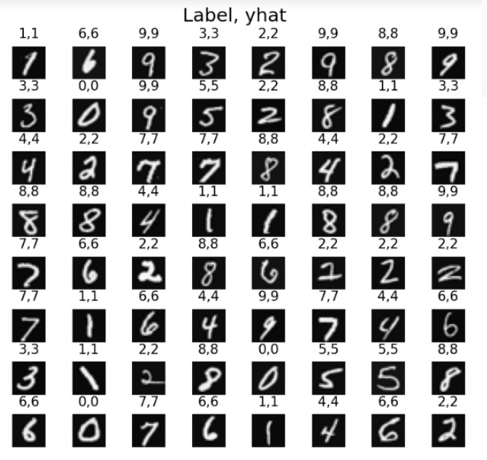
Output:

Slide 14
Result: Thus,the neural network model has been successfully implemented to recognise hand written digits.

Slide 15
Thank you

