Slide 1
Project title: secure data hiding in image using steganography
CAPSTONE PROJECT
Presented By: Sindhu
Student Name : Sindhu Kola
College Name & Department : Kakatiya Institute Of Technology And Science(ARTIFICIAL INTELLIGENCE AND MACHINE LEARNING )

Slide 2
OUTLINE
Problem Statement
Technology used
Wow factor
End users
Result
Conclusion
Git-hub Link
Future scope

Slide 3
Problem Statement
A safe way to conceal and safeguard private communications in digital photos is
desperately needed. Conventional encryption techniques are inadequate.
Developing a web-based application that securely encrypts and decrypts messages
contained in images using steganography and sophisticated encryption while
guaranteeing only allowed access is the challenge.

Slide 4
Technology used
BACKEND:
Python : python is a high-level language for server-side programming.
OpenCV is a library of programming functions used for complex image processing tasks that are primarily focused on real-time computer vision. Flask: The backend server is built using this lightweight Python WSGI web application framework. Pillow: A fork for the Python Imaging Library (PIL) that is used to open, work with, and store image files.
PLATFOERMS:
VS Code
Notepad++
Git hub
IDLE(python)

Slide 5
Wow factors
1.Direct Pixel Manipulation-This technique doesn't require external libraries like LSB steganography tools—it’s a raw, custom approach
2. Passcode-Protected Decryption-The user must enter a passcode to retrieve the hidden message. If the wrong passcode is entered, the decryption fails. This adds a security layer to the steganographic process.
3. Image Integrity Maintained-The hidden message is stored in small pixel value changes, so the image still looks normal.
4. Cross-Channel Encoding-This distributes the data across different color channels, making it harder to detect patterns.

Slide 6
End users
Media and Journalism: Journalists needing to protect sensitive information.
Government and Law Enforcement: Government officials handling classified information.
Healthcare: Healthcare professionals safeguarding patient records.
Legal: Legal professionals protecting client confidentiality.
Education: Researchers and academics working with sensitive information.
Financial Institutions: Financial institutions accessing secure communications.
IT and Cybersecurity: IT administrators ensuring data security within an organization.
Individuals: Individuals wanting to secure personal messages or data.

Slide 7
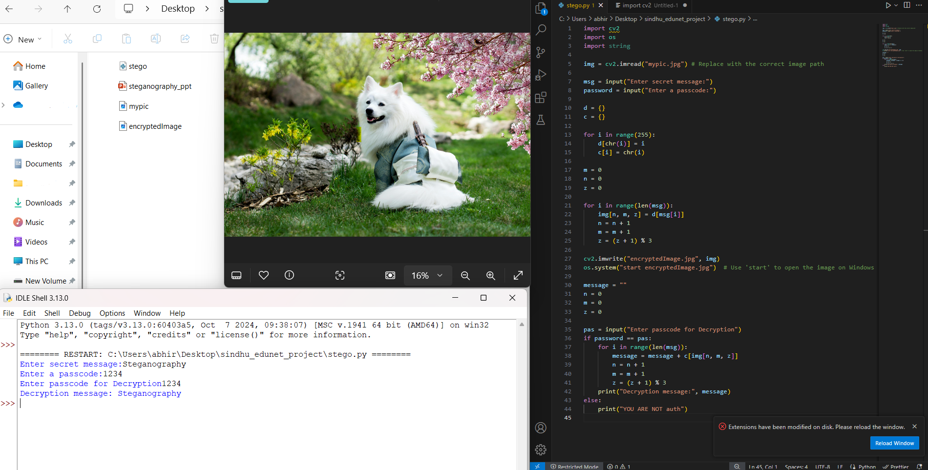
Results

Slide 8
Conclusion
In summary, the IBM-Intern-Secure-Data-Hiding-in-Image-Using-Steganography project effectively meets the vital requirement for secure data transfer in our society that is becoming more and more digital. This online application offers a reliable way to encrypt and decrypt data concealed within photos by utilizing cutting-edge technologies like Python (Flask) and Pillow. Implementing steganography guarantees that private data is shielded from unwanted access and kept private. This project lays the groundwork for future improvements including multi-language support, sophisticated encryption techniques, and mobile application development in addition to showcasing the possibilities of fusing contemporary web development frameworks with cybersecurity concepts.
We have made great progress in protecting digital communication and guaranteeing privacy in the digital era with this endeavor.

Slide 9
GitHub Link
LINK: https://github.com/SindhuKola/Stego_aicte

Slide 10
Future scope(optional)
-Put multilingual support into action. -For increased security, incorporate sophisticated encryption algorithms. -Create a mobile application that enables encryption and decryption while on the go. -Include cloud storage choices for safe data retrieval and backup. -Improve the user interface to make it more smooth and intuitive. -Provide team-based encryption and decryption jobs with real-time collaboration tools. -To improve compatibility and versatility, include support for a variety of picture formats. -Create a browser extension to provide quick and simple access to tools for encryption and decryption.

Slide 11
THANK YOU

