Slide 1
Hackathon scoring appLICATION
TEAM NAME – Cognitive Squads
Participants – Ravi Kumar kurva
Advaith nandelli
Sindhu Reddy Golconda
Uday kiran chowdary mallineni

Slide 2
Application
Scoring Application for HACKATHON event has two users
JUDGE
ADMIN
JUDGE –
Company Sponsors
Can add scores and comments for the participating teams.
ADMIN -
Can add teams participated.
View Scores and provide permissions to view the scores for judges

Slide 3
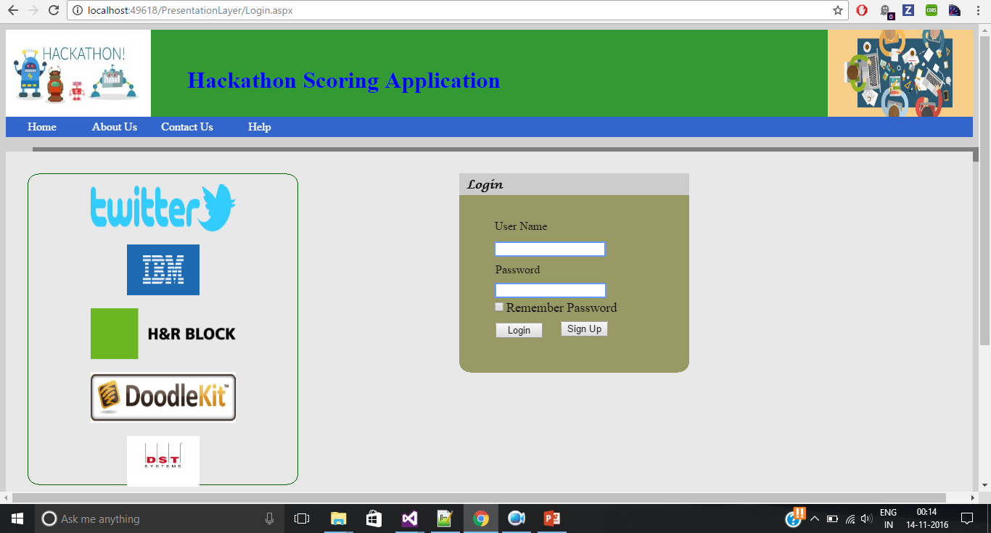

Slide 4
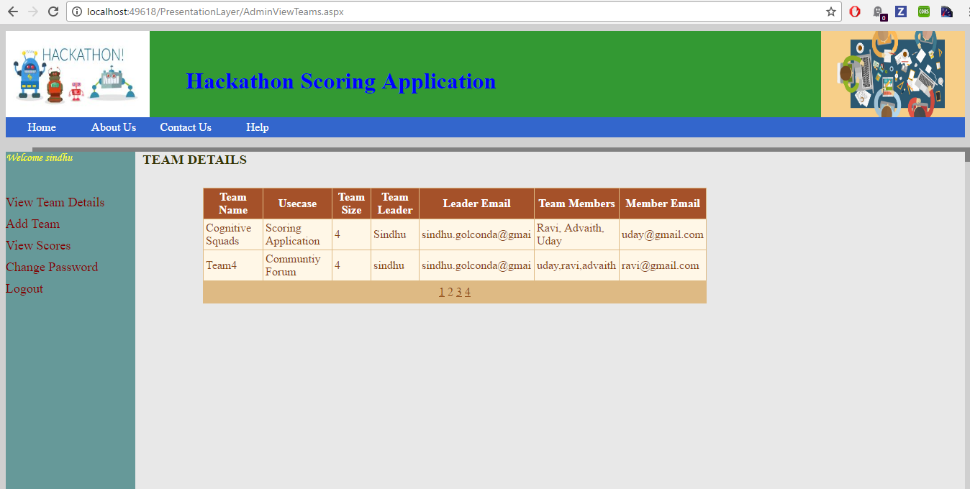
ADMIN PAGE

Slide 5
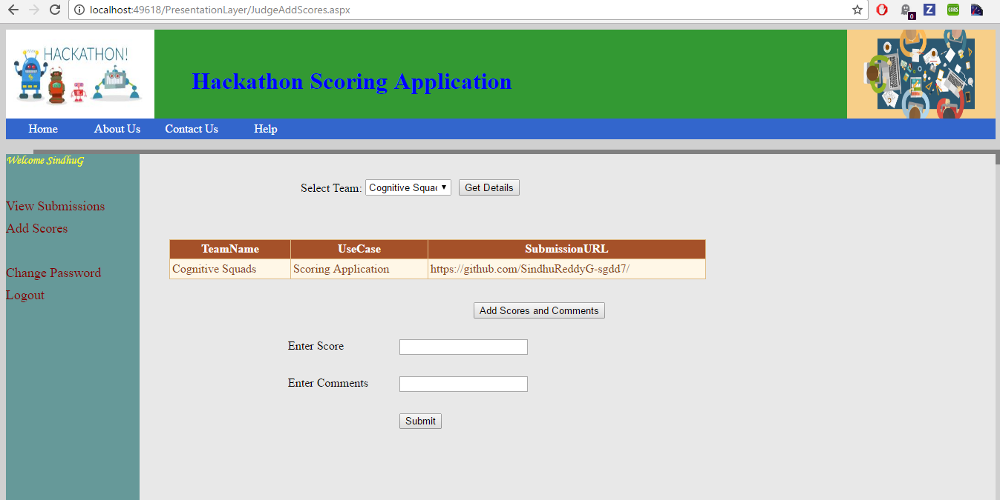
JUDGE PAGE

