Slide 1
NLP powered Appointment Detection System
TEAM NAME – HAPPY CODERS
Participants – Harshini Medikonda
Sindhu Reddy Golconda
Uday Kiran Chowdary Mallineni

Slide 2







ARCHITECTURE
Intellexar
Sender
MongoDB
Recievers

Slide 3
User Registration
Login
Send Details of meeting to other user
Send Details of meeting to other user
View the analyzed text
Analyze the text
Person views in inbox
Clicks to see message details
Edit profile information (optional)
Logout
Access all the chats

Slide 4
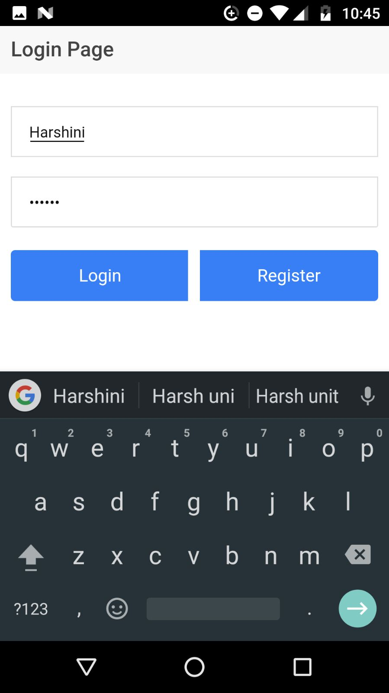
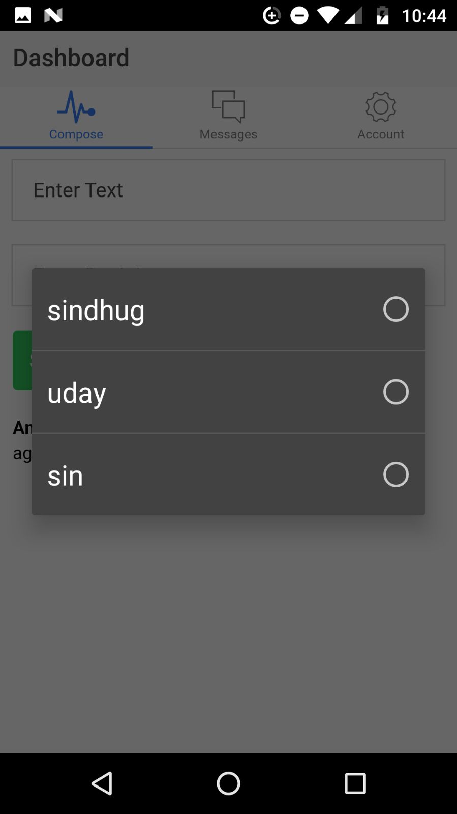
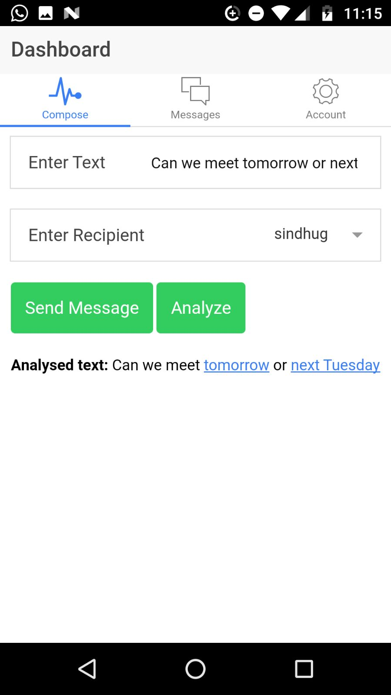

Slide 5
