Slide 1

Introduction to Python & Apps

Slide 2
Renata O-Stewart Tharshika Tharsan Verena Sarrazin
Group 11
Project No.3
Spreadsheet Analysis

Slide 3
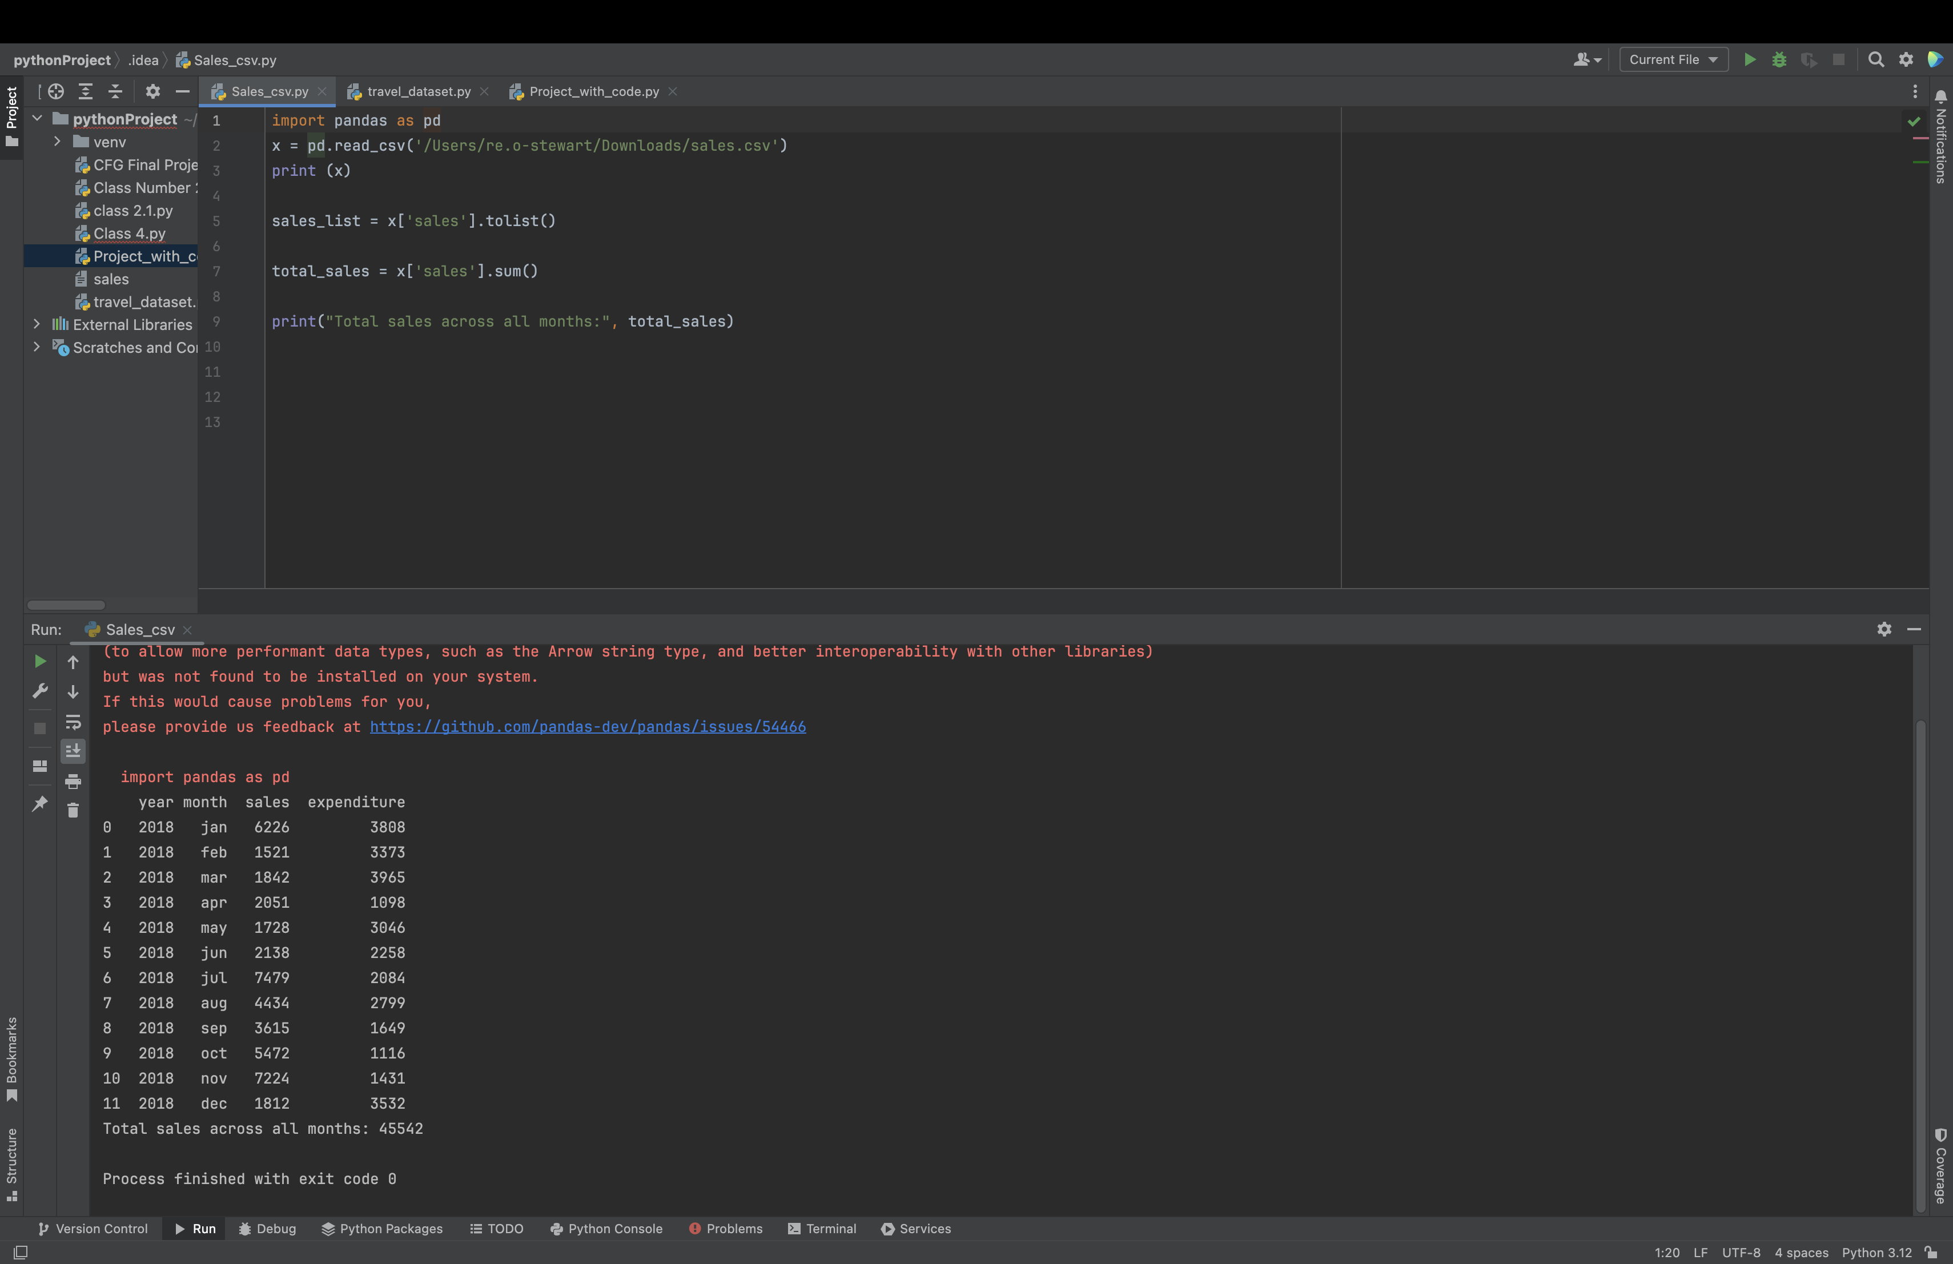
Required Tasks
These are the required tasks for this project.
Read the data from the spreadsheet (sales.csv)
Collect all the sales from each month into a single list
Output the total sales across all months

Slide 4
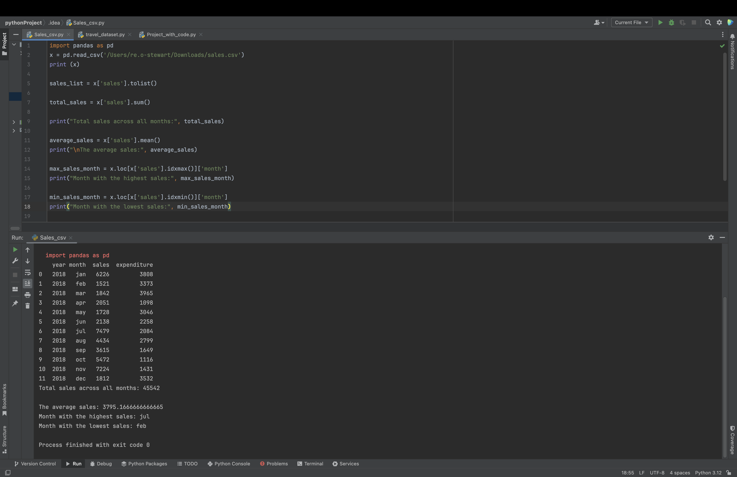
Extending the Project 1
● Calculate the following:
Monthly changes as a percentage.
The average
Months with the highest and lowest sales

Slide 5
Extending the Project 2

