Slide 1
SENTIMENT ANALYSIS
-Using Machine Learning
Presented By:
Badana Sindhuja
Rajiv Gandhi University of Knowledge Technologies-Srikakulam
Computer Science Engineering(CSE)

Slide 2
OUTLINE
Problem Statement
Proposed System/Solution
System Development Approach
Algorithm & Deployment
Result
Conclusion
Future Scope
References

Slide 3
Problem Statement
As online review platforms continue to expand, restaurants increasingly depend on customer feedback to refine their services and attract more patrons. By analyzing the sentiment of these reviews, restaurants can gain valuable insights into customer satisfaction. The goal of this project is to develop a machine learning model that accurately classifies restaurant reviews as positive or negative. This model will empower restaurant owners and managers to efficiently process feedback, identify areas of excellence and opportunities for improvement, and make informed, data-driven decisions to enhance the overall customer experience.

Slide 4
Proposed Solution
The proposed system aims to tackle the challenge of automatically classifying restaurant reviews as positive or negative. By leveraging data analytics and machine learning techniques, the system will accurately analyze the sentiment expressed in customer reviews. The solution will consist of the following components:
Data Collection:
Gather a dataset of restaurant reviews which include two columns : ‘Review’ and ’Liked’; .
‘Review’ contains the text of the customer review .
‘Liked’ is binary label indicating the sentiment ( ‘1’ for positive and ’0’ for negative ) .
Data Preprocessing:
Convert the text to lower case.
Remove HTML tags using Beautiful Soup.
Remove punctuation.
Expand contractions (e.g., "don't" to "do not").
Convert emojis to text descriptions.
Tokenize the text into words.
Remove stop words.
Apply stemming and lemmatization.

Slide 5
Proposed Solution
Exploratory Data Analysis:
Visualize the distribution of sentiment labels.
Generate a word cloud of the most frequent words in the reviews.
Machine Learning Algorithm:
Use TF-IDF vectorization to convert text data into numerical format.
Implement a Multinomial Naive Bayes classifier.
Split the dataset into training and testing sets.Data Preprocessing.
Train the model on the training set and evaluate its performance on the test set.
Deployment:
Predict the sentiment of new reviews within the Jupyter Notebook environment.
Provide real-time sentiment classification using the trained model.
Evaluation:
Assess the model's performance using metrics such as Accuracy and the Classification Report .
Fine-tune the model based on continuous monitoring and feedback .
Result :An effective sentiment analysis model designed to categorize restaurant reviews as either positive or negative, offering restaurants valuable insights into customer satisfaction and actionable areas for enhancement.

Slide 6
System Approach
The "System Approach" section outlines the overall strategy and methodology for developing and implementing the Sentimental analysis of restaurant system. Here's a suggested structure for this section:
System requirements
Windows 11
Anaconda Navigator (includes Python and essential libraries)
Jupyter Notebook (included with Anaconda)
Intel core i5 processor.
Library required to build the model
pandas : For data manipulation and analysis.
Numpy : For numerical operations and handling arrays.
scikit-learn : For machine learning algorithms, model training, and evaluation.
Nltk : For natural language processing tasks such as tokenization, stop words removal, stemming, and lemmatization.
Matplotlib : For creating static, animated, and interactive visualizations.
Seaborn : For statistical data visualization based on Matplotlib.
Word cloud : For generating word clouds from text data.
Beautifulsoup4 : For HTML parsing, primarily used here for cleaning HTML tags from reviews.
Contractions : For expanding contractions in text (e.g., "don't" to "do not").
Emoji : For converting emojis to text descriptions.

Slide 7
Algorithm & Deployment
In the Algorithm section, describe the machine learning algorithm chosen for predicting review . Here's an example structure for this section:
Algorithm Selection
For the sentiment analysis of restaurant reviews, we chose the Multinomial Naive Bayes algorithm due to its proven effectiveness in text classification tasks. Unlike time-series forecasting models such as ARIMA or LSTM, which are used for predicting numerical sequences over time, Naive Bayes is specifically designed for text data classification based on the probability of each word's occurrence in a given class (positive or negative sentiment in this case).
Data Input:
The input features used by the algorithm include:
Review Text: The main textual content of restaurant reviews.
These features are essential as they capture the textual information necessary to determine the sentiment expressed in each review. The algorithm analyzes these features to classify reviews as either positive or negative based on the sentiment conveyed in the text.
Training Process:
The Multinomial Naive Bayes algorithm is trained using a labeled dataset of restaurant reviews, where each review is associated with a sentiment label (positive or negative). The training process involves:
Vectorization: Converting each review text into numerical features using techniques like TF-IDF (Term Frequency-Inverse Document Frequency).
Model Fitting: Training the Naive Bayes classifier on the vectorized features and corresponding sentiment labels.
Specific considerations during training may include:
Cross-Validation: Evaluating the model's performance using techniques like k-fold cross-validation to ensure robustness and generalization.
Hyperparameter Tuning: Optimizing parameters of the Naive Bayes model, such as smoothing parameters, to improve classification accuracy.

Slide 8
Algorithm & Deployment
Prediction Process :
Once trained, the Multinomial Naive Bayes algorithm predicts the sentiment (positive or negative) of new restaurant reviews. The prediction process involves:
Preprocessing: Applying the same preprocessing steps (e.g., tokenization, stop words removal, stemming) used during training to new review texts.
Vectorization: Transforming the preprocessed review text into numerical features using the previously fitted vectorizer.
Classification: Using the trained Naive Bayes classifier to classify the sentiment of each review.
During prediction, real-time inputs such as new reviews are processed through the pre-trained model to provide immediate sentiment analysis results. This allows restaurants to gain insights into customer satisfaction based on the sentiment expressed in their reviews.
This approach with Multinomial Naive Bayes is chosen for its simplicity, efficiency with text data, and ability to provide quick and interpretable sentiment classifications for restaurant reviews.

Slide 9
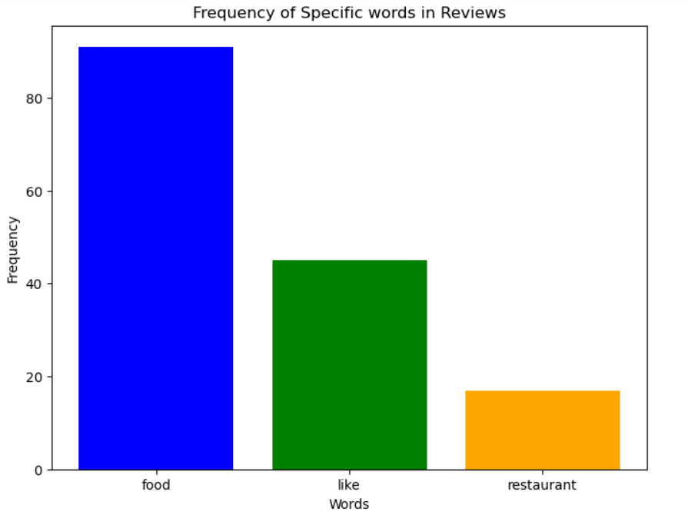
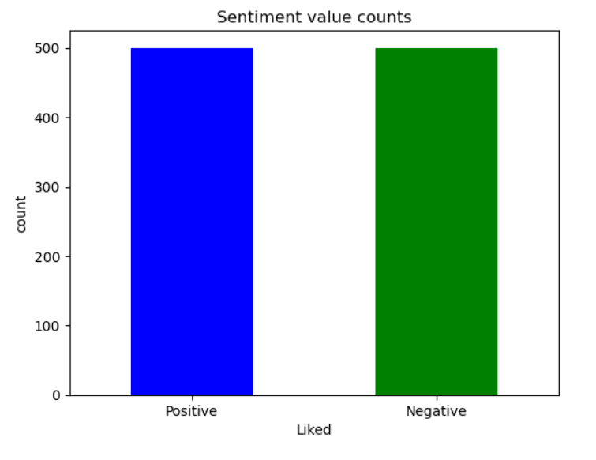
Result

Slide 10
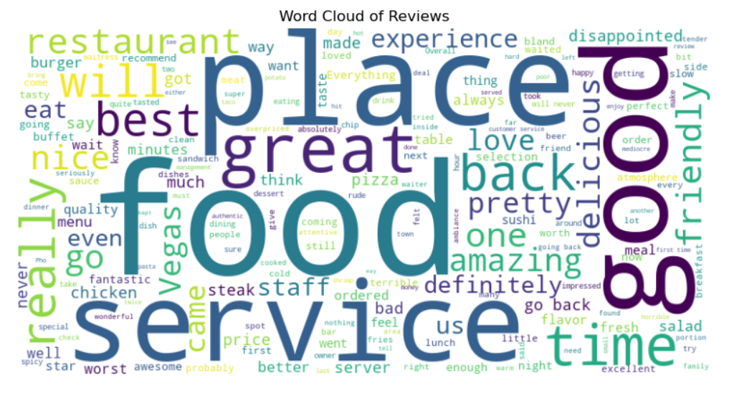
Result

Slide 11
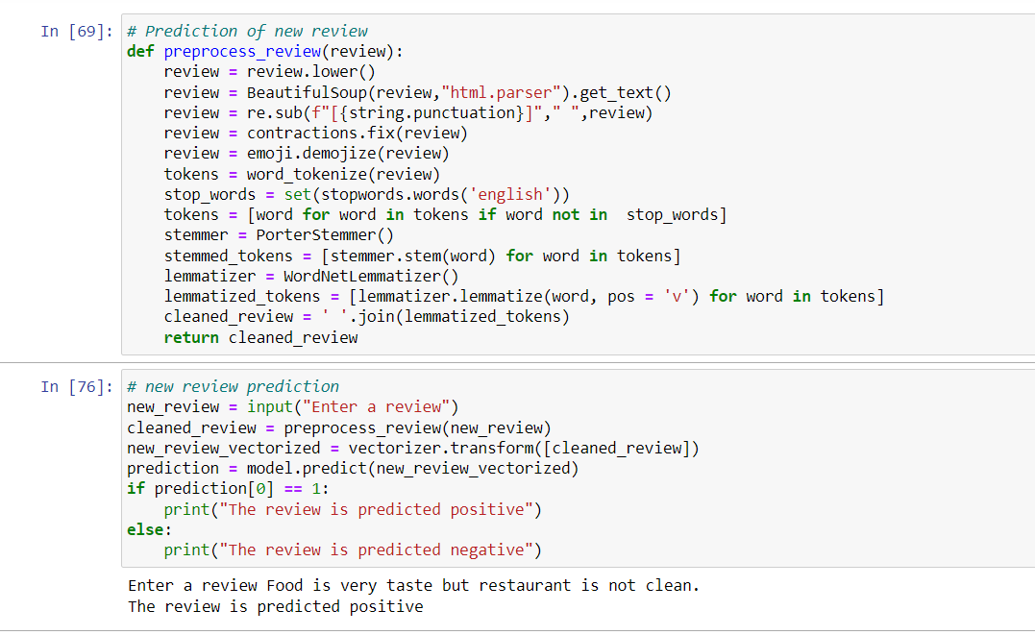
Result

Slide 12
Conclusion
The sentiment analysis model built for restaurant reviews, leveraging the Multinomial Naive Bayes algorithm, has demonstrated efficacy in accurately categorizing reviews as positive or negative based on textual sentiment. This capability has yielded crucial insights into customer satisfaction, empowering restaurants to strategically enhance service quality and elevate overall customer experience.
Challenges and Considerations:
Data Quality and Variability: Ensuring consistency and handling diverse writing styles and expressions within reviews.
Subjectivity and Bias: Addressing subjective interpretations of sentiment, where context and tone influenced classification accuracy.
Key Findings and Effectiveness:
Accurate Sentiment Classification: It reliably categorized reviews, allowing restaurants to promptly identify and address customer sentiments.
Insight Generation: By analyzing sentiment, actionable insights were generated to improve operational efficiencies and customer satisfaction.

Slide 13
Future scope
Optimization of Algorithm and Model:
Ensemble Methods: Combining multiple classifiers (e.g., Naive Bayes, SVM, Neural Networks) to leverage their strengths and improve overall prediction accuracy.
Hyperparameter Tuning: Optimizing model parameters and feature extraction techniques to enhance predictive capabilities and generalization.
Incorporation of Additional Data Sources:
Social Media Feeds: Extracting sentiment from platforms like Twitter, Instagram, or Facebook to capture broader public opinion and trends.
Customer Feedback Systems: Integrating data from CRM systems or feedback forms to gather comprehensive insights into customer experiences beyond online reviews.

Slide 14
References
Rish, Irina. "An empirical study of the naive Bayes classifier." IJCAI 2001 workshop on empirical methods in artificial intelligence. Vol. 3. 2001.
Manning, Christopher D., et al. "Introduction to Information Retrieval." Cambridge University Press, 2008
Pang, Bo, and Lillian Lee. "A Sentimental Education: Sentiment Analysis Using Subjectivity Summarization Based on Minimum Cuts." Proceedings of the ACL. 2004.
Bird, Steven, Ewan Klein, and Edward Loper. Natural Language Processing with Python: Analyzing Text with the Natural Language Toolkit. O'Reilly Media, 2009.

Slide 15
GITHUB LINK:
https://github.com/Sindhuja-1729/Sentimental_Analysis.git

Slide 16
THANK YOU

