Slide 1


NEXT GEN EMPLOYABILITY PROGRAM
CREATING A FUTURE-READY WORKFORCE
Student Name :
Bussa Sindhuja
Student ID :
College Name :
STU6421bafada6ef1679932154
SR UNIVERSITY

Slide 2
CAPSTONE PROJECT SHOWCASE
Project Title
Voting Web Application using Django Framework
Abstract | Problem Statement | Project Overview | Proposed Solution | Technology Used | Modelling & Results | Conclusion | Q&A

Slide 3
Abstract
1
Development of Voting Web Application Using Django, people vote securely and keeps their vote private. It’s built to be safe and easy to use for everyone.
2
Improves upon conventional practices by offering intuitive interfaces tailored for voters and administrators.
3
Features include voting poll questions and checking the results.
4
Utilizes Django framework, Bootstrap for development and deployment.

Slide 4


Problem Statement
In today's world, voting often isn't easy. The old-fashioned ways of voting aren't always efficient, safe, or easy to use. This makes it hard for people to take part in voting and for decisions to be made fairly. We need a better way. So, we want to create a Voting Web App using Django. This app will make it simple for groups and individuals to run online votes. It'll be easy to use and make sure that voting is fair and transparent. Our goal is to change how voting works, making it easier for everyone to get involved and trust the process.

Slide 5

Project Overview
Our project is about making a really good Voting App using Django. This app will let people do lots of different kinds of voting. It'll be easy to use and have lots of features. We want it to be the best platform for voting.
User Participation: People can join in different voting activities by giving their votes on various polls. The app will be easy to understand and use, so everyone can take part without any trouble.
Administrative Control: The app will give administrators the power to set up, handle, and keep an eye on the whole voting process. This helps make sure everything is fair and clear. Administrators can manage voting activities easily and keep everything running smoothly.

Slide 6
Proposed Solution
Django-Powered Web App: Build a sophisticated web application using Django to ensure it can handle growth, stays secure, and performs well.
User-Friendly Interfaces: Design easy-to-use and visually appealing interfaces for users to engage in various online polls effortlessly.
Enhanced Polling Features: Incorporate advanced polling options like multiple-choice questions and prediction-based polls to boost user engagement.
Live Result Updates: Offer real-time updates on poll results, showcasing live voting trends to keep users engaged and informed.
By incorporating these features, the Online Voting Web Application aims to provide an engaging platform for users to actively participate in various online polls, fostering increased interaction and excitement throughout the voting process.

Slide 7
Technology used
HTML
CSS
JavaScript
BootStrap
Python
Django

Slide 8
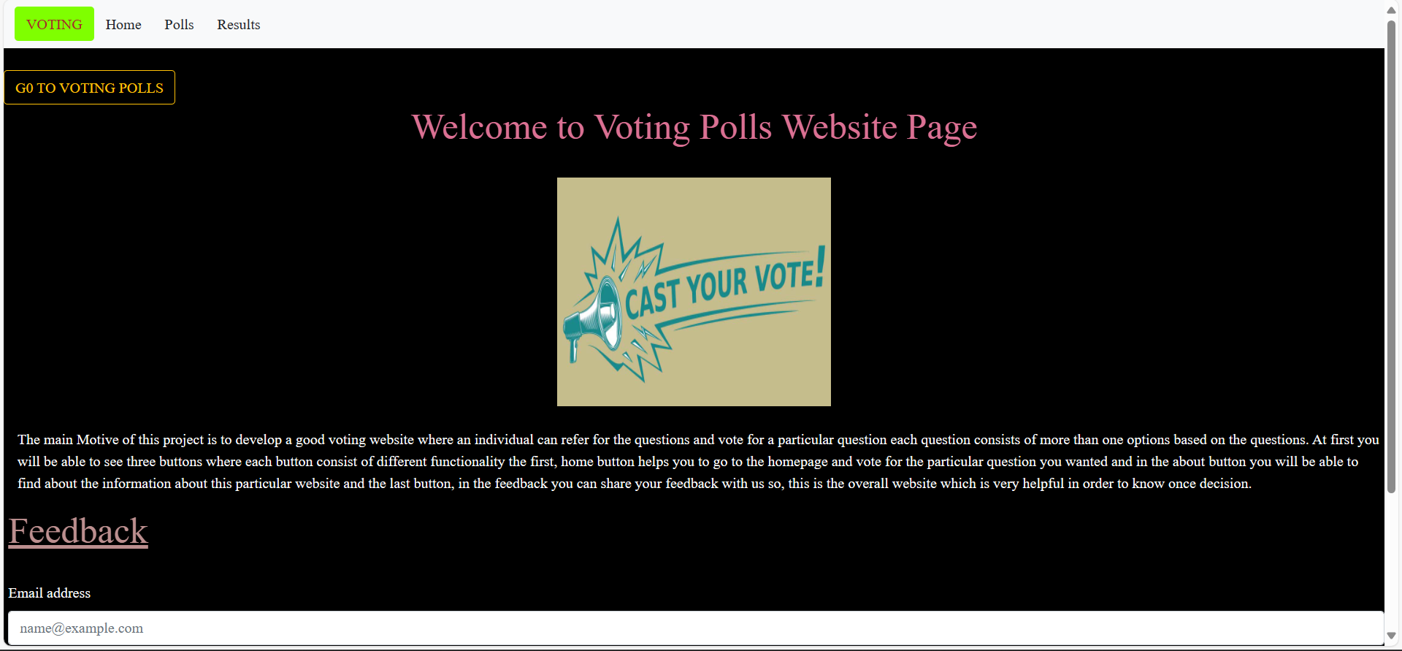
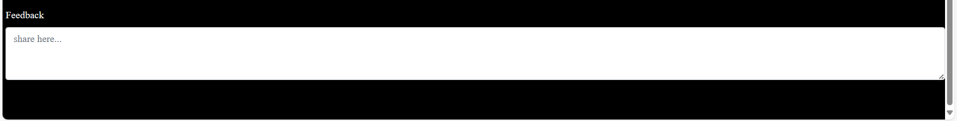
Modelling & Result

Slide 9
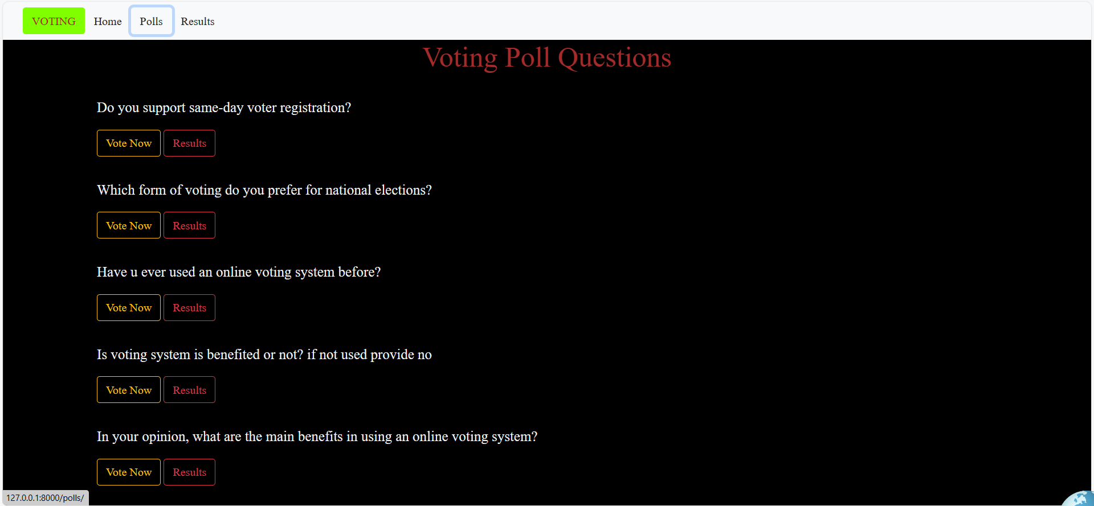
Modelling & Result

Slide 10
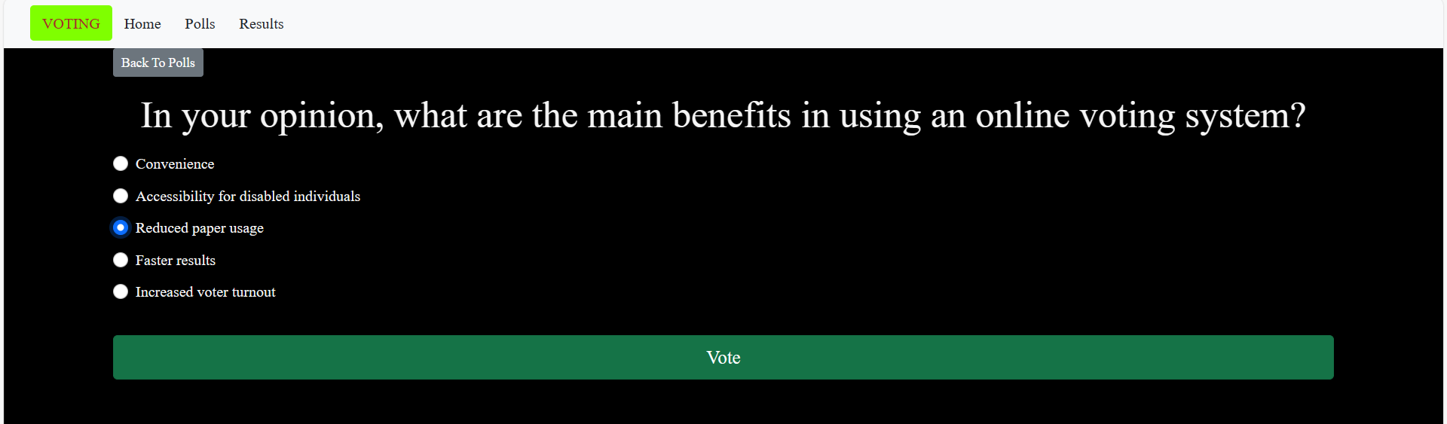
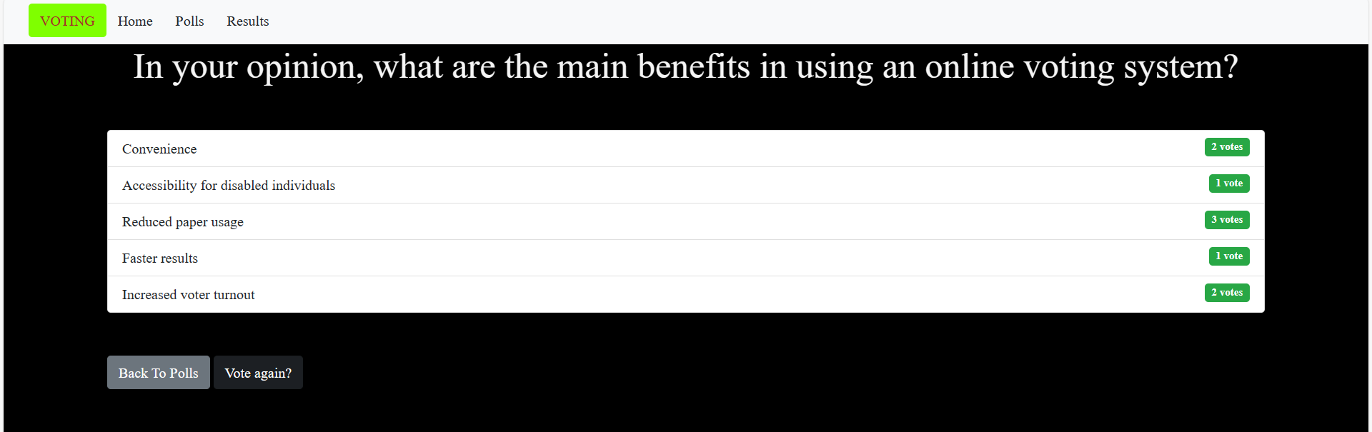
Modelling & Result

Slide 11

Conclusion
The Online Voting Application, powered by Django, revolutionizes how people participate in online voting. It ensures security, scalability, and rapid development through Django's robust features. With personalized user profiles and intuitive interfaces, voters can easily cast their votes. Real-time updates keep users informed about the ongoing voting trends. Advanced admin controls allow for efficient management of the voting process. Overall, this project sets a new standard for online voting systems, promoting greater accessibility and transparency in democratic practices.

Slide 12


Notes:
Thank You !!

