Slide 1

Employee Data Analysis using Excel
STUDENT NAME: SINDHUJA K
REGISTER NO: 312215084/asunm1485312215084
DEPARTMENT: COMMERCE
COLLEGE : SOKA IKEDA COLLEGE OF ARTS & SCIENCE FOR WOMEN

Slide 2
PROJECT TITLE
Employee Performance Analysis using Excel

Slide 3

AGENDA
1.Problem Statement
2.Project overview
3.End Users
4.Our solution and Proposition
5.Dataset Description
6.Modelling Approach
7.Results and Discussion
8.Conclusion
3/21/2024 Annual Review

Slide 4

PROBLEM STATEMENT Employee Data Analysis To focus on growth of the company and to motivate the employees by their performance and give appreciation,promotion,increment in a effective manner

Slide 5

PROJECT OVERVIEW Employee Performance Data Analysis Analysing the performance of the employee by considering various factors like gender, performance,score,ratings,their achievements In order to identify the trends & patterns of different categories if employees like High Medium,Low.
.

Slide 6
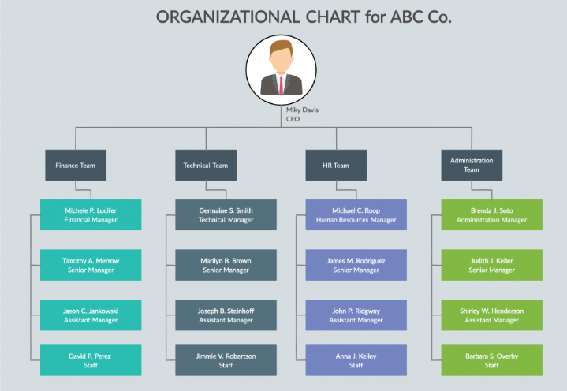


WHO ARE THE END USERS

Slide 7

OUR SOLUTION AND ITS VALUE PROPOSITION Conditional Formatting-Missing Filter–Remove Formula-Performance Pivot-Summary Graph-Data Visualization

Slide 8
Dataset Description employee=- Kaggle 26-features 9=features Emp id-num Name-text Emp type Performance level Gender-male female Employee rating -Num

Slide 9

THE "WOW" IN OUR SOLUTION
Performance level =IFS(Z8>=5,”VERY HIGH”,Z8>=4,”HIGH”,Z8>=3,”MED”,TRUE,”LOW”)
3/21/2024 Annual Review
9

Slide 10
MODELLING
Data Collection-
Kaggle Website,Edunom Dashboard
Feature Collection-
Identifying & Highlighting Data Cleaning-
Conditional Formatting & Filtering
Performance Level- Performance Analysis by systematic order as High,Medium Low,from the departments of Employees
Summary-
Pivot Table,Overall performance of the employees
Visualization-
Trend Lines Exponentioal Lines & Graphs ,Pie Charts
10

Slide 11
RESULTS
11

Slide 12
RESULTS

Slide 13
Conclusion From the overall analysis,In the organization averagely performing employees are more in numbers,So every employee have their own talents and skills based on that you can give the tasks and motivate them for the organization growth. PL Sector is the highest percentage than the other departments PYZ and NEL are nearly closest to the PL sector

