Slide 1
Ansible
March 2018
Prepared by :
Shiju Punnoose and RajiniKammu Pitchumani

Slide 2
Agenda
What is Ansible
Benefits
Architecture
Playbooks and Roles
Demo
Q & A

Slide 3
Benefits
Simple and Powerful Automation tool
Ansible is agent less and perform functions over SSH and winrm
Cross Platform Support
Parallel execution
Reliable and secure
Human understandable language – YAML (Yaml Ain’t Markup Language)
Idempotent
Ansible has collection of module that manages various systems as well as cloud infrastructure
Push base model
Role

Slide 4
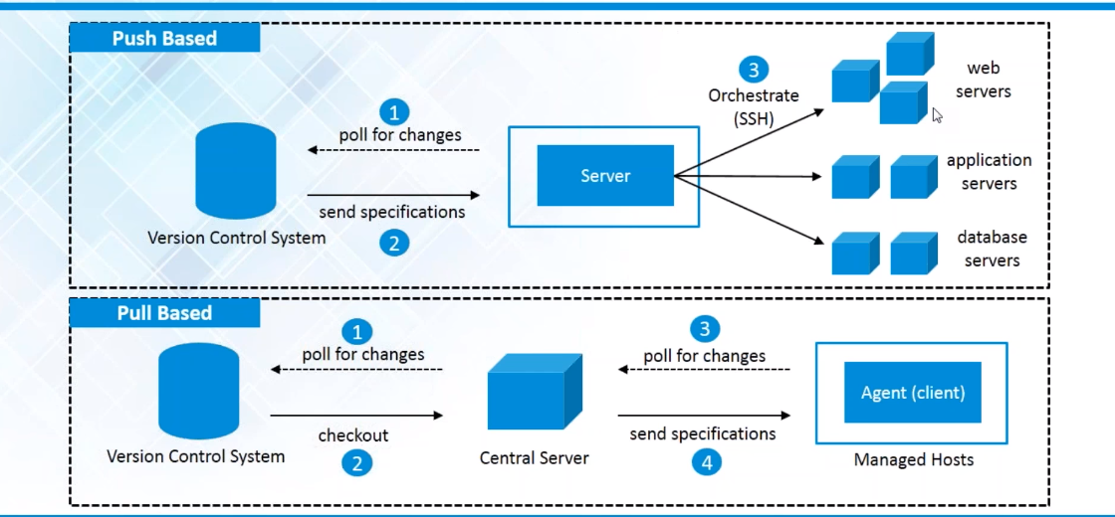
Push based Vs Pull Based

Slide 5
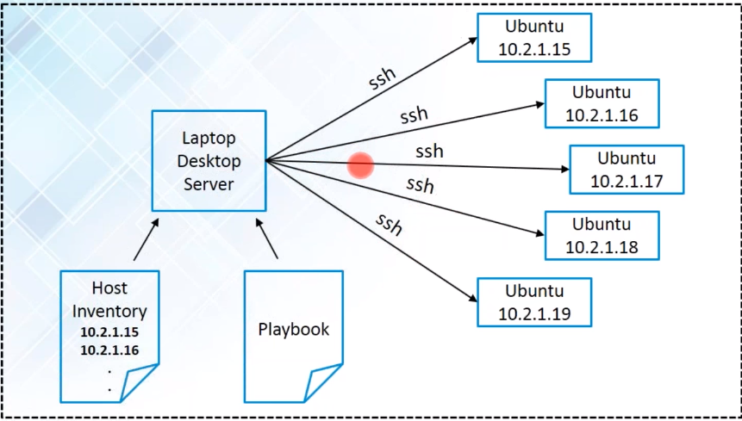
Ansible Agentless Architecture

Slide 6
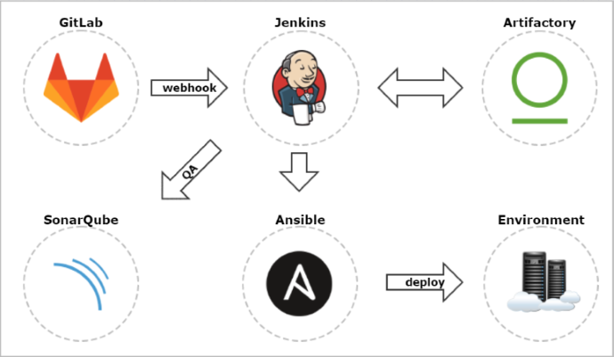
CICD

Slide 7
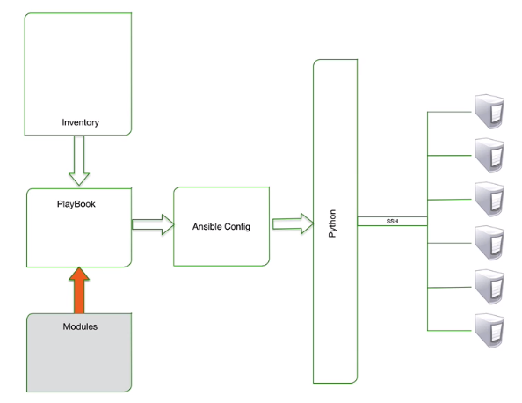
Architecture

Slide 8
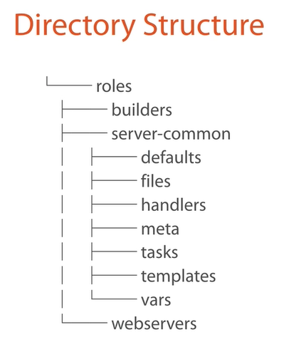
Roles

Slide 9
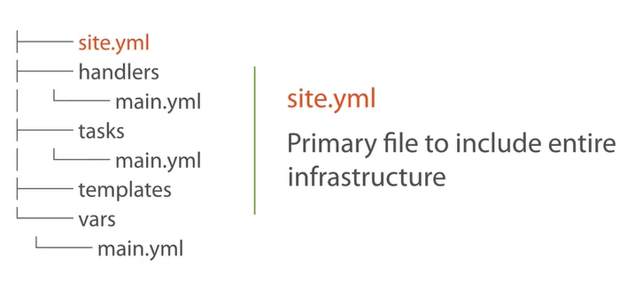
Roles

Slide 10
Scope of Ansible
Automation and orchestration
Role base access
Installation standardization
Access level - sudo
Reduce Human errors
Reduce Man hours and improve productivity
Eliminate repetitive task
Overcome complexity
Resource Usage ( CPU and Memory)
Community and Enterprise solutions

Slide 11
Demo
Install Apache / Tomcat
Authentication method using Vault
Role base model
Apache / Tomcat installation in Linux and Windows
Apply gold standard across
SSL certificate
Deploy Docker Container
Deploy Wordpress on Nginx
Deploy html file on IIS webserver on windows

Slide 12
Q&A
Reference URL’s
http://docs.ansible.com/ansible/latest/intro.html
http://docs.ansible.com/ansible/latest/playbooks_intro.html
Ansbile Tower

