Slide 1
Ansible Continuous Integration, Delivery and Deployment Services
Shiju Punoose
Rajinikamu Pitchumani
Sindhuja Talusani

Slide 2
Benefits of Ansible
Ansible is a radically used IT automation platform that makes your applications and systems easier to deploy.
Ansible is OpenSouce, Agentless, Idempotent automation tool.
Faster deployment of service offerings and infrastructure patterns
Standardization and automation of provisioning cycles eliminates human error.
Automated infrastructure delivery – CI/CD
Integrate with VSTS and AD
Code reusability and self service work flow
Ansible Tower for Enterprise users

Slide 3
POC Initiatives
Automated installation and deployment of Apache and Tomcat in EY on-prem and cloud infrastructure
Ansible Roles – Multiple tasks together into one playbook
VSTS integration / AD integration
Ansible Workflow
IIS Installation and deployment
Manage configuration drift in IIS environment
Automated SSL Certificate renewal
Deploy Docker Container on Windows using Ansible
Ansible Modules(https://docs.ansible.com/ansible/2.5/modules/list_of_windows_modules.html)
Ansible TDD
Deploy wordpress on Nginx web server using Ansible scripts
Light deployment

Slide 4
Project Initiatives
Project and Initiative
TRAC NXGN project – Tax application – KLA and RBC ( Ansible , Terraform , Docker and SWAM)
Ansible Terraform script for Provisioning VM’s for projects
Manage Veeam agents installation and client backup configuration.
Apprenda ARR MSI installation and configuration

Slide 5
Ansible Tower
Installed Ansible Tower in Azure dev subscription
Integrated VSTS-Git with Ansible Tower and Manage repository based on roles
Role based Inventory management using Active Directory , Kerberos,CredSSP, Ansible Vault
Ansible Job templates – Run / Check Mode
Ansible Workflow Template – CI/CD
Clustering
Self Service IT
Full Documented REST API
Cross platform job scheduling (Portal mode)
Notifications to Slack, Hipchat, PagerDuty, SMS, email
Tower Dashboard
Cloud integration
Remote command Execution
Ansible License
Ansible has two versions
Open Source and Enterprise versions
Host based license and Redhat support

Slide 6
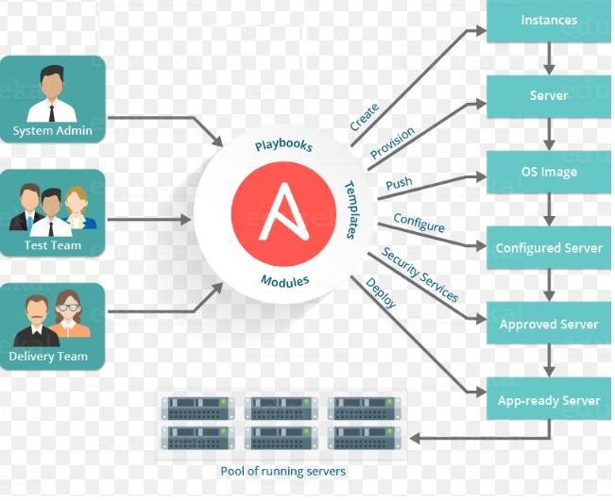
Ansible Architecture

Slide 7
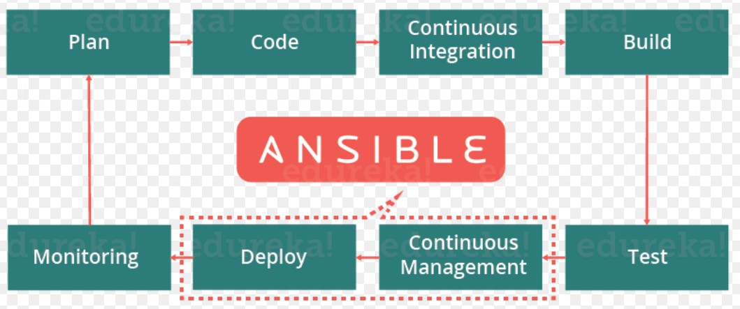
Ansible CI/CD

Slide 8
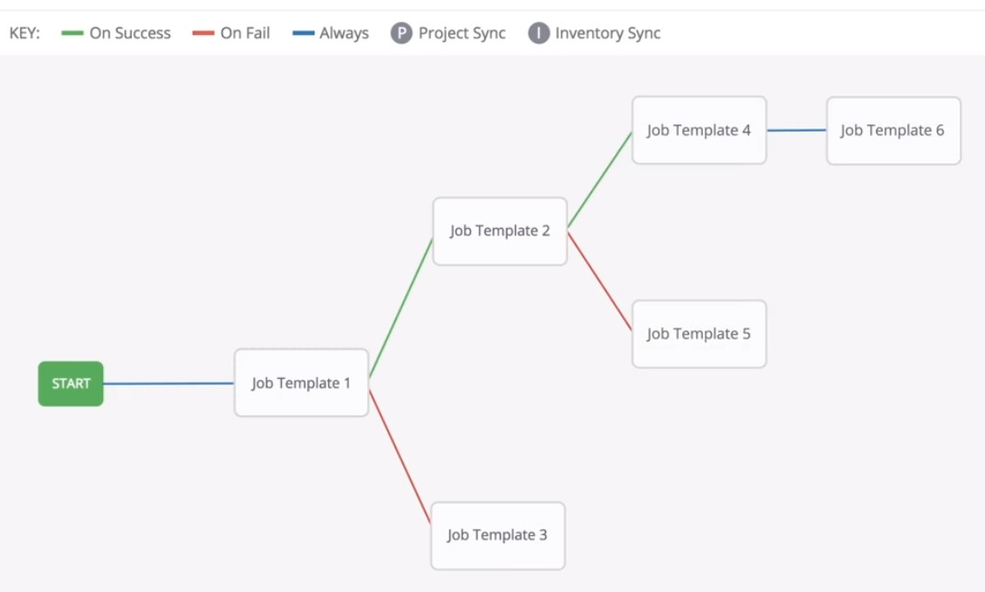
Ansible Work Flow

Slide 9
Recommendations
Request business to use Open source version for POC’s
Bases on the Business requirement we can promote code to Tower environment.
Easy code migration from Open source to Tower
Redhat Support for Tower (24/7)
Maintenance & upgrades will be easy.
Save lot of time of OPS team.
Ansible License Cost
https://www.ansible.com/products/tower/pricing

Slide 10

Thank you
Notes:
For information on applying this template onto existing presentations, refer to the notes on slide 3 of this presentation.
The Input area of the Beam can be customized to reflect the content of the presentation. The Input area is an AutoShape with a picture fill. To change this, ensure you have the image you wish to use (ideally a .jpg or a .png file) in an accessible folder. The image should have a ratio of 1:1 to ensure it does not appear distorted.
Acceptable images for importing into the Input area of the Beam are the three approved graphics (lines), and black and white photography or illustrations which follow the principles laid out on The Branding Zone. Color images should never be imported into this area.
Click on the Insert tab from the menu bar and select Master>Slide Master
Right-click on the Input graphic and select Format AutoShape
From the Fill menu, under the Color and Lines tab, click on the drop-down arrow next to Color and select the Fill Effects menu
From the Picture tab, click on Select Picture. Navigate to the folder containing the image you wish to insert in the Input area. Highlight the image and tick the Lock picture aspect ratio box. Click on Insert.
Click Ok. You can now preview the image before continuing. If you are happy with how it looks, click Ok to continue. Otherwise, repeat the process until you are happy with your selected image
To exit from Master View, click on View>Normal. The change you made to the Input graphic should now be visible on the title slide

