Slide 1
CUSTOMER BEHAVIOUR ANALYSIS - SHOPEASY

Slide 2

TECHNOLOGY USED Python & MYSQL

Slide 3
PROBLEM STATEMENT
Best performing locations, products and customer segments.
Identify improvement areas and recommend strategies to enhance customer satisfaction.
Factors influencing customer engagement?.
At what stage are customers dropping off?.
Impact of customer reviews .

Slide 4
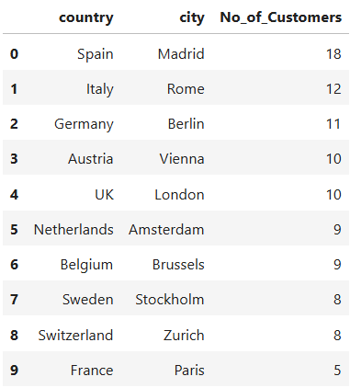
REGIONAL INSIGHTS & ANALYSIS – Shop EASY
Focus on High-Potential Markets (Spain, Italy, Germany, UK, Austria)
Strengthen Presence in Moderate Markets (Netherlands, Belgium, Sweden, Switzerland)
Address Weak Performance in France (Paris)
Regional Expansion - test expansion in Barcelona or Valencia as Madrid is performing well.
Optimize Resource Allocation - Plan optimized advertising budgets based on performance data

Slide 5
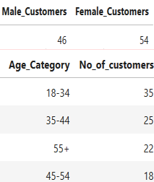
DEMOGRAPHIC INSIGHTS & ANALYSIS – Shop EASY
Gender Based -
Female-Focused Engagement (54%)
Male-Focused Opportunities (46%)
Age Category Based -
Young Adults (18-34) - 35 Customers (Largest Group)
Mid-Age (35-44) - 25 Customers
Senior Audience (55+) - 22 Customers
Older Middle-Age (45-54) - 18 Customers

Slide 6
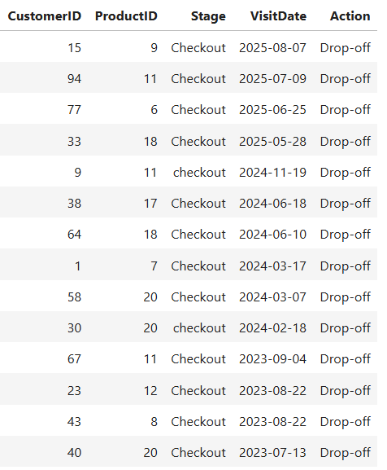

Customer JOURNEY & ENGAGEMENT ANALYSIS – SHOPEASY
Drop-off points -
All drop-offs occurred at the checkout stage. Common reasons may include unexpected costs, complicated checkout processes, or payment failures.
Recurring Drop-Offs for specific products (Boxing Gloves, Ski Boots, Volley ball and Surf Board) may have issues like pricing concerns, lack of trust, or missing features. Investigating customer feedback for these products could help address the problem.
Ongoing issue, needs immediate attention. Possible causes from the below
Simplify Checkout: Reduce unnecessary steps, allow guest checkouts.
Transparent Pricing: Display all costs upfront.
Payment Options: Offer multiple payment methods, including digital wallets.
Cart Reminders: Send follow-up emails or notifications.
User Feedback: Collect insights from drop-off users for direct improvements.
SUGGESTION

Slide 7

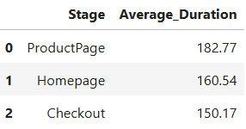
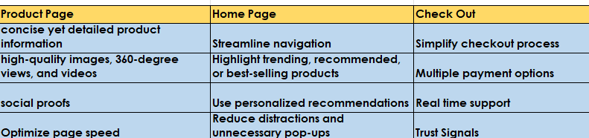
Customer JOURNEY & ENGAGEMENT ANALYSIS – SHOPEASY - cont.…
Successful Conversions -
Conversion rate is less. To increase,
Optimize the Checkout Experience – simplify forms, Guest Checkout Option, Auto-Fill & Payment Preferences.
Enhance Trust & Transparency - Clear Pricing, Trust Signals , Live Support
Improve Payment Options & Speed
Leverage Abandoned Cart Recovery
Offer Post-Purchase Engagement
Average Duration spent on each stage - Enhancement to increase engagement

Slide 8
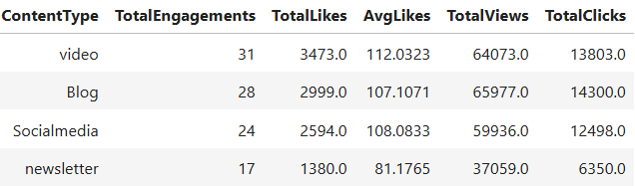
Customer JOURNEY & ENGAGEMENT ANALYSIS – SHOPEASY - cont.…
Videos
Strong engagement
Experiment with video length and style to maximize retention
1
Blogs
Strong views and total clicks
Ensure it contains headlines and internal links
2
Social Media
Balanced
Encourage influencer promotions
And improve frequency
3
Newsletter
Lowest engagement
Encourage different subject lines and include more interactive elements
4

Slide 9
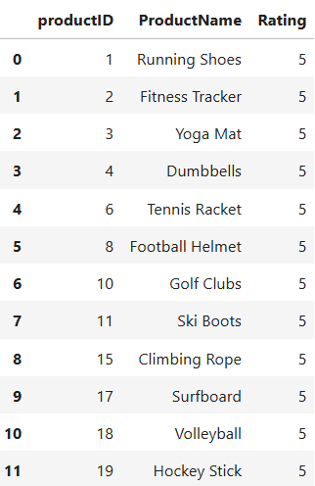
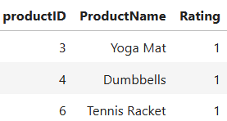
Customer REVIEW ANALYSIS - SHOPEASY
High Rated
Encourage more reviews, Leverage high ratings for marketing, Ensure stock availability
Football Helmet (5.0), Hockey Stick (4.4), Volleyball (4.0), Climbing Rope (4.0), Running Shoes (4.0), Ski Boots (4.0), Boxing Gloves (4.0), Soccer Ball (4.0)
Avg. Rating
of products and its action plan
Mid Rated
Analyse negative feedback, Improve product description, price adjustment
Surfboard (3.89), Tennis Racket (3.86), Yoga Mat (3.71), Swim Goggles (3.67), Fitness Tracker (3.57), Golf Clubs (3.5)
Baseball Glove (3.4), Kayak (3.4), Dumbbells (3.0), Ice Skates (3.0), Basketball (2.67)
Low Rated
Check for recurring issues , Offer better warranty and customer support, encourage honest reviews

Slide 10
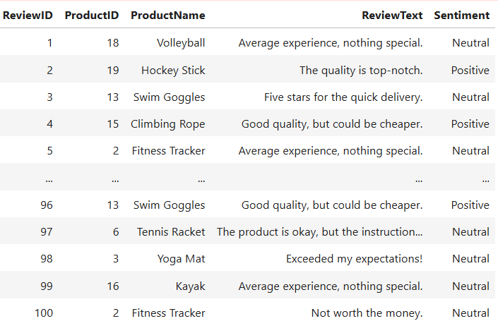
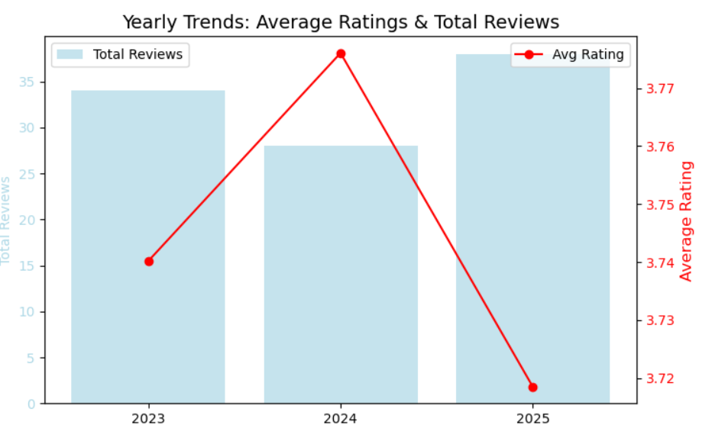
Customer REVIEW ANALYSIS – SHOPEASY - cont.…
Positive - Showcase these reviews in product pages in videos/
images format, offer discounts for price related concerns.
Neutral - Need improvement and differentiation which can be
analyzed with the help of feedback surveys.
Negative - Requires immediate attention by adjusting price, quality
and customer support.
Review Trends:
Total reviews - Saw a dip in 2024 however recovered in 2025
which shows customer interest towards products.
Average Rating - Though number of reviews increased in 2025,
there is a dip in rating which shows customers are not satisfied
with products/services. Improve the quality and policies to
retain the customers.

Slide 11
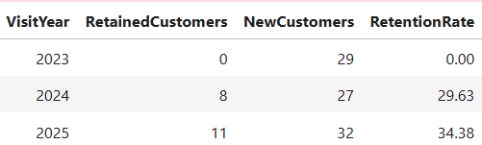


Marketing Effectiveness
Retention rate shows positive trend, significantly there are opportunities for improvement.
To increase retention rate,
Enhance Customer Experience & Satisfaction.
Engage New Customers for Repeat Purchases.
Reduce Churn & Identify Pain Points.
Set a target of 50% in 2026 and strive to achieve.
First time Vs. Repeat Buyers/Visitors
There are no repeat buyers, all the buyers are first time.
First time visitors contribute 40% of total customers. Develop the strategies to come back again by offering first time discount, loyalty incentives to push purchase
To push the repeated visitors to purchase, offer VIP programs like early access to new products, sales, referral incentives.

Slide 12
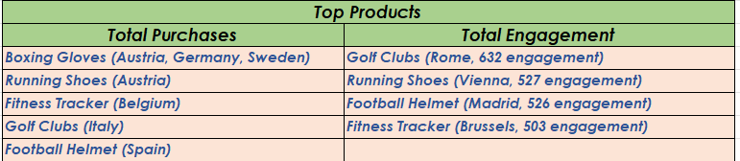
Marketing Effectiveness – CONT… Top Performing Products PER REGION
High Purchase and High Engagement Products – Strong performers - Run loyalty campaigns or bundle offers to encourage repeat purchases.
Lower Purchase but High Engagement Products – Potential performers - Offer limited time promotions and improvise product descriptions and images to push the conversion.

Slide 13
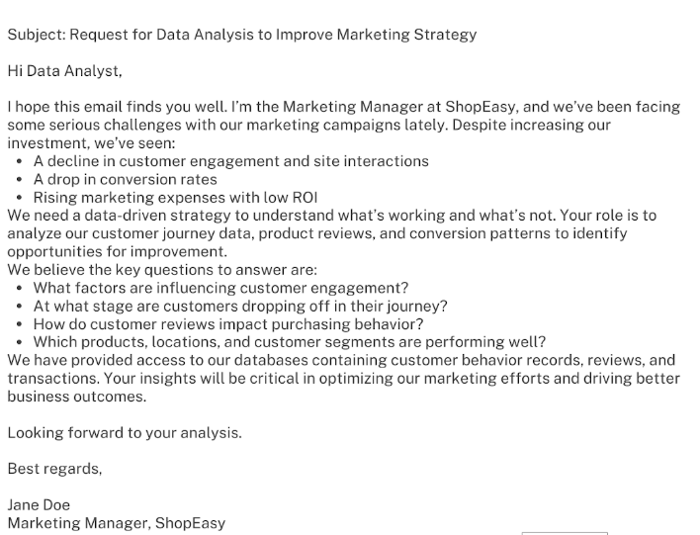
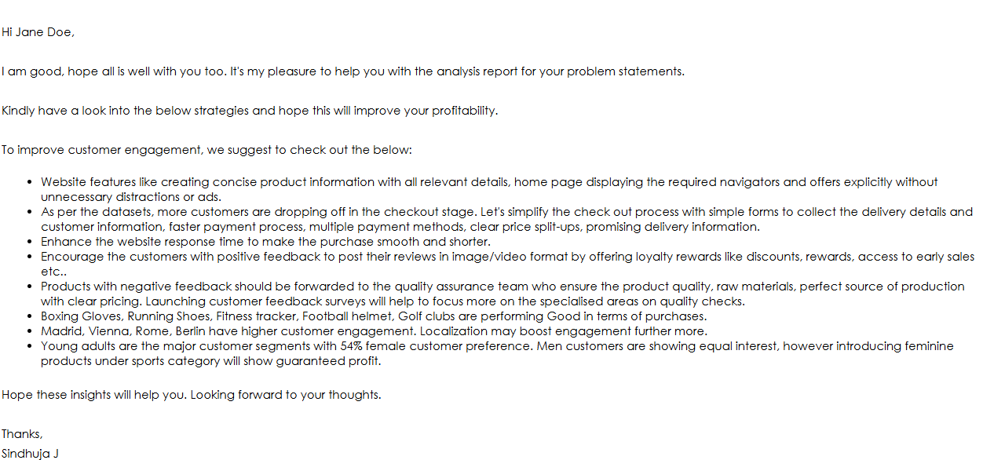

Slide 14
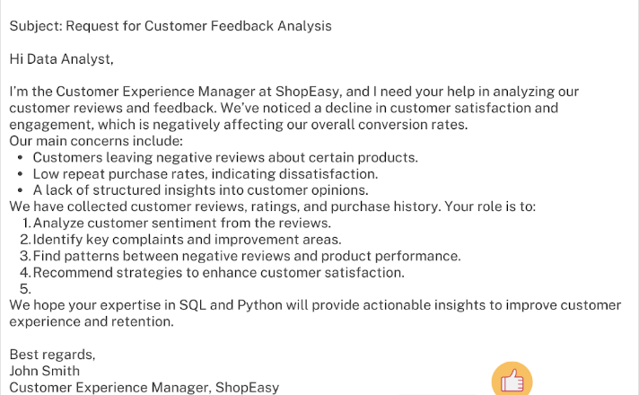
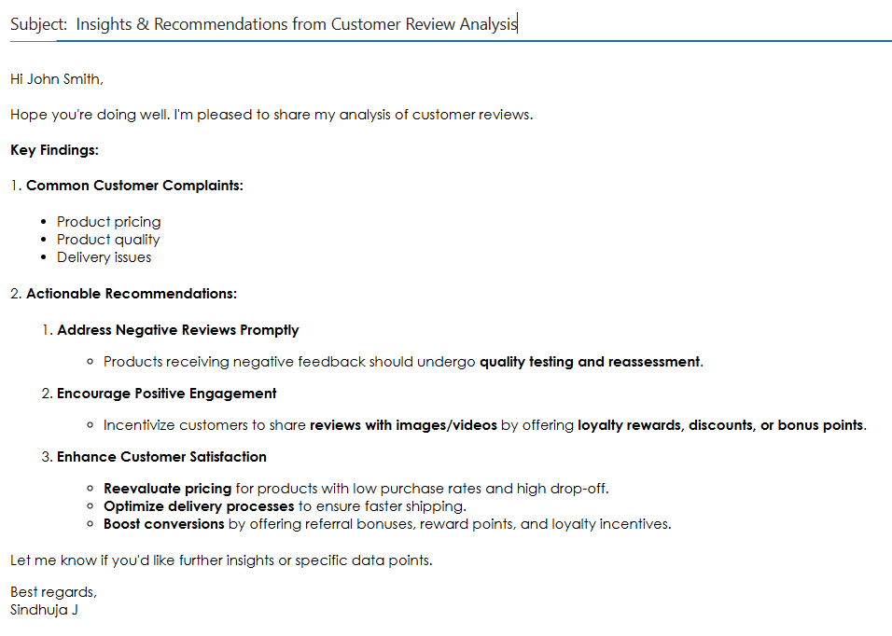

Slide 15
Thank you

