Slide 1


Nutri-Class: Food Classification Using Nutritional Data

Slide 2


Objective
Robust Classification System
Gain Insights
Compare multiple classifiers
Machine Learning
Domain

Slide 3
Steps INVOLVED
Import libraries & Load Data
Explore basic info of data
Data Visualization
Null & Duplicate Handling
Data Encoding
Outlier Treatment
Feature Scaling
Model Building
Model Training & Evaluation

Slide 4
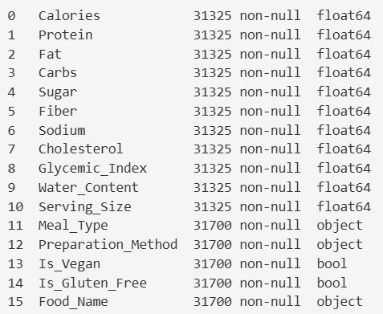
Data Exploration
Total Rows – 31700
Total Columns – 16 (11 – Numeric column, 3 – Object column,2 – Boolean column)
No of records are not same across the features, it denotes there are NULL values in the numeric columns.

Slide 5
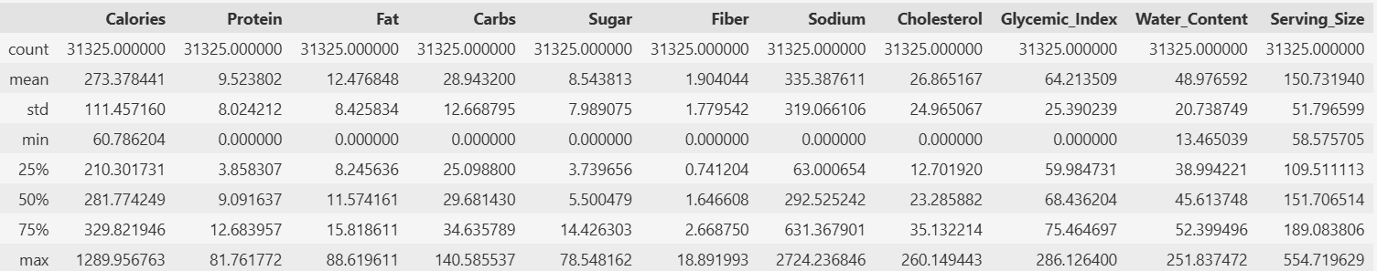
Data Exploration …
Statistical information of numerical features shows below info:
Mean > 50% median for Protein,fat,Sugar,Fiber,Sodium,Cholesterol,Water_Content. Hence, data should be right skewed.
Mean < 50% Median for Calories,Carbs,Glycemic_Index,Serving_Size. Hence, data must be left skewed here.
Mean != Median but their difference is not much high numbers for Protein,Carbs,Serving_Size. Hence, data must be a balanced/symmetric distribution.

Slide 6
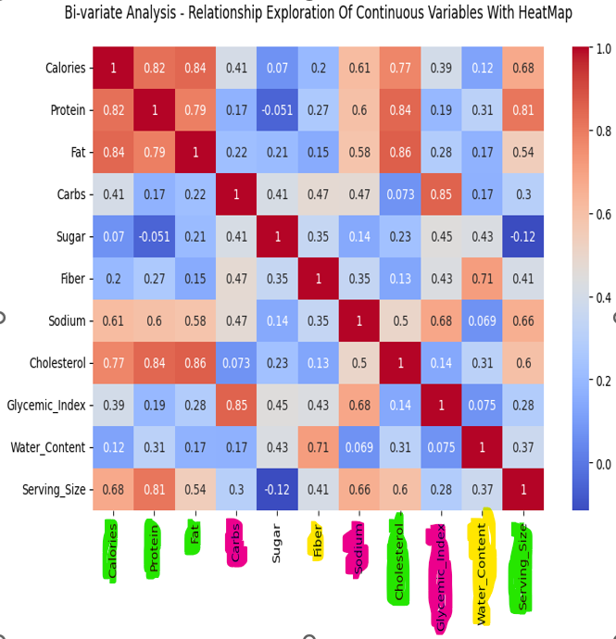
DATA VISUALIZATION
Univariate Analysis
Kde plot – Shows skewness of the data
Box plot – Shows Outliers
Count plot – Shows the domination of each category
Pie Chart – Shows the distribution of the data across each category
Bi-Variate Analysis
Heat Map – Shows the relationship between numeric variables
Violin Plot – Shows the relationship between categorical vs. Numerical features

Slide 7
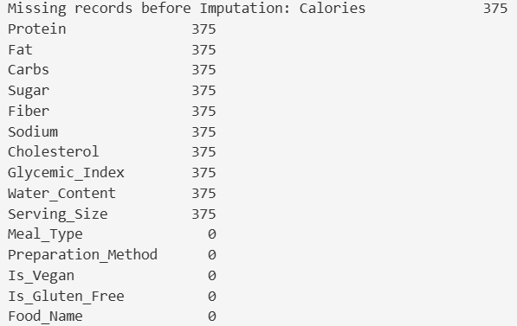
NULL & DUPLICATE HANDLING
N=375 (1.18%) null values in Numeric columns
Null Imputation by MEDIAN, as all numeric features are roughly normal distributed and have outliers.
As per the domain knowledge, there are chances of same nutritional values in the dataset, however it should differ by either preparation method/meal type/food name.
Hence, removing all the redundant rows by keeping only the first occurrence

Slide 8
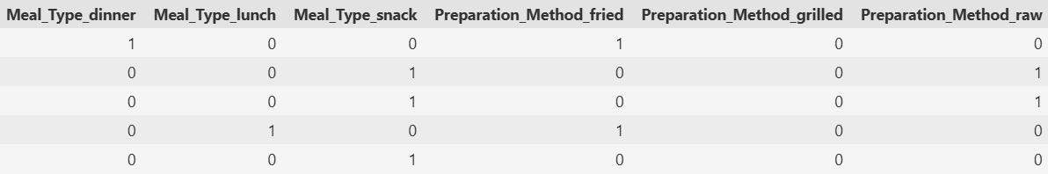
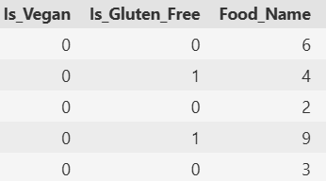
DATA ENCODING
Since all the categorical column follows nominal order, one-hot encoding is choosen to encode the categorical data in columns - Meal_Type and Preparation_Method.
It makes the datatype into bool values, so converted into int, makes these categorical column encoding successful.
Since Food_Name is a target column, label encoding is choosen and applied successfully.

Slide 9
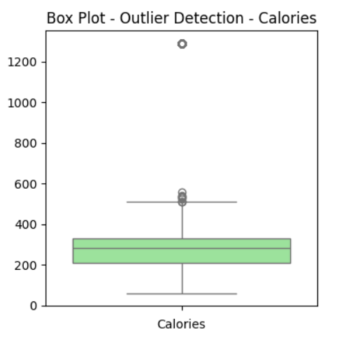
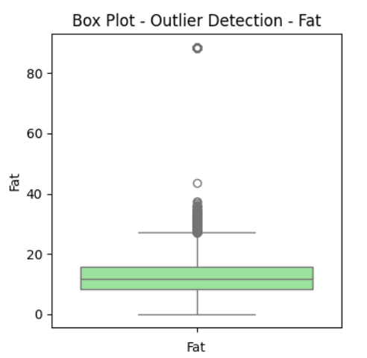
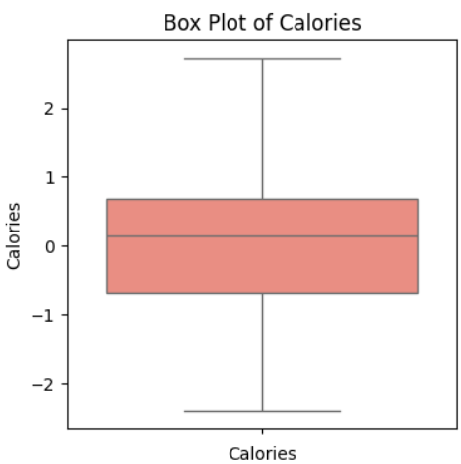
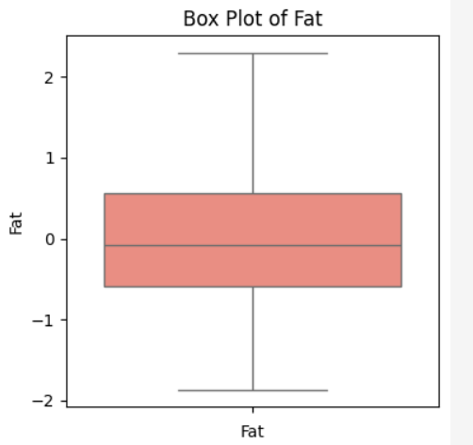
OUTLIER TREATMENT
Preferred IQR method as it doesn’t remove much data. As per domain knowledge, there are chances of nutrients like calories, fat etc.. to have high values for certain food items like pizza, burger which may be not aligned to other food items.

Slide 10
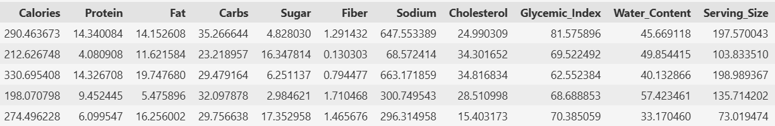
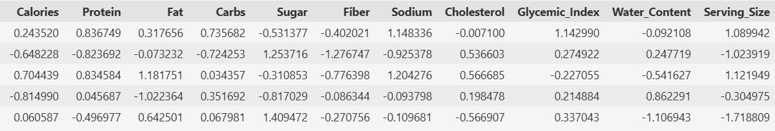
Feature Scaling
Nutrition scores like Calories, protein etc.. have different scales. So, standard scaling is applied to all those nutritional features to make it common scaling.

Slide 11
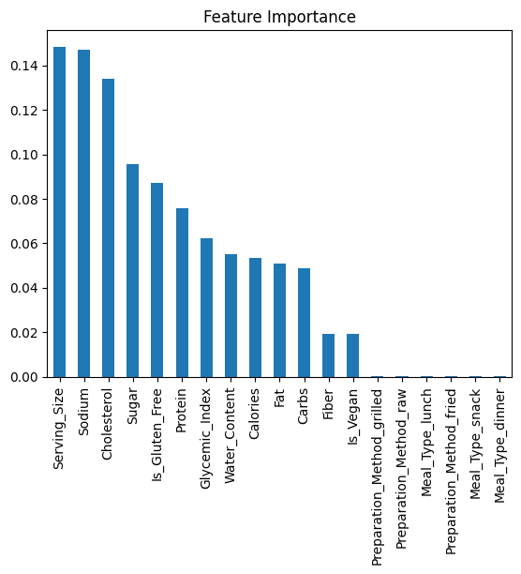
Feature Importance
Opted for Tree based ensemble model - RandomForestClassifier to do the feature selection.
Top 6 features were selected to do the model building.

Slide 12
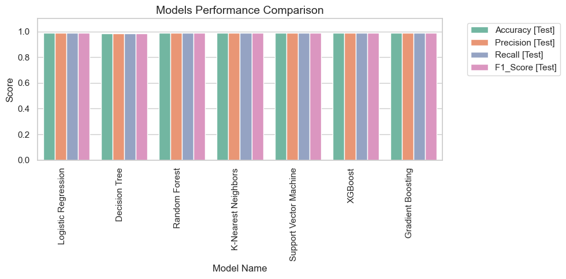
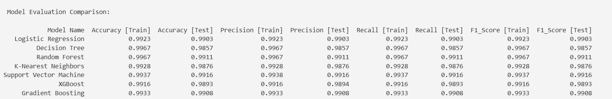
MODEL EVALUATION & PERFORMANCE
7 Classifier models were built.
Out of which
XG boost,
SVM,
Gradient Boost,
Logistic regression model performs well.

Slide 13
THANK YOU - SINDHUJA J

