Slide 1
Bookstore Management System
CIS 552: Database Design (Online – Summer ’24)
Group 12
Sindhuja Baikadi (4)
Vaishnavi Paineni (49)

Slide 2
INTRODUCTION
This project is a comprehensive Bookstore Management System developed to streamline the operations of a bookstore, offering both customer and admin functionalities. Built using Streamlit for the web interface and MongoDB for the backend database, the system efficiently manages books, orders, user accounts, and reviews. The project leverages Python for backend logic and Pymongo to facilitate seamless interaction with MongoDB, ensuring a robust and user-friendly application.

Slide 3
TECHNOLOGIES USED
Streamlit: For building the web-based user interface.
MongoDB: To store and manage data on books, orders, reviews, and users.
Python: For backend development, handling business logic like user authentication, account creation, and management tasks.
Pymongo: For integrating MongoDB with Python, allowing database interactions within your application.

Slide 4

ER DIAGRAM

Slide 5
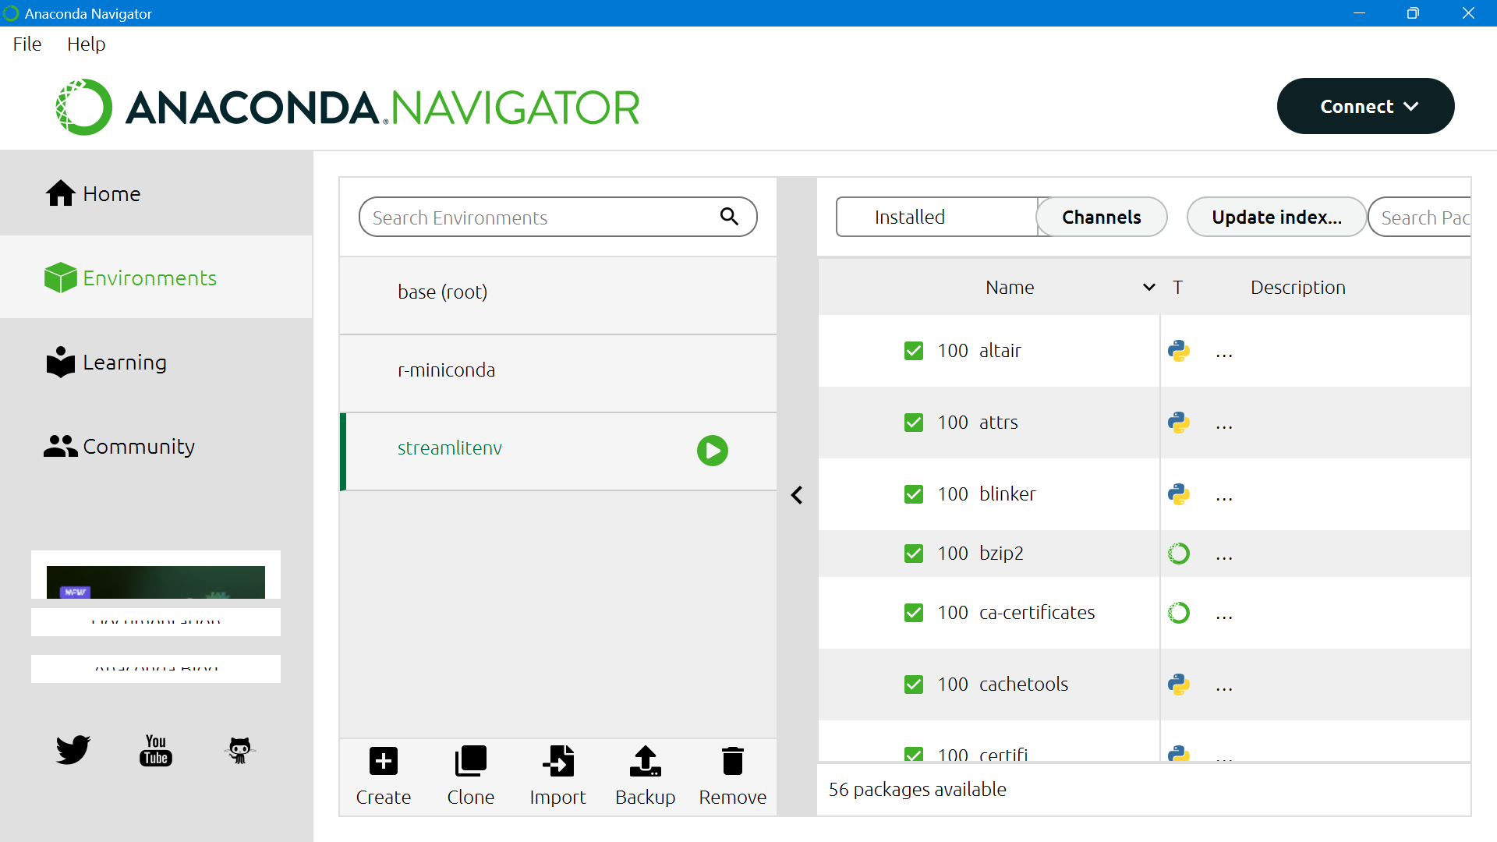
SET UP THE ENVIRONMENT

Slide 6
Created Streamlit Environment:
Set up a `streamlitenv` environment using Anaconda Navigator.
Installed Libraries:
Used CMD to install `pymongo` and `streamlit`.
Configured Visual Studio Code:
Set the interpreter to the `streamlitenv` environment.
Wrote and tested the code.
Ran Application:
Used the command `streamlit run final.py` in the integrated terminal.
Frontend Launch:
Application opened in a web browser for customer and admin management.

Slide 7
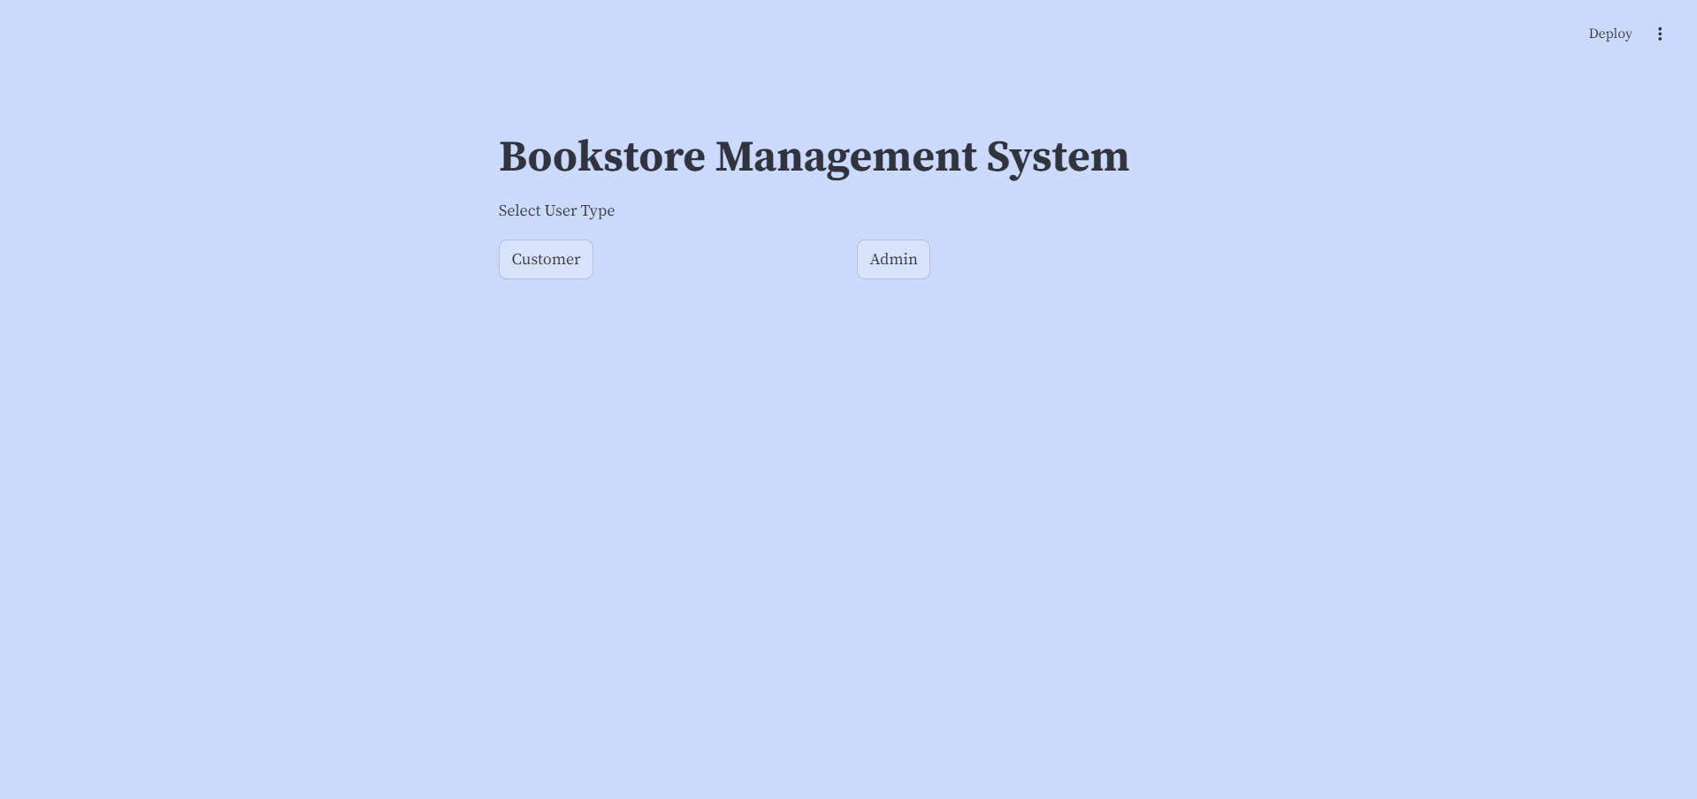
WEB APP

Slide 8
THANK YOU

