Slide 1
GHG and Methane Emissions Monitoring and Analysis Using AWS Glue and Quicksight
Big Data Analytics
CIS 602: Special Topics in CIS, Summer 2024
Group 17
Sindhuja Baikadi (3)
Vaishnavi Paineni (38)

Slide 2
INTRODUCTION
This project focuses on building a scalable system for the monitoring and analysis of GHG and Methane emissions.
By utilizing AWS services such as S3 for data ingestion, Glue for data processing, and QuickSight for analysis, the platform will efficiently process and analyze large datasets.
The goal is to provide timely and actionable insights that support environmental management and policy-making, enabling continuous and detailed monitoring of emissions.

Slide 3
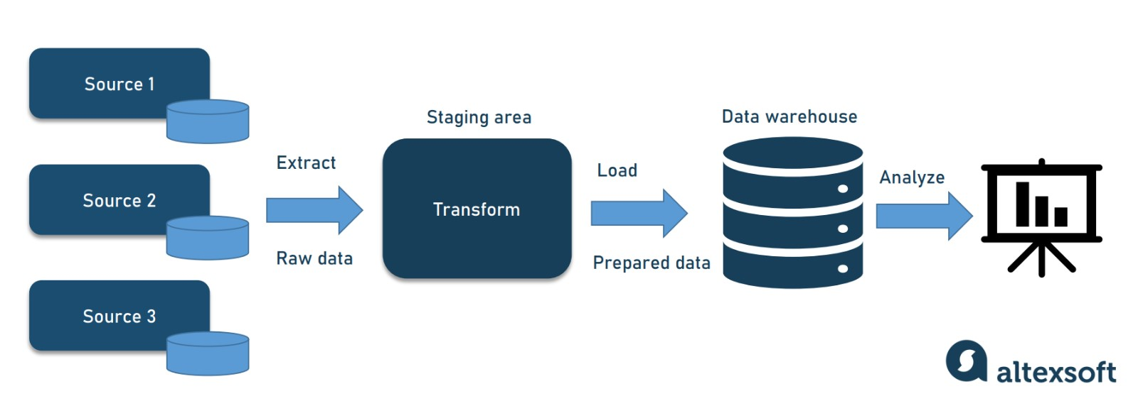
AWS DATA PIPELINE

Slide 4
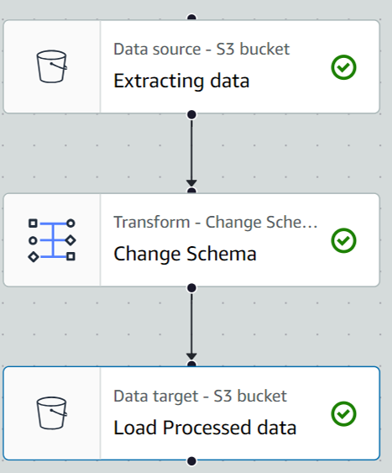
ETL Process by AWS Glue

Slide 5
Pipeline in GHG and Methane Emissions
1. Data Ingestion: Ingest data related to GHG and Methane into an AWS S3 bucket.
2. Data Transformation: Use AWS Glue to preprocess and transform the incoming data on GHG and Methane. This step includes data cleaning, renaming columns, converting data types, and converting the data into Parquet format. Additionally, the data can be cataloged using the AWS Glue Data Catalog for streamlined access and discovery.
3. Data Storage: Store the transformed data in Amazon S3.
4. Batch Data Processing: Configure AWS Glue jobs to execute periodic batch processing tasks on the GHG and Methane data.
5. Data Visualization: Employ a visualization tool like Amazon QuickSight to create interactive dashboards for data analysis and presentation.

Slide 6
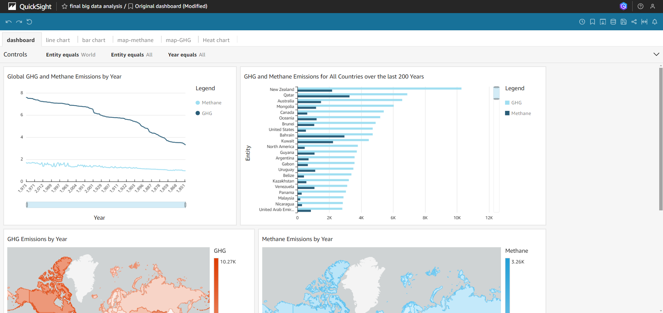
Visualizations

Slide 7
THANK YOU

