Slide 1

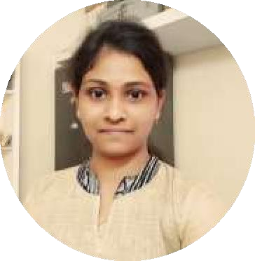



Sindhupriya Kona
Education and certificates
Bachelor of Technology Computer Science Engineering: 2017 – 2021
Analyst/Software Engineer
Base Location: Bangalore
Skills
JAVA 8
Spring(Springcore(IOC,DI)) Spring Boot
Html Css
React Framework
Database:
SQL database-MySQL
postgressql
Email ID: Mobile No:
sindhupriya.kona@capgemini.com
+91 9160960185
Grade:
A4
Strengths
Achivement
A self driven learner with Front-End and Back-End knowledge. Passionate about implementing and launching new projects.
Electricity Bill Payment Application:
Completed end to end case study of Electricity Bill Payment Application along with Validations, Swaggerand Angular used for user interface with Postgres asDatabase.
Additional Details:
Leadership Peer Learning
Team management
Has working knowledge on ReactJs,Java Microservice Development using Spring framework on an intermediate level.
SENTIMENT ANALYSIS OF BILLING IN ELECTRICITY BILL PAYMENT APPLICATION:
Practical Understanding of Query Language Like Postgres SQL, My SQL.
AddOns:
GitHub Postman Swagger Certification:
Certification on Agile Software Development by University of Minnesota and offered through Coursera.
Aws cloud Practitioner Certification.
Online electricity bill payment application is a self service facility for view and pay bill online and other related services.
User needs to signup and need to fill up the Customer detail form
Apply for new electricity connection and needs to
upload the details of meter.
Bill will be generated based on the reading submittedby customer, then customer view and pay bill.
Ready to learn new technologies/Frameworks and implement them to further improve my knowledge.
Implemented Web API and Angular in case study and up skilling this knowledge continuously.
Projects
I have worked for Darden project for 4 months as a Backend Developer.

