Slide 1

STUDENT PERFORMANCE CLASSIFICATION
DATA SCIENCE (24AD3107) Project Review-2
Date& Time
Team Members Name V.ARJUN M.BHARATH K.SINDHURA Roll Numbers: 24200301395 24200301275 2322420030142
 | Under the Guidance of Dr.PRATHUSHA ASSISTANT Professor, Department of Computer Science and Engineering, KLH CSE Bowrampet Campus

Slide 2
Outline of Project Work
Focus
Introduction
Literature Survey
Challenges
Research Objectives
Conclusion & Future Work
References
Publications Details

Slide 3
Problem Statement
Educational institutions possess large amounts of student data (academic records, attendance, demographics, and behavioral logs) but lack automated, data-driven systems for proactive academic support.
Early identification of at-risk students remains difficult, leading to delayed interventions and lower retention rates.
Existing tools often rely solely on final examination marks rather than a holistic analysis of multifaceted student attributes.

Slide 4
Objectives
Data Preprocessing & Cleaning: Implement data validation, missing value imputation, duplicate removal, outlier detection, encoding, feature selection, and normalization.
Exploratory Data Analysis (EDA): Perform EDA to discover key behavioral and socio-demographic indicators driving academic outcomes.
Multi-Model Implementation: Construct and train multiple classification algorithms—K-Nearest Neighbors (KNN), Support Vector Machine (SVM), Decision Tree, Random Forest, and Artificial Neural Network (ANN).
Comparative Evaluation: Assess performance across standard metrics: Accuracy, Precision, Recall, F1-Score, and Confusion Matrix.
Dashboard Deployment: Deliver an interactive web platform for real-time risk assessment and decision support.

Slide 5
Literature Survey
Authors | Title of the Paper | Methodology | Inferences | Limitation/Future work
Hilal et. al. [3] | Intelligent Epileptic Seizure Detection and Classification Model Using Optimal Deep Canonical Sparse Autoencoder, Biology, 2022-mdpi | Coyote optimization algorithm (COA) for feature selection Krill herd algorithm (KHA) for parameter tuning | intelligent deep canonical sparse autoencoder-based epileptic seizure detection and classification model using EEG signals. It achieves a maximum accuracy of 98.67% and 98.73% under binary and multi-classification, respectively. | The paper does not mention the specific limitations of the proposed DCSAE-ESDC technique or the experimental analysis conducted using the benchmark epileptic seizure dataset
Harikumar Pallathadka et al. | Classification and Prediction of Student Performance Data Using Various Machine Learning Algorithms | Uses Naive Bayes ID3 C4.5 Support Vector Machine (SVM) | The study demonstrates that machine-learning classification algorithms can be used to classify and predict student performance. It compares multiple algorithms to determine their performance on educational data. | The study uses a particular student-performance dataset, so the results may not directly generalize to every institution or student population.
Sami Dhahbi | False-positive reduction in computer-aided mass detection using mammographic texture analysis and classification | Hilbert's image representation Kolmogorov-Smirnov distance Maximum sub-region descriptors Fractal texture features GLCM (Gray-Level Co-occurrence Matrix) | Combining different texture features improved classification compared with using individual feature sets. Feature selection improved accuracy. Random Forest achieved 81.09% accuracy, compared with 80.01% for SVM and 79.12% for Decision Tree. | The method focuses specifically on false-positive reduction, not the complete mammogram detection process.

Slide 6
Problem Gap Identification
Lack of Multidimensional Feature Integration: Existing models focus primarily on academic scores, underutilizing behavioral, engagement, and demographic factors.
Inadequate Data Pipeline Standardization: Literature often omits comprehensive preprocessing pipelines (handling missing values, encoding, scaling, outlier handling), leading to model overfitting.
Limited Comparative Baselines: Many studies evaluate only one or two algorithms, failing to benchmark traditional algorithms (KNN, Decision Trees) against deep learning architectures (ANN).
Absence of Actionable Deployment: Most research ends at offline model metrics without delivering interactive dashboards for non-technical academic stakeholders.

Slide 7
Methodology
Data Collection
Collect a structured student dataset containing academic, demographic, and behavioral attributes along with the student performance category.
Data Preprocessing
Clean and prepare the dataset by validating the data, handling missing values, removing duplicate records, detecting outliers, encoding categorical variables, and scaling numerical features.
Feature Selection
Identify the relevant features that contribute to predicting student performance and separate the input features from the target performance category.
Exploratory Data Analysis (EDA)
Analyze the dataset using statistical methods and visualizations to identify patterns, relationships, distributions, and factors related to student performance.
Train-Test Split
Divide the processed dataset into training and testing subsets. The training data is used to build the models, while the testing data is used to evaluate their performance on unseen data.

Slide 8
Model Development
Implement and train five classification algorithms:
  K-Nearest Neighbors (KNN)
  Support Vector Machine (SVM)
  Decision Tree
  Random Forest
  Artificial Neural Network (ANN)
Performance Prediction
Use the trained models to classify students into their respective performance categories.
Model Evaluation
Evaluate each model using:
  Accuracy
  Precision
  Recall
  F1-Score
  Confusion Matrix
Model Comparison
Compare the performance of all five algorithms using the evaluation metrics to understand their behavior
on the student dataset.
Visualization and Dashboard
Present the predictions, model performance, and analysis results through graphs, charts, and an interactive dashboard.

Slide 9
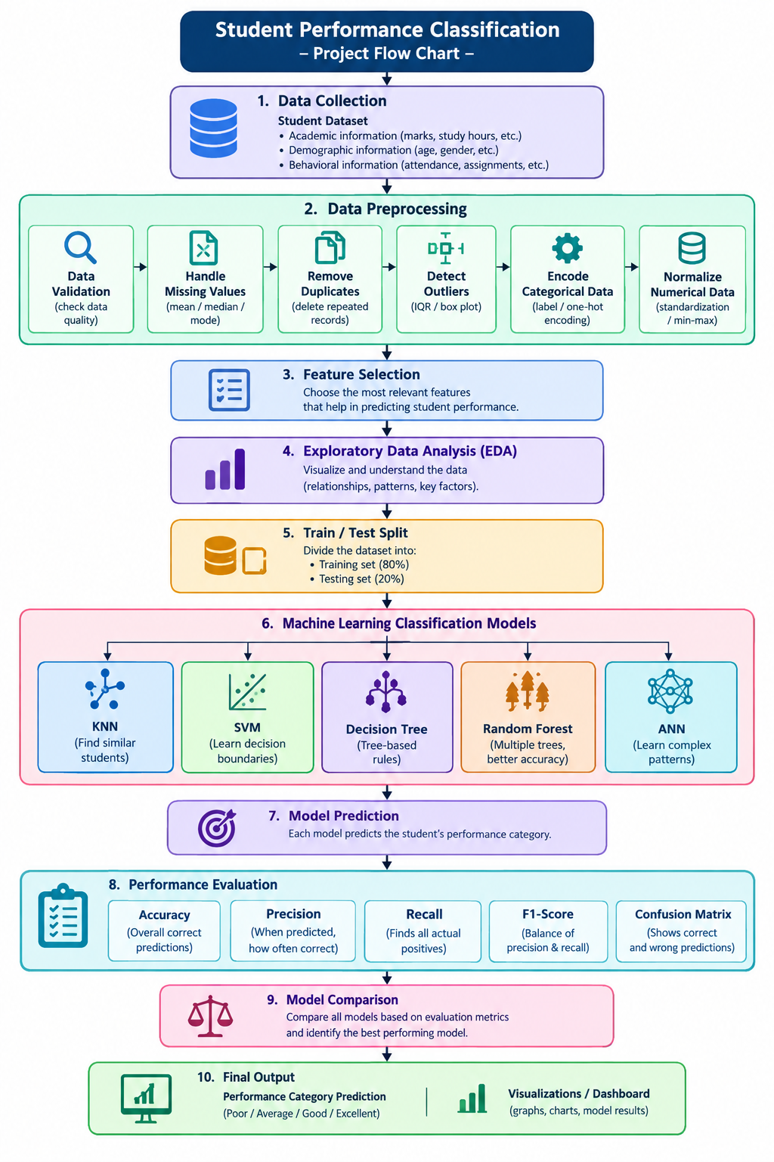
PROJECT DESIGN

Slide 10
Innovation, Creativity, and Novelty
Holistic Data Engineering: Integrates academic, demographic, and behavioral features into an automated, reusable preprocessing pipeline.
Multi-Algorithm Benchmarking: Directly compares classical ML models (KNN, SVM, Decision Tree, Random Forest) with an Artificial Neural Network (ANN) on the same standardized dataset.
Comprehensive Metrics Suite: Evaluates models beyond simple accuracy, focusing on Precision, Recall, F1-Score, and Confusion Matrices to minimize false negatives (misclassifying at-risk students).
Interactive Decision Support System: Features a dashboard that translates model predictions into visual insights for educators to enable timely intervention.

Slide 11
Feasibility
1. Technical Feasibility
Python-based implementation
Machine learning libraries: Pandas, NumPy, Scikit-learn
ANN can be implemented using TensorFlow/Keras
Data visualization using Matplotlib/Seaborn
Interactive dashboard using Streamlit
2. Dataset Feasibility
Structured student performance dataset
Contains academic, demographic, and behavioral attributes
Suitable for classification and analysis
Data can be preprocessed and divided into training and testing sets
3. Cost Feasibility
Uses open-source software and libraries
No expensive hardware required
Can be developed using a standard computer
Low development cost
4. Operational Feasibility
Simple workflow: data input → prediction → evaluation
Results can be presented through an interactive dashboard
Can support educational performance analysis and decision-making

