Slide 1
STUDENT PERFORMANCE CLASSIFICATION
KLH Bowrampet Campus
Final Project Review | Department of CSE | KLH Bowrampet Campus | Batch 23
TEAM MEMBERS
2420030142 – K. SINDHURA
2420030395 – V. ARJUN RISSHI
2420030275 – M. BHARATH REDDY
Guide: Dr. Prathusha, Assistant Professor | Academic Year: 2026–27
Notes:
Title slide. Replace all bracketed text. Use the full project title, list every team member with registration number, and name your guide. Insert the institution logo in the dashed box.

Slide 2



Introduction & Problem Statement
Background
Educational institutions hold large volumes of academic, demographic and behavioral student data. Machine learning can turn this data into early, actionable insight.
Problem Statement
Institutions lack automated, data-driven systems to classify student performance and identify at-risk students early; existing tools rely mainly on final exam marks.
Motivation / Need
Educators, students and administrators benefit from timely support. Without it, interventions come late and retention suffers.
Notes:
State the domain, the exact problem and why it matters. Keep it to about 2 minutes. Add one real-world statistic if you can, with a citation.

Slide 3


Objectives & Scope
Objectives
1
Build a preprocessing pipeline: validation, missing values, duplicates, outliers, encoding, feature selection and scaling.
2
Perform EDA to find behavioral and socio-demographic factors driving academic outcomes.
3
Train and compare KNN, SVM, Decision Tree, Random Forest and ANN classifiers.
4
Evaluate with accuracy, precision, recall, F1-score and confusion matrix; deliver an interactive dashboard.
Notes:
Objectives should be measurable and start with action verbs. The scope slide tells the panel what you did and did not attempt.

Slide 4

Literature Survey
S.No | Author(s) & Year | Method / Technique | Key Findings | Limitation / Gap
1 | Pallathadka et al. | Naive Bayes, ID3, C4.5, SVM | ML classifiers can classify and predict student performance; algorithms compared | Single dataset; may not generalize to other institutions
2 | Hilal et al., 2022 | Deep canonical sparse autoencoder; COA + KHA tuning (EEG) | 98.67% binary and 98.73% multi-class accuracy | Limitations not stated; different domain
3 | Dhahbi | Texture features (GLCM, fractal) + RF, SVM, DT | Random Forest 81.09% vs SVM 80.01%, DT 79.12%; feature selection helped | Covers false-positive reduction only
4 | Proposed (this work) | KNN, SVM, DT, RF, ANN on one pipeline | Fair benchmark with dashboard for educators | Depends on dataset quality
Research Gap
Existing studies compare few algorithms, skip full preprocessing, use mostly marks, and stop at offline metrics. We benchmark five models and deliver a dashboard.
Notes:
Summarise four to six relevant papers or existing systems. End with the research gap, because that gap justifies your project.

Slide 5





Proposed System & Methodology
STEP 1
STEP 2
STEP 3
STEP 4
STEP 5
Define Problem
Collect Data
Design
Implement
Test & Evaluate
Identify the need, scope and success criteria.
Structured student dataset: academic, demographic, behavioral attributes plus performance category.
KNN, SVM, DT, RF and ANN with a reusable preprocessing pipeline; Python tools.
Pipeline, EDA, five models and Streamlit dashboard.
Accuracy, precision, recall, F1, confusion matrix on held-out test data.
Key Novelty / Contribution
Holistic features, a standardized pipeline and a five-model benchmark (classical ML vs ANN), with recall focus on at-risk students and an interactive decision-support dashboard.
Notes:
Walk through the five steps left to right. Rename the steps to match your project (for example, Requirement Analysis, Design, Coding, Testing, Deployment). End with your novelty.

Slide 6
System Architecture
Components
Student Dataset
Preprocessing
EDA & Feature Selection
Train–Test Split
1
Data & Preprocessing
Cleans, encodes and scales the data
2
EDA & Feature Selection
Finds patterns and key predictors
Model Training
KNN · SVM · DT · RF · ANN
Evaluation
Acc · Prec · Rec · F1 · CM
Streamlit Dashboard
3
Model Layer
Trains five classifiers, compares metrics
4
Dashboard
Shows predictions and insights
Notes:
Insert a clear block diagram: input, processing, storage, output. Number each block and explain them on the right. Redraw the figure yourself rather than copying it.

Slide 7


Hardware & Software Requirements
Hardware
Software & Tools
Libraries / Frameworks
Standard PC / laptop, Intel i5 or similar
8 GB RAM recommended
No GPU required
Internet for libraries and dataset
Windows / Linux / macOS
Python 3
Jupyter Notebook / Google Colab
GitHub for version control
Pandas, NumPy, Scikit-learn
TensorFlow / Keras (ANN)
Matplotlib, Seaborn
Streamlit (dashboard)
Deployment / Platform: Local machine or Google Colab; Streamlit web dashboard
Notes:
List only what you actually used, with versions. For a pure software project, shorten the hardware list and add cloud or deployment resources.

Slide 8
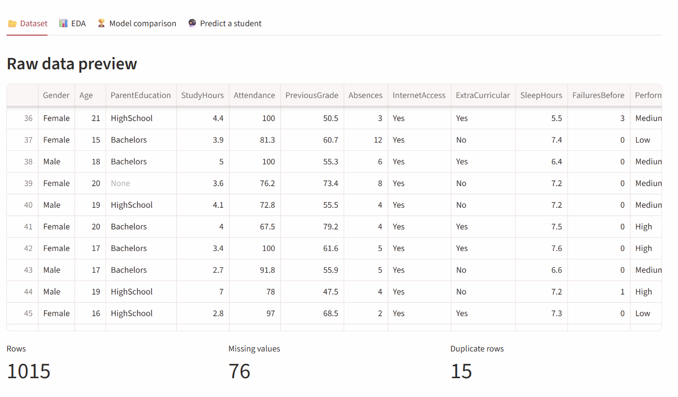
Dataset / Data Understanding
—
—
Records (rows)
Features (columns)
—
—
Missing values
Performance classes
Source: Structured student performance dataset
Features: academic, demographic and behavioral inputs; target = performance category
Quality: validated for missing values, duplicates and outliers (see next slide)
Notes:
Explain where the data came from and what it contains. Show a screenshot of the first rows or the info summary. For non-data projects, replace this slide with “Requirement Analysis” or “Input Specification”.

Slide 9
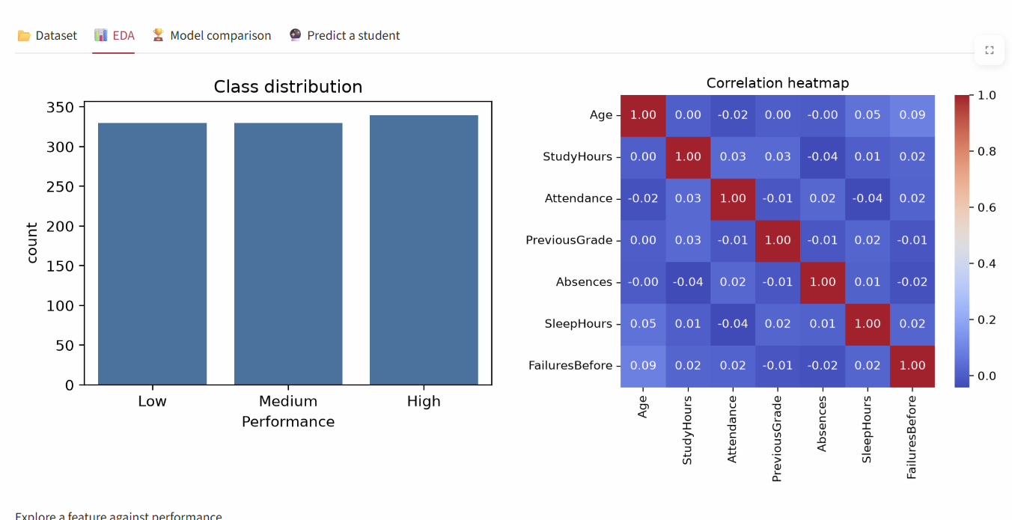
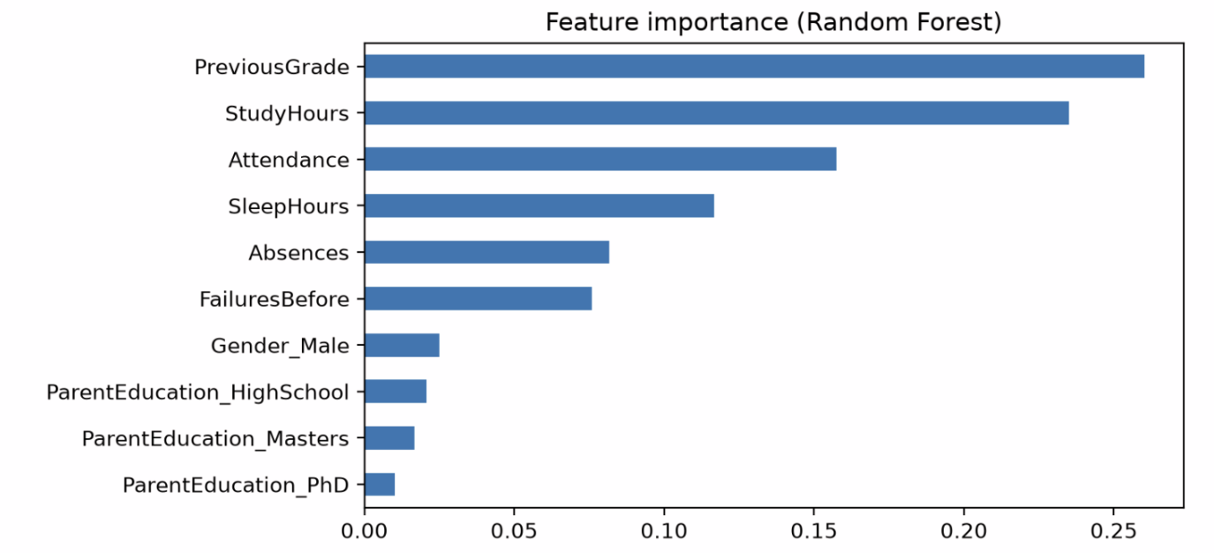



Data Preprocessing & Exploratory Analysis
[Insert correlation heatmap / outlier box-plot]
Cleaning
Transformation
Feature Selection
Validate data, impute missing values, drop duplicate records, detect and treat outliers.
Encode categorical variables; normalize / scale numerical features.
Select features that contribute to prediction; separate inputs from the target category.
Notes:
Show two or three plots that tell a story: distributions, correlations, outliers. Explain what each plot told you and what you did about it.

Slide 10
Module-wise Description
1
Data Preprocessing
2
EDA & Feature Selection
Purpose: Validate, clean, encode and scale the dataset
Input → Output: Raw student dataset → clean, scaled data
Developed by: Arjun
Purpose: Study patterns and choose relevant features
Input → Output: Clean data → insights and selected features
Developed by: Sindhura
3
Model Development & Evaluation
4
Dashboard & Visualization
Purpose: Train KNN, SVM, DT, RF, ANN and compare them
Input → Output: Train/test data → 5 models and metrics
Developed by: Sindhura, Bharath
Purpose: Present results and predictions visually
Input → Output: Predictions and metrics → interactive dashboard
Developed by: Bharath
Notes:
Divide the project into three to five modules. For each, state its purpose, inputs, outputs and who built it. Duplicate a card if you have more modules.

Slide 11

Algorithms & Technologies Used
KNN & SVM
Decision Tree & Random Forest
Artificial Neural Network
Why chosen
Simple, distance/margin-based baselines for classification
Key parameters
k and distance metric; kernel and C
Why chosen
Interpretable; ensemble reduces overfitting
Key parameters
max depth; number of trees
Why chosen
Learns non-linear patterns across many attributes
Key parameters
layers, activation, epochs (Keras)
Selection criteria: best F1-score and recall on test data, with accuracy and confusion matrix
Notes:
Name each model, algorithm or technology, say why you chose it, and list the key settings. Then explain how you picked the final one.

Slide 12
Implementation / Model Building
Feature Selection
Code snippet / pseudocode
Relevant academic, demographic and behavioral attributes; target is the performance category.
# Key workflow (sample)
X_train, X_test, y_train, y_test = \
train_test_split(X, y, test_size=0.2,
random_state=42)
for name, model in models.items():
model.fit(X_train, y_train)
pred = model.predict(X_test)
print(name, classification_report(y_test, pred))
Preprocessing Pipeline
Validate → impute → remove duplicates → handle outliers → encode → scale.
Data Splitting
Train and test subsets (sample: 80/20); test data kept unseen.
Configuration
Same split and pipeline for all five models; hyperparameters set per model.
Notes:
Describe the build in the order you did it. Paste only the most important code or pseudocode, not entire files. For hardware projects, show the circuit or wiring summary instead.

Slide 13
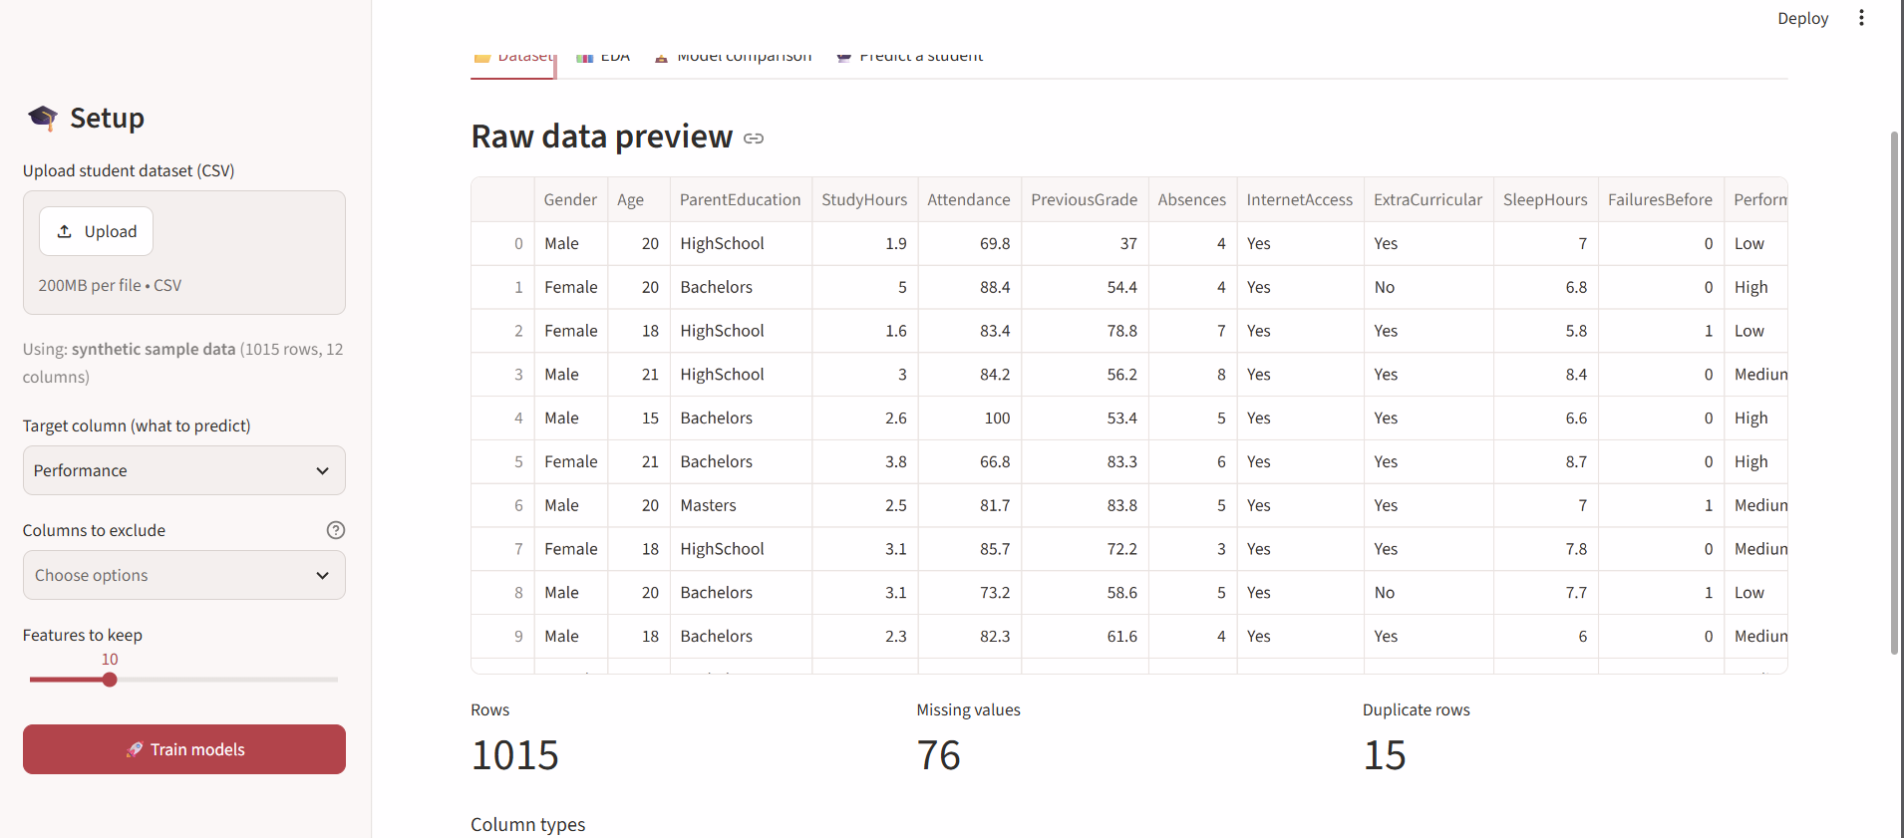
Working Prototype / Output Screens
Dashboard Home
Upload data and select a model
Notes:
Show real screenshots, photos of the hardware or a short demo video link. Caption each one with what the viewer should notice.

Slide 14
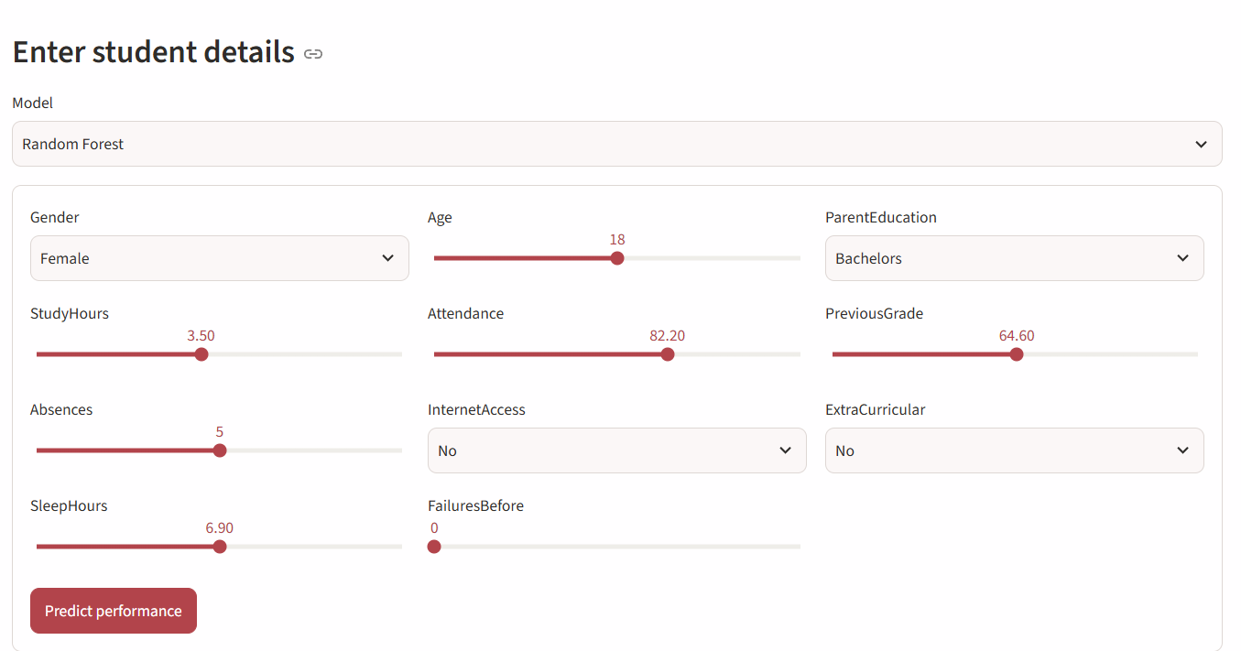
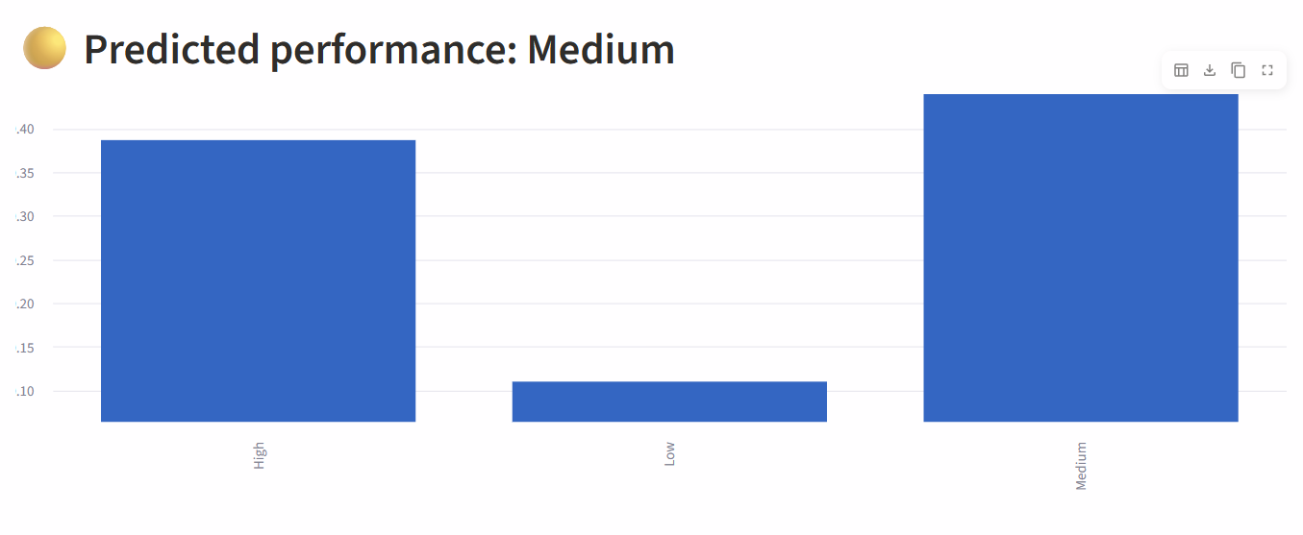
Prediction View
Shows predicted performance category

Slide 15
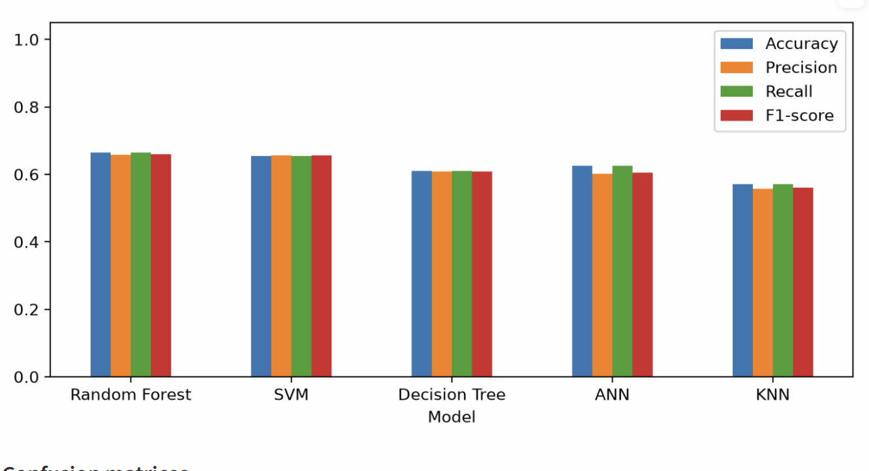
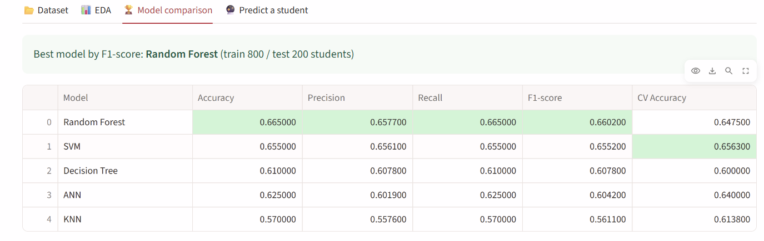
Model Comparison
Metrics and confusion matrices side by side

Slide 16
Results & Performance Comparison
Metric | KNN | SVM | DT
Accuracy | — | — | —
Precision | — | — | —
Recall | — | — | —
F1-score | — | — | —
ROC-AUC | — | — | —
Best: to be filled after final run
Fill the table with your own test-set results for all five models.
Notes:
Right-click the chart and choose Edit Data to enter your real numbers. Replace the metrics with the ones that fit your project (accuracy, latency, power, throughput, user rating). State clearly which option performed best.

Slide 17
Analysis & Key Findings
[Insert confusion matrix / feature importance /
ROC curve / output comparison]
—
Best F1-score: model to be confirmed after final run
Interpretation: compare which model separates performance classes best
Error analysis: use confusion matrix to spot missed at-risk students
Key drivers: from EDA and Random Forest feature importance
Notes:
Explain what the numbers mean. Use a confusion matrix, ROC curve, feature-importance chart or output comparison. Be honest about weak results; panels value that.

Slide 18

Testing & Validation
Test ID | Test Description | Expected Result | Actual Result | Status
TC-01 | Missing values and duplicates removed | No nulls or duplicate rows remain | Record after run | Pending
TC-02 | Encoding and scaling applied | All features numeric and scaled | Record after run | Pending
TC-03 | All five models train and predict | Valid performance category output | Record after run | Pending
TC-04 | Dashboard returns a prediction | Category and metrics displayed | Record after run | Pending
Functional Testing
Validation Method
Performance Testing
Unit checks on each pipeline step; integration test from data input to dashboard.
Hold-out test set; optional cross-validation.
Accuracy, precision, recall, F1 compared across models; training and prediction time noted.
Notes:
List representative test cases with expected and actual outcomes. Name the validation methods you used. Delete rows you do not need.

Slide 19


Challenges & Limitations
Challenges Faced
Limitations
Mixed data types → encoding and scaling pipeline
Overfitting risk → train–test split and multiple metrics
Fair comparison → same split for all models
Depends on one structured dataset
Results may not generalize to other institutions
Offline analysis, not live student data
Notes:
Be candid. Pair every challenge with how you solved it, and list limitations that the panel would otherwise spot themselves.

Slide 20

Conclusion
Built an end-to-end ML system to classify student performance from academic, demographic and behavioral data.
1
Final Outcome
Compared KNN, SVM, Decision Tree, Random Forest and ANN using accuracy, precision, recall, F1 and confusion matrix.
5
2
5 classification models benchmarked
Objectives targeted: 5
Meets the five objectives and adds an interactive dashboard for educators.
3
Notes:
Revisit each objective and say whether you met it. Quote your headline result with numbers. Do not introduce new material here.

Slide 21



Future Scope & Applications
Improve Performance
Hyperparameter tuning, ensembles, deeper networks
Applications
Early warning for at-risk students
Academic counselling and mentoring
Institutional decision support
Colleges and universities
Expand Data / Features
More institutions, attendance and engagement logs
Deploy & Build an Interface
Web or mobile app with live prediction API
Scale & Secure
Cloud deployment, student data privacy
Notes:
Give concrete next steps, ideally tied to the limitations. Then name two or three real-world uses.

Slide 22
Team Contribution
Reg. No. | Name | Contribution / Modules Handled
2420030142 | K. Sindhura | Feature selection, KNN / SVM / DT models, evaluation
2420030395 | V. Arjun Risshi | Data collection, preprocessing, EDA, documentation
2420030275 | M. Bharath Reddy | Random Forest and ANN models, dashboard, presentation
Notes:
Show that work was planned and shared. Every member should be able to explain their own module.

Slide 23

References
[1] H. Pallathadka et al., “Classification and Prediction of Student Performance Data Using Various Machine Learning Algorithms.”
[2] Hilal et al., “Intelligent Epileptic Seizure Detection and Classification Model Using Optimal Deep Canonical Sparse Autoencoder,” Biology (MDPI), 2022.
[3] S. Dhahbi, “False-positive reduction in computer-aided mass detection using mammographic texture analysis and classification.”
[4] F. Pedregosa et al., “Scikit-learn: Machine Learning in Python,” J. Mach. Learn. Res., vol. 12, 2011.
Notes:
Use IEEE style, numbered in order of first citation in the deck. Include datasets, documentation and code repositories.

Slide 24
THANK YOU
Questions & Discussion
Batch 23 – Department of CSE, KLH Bowrampet Campus
Guide: Dr. Prathusha, Assistant Professor, CSE
Notes:
Leave this slide up during questions. Make sure every team member can answer questions about their own module.

