Slide 1
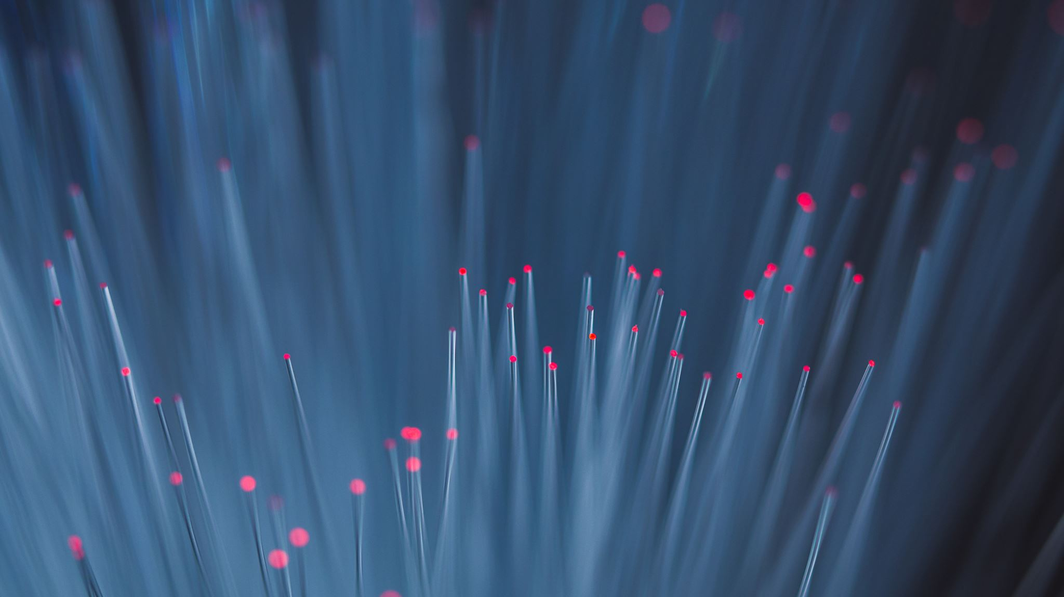
Payment Tracker
Team members:
Sindhura.L (01JST17IS050)
Spoorthi.S (01JST17IS062)

Slide 2
Product Scope:
Investments and deposits are keys to save money for future.
People tend to invest their money in multiple financial institutions because, depositing all the saved money in same investment platform may involve risk of losing the money and investing in different platform also gives them tax concessions.
People also have a lot of commitments like paying rent,EMI’s, loan interests, premiums, school/college fees of children etc.
Different government policies like Atal pension yojana have small investment amount and longer maturity time.
Because of this it is difficult to keep track of their income, expenses and investments.

Slide 3
Advantages of proposed system:
Users can set periodic reminders based on their requirement.
They can also store images like bonds related to the reminder.
Users can calculate their total income and expenditure over particular time period specified by them. By providing a current balance they can also find out the amount they would have after a certain interval of time like after a year or 10 years etc.
Users can set one-time reminders by providing end date same as start date and ignoring the interval values.

Slide 4
Incremental model.
Firebase realtime database.
Client-Server architecture.
Android Studio and JAVA.
Object oriented model.

Slide 5
FUTURE SCOPE
A search bar can be added in order to search through the reminders and also tags can be added to filter the reminders based on categories like FD, premium, income, expense.
Using the bank balance provided by the user, they should be warned whenever the addition of a new commitment(reminder) results in a balance below their specified limit. The app should also suggest investment options when the balance exceeds a certain value.
We can also add another feature that can be used by financial institutions to advertise their investment plans to the users. The users should be able to view and select plans suitable to their requirements.

Slide 6
THANK YOU

