Slide 1
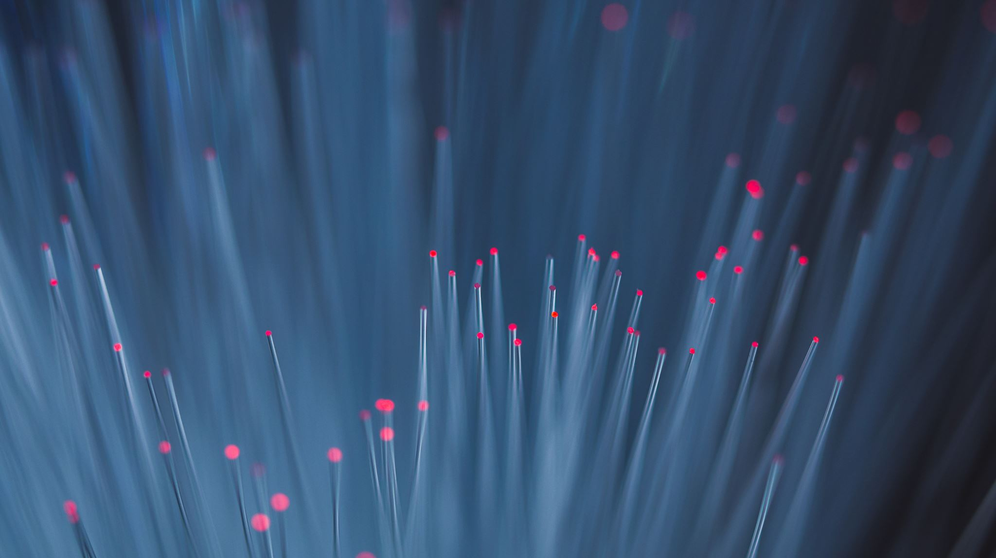
Payment Tracker
Team members:
Sindhura.L(01JST17IS050)
Spoorthi.S(01JST17IS062)

Slide 2
Product scope:
Investments and deposits are keys to save money for future.
As a general rule long term investments yield more profits.
People tend to invest their money in multiple financial institutions, because depositing all the saved money in same bank or same investment platform may involve risk of losing the money and investing in different platform also gives them tax concessions.
Because of this if difficult for

Slide 3
Solution
Users can set periodic reminders based on there requirement.
They can also store image of the bond which they will provided while depositing the money or any related image.
Users can calculate gross investment or profit amount for a particular time period (specified by users).
Users can set normal reminders by giving interval period as 1.

Slide 4
We have used incremental model to develop the app.
Firebase realtime database.
Client-Server architecture.
Android Studio.
Object oriented model.

Slide 5
THANK YOU

