Slide 1
Crisp: A Debugging Tool for Java Programmers
Ophelia C. Chesley, Xiaoxia Ren and Barbara G. Ryder
Sindhura Bonthu

Slide 2
Problem
After a long code editing session, regression tests are executed to ensure that the changed code in the updated program version does not conflict with previous releases of the software.
When the test fails, programmers are burdened with the task of searching through the program for the source of the failure.

Slide 3
Solution
CRISP - A tool for constructing intermediate versions of a Java program that is being edited in Eclipse IDE.
It helps programmers isolate relevant portion of code and choose the changes to include.
CRISP is built on Chianti – an eclipse plug-in that performs change impact analysis of Java Program.

Slide 4
Chianti
Divides program edit into atomic changes
Identifies a set of regression
tests that are impacted by these changes
Identifies subset of changes for each affected test

Slide 5
Chianti Cont.
Examining each of these changes and pinpointing the few that induce the failure of a test is a tedious task for programmers.
It is beneficial to automate the iterative process of selecting changes and applying them to the original software version to create intermediate source program versions.

Slide 6
Crisp
An eclipse plug-in built on Chianti that generates valid intermediate programs automatically for programmers, given their choice of the changes to include.
The programmers need not to be concerned with the syntactic inter-relationship of the changes, nor with manually changing any code until they have found the failure-inducing changes.

Slide 7
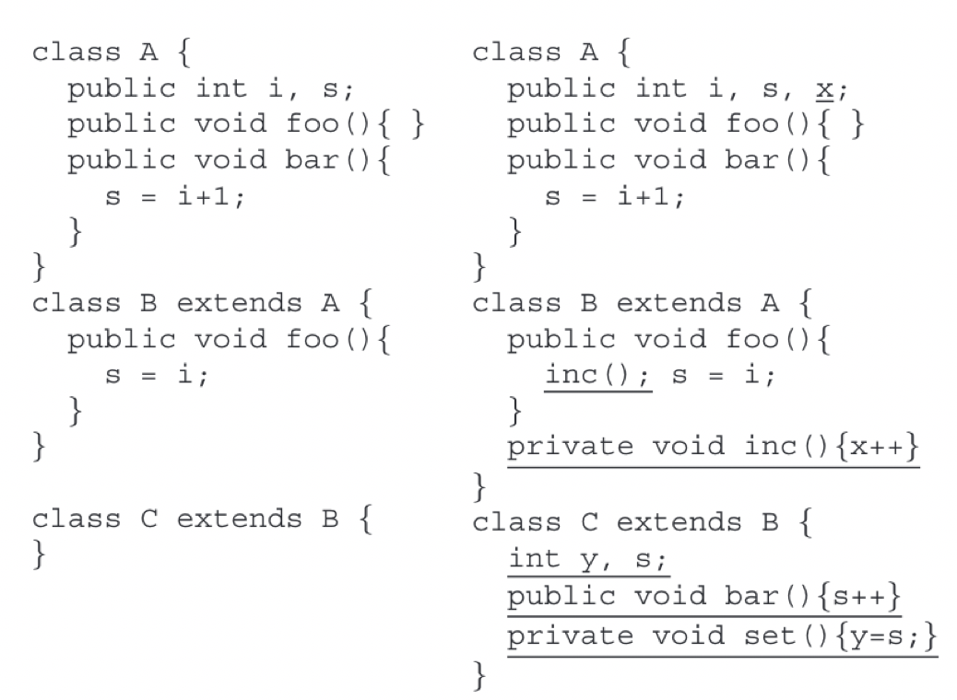
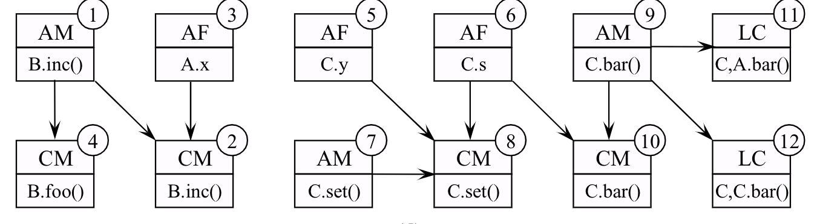
Atomic Changes of Program Edit

Slide 8
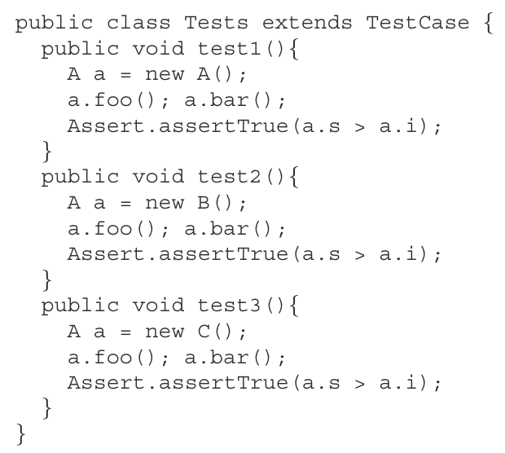
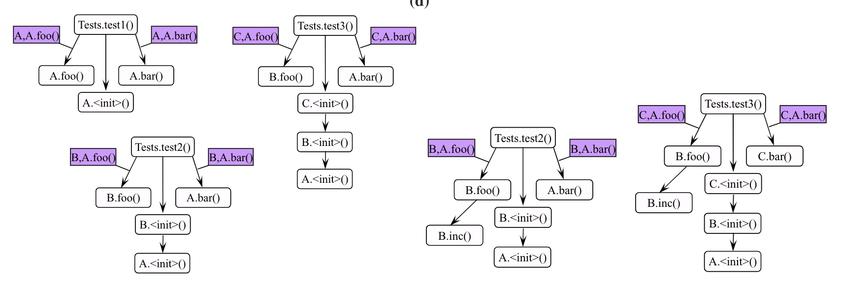
Call Graphs for Tests

Slide 9
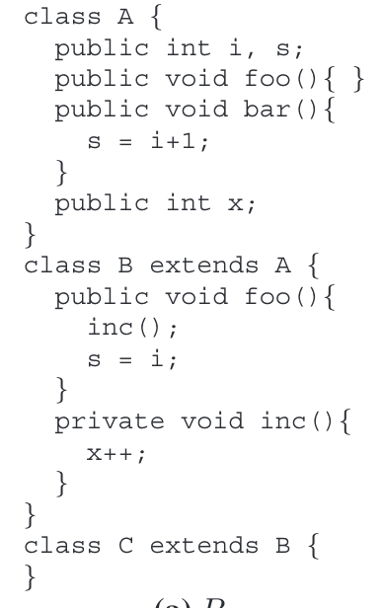
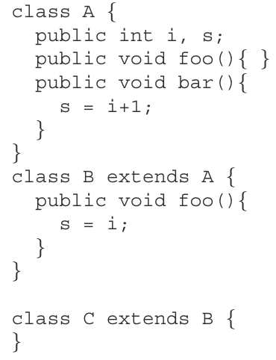
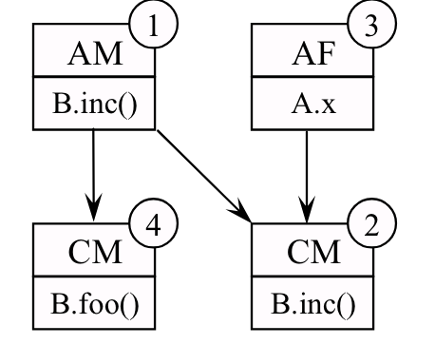
Debugging with CRISP

Slide 10
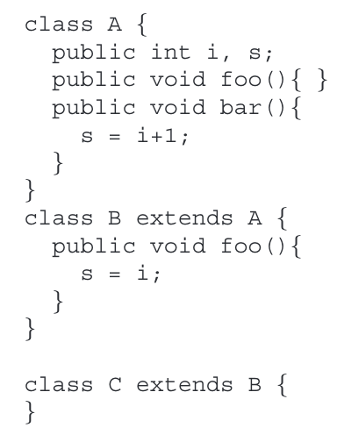
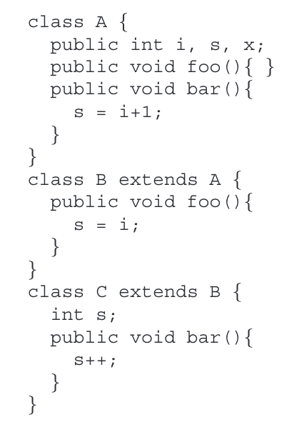
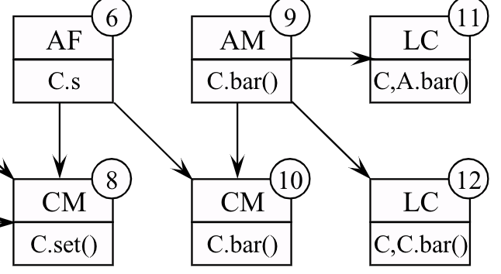
Debugging with CRISP Cont.

Slide 11
Atomic Changes and Dependencies
Frame-Body Rule - A new program element must be declared before making any changes to its body. Similarly, the program element body must be cleared before deleting the element itself.
Define-Use Rule - A program element must be declared before any other program element can have a reference to it. Similarly, a program element can only be deleted when there is no other program element referring to it.

Slide 12
Atomic Changes and Dependencies Cont.
Abstract -Method Rule - An abstract method must be implemented in all the sub-classes of an abstract class, before its declaration in this class. Similarly, the declaration of an abstract method must be deleted before the deletion of its implementation in the subclasses.
Dynamic-Dispatch Rule - An LC change is dependent on the corresponding source code changes that result in the dynamic dispatch change.

Slide 13
Constructing Intermediate Versions
Two major tasks of CRISP:
Gather and order all the prerequisites of the affecting changes and present them in a dependence tree format
Respond to a programmer’s selection of an affecting change and automatically update the original source program with the affecting change as well as all of its (indirect and direct) prerequisites

Slide 14
Grouping editable changes
CRISP aggregates editable changes based on their semantics:
add/changeMethod – add the method declaration and body
change/deleteMethod- delete the method body and declaration
add/changeFieldInitializer – add a field variable, its type and its initial value
change/deleteFieldInitializer – delete a field variable, its type, and its initial value.

Slide 15
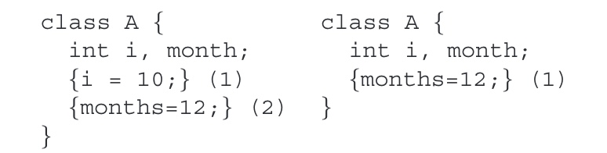
Initializers
Atomic changes: CI(A2), DI(A2), CI(A1)
CI and DI are taken as pair of atomic changes, selecting one of them resulted in deletion of the second initializer
Block. Selecting CI for block 1 produces two identical initializer blocks of {months = 12}
Initializer changes cannot be presented to users as separate editable units.

Slide 16
Comparison with Delta Debugging
Delta debugging searches the entire set of changes to find the
failure-inducing changes.
In our approach, we first obtain the set of affecting changes for a failed test with Chianti, and then generate the intermediate versions of programs just from this small set of changes.

Slide 17
Benefits
Crisp can potentially assist programmers in focusing on a very small subset of changes that has altered the behavior of a regression suite.
It automatically builds the intermediate versions of code with selected changes, saving the programmer’s time.
The programmers need not be concerned about the syntactic inter-relationship of changes.

Slide 18
Future Work
Integrate Crisp, Junit, Chianti to automate the entire process of finding failure- inducing change sets without programmer intervention.

Slide 19
THANK YOU

