Slide 1
SYNCWORKTRACK
Azure DevOps work items aligned across projects
A
SOURCE PROJECT
One source project. Multiple destinations. Destination workflow states remain unchanged.
B C … N
DESTINATION PROJECTS
Epic, Feature, Requirement, Task and Test Case
Demo overview
01
Notes:
Purpose: introduce the business need before opening the live application. Source: Summary of requirements (2).docx and the current SyncWorkTrack implementation.

Slide 2
What SyncWorkTrack delivers
Synchronization coverage
Control and safety
01
Creates mapped copies, then updates the same destination IDs on later runs
Destination State never changes
Copies selected fields, Test Steps, discussions, hyperlinks and the FA-Synced tracking tag
Preview separates To create, Changes to sync and Up to date before any write
02
Reconciles mapped Parent/Child, Affects/Affected By and other Azure work-item links
Manual runs stay available. Windows Task Scheduler can run daily at a selected time
03
The PAT stays session-only or in Windows Credential Manager
Result: source-controlled work items stay aligned while each destination keeps its own workflow state.
02
Notes:
Source: Summary of requirements (2).docx; SyncWorkTrack app.py, templates/index.html and README.md. Clarify that Test Plans and Test Suites remain outside the current work-item scope.

Slide 3
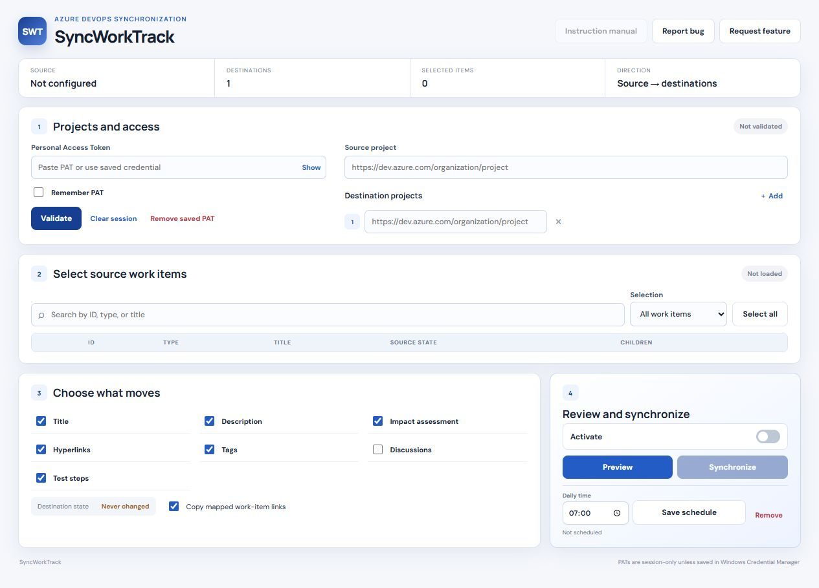
Live demo path
A short walkthrough from connection to verified destination IDs
1
Validate the source and destination projects
2
Select work items and fields
3
Preview creates, changes and unchanged mappings
4
Synchronize, then verify IDs, links and destination states
Next: open SyncWorkTrack
03
Notes:
Demo sequence: validate using a PAT with Work Items read/write access; select one mapped item and one new item; preview; activate; synchronize; open the destination IDs; confirm State remained unchanged; show the daily schedule control. Screenshot captured from the current local build.

