Slide 1


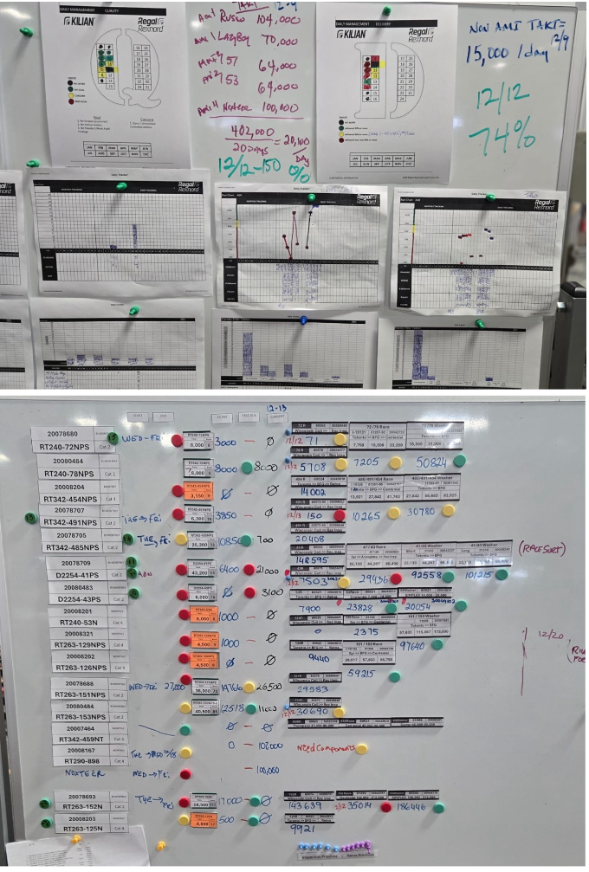
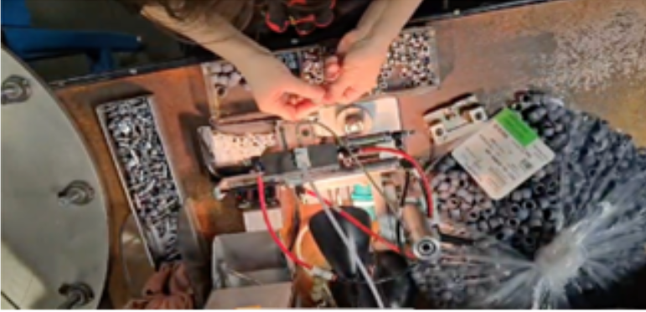
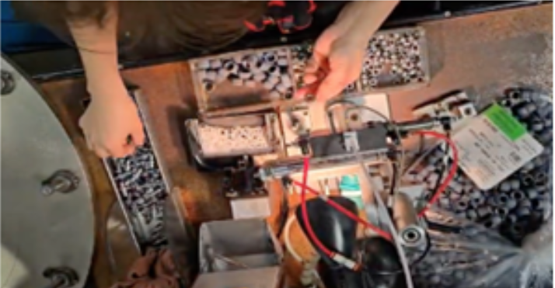
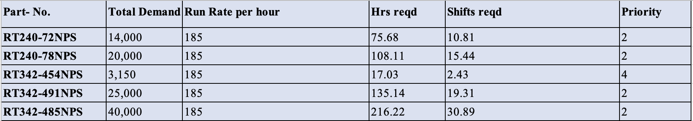
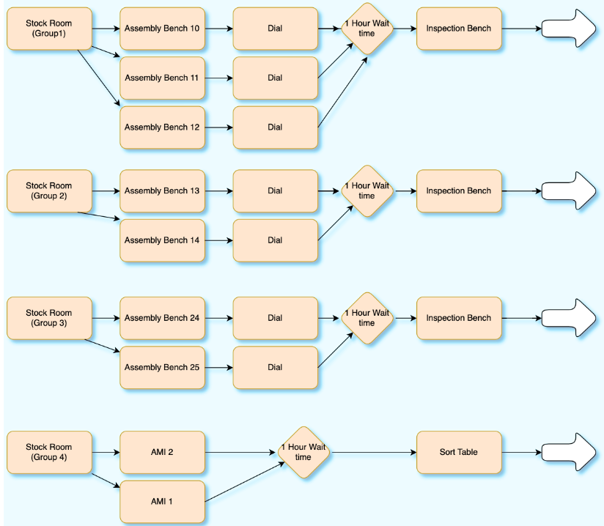
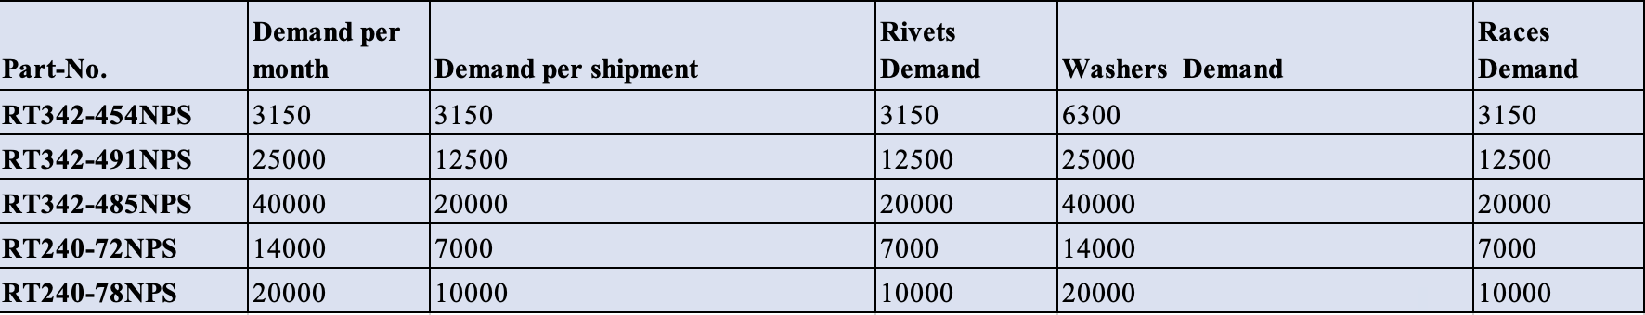
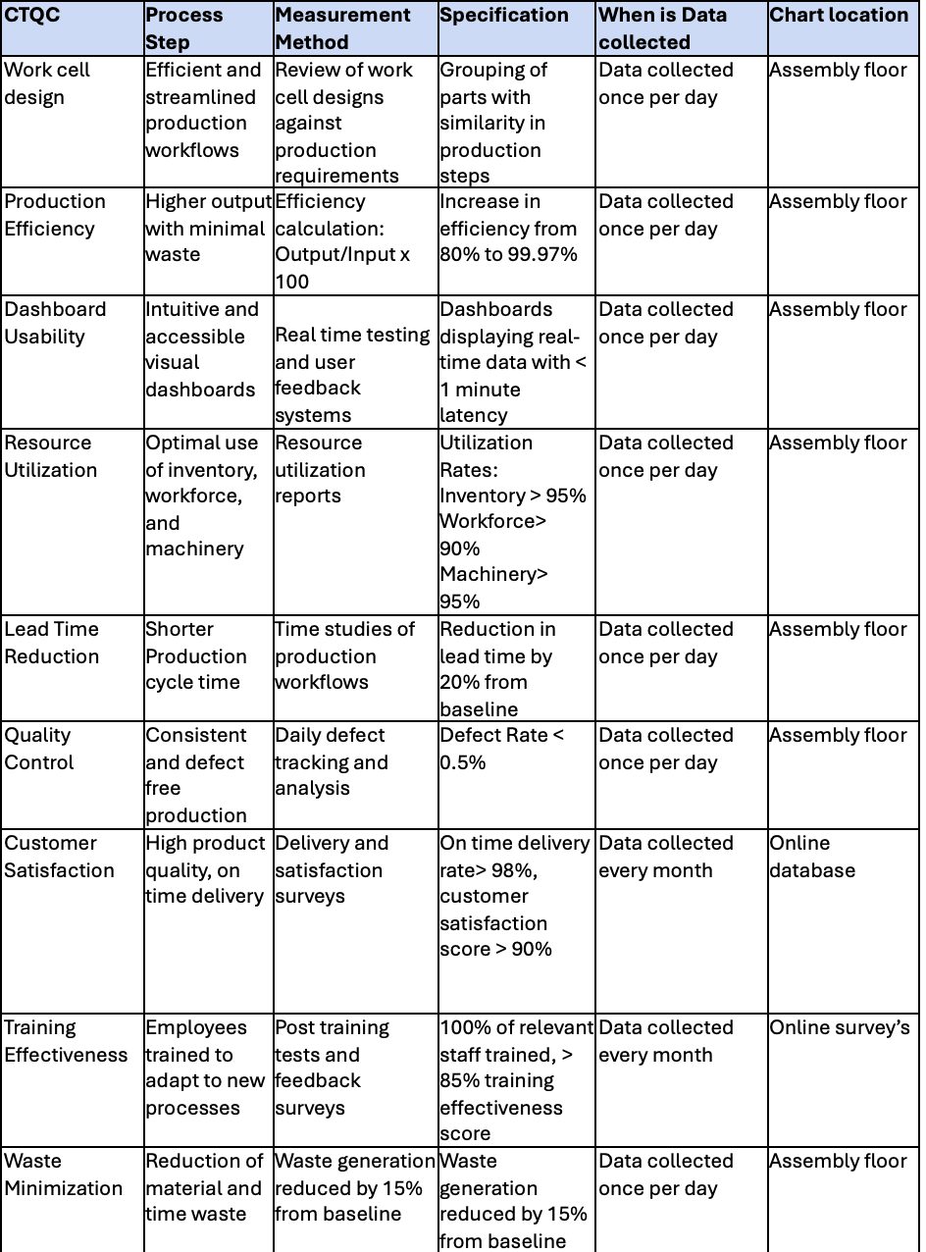
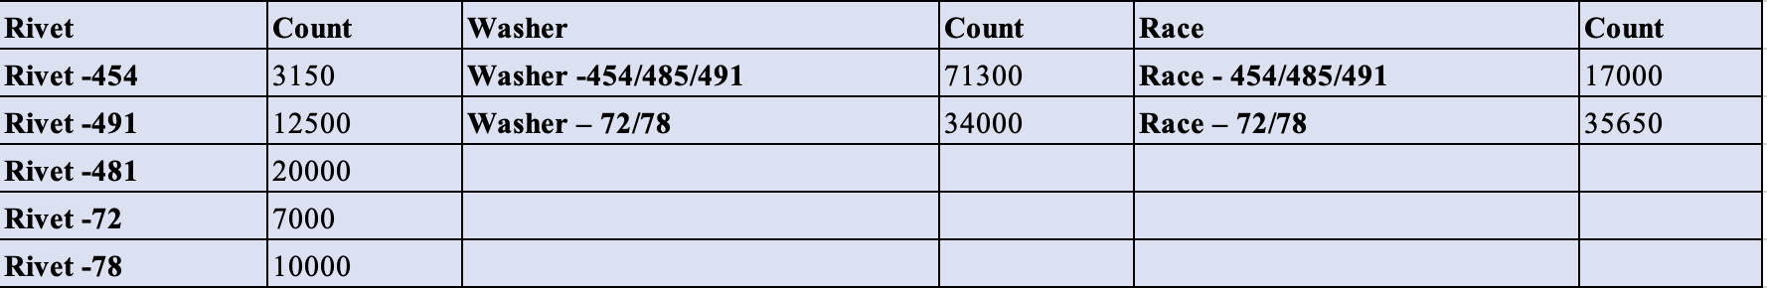
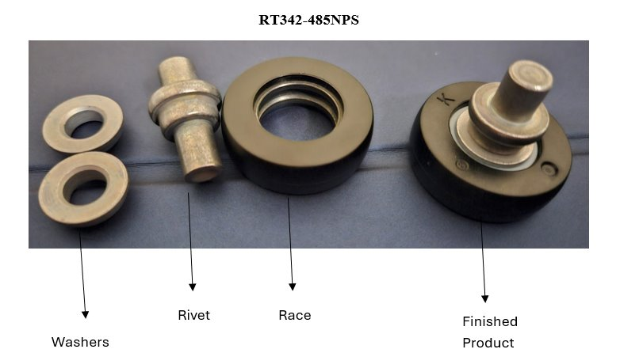
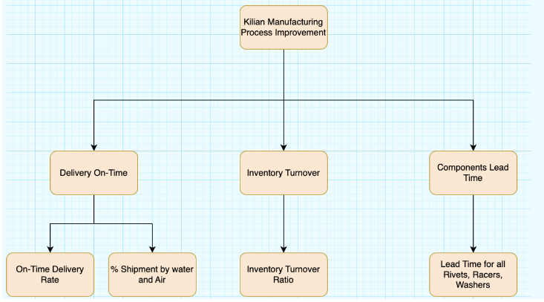
Define Phase
4. Improve Phase
SIPOC Table-
VDM Dashboard: This board plays a critical role in ensuring production targets are met, maintaining high levels of operational efficiency, and driving continuous improvement initiatives.
Lean Training for employees: We propose implementing a lean training program combined with ergonomic improvements to optimize worker efficiency and streamline the assembly process.
Category | Details
Suppliers | Internal: Assembly, Dial, Inspection Teams External: Suppliers, Logistics
Inputs | Components: Washers, Rivets, Equipment: Benches, Gauges, Data & HR: Schedules, Operators
Process | Assembly, Dial Gauging, Wait Management, Inspection, Sorting, Shipment
Outputs | Finished Products, Quality Reports, Optimized Workflows, Delivery Ready
Customer | Internal: Assembly, Logistics, External: End Customers, Plants (Korea)
Process Improvement Process
Problem Statement: Kilian Manufacturing delivers products to meet customer needs, but the current 80% on-time efficiency highlights gaps in resource utilization and operations, raising concerns about sustaining satisfaction for its top 10 customers and long-term competitiveness.
Goal Statement: The goal of this project is to enhance Kilian Manufacturing's operations by improving efficiency from 80% to 99.97% through lean production practices. This includes designing work cells for parts with similar production steps to streamline workflows and implementing visual dashboards for real-time insights into production and resource usage, enabling data-driven decisions and ensuring high customer satisfaction.
3. Analyze Phase
2. Measure Phase
Group 1 Calculations
Process flow chart: Outlines the standardized workflow across four groups, starting from the Stock Room and progressing through assembly and inspection stages
Supermarket Calculations
5. Control Phase
KPI Tree: The KPI Tree for the Operational Efficiency and Optimization project is designed to provide a structured framework to monitor and evaluate critical performance metrics.

