Slide 1


SLIIT STUDENT'S ATTITUDES AND PREFERENCES REGARDING
MIGRATING FOR HIGHER STUDIES

Slide 2
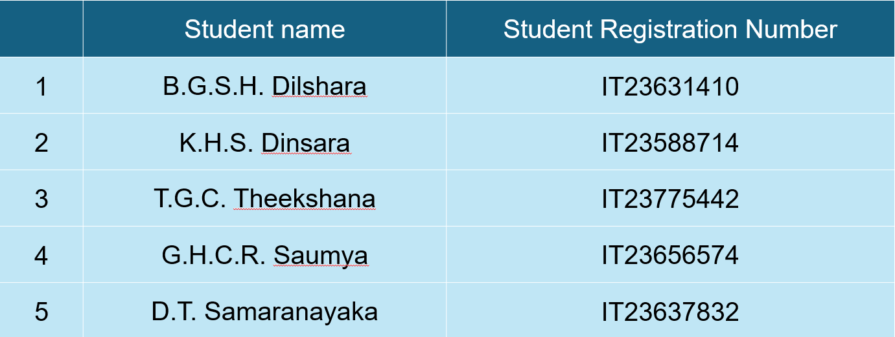
OUR TEAM
Group Number : MLB_04.02_07
Batch Number : 04.02
2

Slide 3

Introduction
What is higher education ?
The term "higher education" describes the level of learning that takes place at universities, colleges, and other establishments that grant professional certificates and academic degrees, usually following the conclusion of secondary school.
Associate degrees: Typically available through community institutions, they require two years to complete.
Bachelor's degrees :are awarded by universities and institutions for undergraduate studies that typically take four years to finish
2

Slide 4
METHODOLOGY
The research employed a mixed-methods approach, combining both qualitative and quantitative techniques to explore students' attitudes and preferences regarding migrating for higher education. A structured survey was distributed to students at SLIIT, gathering data on their motivations for studying abroad, preferred countries, as well as the challenges they face and the factors that impact their decision-making process.

Slide 5
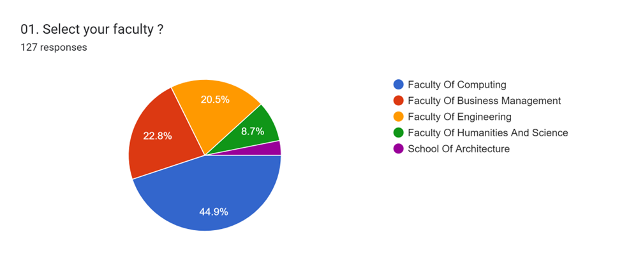
Faculty Distribution
Figure 01
2

Slide 6
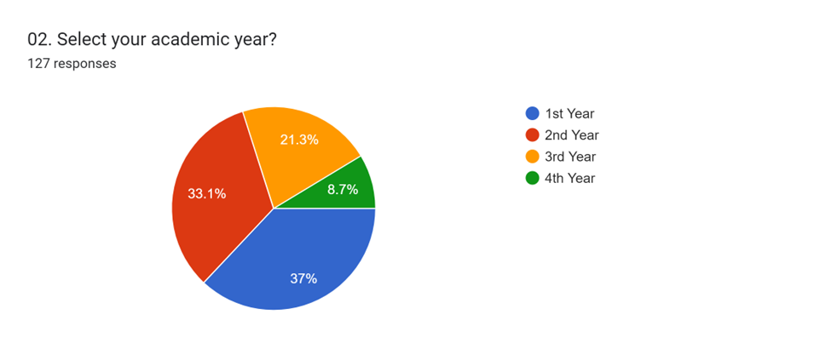
Academic Year Representation
Figure 02
2

Slide 7
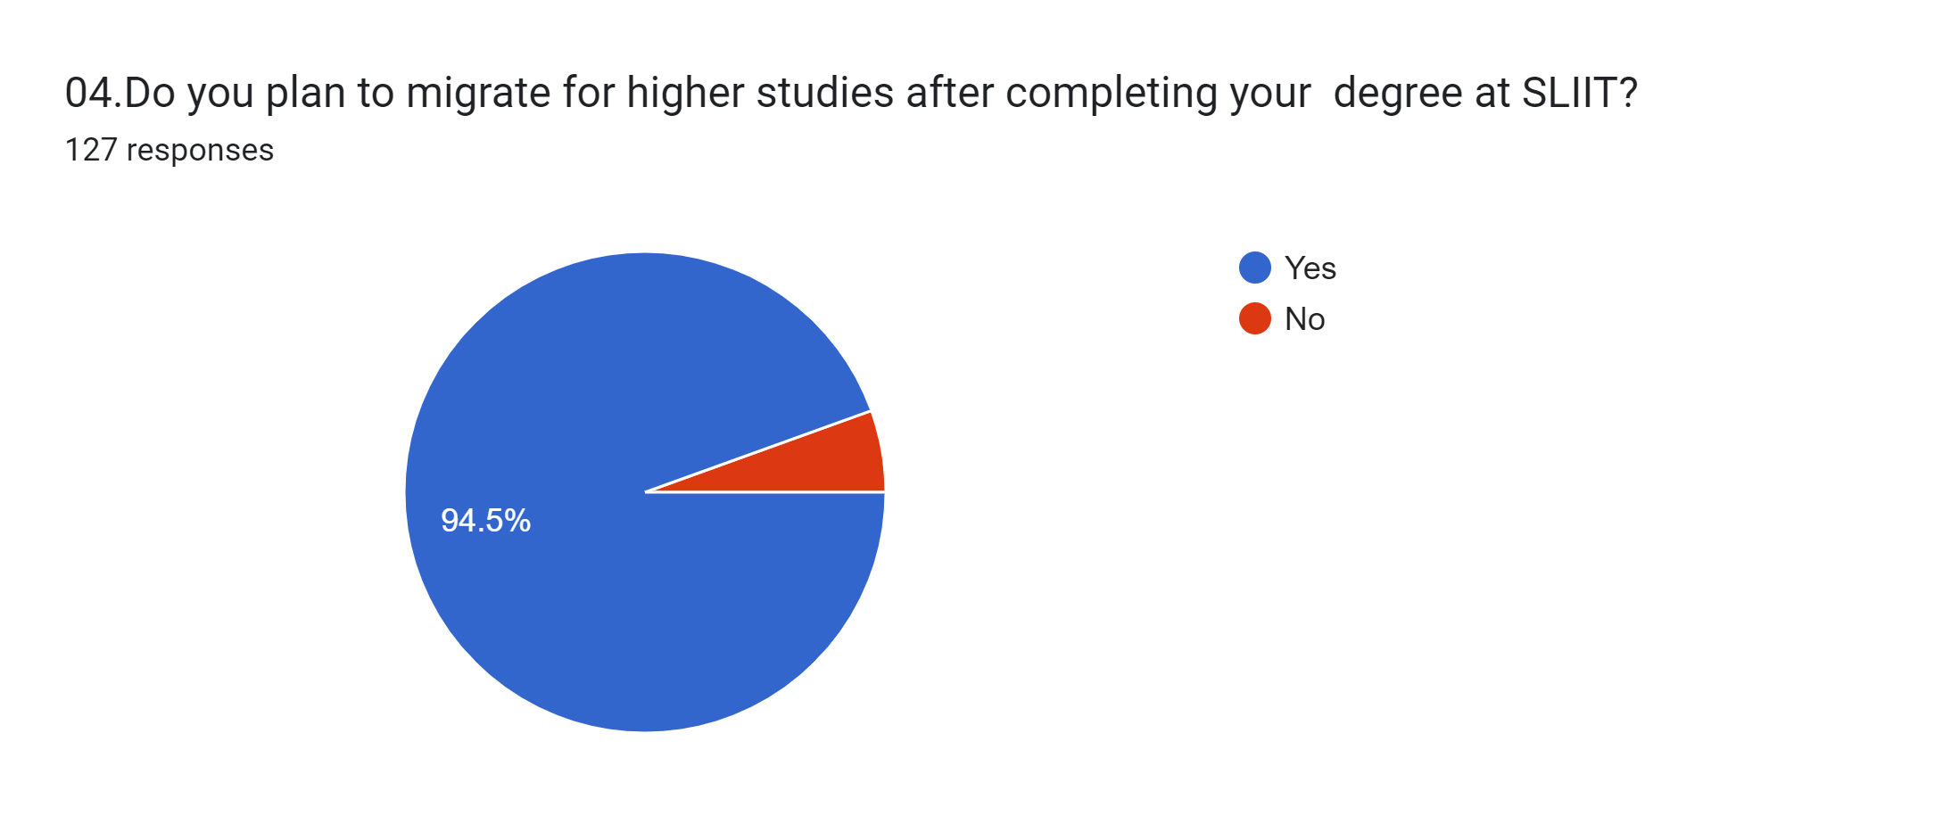
Higher education after completing
Graduation in sliit
H
Figure 03
2

Slide 8
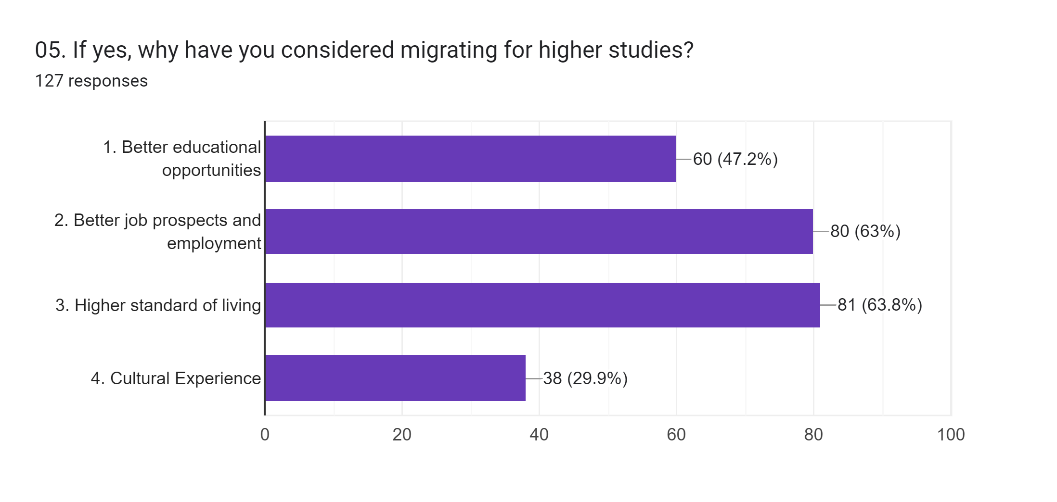
Migration for higher education
Figure 04
2

Slide 9
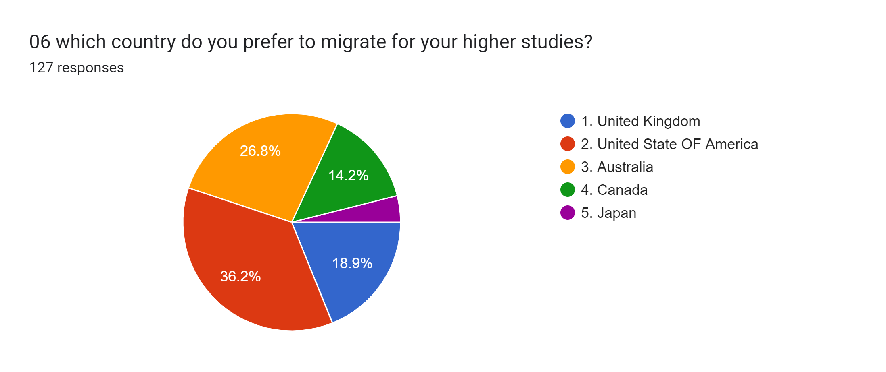
Countries to migrate higher education
Figure 05
2

Slide 10
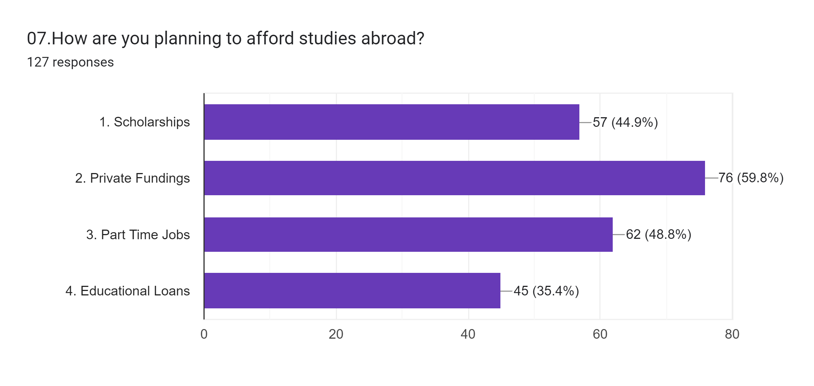
Plans to study abroad.
Figure 06
2

Slide 11
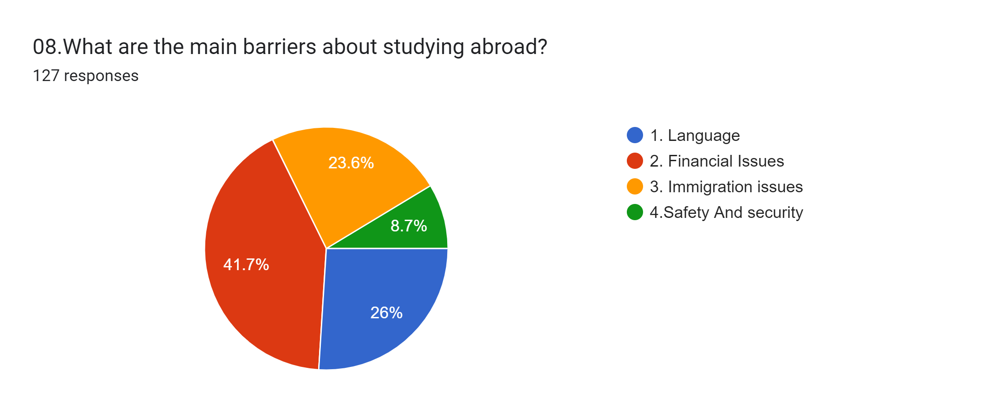
Main barriers about studying abroad.
Figure 07
2

Slide 12
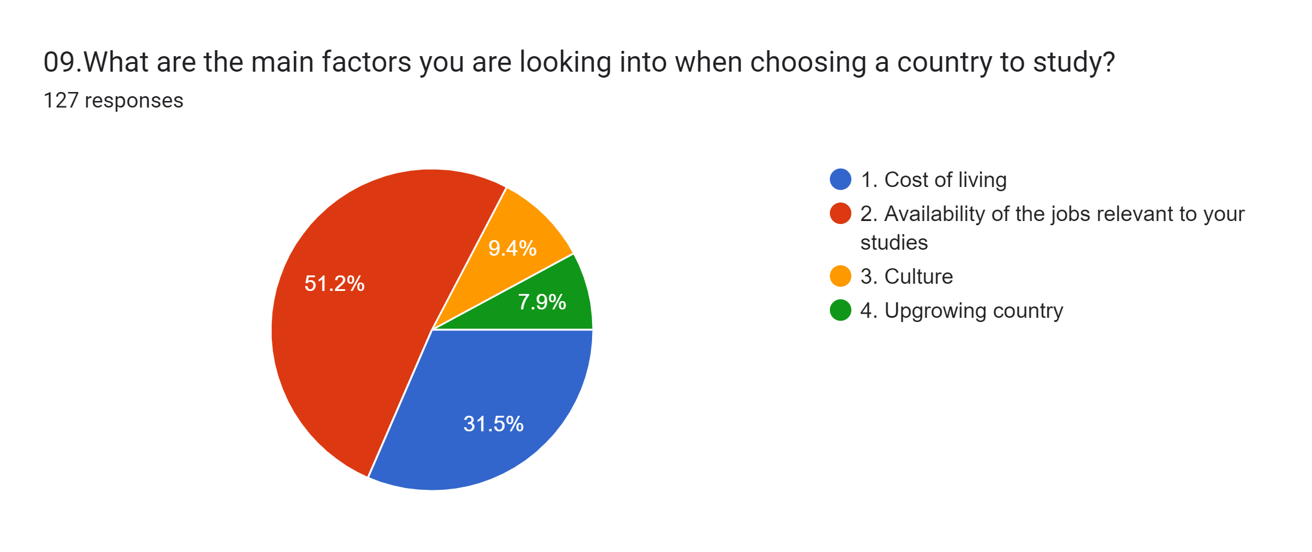
The mainfactors considered in choosing a country to study.
Figure 08
2

Slide 13
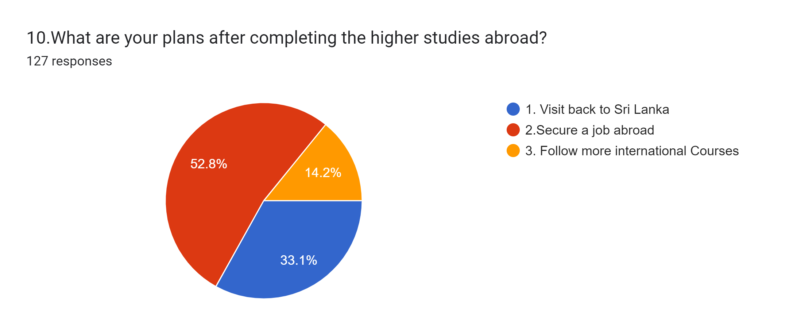
Final Plans after higher education abroad.
Figure 09
2

Slide 14
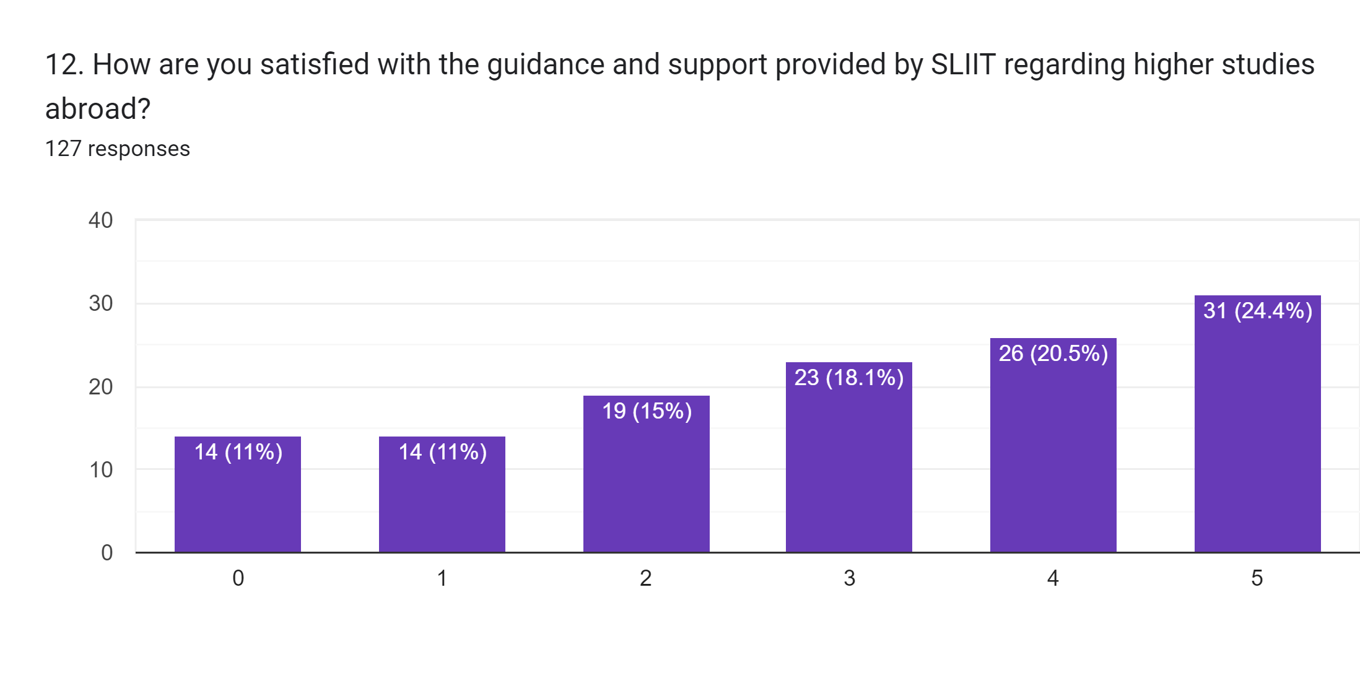
Guideance and Support from SLIIT for higher education abroad
Figure 10
2

Slide 15
The goal of stress management is to lessen the detrimental effects of stress and enhance an individual's physical and mental health.
Summary
What is higher education ?
How to higher education ?
SLIIT student’s Preferences about
SLIIT student’s stress management
2

Slide 16
The goal of stress management is to lessen the detrimental effects of stress and enhance an individual's physical and mental health.
References
Data Gathering : Google Forms
Responses :127
Undergraduates from SLIIT
Anonymous responses
Google
2

Slide 17
THANKS!
Any questions?
2

