Slide 1
Database management systems (it 2040)
Lecture 02- ER and EER to relational model mapping

Slide 2
Lecture content
Logical database design
Relational model and its components
ER to relational mapping

Slide 3
Learning outcomes
Explain the process of logical database design
Explain relational model and its components
Convert a complex ER model to the relational model

Slide 4
Logical database design
Once we finished the step of conceptual database design we next select a DBMS to implement our database design.
We then convert the conceptual database design into a database schema in the data model of the chosen DBMS.
Before 1970 most database systems were based on two older data models namely, hierarchical model and network model.
Leading DBMS products nowadays are based on the relational model which introduced by Codd in 1970.

Slide 5
The relational model
The major advantage of relational model is its simplicity in data representation.
A relational database is a collection of relations with distinct relation names.
The main construct representing data in the relational model is the relation.
A relation consists of a relational schema and a relational instance.

Slide 6
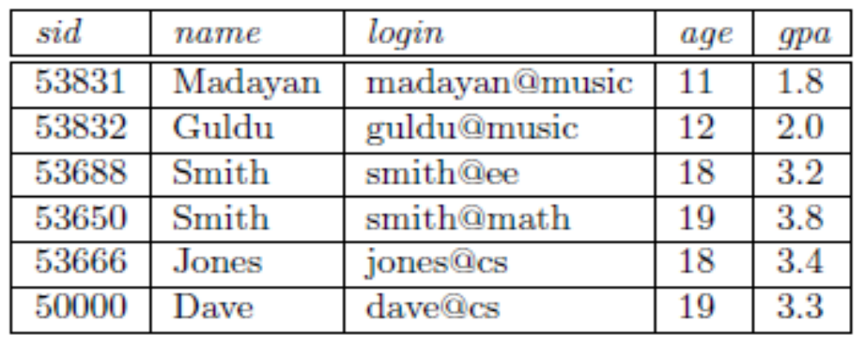
The relational model (Contd.)
The relational schema describes the columns for a relation.
  Ex: Students(sid: string, name: string, login: string, age: integer, gpa: real)
  The schema species the relation's name, the name of each field and the domain of each field.
An instance of a relation is a set of tuples, also called records, in which each tuple has the same number of fields as the relation schema.
  A relation instance can be thought of as a table in which each tuple is a row, and all rows have the same number of fields.

Slide 7
Integrity constraints
An integrity constraints (IC) is a condition specified on a database schema and restricts the data that could be stored in an instance of the database.
If a database instance satisfies all the integrity constraints specified on the database schema, it is a legal instance.
There are several types of integrity constraints
  Domain constraints
  Referential integrity constraints
  Key constraints
  Other constraints

Slide 8
Integrity constraints (Contd.)
Domain Constraint
  Domain constraint specifies that the values that appear in a column must be drawn from the domain associated with that column.
  Relational database provides data types to specify valid domains.
Key Constraint
  The minimal set of attributes that uniquely identify a tuple is called the key of a relation
  A set of fields that uniquely identifies a tuple according to a key constraint is called a candidate key for the relation; we often abbreviate this to just key.
  One of the candidate keys is designated as the primary key.

Slide 9
Integrity constraints (Contd.)
Referential integrity Constraint
  The referential integrity constraint is specified between two relations and is used to maintain the consistency among tuples in the two relations.
  Informally, the referential integrity constraint states that a tuple in one relation that refers to another relation must refer to an existing tuple in that relation.
  Foreign keys enforce referential integrity constraints
  Foreign key attributes in R1 referring to R2 have the following rules:
    The FK attributes in R₁ have the same domain(s) as the primary key attributes if R₂
    The value of FK in tuple t₁ in R₁ must reference an existing PK value in tuple t₂ of R₂
  We can diagrammatically display the foreign keys by drawing an arrow from the foreign key to the primary key

Slide 10
Integrity constraints (contd.)
Other constraints
  Table Constraints (constraints within tables)
    Example : Balance of the account should be greater than 0
    In SQL, CHECK constraint can be used
  Assertions (constraints between multiple tables)
    For example: consider the following schema
        Emp( eid, ename, salary, did)
        Department (did, dname, mgr)
    Suppose that an employee’s salary should not exceed his/her manager’s salary
    Such constraints can be using specific language features such as triggers and assertions

Slide 11
activity
In two minutes summarize the integrity constraints discussed in today’s lecture on a blank paper.
Exchange what you have written with your peer and correct the answer.
Have you understood each constraint well?

Slide 12
Mapping entities and attributes
Go through page 1 of the handout 2.
Map the entity below to relational model.
Compare what you have written with your peer.
vehicleID
model
province
Car
year
regNo
color
number

Slide 13
Mapping binary relationships
Go through page 1 of the handout 2.
Now lets map the following ER diagram to relational model
publisher
SectionNo
name
ISBN
title
1
N
belongs
Section
Copy
1
M
Headed by
Rented by
name
id
memNo
1
N
phone
Librarian
name
Member
address

Slide 14
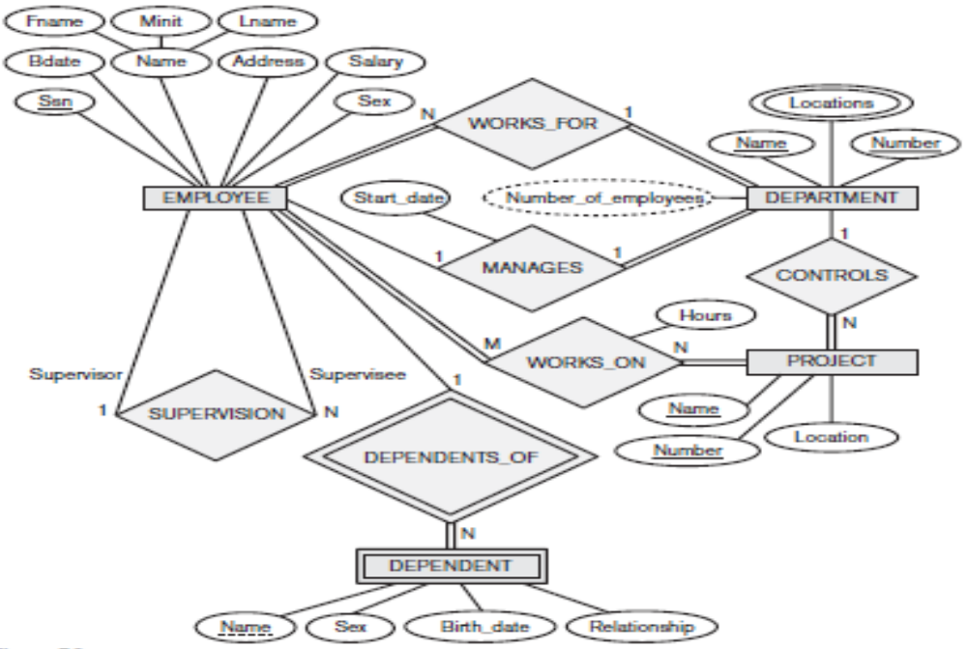
Activity
Map the ER diagram to relational model

Slide 15
Mapping n-ary relationships
N-ary relationship is mapped in to a “Relationship” relation and foreign keys
pkA
a
pkB
b
A(pKA, a) B(pKB, b)
R(pKA, pKB, pKC, pKD)
C(pKC, c) D(pKD, d)
A
B
R
C
D
pkC
c
pkd
d

Slide 16
Mapping isa-relationships
There are four different options for mapping ISA relationships.
  Multi-relation options : option 1 & option 2
  Single-relation options : option 3 & option 4
Each option is suitable for specific situations.

Slide 17
ISA mapping – option 1
Create a relation for the superclass with its attributes. Primary key of the superclass becomes the primary key of the relation.
Create separate relations for the sub classes with their attributes. Primary key of the superclass is also primary key of each subclass. They are also foreign keys referring to the primary key of the relation created for the super class.
Option 1 works for all constraints disjoint, overlapping, total and partial
name
NIC
age
Person
Person
NIC name age
ISA
Student
NIC gpa
Faculty member
NIC salary
Student
Faculty member
salary
GPA

Slide 18
ISA mapping – option 1 (Contd.)
Now think how you would store information of following people
  A person who is not a student or a faculty member(i.e when the ISA relationship is parial)
  A person who is a student but not a faculty member (i.e disjoint)
  A person who is both a student and a faculty member (i.e: overlapping classes)
Person
NIC name age
Student
NIC gpa
Faculty member
NIC salary

Slide 19
ISA mapping – option 2
Create separate relations for all the subclasses with their own attributes and the attributes of the superclass.
Primary key of the superclass becomes primary key of the subclasses.
The ISA relationship must be total (i.e. subclasses must cover the super class)
name
NIC
age
Person
ISA
Student
NIC name age gpa
Faculty member
NIC name age salary
Student
Faculty member
salary
GPA

Slide 20
ISA mapping – option 2 (Contd.)
Now think how you would store information of following people
  A person who is not a student or a faculty member(i.e when the ISA relationship is parial)
  A person who is a student but not a faculty member (i.e disjoint)
  A person who is both a student and a faculty member (i.e: overlapping classes)
Student
NIC name age gpa
Faculty member
NIC name age salary

Slide 21
ISA mapping – option 3
name
NIC
age
Create a single relation including attributes of the superclass as well as attributes of all sub classes.
Include an attribute named type for specifying which subclass the entity belongs if any.
Primary key of the superclass becomes primary key of the relation.
The specialization/generalization relationship must be disjoint
Good if subclasses have few attributes
Person
ISA
Person
NIC name age gpa salary type
Student
Faculty member
salary
GPA

Slide 22
ISA mapping – option 3 (Contd.)
Now think how you would store information of following people
  A person who is not a student or a faculty member(i.e when the ISA relationship is parial)
  A person who is a student but not a faculty member (i.e disjoint)
  A person who is both a student and a faculty member (i.e: overlapping classes)
Person
NIC name age gpa salary type

Slide 23
ISA mapping – option 4
name
Create a single relation including attributes of the superclass as well as attributes of all sub classes.
Include a Boolean attribute to indicate which subclass each tuple belongs to
Primary key of the superclass becomes primary key of the relation.
This relation allows overlapping constraints for specialization/generalization relationship
NIC
age
Person
Person
NIC name age gpa salary student faculty
ISA
Boolean attributes
Student
Faculty member
salary
GPA

Slide 24
ISA mapping – option 4 (Contd.)
Now think how you would store information of following people
  A person who is not a student or a faculty member(i.e when the ISA relationship is parial)
  A person who is a student but not a faculty member (i.e disjoint)
  A person who is both a student and a faculty member (i.e: overlapping classes)
Person
NIC name age gpa salary student faculty

Slide 25
activity
Fill the table below indicating the which constraints work with which option.
 | Overlapping | Disjoint | Total | Partial
Option 1
Option 2
Option 3
Option 4

Slide 26
Mapping aggregation relationships
Aggregation mapping could be performed in two steps.
  Step 1: First map the aggregation relationship R.
  Step 2 :To map relationship set involving aggregation of R, treat the aggregation like an entity set whose primary key is the primary key of the table for R

Slide 27
Mapping aggregation relationships (contd.)
Step 1: First map the aggregation relationship R.
Player (pId, name)
Match (matchId, venue)
Play (pId, matchId)
  Step 2 :To map relationship set involving aggregation of R, treat the aggregation like an entity set whose primary key is the primary key of the table for R.
    Table for aggregation is ‘Play’. Thus, the relationship win should be mapped considering 1:N relationship between play (primary key : pId,matchId) and award,
    Award (awardName, pId, matchId)
pId
name
matchId
venue
M
play
N
Player
Match
1
win
awardName
N
Award

Slide 28
Mapping aggregation relationships (contd.)
Map the following EER diagram to relational model.
eid
ename
Employee
N
monitor
1
dname
1
sponsors
N
pid
Department
Project
did
budget

Slide 29
What you have to do by next week
Try out the self-test questions on the course web.
Complete the tutorial.
Complete the lab sheet

