Slide 1
IT2070 – Data Structures and Algorithms
Introduction

Slide 2
Subject Group
Chaumika Ragunathan
Chaumika Ragunathan
Theevika Arumaiththurai
Malabe Campus
Dr. Dinuka R. Wijendra – LIC
Dr. Nathali Silva
Ms. Jenny Krishara
Metro Campus
Ms. Poorna Panduwawela
Kandy Center
Ms. Chaumika Ragunathan
Matara Center
Mr. Ravi Supunya
Jaffna Center
Ms. Theevika Arumaiththurai

Slide 3
Teaching Methods
  Lectures – 2 hours/week
  Tutorials – 2 hour/week (WD)
  Labs – 2 hours /week

Slide 4
Student Evaluation
Assessments (Two exams) - 40 %
Final Examination - 60 %

Slide 5
Lectures will cover
Data Structures
  Stack data structure
  Queue data structure
  Linked list data structure
  Tree data structure
  Algorithms
  - Asymptotic Notations
  - Algorithm designing techniques
  - Searching and Sorting algorithms

Slide 6
Tutorials and Labs will cover
-Solve problems using the knowledge acquired in the lecture
-Get hands on experience in writing programs
- Java
- Python

Slide 7
Data Structures and Algorithms
Data Structures
- Data structure is an arrangement of data in a computer’s memory or sometimes on a disk.
Ex: stacks, queues, linked lists, trees
Algorithms
- Algorithms manipulate the data in these structures in various ways.
Ex: searching and sorting algorithms

Slide 8
Data Structures and Algorithms
Usage of data structures
  Real world data storage
  Real world modeling
  - queue, can model customers waiting in line
  - graphs, can represent airline routes between cities
  Programmers Tools
    - stacks, queues are used to facilitate some other operations

Slide 9
Data Structures and Algorithms
Algorithms
Algorithm is a well defined computational procedure that takes some value or set of values as input and produce some value or set of values as output.
An algorithm should be
- correct.
- unambiguous.
- give the correct solution for all cases.
- simple.
- terminate.

Slide 10
Academic Integrity Policy
Are you aware that following are not accepted in SLIIT???
Plagiarism - using work and ideas of other individuals intentionally or unintentionally
Collusion - preparing individual assignments together and submitting similar work for assessment.
Cheating - obtaining or giving assistance during the course of an examination or assessment without approval
Falsification – providing fabricated information or making use of such materials
From year 2018 the committing above offenses come with serious consequences !
See General support section of Courseweb for full information.

Slide 11
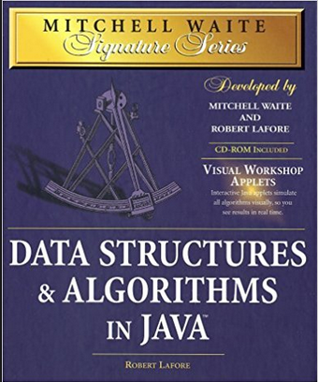
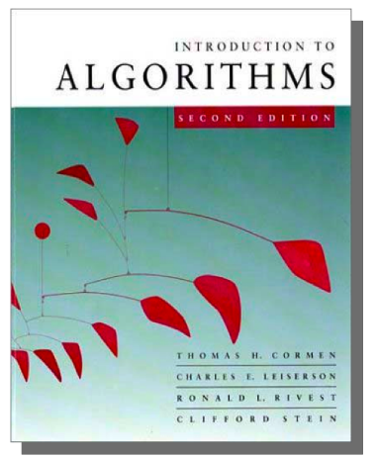
References
Mitchell Waite,Robert Lafore, Data Structures and Algorithms in Java,2nd Edition, Waite Group Press,1998.
T.H. Cormen, C.E. Leiserson, R.L. Rivest, Introduction to Algorithms,3rd Edition, MIT Press, 2009.

Slide 12
IT2070 – Data Structures and Algorithms
Lecture 01
Introduction to Stack

Slide 13

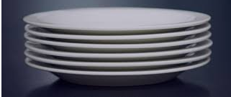
Stack
Allows access to only one data item; the last item inserted
If you remove this item, then you can access the next-to-last item inserted

Slide 14
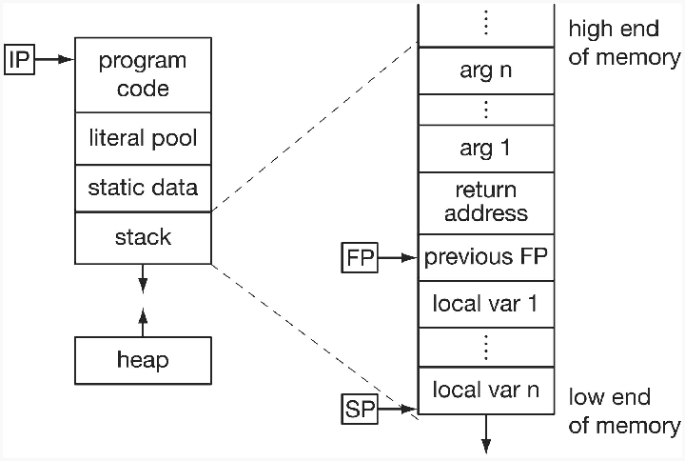
Application of Stacks
String Reverse
Page visited history in Web browser.
Undo sequence of text editor.
Recursive function calling.
Auxiliary data structure for Algorithms.
Stack in memory for a process

Slide 15


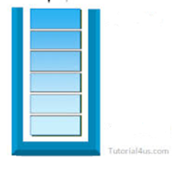
Stack
Top
In a stack all insertions and deletions are made at one end (Top). Insertions and deletions are restricted from the Middle and at the End of a Stack
Adding an item is called Push
Removing an item is called Pop
Elements are removed from a Stack in the reverse order of that in which the elements
were inserted into the Stack
The elements are inserted and removed according to the Last-In-First-Out (LIFO) principle.

Slide 16
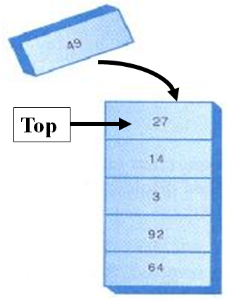
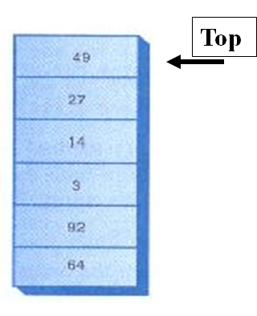
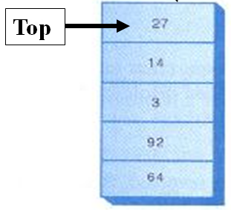
Stack - Push
Push item 49
Before inserting
Item 49 is inserted on top
After inserting

Slide 17

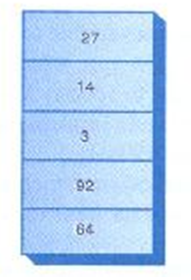
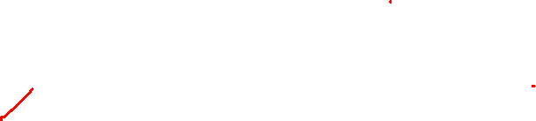
Stack - Pop
Pop
Before removing
Top item is removed
After removing

Slide 18
Stack - Peek
49
Peek
Stack remains the same
Peek is used to read the value from the top of the stack without removing it. You can peek only the Top item, all the other items are invisible to the stack user.

Slide 19
Question
Draw the stack frame after performing the below operations to the stack given below.
25
300
Top
Maximum size of
this stack is 4
Push item 50
Push item 500
Peek
Push item 100
Pop
Pop
Pop
Pop

Slide 20
Uses of Stack
The stack operations are built into the microprocessor.
When a method is called, its return address and arguments are pushed onto a stack, and when it returns they’re popped off.

Slide 21
Stack - Implementation
Stack implementation using an array
class StackX {
private int maxSize; // size of stack array
private double[] stackArray;
private int top; //top of the stack
public StackX(int s) { // constructor
maxSize = s; // set array size
stackArray = new double[maxSize];
top = -1; // no items
}
…………………….
…………………….
}
Constructor creates a new stack
of a size specified in its argument.
Variable top, which stores the
index of the item on the top of the
stack.

Slide 22
Stack – Implementation - push
class StackX{
private int maxSize; // size of stack array
private double[] stackArray;
private int top; //top of the stack
publc StackX(int s) { // constructor
maxSize = s; // set array size
stackArray = new double[maxSize];
top = -1; // no items
}
public void push(double j) {
// increment top
// insert item
}

Slide 23
Stack – Implementation - push
class StackX {
private int maxSize; // size of stack array
private double[] stackArray;
private int top; //top of the stack
publc StackX(int s) {// constructor
maxSize = s; // set array size
stackArray = new double[maxSize];
top = -1; // no items
}
public void push(double j) {
// increment top. insert item
stackArray[++top] = j;
}
What if the stack is full ?

Slide 24
Stack – Implementation - push
class StackX
{
private int maxSize; // size of stack array
private double[] stackArray;
private int top; //top of the stack
public StackX(int s) {// constructor
maxSize = s; // set array size
stackArray = new double[maxSize];
top = -1; // no items
}
public void push(double j) {
// check whether stack is full
if (top == maxSize – 1)
System.out.println(“Stack is full”);
else
stackArray[++top] = j;
}

Slide 25

Stack – Implementation – pop/peek
class StackX
{
private int maxSize; // size of stack array
private double[] stackArray;
private int top; //top of the stack
public StackX(int s) {// constructor
maxSize = s; // set array size
stackArray = new double[maxSize];
top = -1; // no items
}
public void push(double j) {
// check whether stack is full
if (top == maxSize – 1)
System.out.println(“Stack is full”);
else
stackArray[++top] = j;
}
public double pop() {
// check whether stack is empty
// if not
// access item and decrement top
}
public double peek() {
// check whether stack is empty
// if not
// access item
}

Slide 26
Stack – Implementation – pop/peek
class StackX {
private int maxSize; // size of stack array
private double[] stackArray;
private int top; //top of the stack
public StackX(int s) { // constructor
maxSize = s; // set array size
stackArray = new double[maxSize];
top = -1; // no items
}
public void push(double j) {
// check whether stack is full
if (top == maxSize – 1)
System.out.println(“Stack is full”);
else
stackArray[++top] = j;
}
public double pop() {
if (top == -1)
return -99;
else
return stackArray[top--];
}
public double peek() {
if (top == -1)
return -99;
else
return stackArray[top];
}

Slide 27
Question
isEmpty() method returns true if the stack is empty and isFull() method return true if the
Stack is full.
Implement isEmpty() and isFull() methods of the stack class.

Slide 28
Creating a stack
Question
Using the implemented StackX class, Write a program to create a stack with
maximum size 10 and insert the following items to the stack.
80 100 25
Delete all the items from the stack and display the deleted items.

Slide 29
Creating a stack
class StackApp {
public static void main(String[] args) {
StackX theStack = new StackX(10); // create a stack with max size 10
theStack.push(30); // insert given items
theStack.push(80);
theStack.push(100);
theStack.push(25);
while( !theStack.isEmpty() ) { // until it is empty, delete item from stack
double val = theStack.pop();
System.out.print(val);
System.out.print(“ “);
}
}
} // end of class

Slide 30
References
Mitchell Waite,Robert Lafore, Data Structures and Algorithms in Java,2nd Edition, Waite Group Press,1998.

