Slide 1

01
Fish 6004 Lab
Welcome!
Lab instructor: Andrea Perreault (she/her)
andrea.perreault@mi.mun.ca

Slide 2
02
Quick intro:
name/supervisor/research topic/ anything else you want to add

Slide 3
General Lab Format
9-915ish: Group chat - thoughts on the previous lecture. This is the space to let me know if there's anything you'd like to know more about or a topic that needs clarification. I'll try and bring relevant answers/docs to the next lab!
915ish - 1130: Lab work - there will be a new folder in the github folder "Lab xx" with a pdf "Lab xx.pdf" that will describe the task for the day
03

Slide 4
04
Thoughts/questions/comments?

Slide 5

LAB 1
05
1) Group chat: thoughts on first lecture?
2) A bit different today, quick intro to github desktop

Slide 6
06
Lecture 1 chat!

Slide 7
First, a few definitions
07
Version control: the task of keeping a software system consisting of many versions and configurations well organized
Git: software for tracking changes in any set of files
Github: a cloud-based hosting service that lets you manage Git repositories
Github Desktop: a more user-friendly interface than the basic git command shell (we'll be using this!)

Slide 8
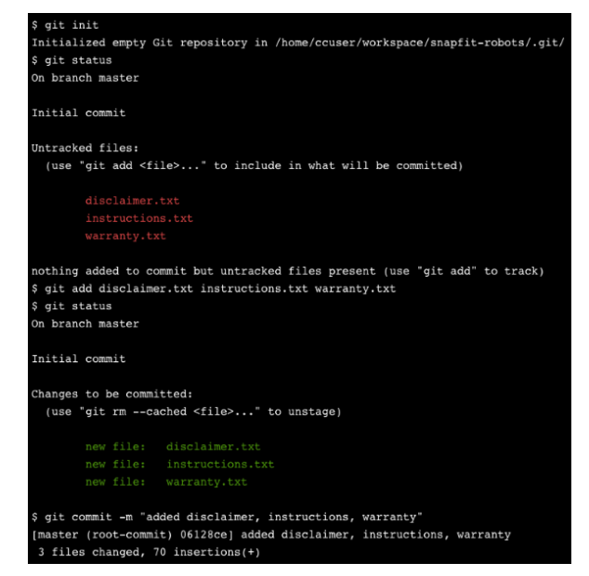
Why github Desktop?
08
git command shell can be a bit daunting for non-programmers
github Desktop prompts your workflow; really great to help avoid errors
no pressure to use github Desktop if you're familiar with the command shell - the end result will be the same!

Slide 9
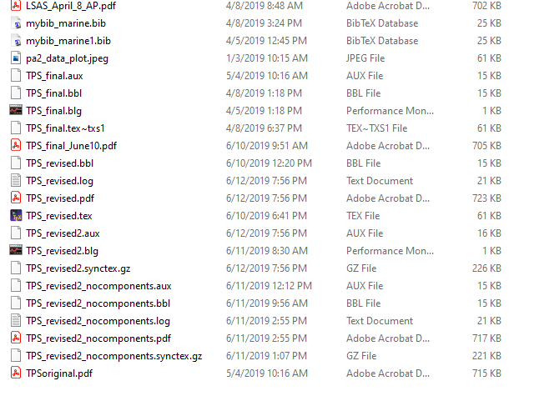
Why use version control?
Accidentally adding edits to an old version of a paper/code is annoying and often a waste of time
Even harder to keep track of when multiple people are working on the same document
Sometimes want to explore effect of small change in code on output, but accidentally break everything and can't get original model to run again (this has happened to me more times than I'd like to admit!!)
Actual footage from my Master's degree 2019
09

Slide 10
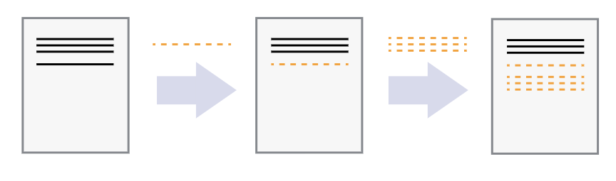
Version control: the task of keeping a software system consisting of many versions and configurations well organized
10

Slide 11
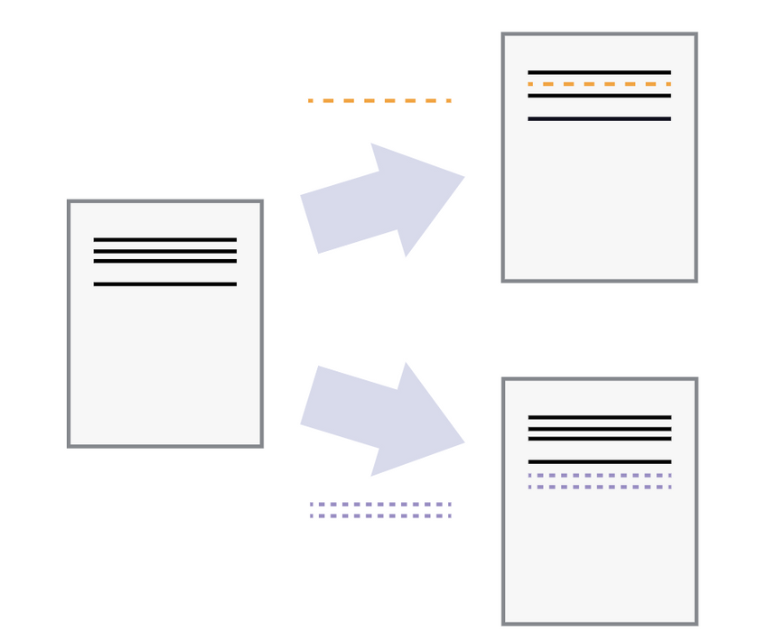
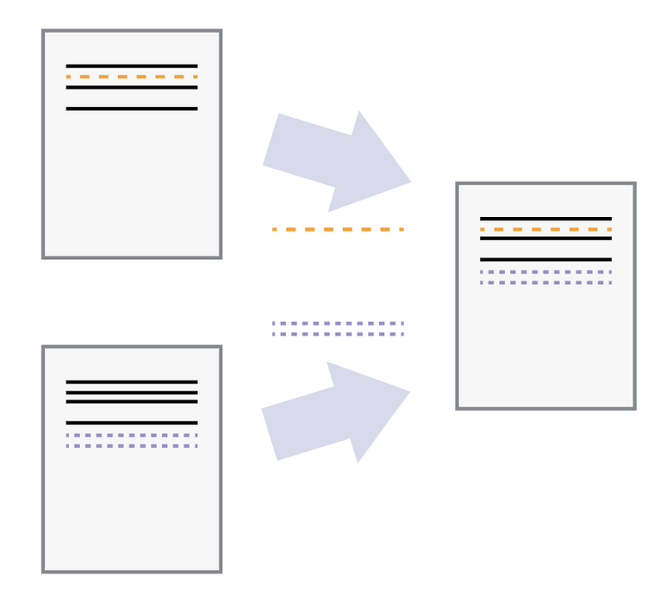
Version control: the task of keeping a software system consisting of many versions and configurations well organized
11

Slide 12
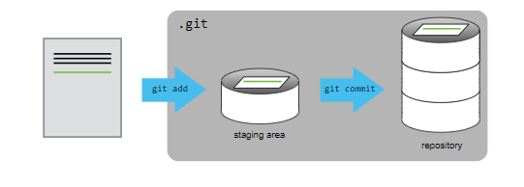
More formally:
1) Set up a repository (i.e. tell the computer that we want to track changes in this folder)
2) Set up a .gitignore file (often there are files we don't want to track changes for, e.g. saved figures from R output that will change often as we update code) and a README file (both optional, but I recommend)
3) add files, initially they're in the staging area and untracked
4) when you're happy with them,
commit them and they'll be moved
to the repository (aka tracked)
12

Slide 13
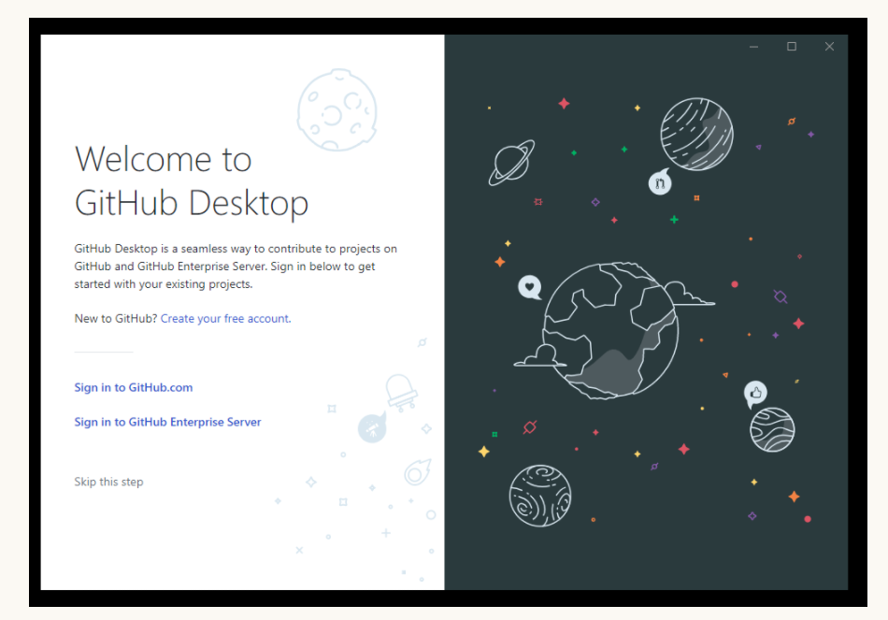
Let's walk through an example together!
13

Slide 14
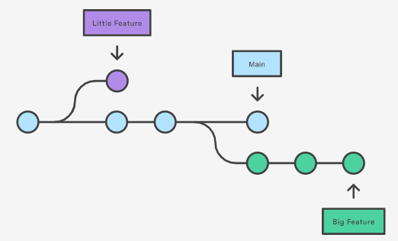
Branching
14
A branch is super useful to explore/test/develop since changes in the branch don’t affect the main file

Slide 15
Git desktop + Github
15
1) Upload your local repository to github (called the remote repository) using publish repository
2) Use fetch to connect to your local repo and pull to make sure your local repo is up to date with the remote repo
3) Push your local changes to remote repo

Slide 16
Collaboration
16
clone - creates a local copy, or clone, of a repo. Your local repo must stay in-sync with the remote repo. Repo owner approves all changes through pull requests.
fork- creates a local and remote copy of a repo. You become the owner of the forked repo, but it remains linked to the original repo.
import - creates a local and remote copy of a repo that is un-linked from the original.

Slide 17

Rstudio and Git
17
Rstudio makes it incredibly easy to implement version control!
1) Create a new project and check the "create a git repository" box
2) Close Rstudio and re-open; you should now have a git tab in the right
hand panel
3) You can directly track changes (e.g push/pull) in the R studio console or
you can add the repo to your git Desktop and manage it from there

Slide 18
Final note!
18
I glossed over a lot of details - but we can expand on this closer to the end of the semester when we're more familiar with git and will be collaborating on projects!
Highly recommend checking out the tutorials below, especially the sections on conflicts and history.
Git command shell tutorial: http://swcarpentry.github.io/git-novice/
Git desktop tutorial: https://joshuadull.github.io/GitHub-Desktop/

