Slide 1
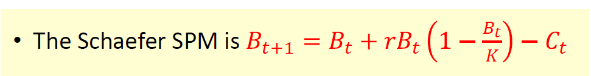


Slide 2
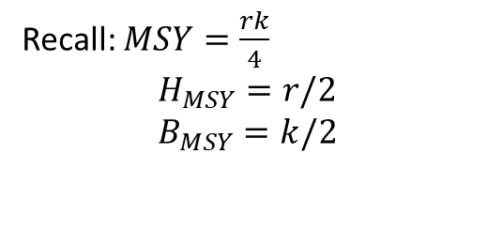

Surplus production model (observation error)
Process equations
$$B_{y+1}=\left\{B_{y}+{rB}_{y}(1−\frac{B_{y}}{k})−C_{y}\right\}$$
Observation equations
$${\hat{I}}_{y}=qB_{y}\exp{ε_{y}}$$
Recall: $MSY=\frac{rk}{4}$
$$H_{MSY}=r/2$$
$$B_{MSY}=k/2$$

Slide 3
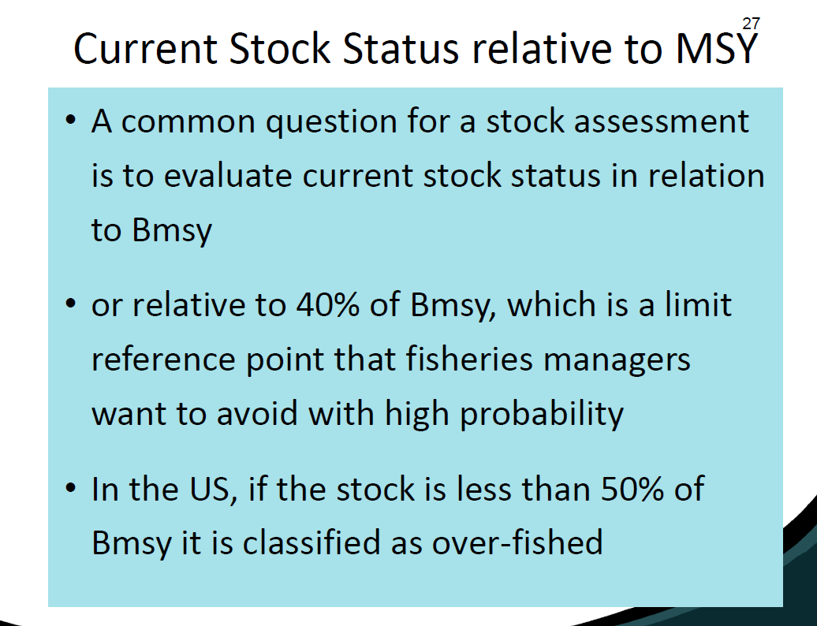

Slide 4
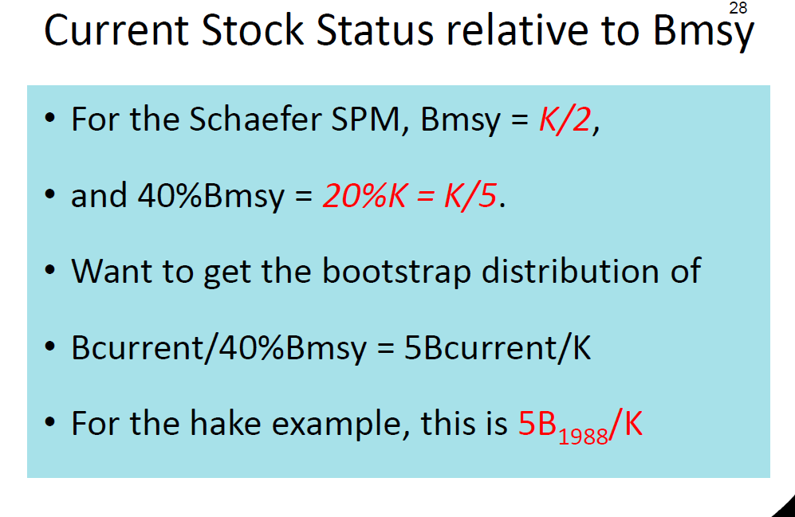

Slide 5
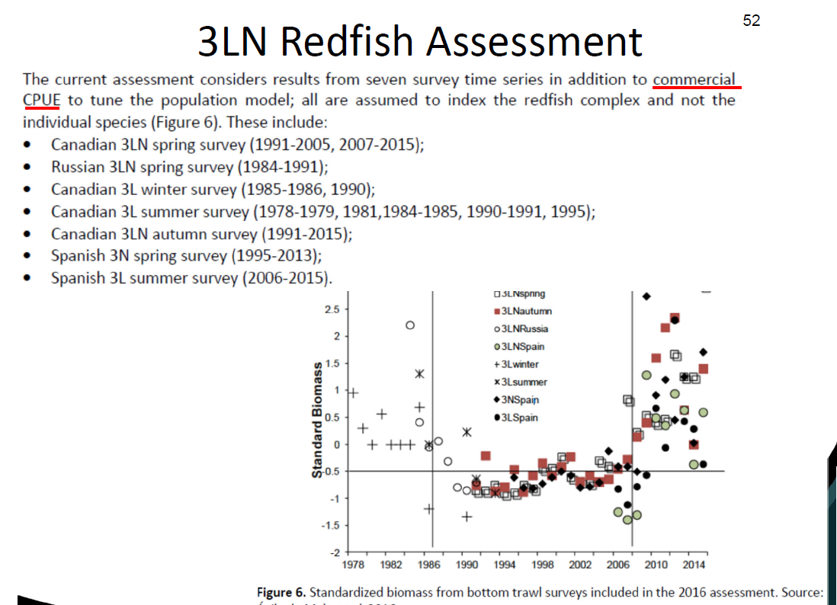

Slide 6
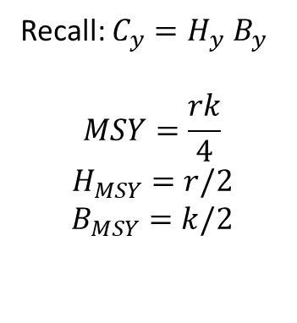

Surplus production model (observation error)
Process equations
$$B_{y+1}=\left\{B_{y}+{rB}_{y}(1−\frac{B_{y}}{k})−C_{y}\right\}$$
Observation equations
$${\hat{I}}_{CPUE,y}=q_{8}B_{y}\exp{ε_{y}}$$
${\hat{I}}_{3LFall,y}=q_{1}B_{y}\exp{ε_{y}}$…
Recall: $C_{y}=H_{y}$ $B_{y}$
$$MSY=\frac{rk}{4}$$
$$H_{MSY}=r/2$$
$$B_{MSY}=k/2$$

Slide 7
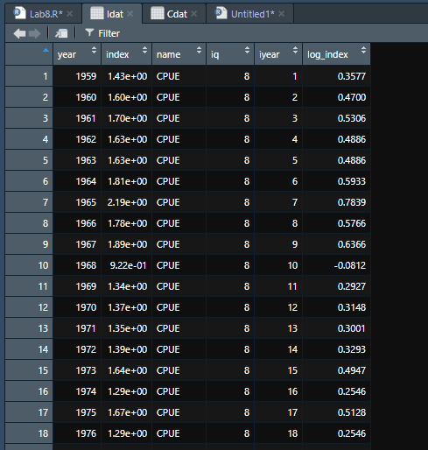
Surplus production model (observation error)
Process equations
$$B_{y+1}=\left\{B_{y}+{rB}_{y}(1−\frac{B_{y}}{k})−C_{y}\right\}$$
Observation equations
$${\hat{I}}_{CPUE,y}=q_{8}B_{y}\exp{ε_{y}}$$
${\hat{I}}_{3LFall,y}=q_{1}B_{y}\exp{ε_{y}}$…

Slide 8
