Slide 1

EDA on Olist Dataset
UP School Data Analysis
Capstone Project
Sinem Mutlu

Slide 2
Agenda
01
04
AIM OF THE PROJECT
FUTURE WORK
02
INTRO & DATASET
03
EXPLORATORY DATA ANALYSIS & VISUALIZATIONS

Slide 3

Aim of The Project
Analysis on e-commerce data
Get maximum insights from the data set
Understanding data with various visualizations
Discovering behavior of different customers

Slide 4

Intro & Dataset
Olist company
Brazilian e-commerce public dataset
Includes ~100k orders from 2016-09-04 to 2018-10-17
Contains informations about orders,
products purchased, customer and reviews

Slide 5


Slide 6
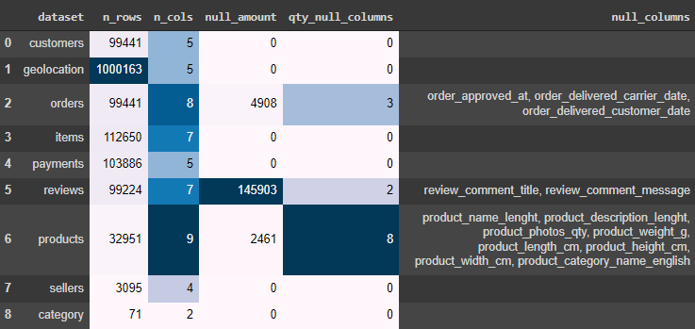
Null Values in Dataset

Slide 7
Customers
customer id: each order has a unique customer_id.
customer unique id: unique identifier of a customer.
customer zip code
customer city
customer state
non-null

Slide 8

Summary information about the customers
Customer
Id 99.441
Customer
Unıque Id 96.096
Customer
City 4.119
Customer
State 27

Slide 9
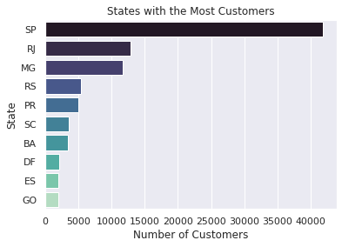
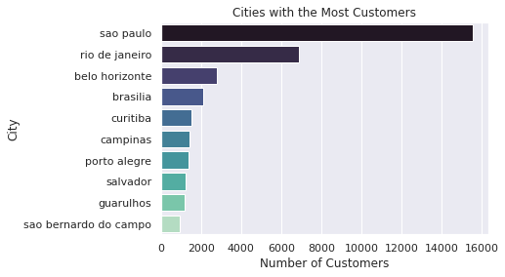
Customer numbers in cities and states
A customer has a customer_id per order, whereas he gets only one customer_unique_id in the database.
41.98 %

Slide 10
Sellers
seller id
seller zip code
seller city
seller state
non-null

Slide 11

Summary information about sellers
Unique
Seller 3.095
Seller
State 23
Seller
City 621

Slide 12
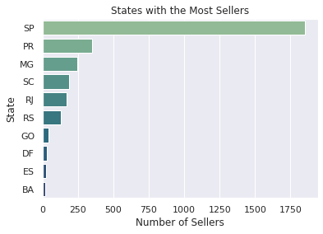
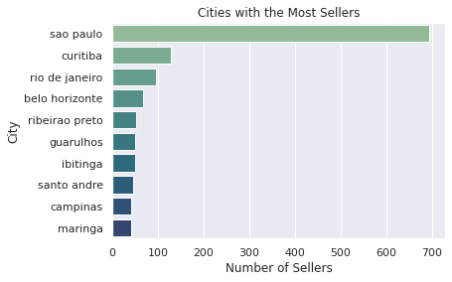
Seller numbers in cities and states

Slide 13
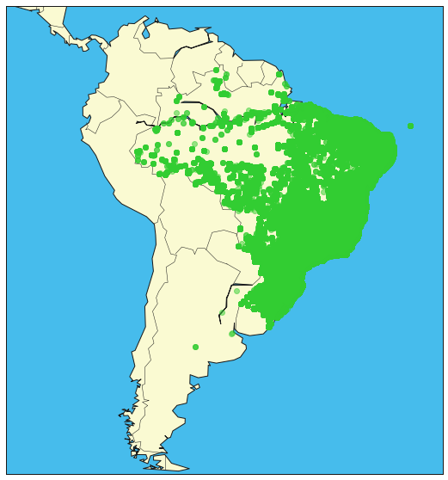

Slide 14
Reviews
review id
order id
review score
review comment title 87.656 null values
review comment message 58.247 null values
review creation date
review answer timestamp

Slide 15

Summary information about reviews
Review Comment Message
0.5870253 %
Review Comment Title
0.8834153 %
Delivered Orders without
Review Message
99.4179957 %
Mean of Review Scores
4.0864

Slide 16
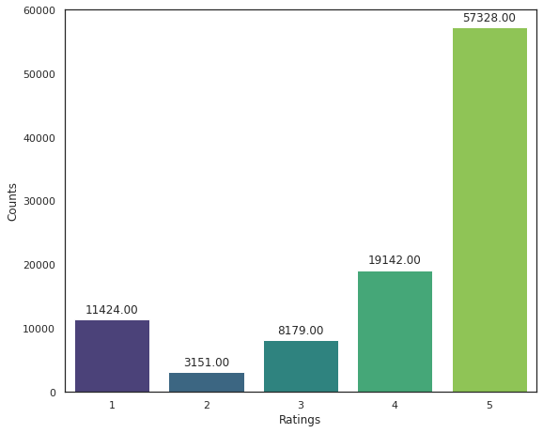
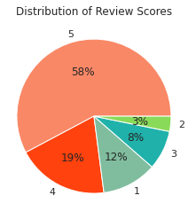
Distribution of Review Scores
Total: 99.224 reviews

Slide 17
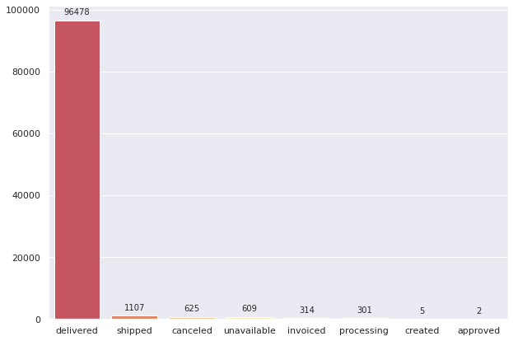
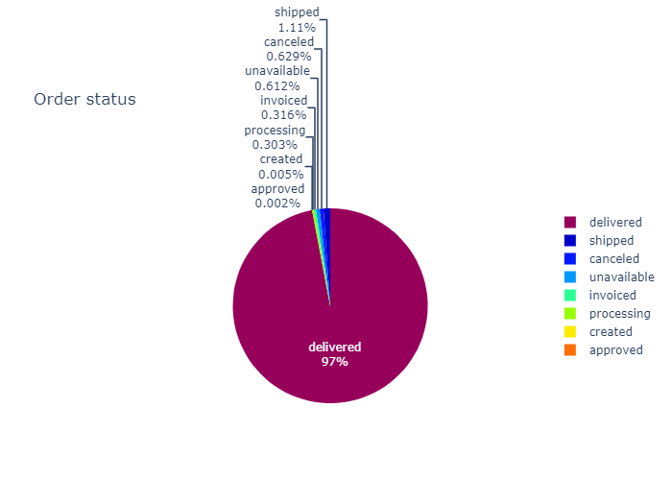
Distribution of Order Status

Slide 18
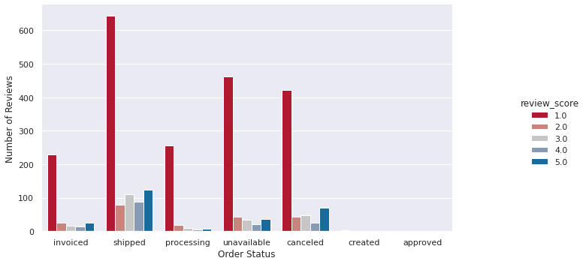
Effect of Order Status on Review Score

Slide 19
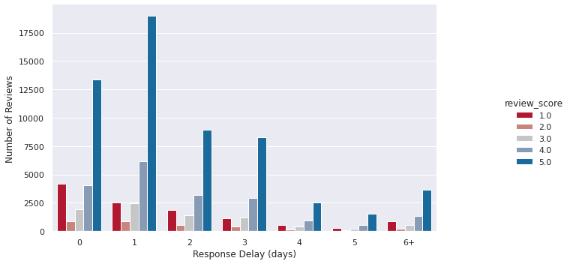
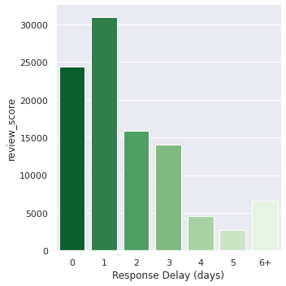
Response Delay and Review Score

Slide 20
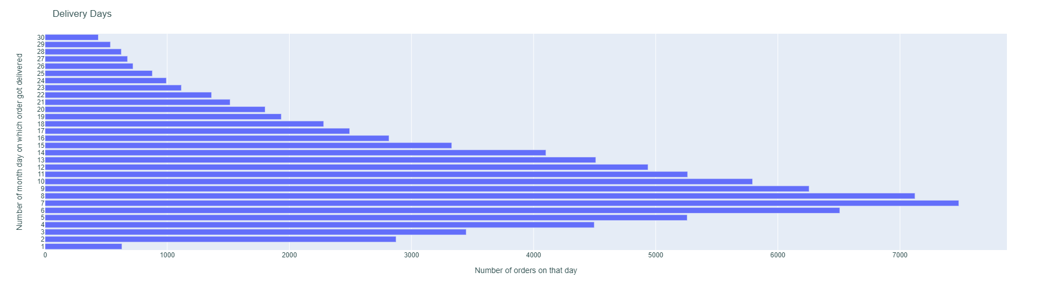
Delivery Time Distribution (1st 30 days)
72,409 % of orders were delivered in the first 15 days.

Slide 21

Delay Time and Review Score
Delay Time
1 day
<5 days
>5 days
>10 days
>20 days
Review Score
4.0333075135
3.4606584821
1.7881952878
1.7004895416
1.7570093457

Slide 22
Order Items
order id
order item id
product id
seller id
shipping limit date
price
freight value
non-null

Slide 23

Summary information about order items
Mean of Price Column
120.653739
Mean of Revenue Column
136.686539
Mean of Freight Value
19.990320

Slide 24


Slide 25
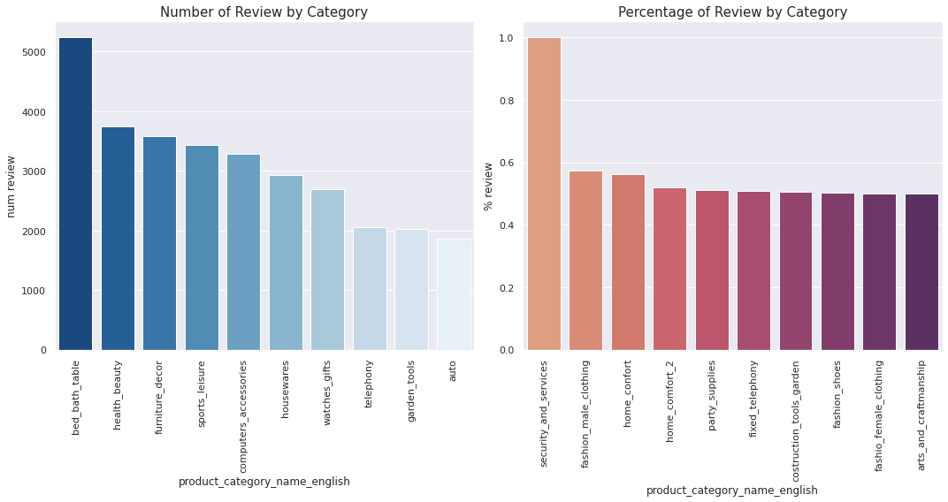
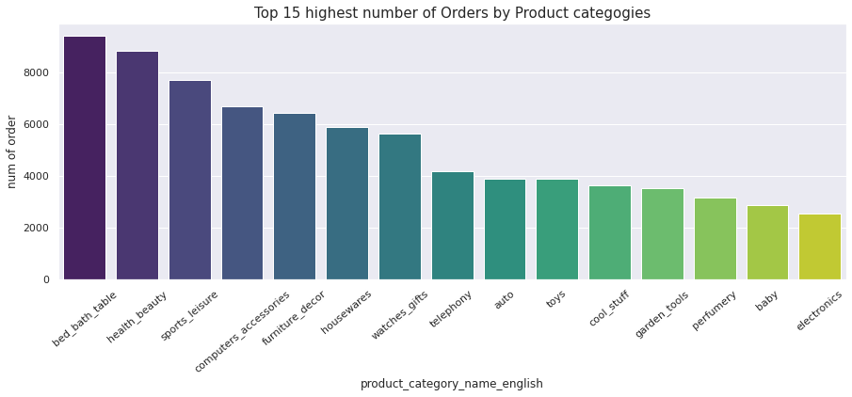

Slide 26
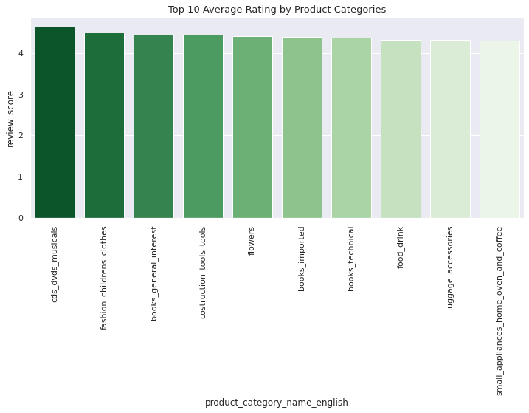
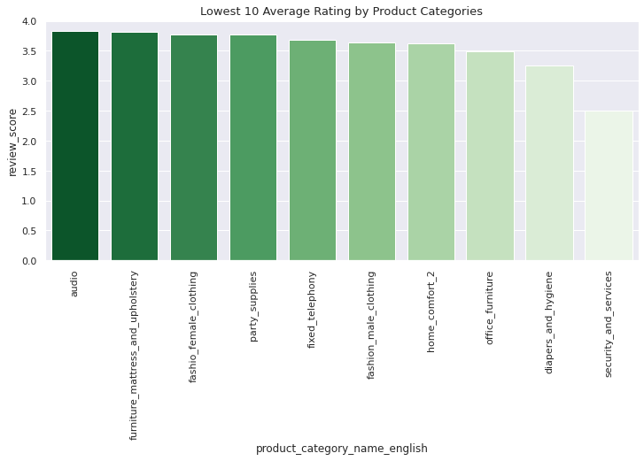
Avg Scores of Top and Lowest 10 Category

Slide 27
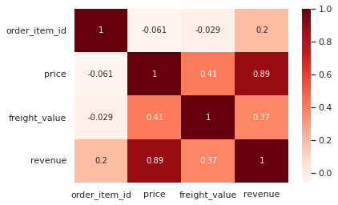
Correlation Matrix of Order Items

Slide 28
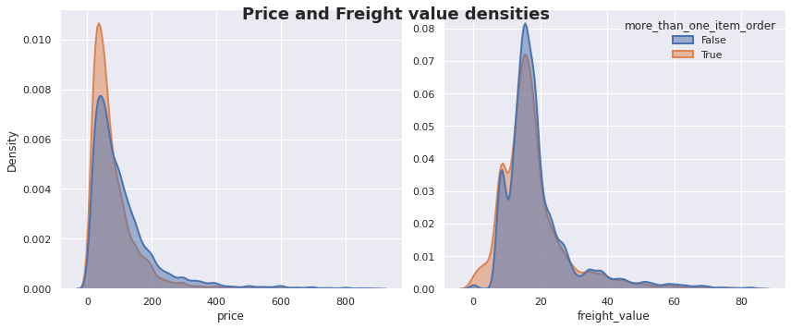

Slide 29
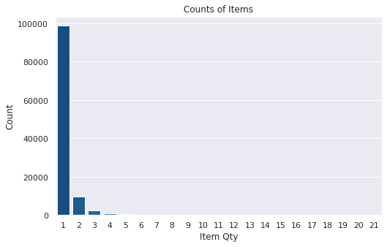
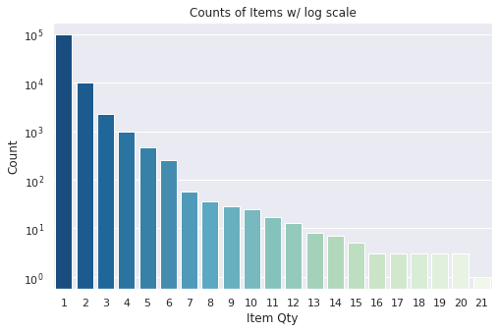
Frequency Distribution of Order Quantity

Slide 30
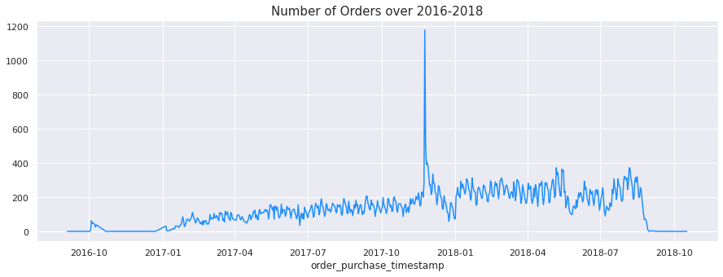
Numbers of Orders

Slide 31

Products
product id
product name length
product description length
product photos qty
product weight g
product length cm
product height cm
product width cm
product category name english

Slide 32
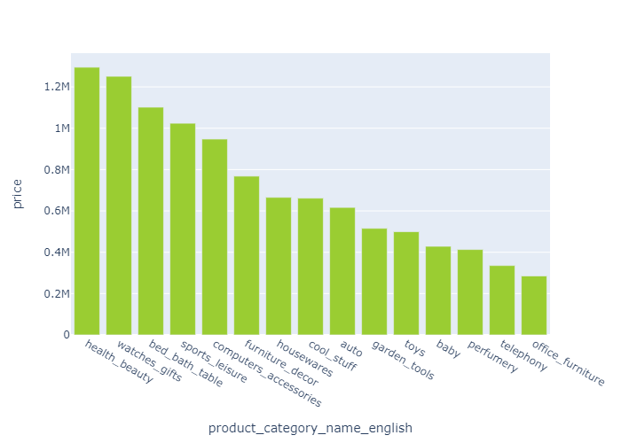
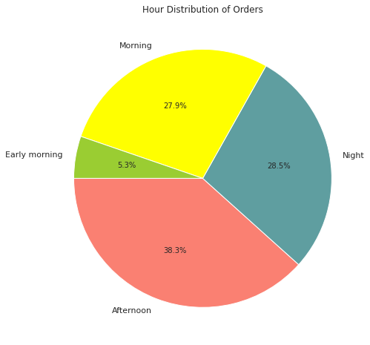
Categories with the Most Revenue

Slide 33
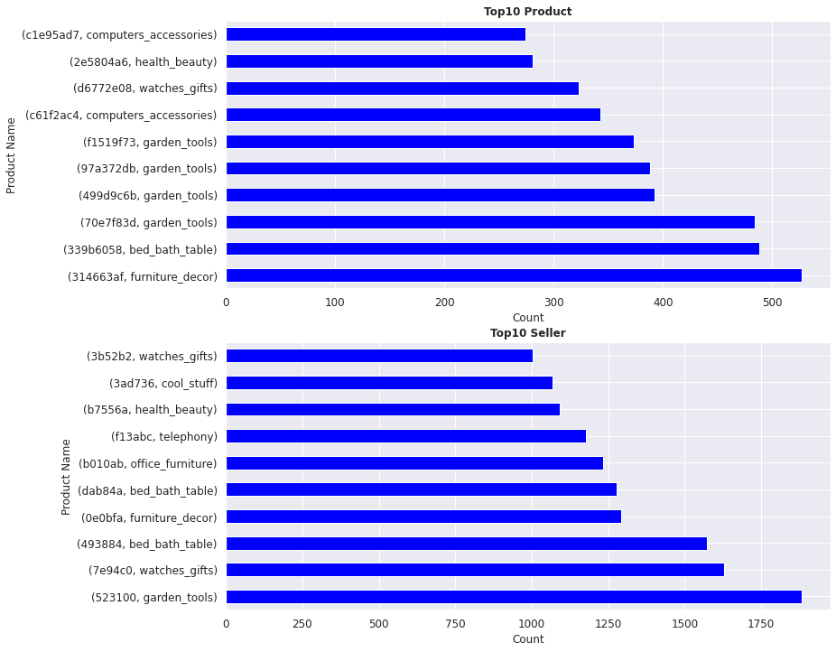
TOP 10 Products, Categories and Sellers

Slide 34
TOP 10 Products, Categories and Sellers

Slide 35

*revenue of first 9 months (until October)
Revenue in 2017*
3737.402010
Revenue in 2018*
7386.050800
Yearly Growth
97.625270 %

Slide 36
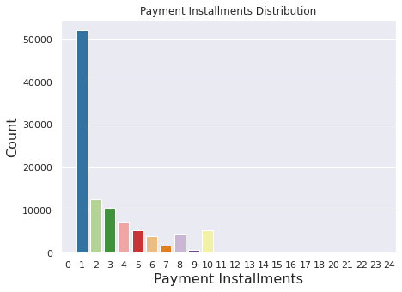
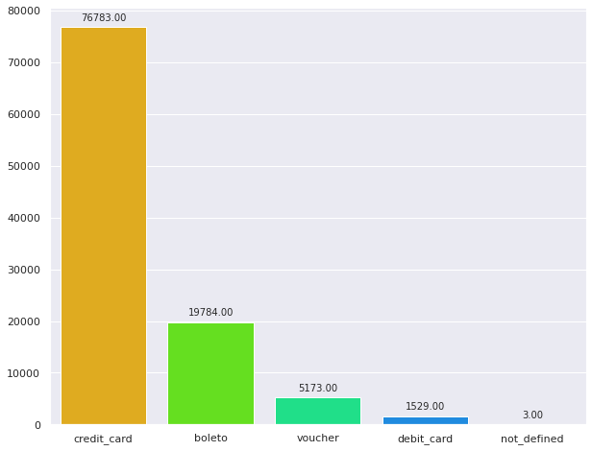
Distribution of Payment Methods and Installments

Slide 37

RECOMMENDATION & FUTURE WORK
Basket Analysis
Weekend Discount
Free Shipping Over X Dollars
X% Discount to 2nd Piece
Estimated Delivery Date
Warehouses (Checking)
Share-Win & Follow-Win
Geo-Delay-Review
Canceled Orders
Customer Segmentation

