Slide 1



CLASSIFICATION Predict customers who are likely to default on their loan
10 February 2023

Slide 2
Risk Credit
– Introduction

Slide 3
INTRODUCTION
Problem Statement
The bank wants to improve their services by finding interesting groups of clients (e.g., to differentiate between good and bad clients) in order to minimize the loses and maximizing profit.
Objective:
The objective is to build the optimal machine learning model to maximize predictive capability while decreasing the risk of future loan defaults.
EDA
Data insights by visualizations
Imputation
Outlier detection
Feature Engineering
Sampling
Sampling
Feature Selection, Multicollinearity, and Encoding & Transforming
Model development, Performance & interpretation
Comparing model performance, Model optimization, Model Selection and interpretation.
3

Slide 4

Exploratory Data Analysis (EDA)

Slide 5
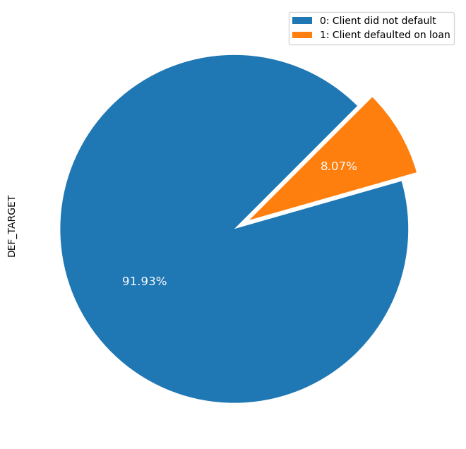
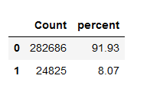
EXPLORATORY DATA ANALYSIS
Distribution of target variable
92% of data belong to good clients while 8% it is clients that defaulted on a loan.
Highly unbalanced dataset
5

Slide 6
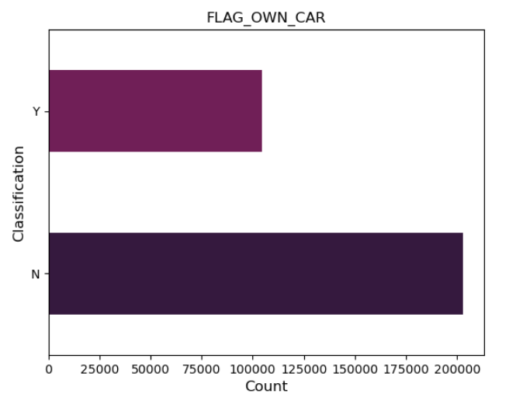
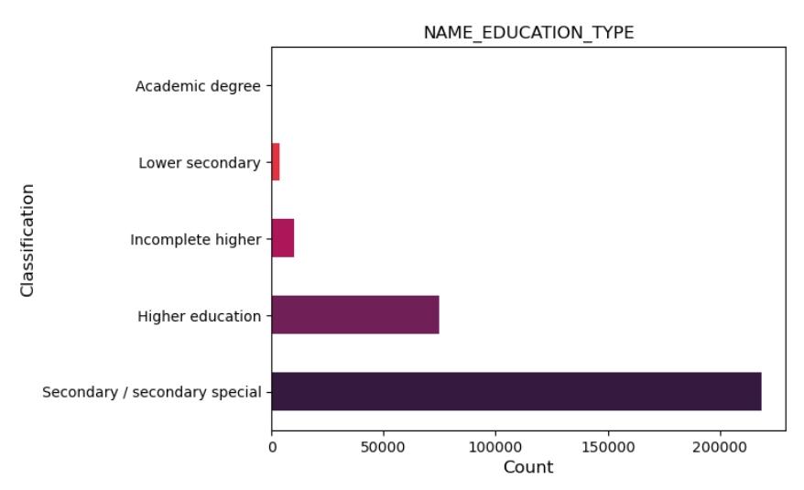
EXPLORATORY DATA ANALYSIS
Visualization of the categoric distribution:
6

Slide 7
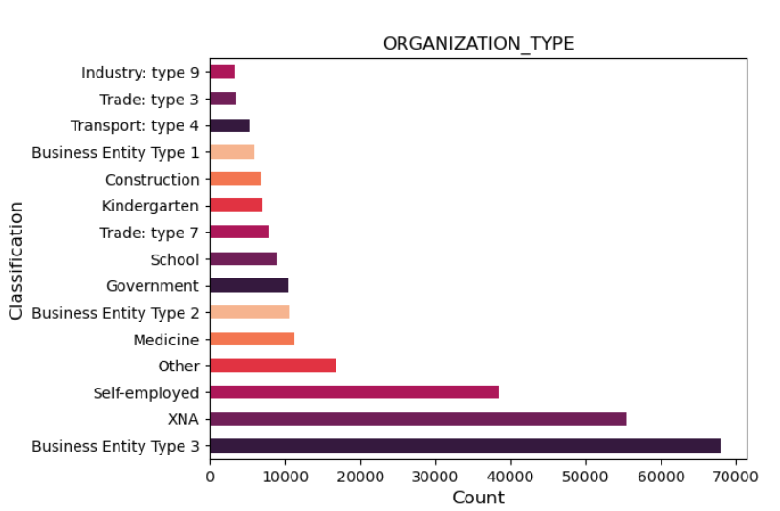
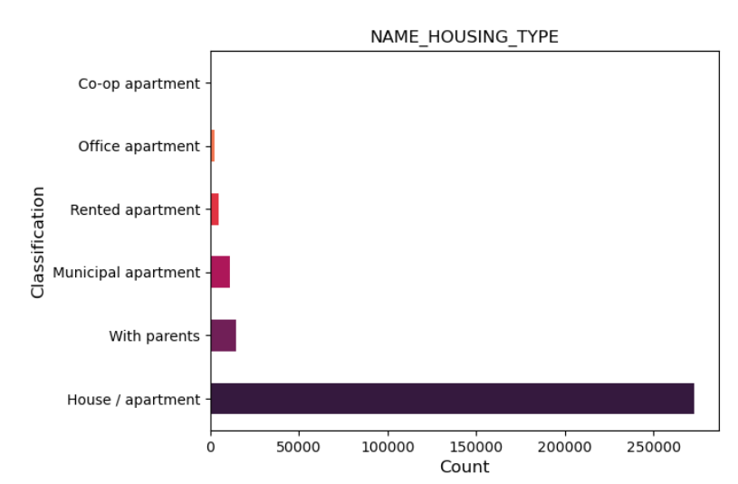
EXPLORATORY DATA ANALYSIS
Visualization of the categoric distribution:
7

Slide 8
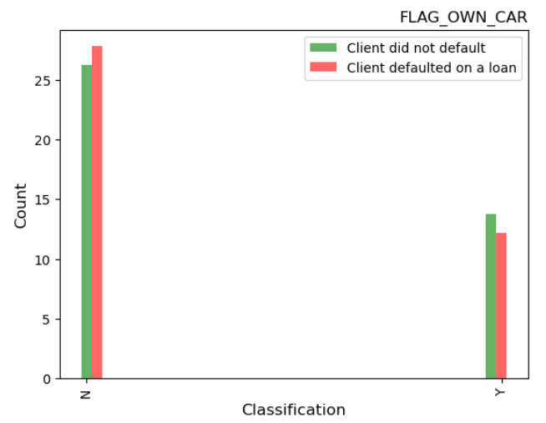
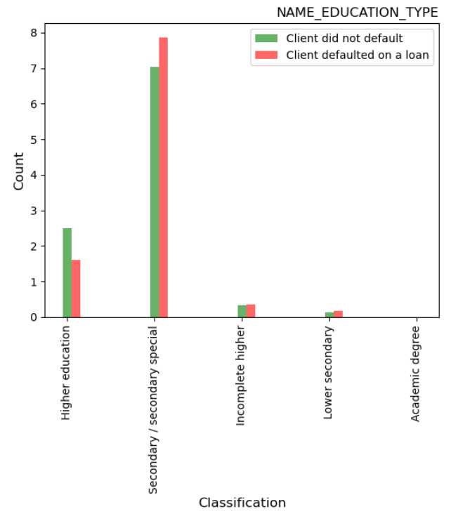
EXPLORATORY DATA ANALYSIS
Visualization of the feature distribution on the target feature:
8

Slide 9
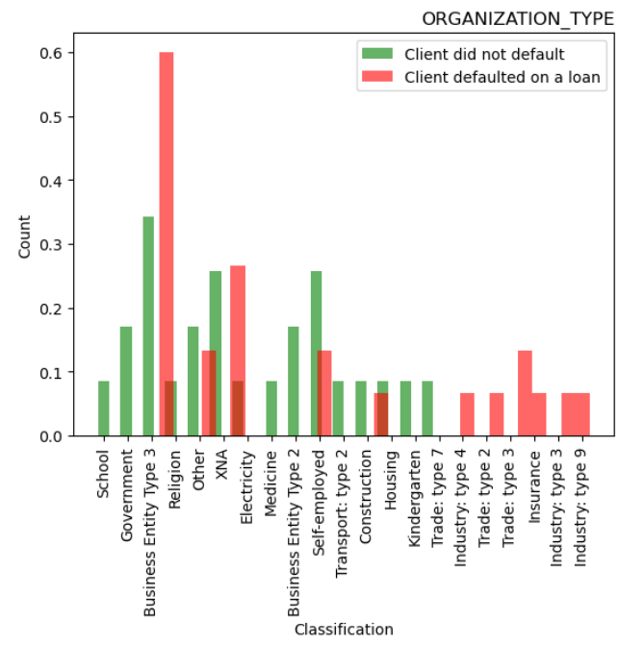
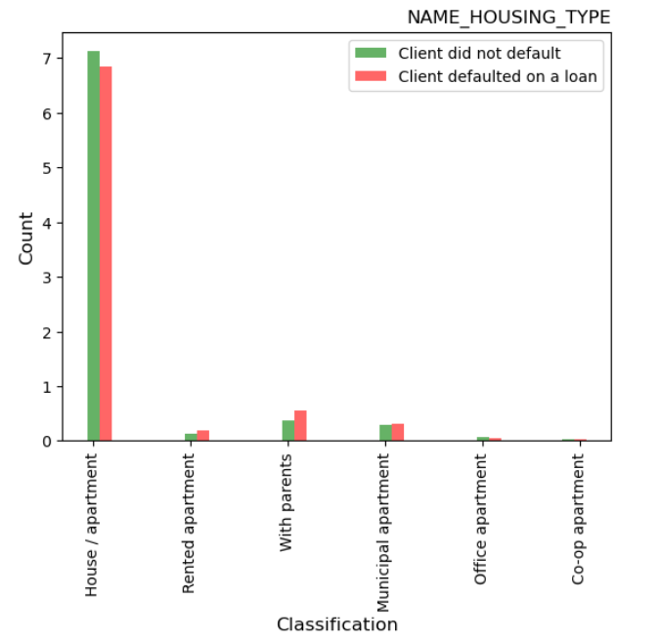
EXPLORATORY DATA ANALYSIS
Visualization of the feature distribution on the target feature:
9

Slide 10
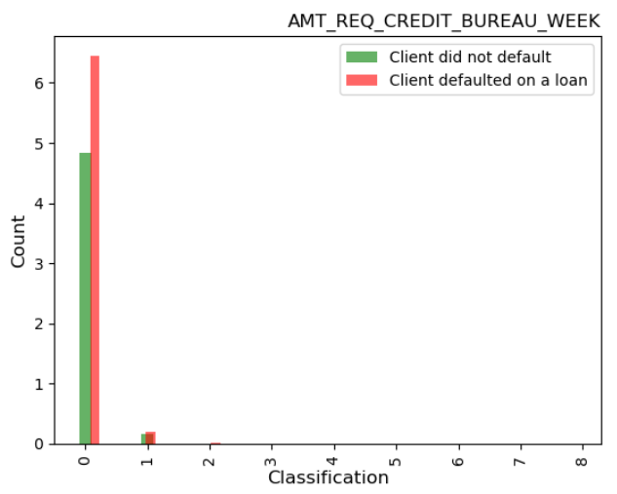
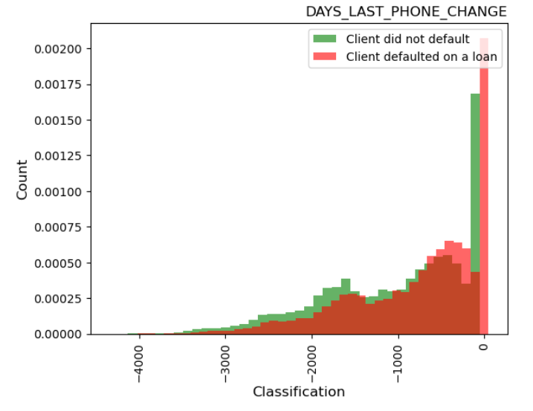
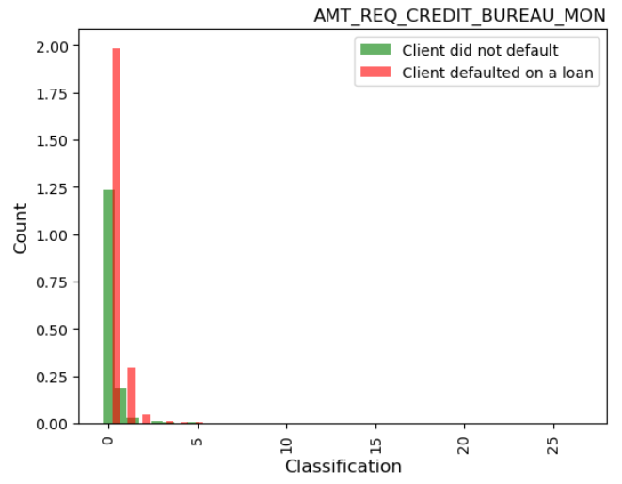
EXPLORATORY DATA ANALYSIS
Visualization of the feature distribution on the target feature:
10

Slide 11
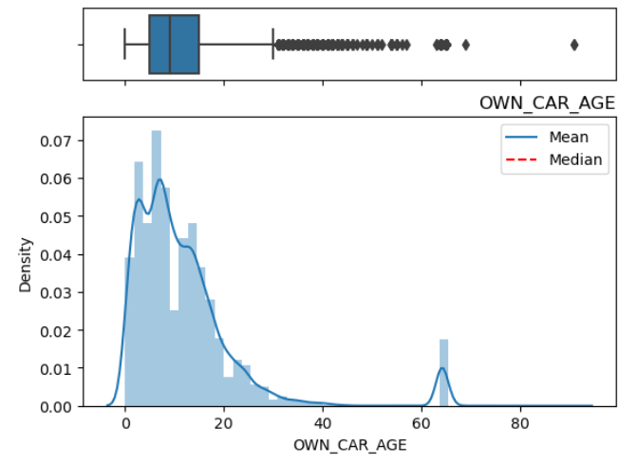
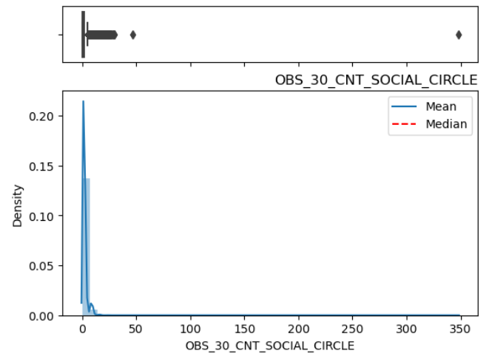
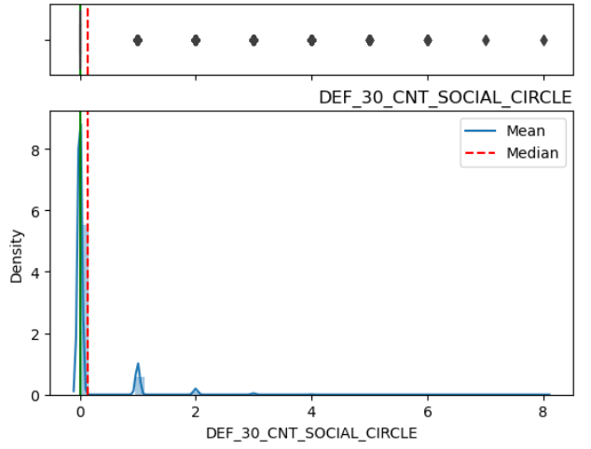
EXPLORATORY DATA ANALYSIS
Outliers or Anomalies detected:
11

Slide 12
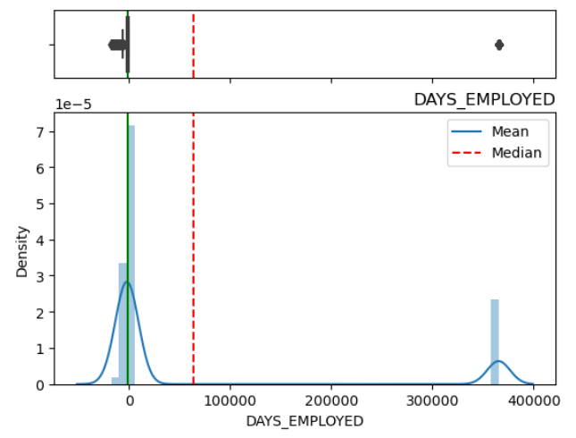
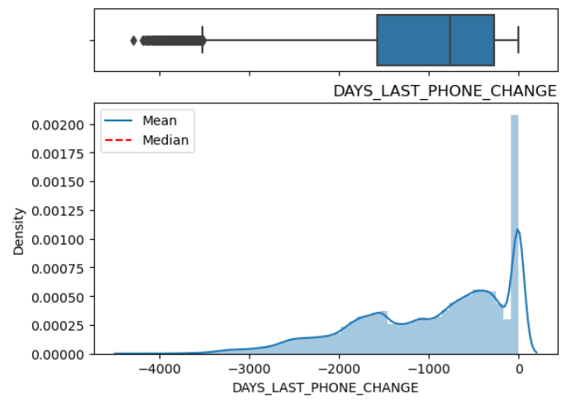
EXPLORATORY DATA ANALYSIS
Outliers or Anomalies detected:
12

Slide 13
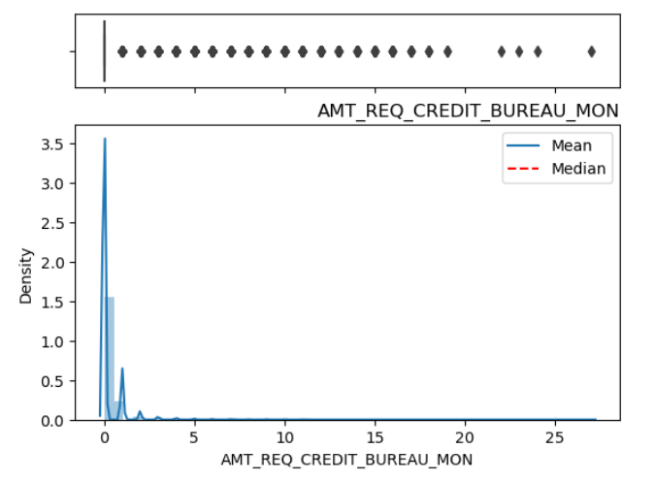
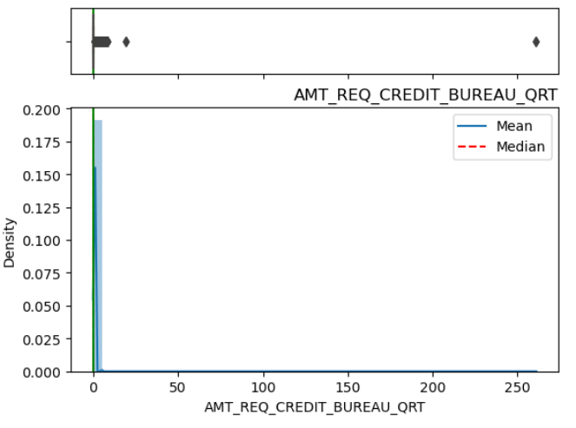
EXPLORATORY DATA ANALYSIS
Outliers or Anomalies detected:
13

Slide 14

Data Cleaning

Slide 15

Data Cleaning
The process of correcting or eliminating inaccurate, damaged, improperly formatted, duplicate, or missing data from a dataset.
Missing values over 40% is eliminated
Missing values less than 40% are imputed with statistical measures
Duplicates are removed
15

Slide 16
Feature selection and feature engineering

Slide 17
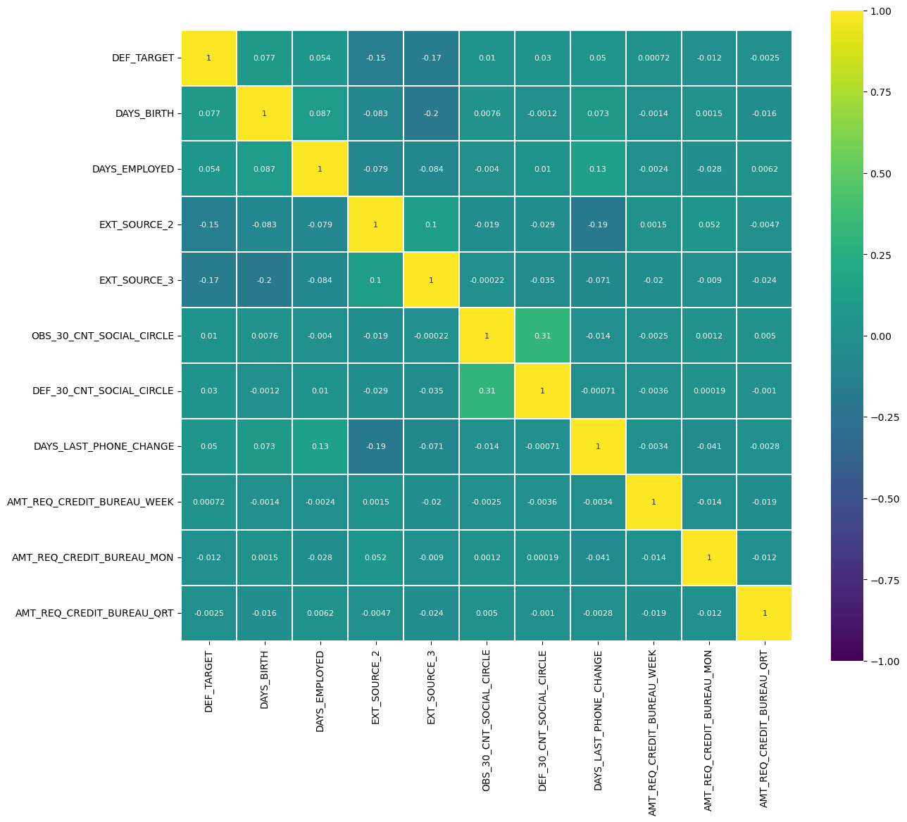
Feature selection and feature engineering
Correlation between features using Pearson method:
The heatmap shows there are some positive and negative correlations amongst variables
It is easy to understand that the variables ‘DEF_30_CNT_SOCIAL_CIRCLE’ and ‘OBS_30_CNT_SOCIAL_CIRCLE’ are the two most correlated features with the highest monotonic relationship (31%).
17

Slide 18
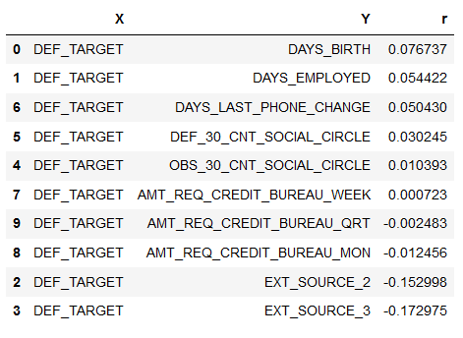
Feature selection and feature engineering
Correlation between features to target variable using Pearson method:
The variable that is most correlated with the target is 'EXT_SOURCE_3' with a weak and negative correlation of -0.172975 folowered by EXT_SOURCE_2 with a weak negative correlation of -0,152998.
also Client's age in days at the time of application (DAYS_BIRTH) is most correlated with the target with a weak and positive correlation of 0.076737.
18

Slide 19
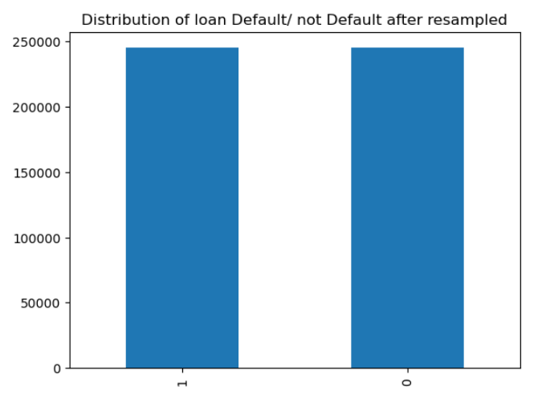
Feature selection and feature engineering
Dealing with Imbalanced dataset:
Given dataset has 92% Not defaulted loans and 8% defaulted, to improve accuracy of our model, sampling method is applied (oversampling).
Oversampling does not decrease the dataset or loose any information on the dataset
19

Slide 20
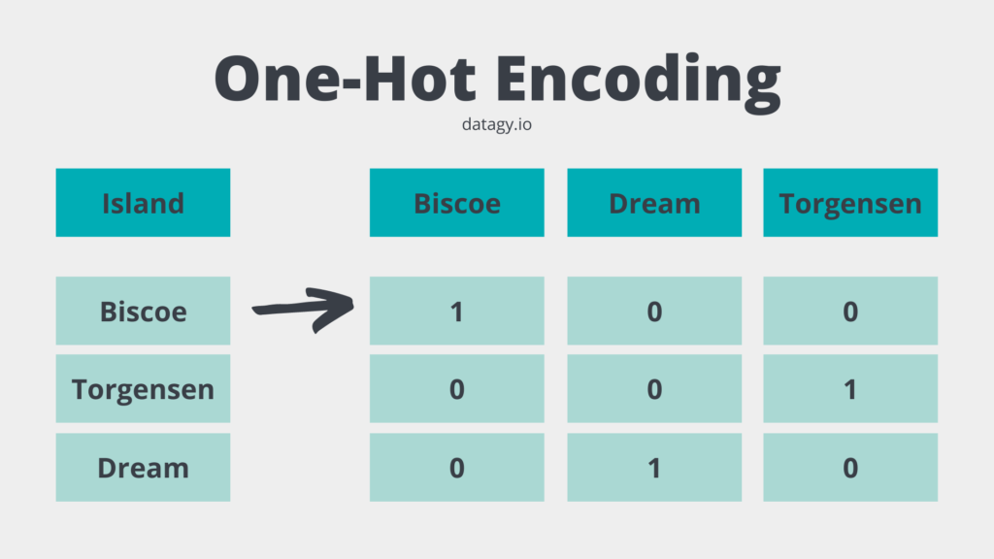
Feature selection and feature engineering
ENCODING & TRANSFORMATIONS:
Encoding and transforming the categorical variables into numeric ones.
‘FLAG_OWN_CAR’, ‘NAME_EDUCATION_TYPE’, ‘ORGANIZATION_TYPE’, ‘NAME_HOUSING_TYPE’ columns which are categorical have been encoded into numerical values using one-hot-encoding for preparation of model training.
20

Slide 21
Model Development, Performance, Interpretation

Slide 22
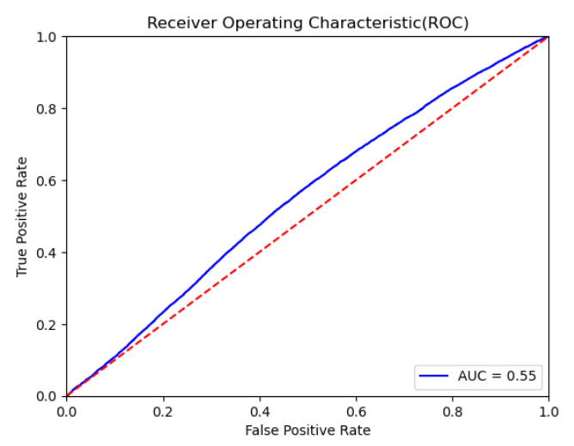
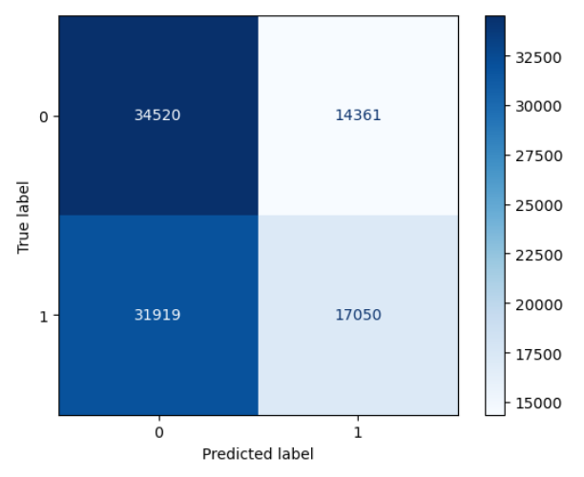
Model Development, Performance, Interpretation
Model Development:
Logistic Regression (LR)
the LR model achieved accuracy of 55%.
The model correctly predicted 34520 settled loans and 17050 defaulted loans.
There are 31919 defaults missed (Type I Error) and 14361 good loans missed (Type II Error).
In our application, the number of missed defaults (bottom left) needs to be minimized to save loss, and the number of correctly predicted settled loans (top left) needs to be maximized in order to maximize the earned interest.
22

Slide 23
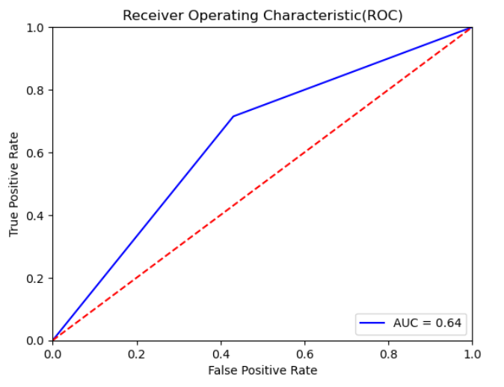
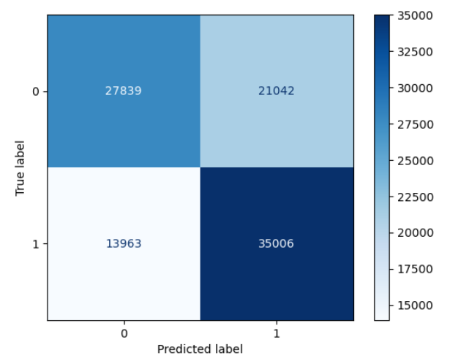
Model Development, Performance, Interpretation
Model Development:
K-Nearest Neighbours (KNN)
the KNN model achieved accuracy of 64%.
The model correctly predicted 27839 settled loans and 35006 defaulted loans.
There are 13963 defaults missed (Type I Error) and 21042 good loans missed (Type II Error).
In our application, the number of missed defaults (bottom left) needs to be minimized to save loss, and the number of correctly predicted settled loans (top left) needs to be maximized in order to maximize the earned interest.
23

Slide 24
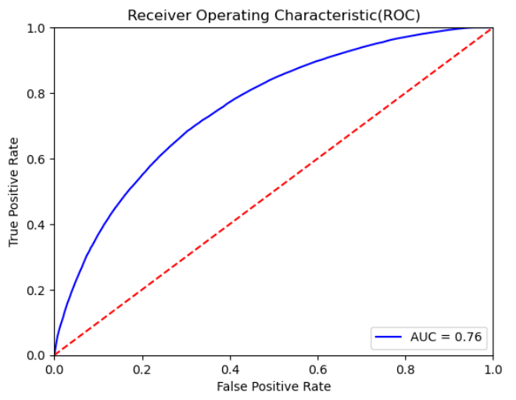
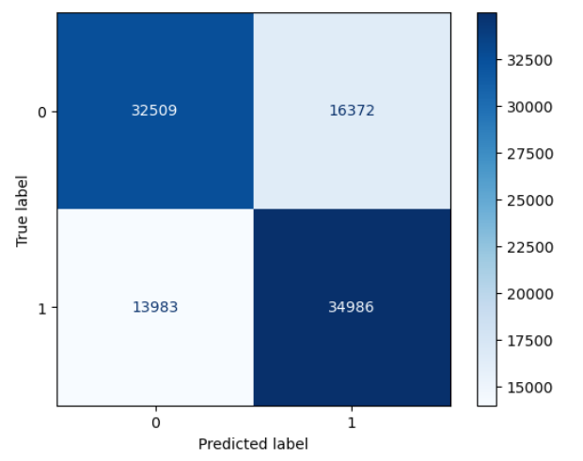
Model Development, Performance, Interpretation
Model Development:
Decision Trees (DT)
the DT model achieved accuracy of 76%.
The model correctly predicted 32509 settled loans and 34986 defaulted loans.
There are 13983 defaults missed (Type I Error) and 16372 good loans missed (Type II Error).
In our application, the number of missed defaults (bottom left) needs to be minimized to save loss, and the number of correctly predicted settled loans (top left) needs to be maximized in order to maximize the earned interest.
24

Slide 25
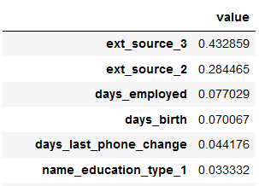
Model Development, Performance, Interpretation
Model Feature Importance:
Decision Trees (DT)
the DT model achieved accuracy of 76%.
Top 6 important features to the target features.
Normalized score from external data sources shows that it have high importance of determining whether the client will default/ not default on a loan.
25

Slide 26
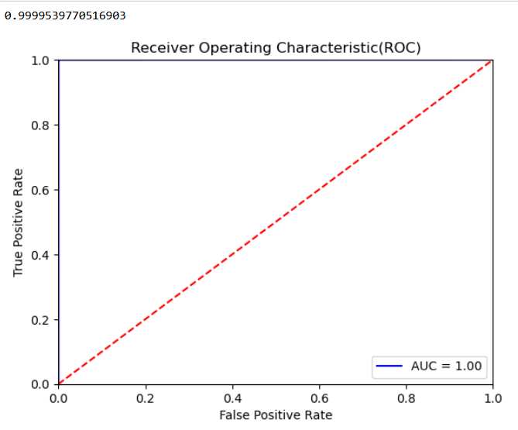
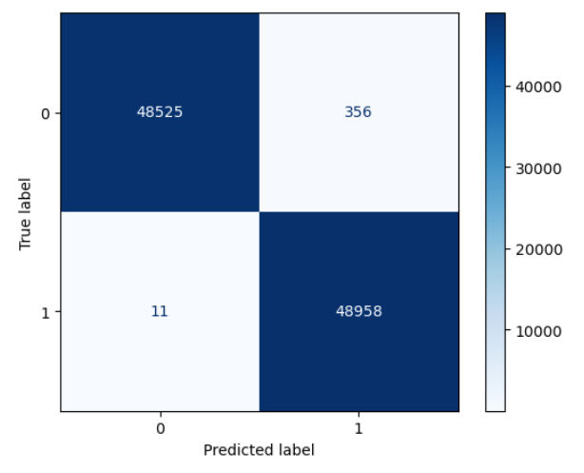
Model Development, Performance, Interpretation
Model Development:
Random Forest (RF)
the RF model achieved accuracy of 99%.
The model correctly predicted 48525 settled loans and 48958 defaulted loans.
There are only 11 defaults missed (Type I Error) and 356 good loans missed (Type II Error) which is not that bad compared to other models.
In our application, RF is by far the most accurate model on our dataset that we train it on.
It is a great model to maximize profit while minimizing loss in terms of loans given to clients.
26

Slide 27
Model Development, Performance, Interpretation
Model Feature Importance:
Random Forest (RF)
the RF model achieved accuracy of 99%.
Top 6 important features to the target features.
Normalized score from external data sources shows that it have high importance of determining whether the client will default/ not default on a loan.
27

Slide 28
Model Development, Performance, Interpretation
Model Performance and Interpretation:
28

Slide 29
Model Deployment, Monitoring & documentation

Slide 30
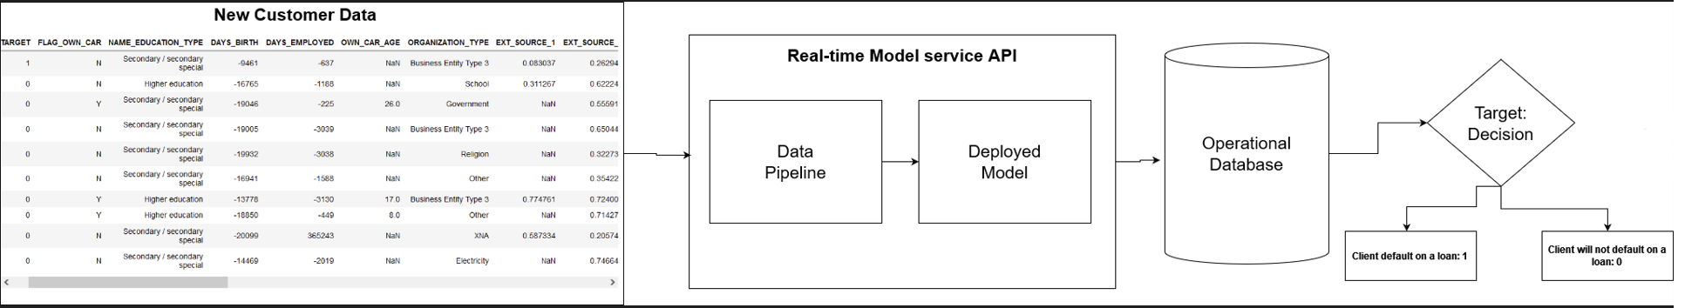
Model Deployment, Monitoring & documentation
Model Deployment:
Objective is to know which client is most likely to default on a loan .
Real time online scoring with kafka and spark streaming
Continuously update the database as new data is generated.
Spark process can make new predictions based on the new data and update the operational database.
This removes the problem of potential incorrect prediction for a customer based on outdated data.
30

Slide 31
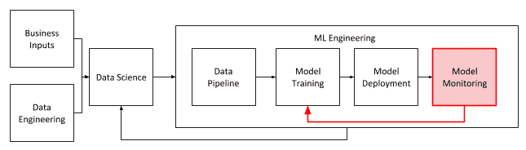
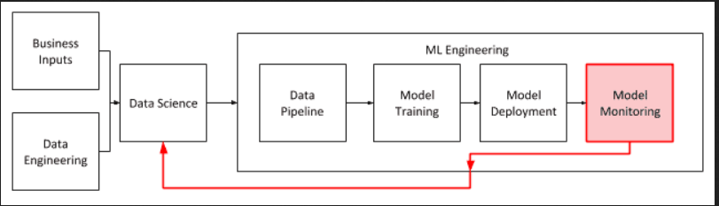
Model Deployment, Monitoring & documentation
Monitoring Model performance:
Once we have deployed the model, we need to put some metrics and measures to monitor the model performance.
Model Drift:
Term used to describe change in the predictive power of a model life cycle.
Change in accuracy when new data is being acquired.
Most commonly measures for model accuracy are Receiver Operating Characteristic curve (ROC) and Average Precision (AP)
When Model falls below acceptable performance threshold, then a new process to retain the model is initiated, and that newly trained model is deployed.
31

Slide 32
Conclusion
The machine learning model operations life cycle process is still new and there is no industry standard. There are many ideas and opinions on the right way to do things, but no single consensus view. There are certain design patterns that are being repeated more often and these are what I have presented in this post.
The key takeaway is that models change, and their performance will decline over time. Any model that makes a prediction of a possible future event and acts to change the cause leading to that event will change the data and its predictive power. It is important to understand what model performance measurements matter to the business, how quickly the model performance is changing, and where to set the threshold to trigger the model retraining process.

Slide 33
THANK YOU

