Slide 1
應用機器學習
Brian Chan 陳醒凡

Slide 2
課程目標
了解基本的數據分析
了解基本的機器學習(Machine Learning)方法
掌握Python的基本操作和一些有用的package
處理及從網上下載數據
在Python上應用機器學習

Slide 3
今天課堂概要
Decision Tree & Random Forest
The fundamental concepts of decision trees
The mathematics behind the decision tree learning algorithm
Information gain and impurity measures
Classification trees

Slide 4
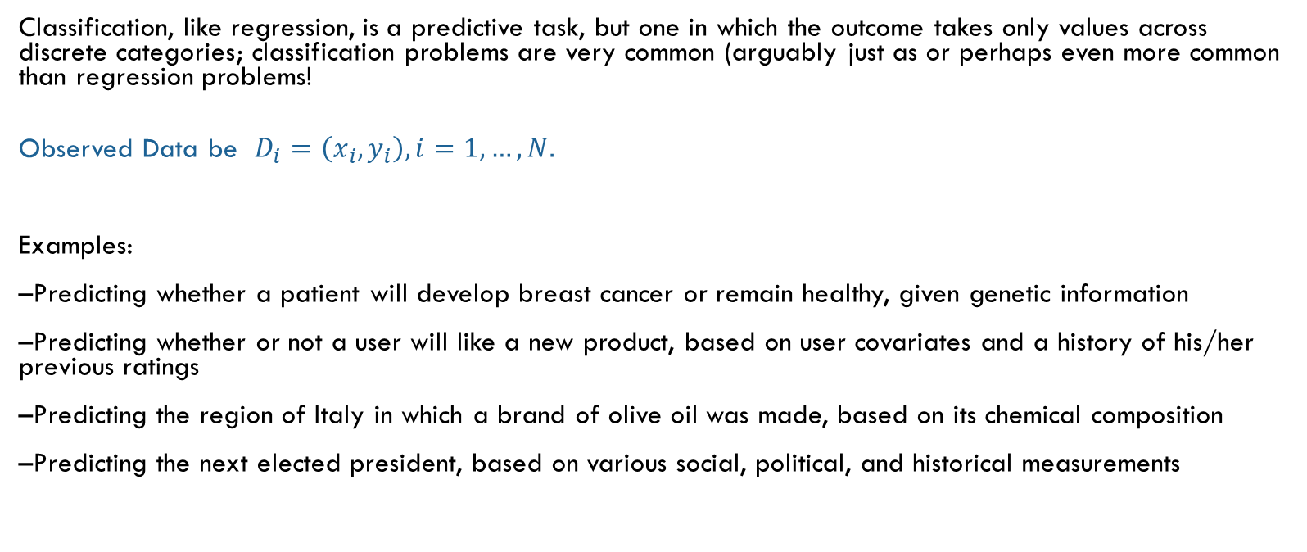
Classification
Classification, like regression, is a predictive task, but one in which the outcome takes only values across discrete categories; classification problems are very common (arguably just as or perhaps even more common than regression problems!
Observed Data be $D_{i}=\left(x_{i},y_{i}\right), i=1,…,N.$
Examples:
–Predicting whether a patient will develop breast cancer or remain healthy, given genetic information
–Predicting whether or not a user will like a new product, based on user covariates and a history of his/her previous ratings
–Predicting the region of Italy in which a brand of olive oil was made, based on its chemical composition
–Predicting the next elected president, based on various social, political, and historical measurements
Notes:
https://towardsdatascience.com/support-vector-machines-svm-c9ef22815589

Slide 5
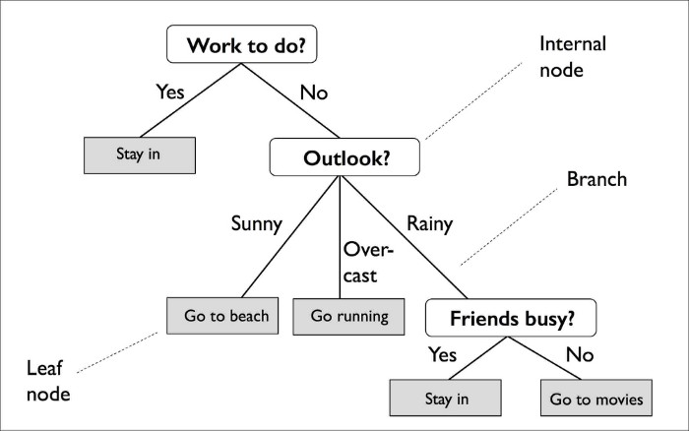
Decision tree

Slide 6
Decision tree
A decision tree is a supervised machine learning model used to predict a target by learning decision rules from features. As the name suggests, we can think of this model as breaking down our data by making a decision based on asking a series of questions.
A decision tree is constructed by recursive partitioning — starting from the root node (known as the first parent), each node can be split into left and right child nodes. These nodes can then be further split and they themselves become parent nodes of their resulting children nodes.

Slide 7

Decision tree
Maximizing Information Gain
$IG\left(D_{p},f\right)=I\left(D_{p}\right)−\sum_{j=1}^{m}{\frac{N_{j}}{N_{p}}I(D_{j})}$
Binary case
$IG\left(D_{p},f\right)=I\left(D_{p}\right)−\frac{N_{left}}{N_{p}}I\left(D_{left}\right)−\frac{N_{right}}{N_{p}}I\left(D_{right}\right)$

Slide 8

Impurity measure
Gini measure
$$I_{G}\left(t\right)=1−p{\left(left | t\right)}^{2}−p{\left(right | t\right)}^{2}$$
Entropy
$$I_{E}\left(t\right)=−p\left(left | t\right)∗log\left(p\left(left | t\right)\right)−p\left(right | t\right)∗log⁡(p(right|t))$$

Slide 9
Example-Gini impurity
A (40,40) -> (30,10) & (10,30)
B (40,40) -> (20,40) & (20, 0)
IG = (1-0.5^2-0.5^2)=0.5
A: IG_left = (1-(3/4)^2-(1/4)^2)=0.375
A: IG_right = (1-(1/4)^2-(3/4)^2)=0.375
A: IG_G = 0.5 – 4/8*0.375 – 4/8*0.375=0.125
B: IG_left = (1-(2/6)^2-(4/6)^2)=4/9
B: IG_right = (1-(1)^2-(0)^2)=0
B: IG_G = 0.5 –6/8*4/9=0.16
Case B gives higher IG_G, so it should be chosen.

Slide 10
Gini OR Entropy?
“Gini” will tend to find the largest class, and “entropy” tends to find groups of classes that make up ~50% of the data.
Some studies show this doesn’t matter – these differ less than 2% of the time.
Entropy might be a little slower to compute (because it makes use of the logarithm).
https://www.garysieling.com/blog/sklearn-gini-vs-entropy-criteria
https://www.unine.ch/files/live/sites/imi/files/shared/documents/papers/Gini_index_fulltext.pdf
Notes:
https://www.garysieling.com/blog/sklearn-gini-vs-entropy-criteria

Slide 11
Random forest
The random forest algorithm can be summarized in four simple steps:
1. Draw a random bootstrap sample of size n (randomly choose n samples from the training set with replacement).
2. Grow a decision tree from the bootstrap sample. At each node:
a. Randomly select d features without replacement.
b. Split the node using the feature that provides the best split according to the objective function, for instance, maximizing the information gain.
3. Repeat the steps 1-2 k times.
4. Aggregate the prediction by each tree to assign the class label by majority vote.

Slide 12
Advantages & disadvantages
Advantages
1. Higher accuracy (remedy overfitting)
2. Handle thousands of input variables without variable selection
3. Indicate the variables that are important in the classification task
Disadvantages
1. Computationally expensive
2. Not easy to interpret (hard to visualize the model or understand why it predicted something)

Slide 13
reference
Some illustration to the parameters of the code
https://scikit-learn.org/stable/modules/generated/sklearn.ensemble.RandomForestClassifier.html
https://blog.csdn.net/u012102306/article/details/52228516
Decision Tree:
https://towardsdatascience.com/https-medium-com-lorrli-classification-and-regression-analysis-with-decision-trees-c43cdbc58054

Slide 14
今天課堂概要
Decision Tree & Random Forest
The fundamental concepts of decision trees
The mathematics behind the decision tree learning algorithm
Information gain and impurity measures
Classification trees

Slide 15
下一課…
Dimension reduction method

