Slide 1
應用機器學習
Brian Chan 陳醒凡

Slide 2
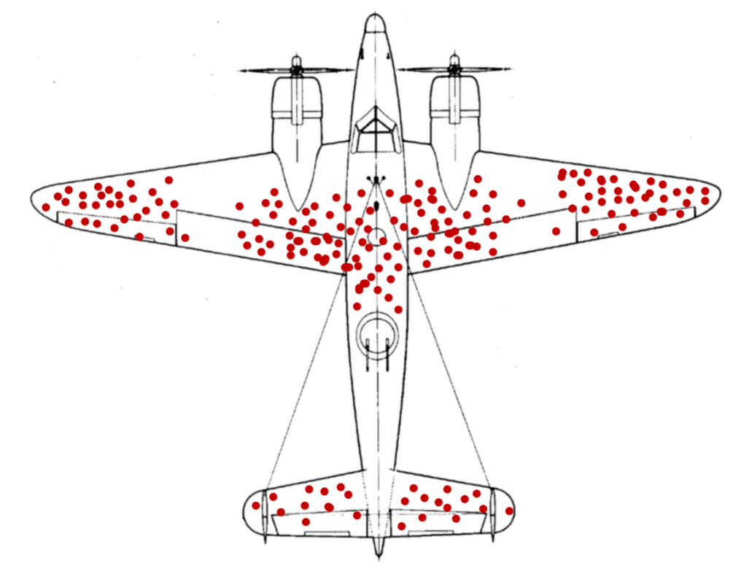
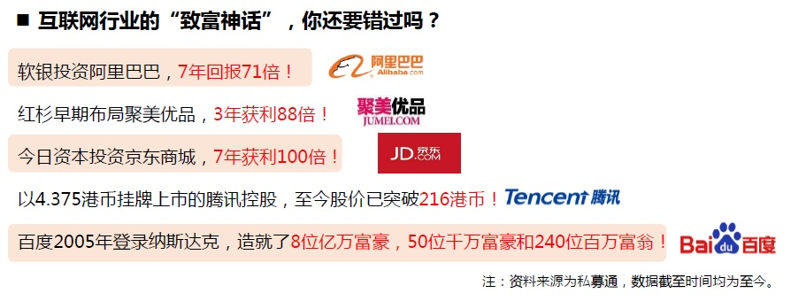
Survivorship bias 倖存者偏差
Survivorship bias or survival bias is the logical error of concentrating on the people or things that made it past some selection process and overlooking those that did not, typically because of their lack of visibility.
This can lead to false conclusions in several different ways. It is a form of selection bias.
https://en.wikipedia.org/wiki/Survivorship_bias

Slide 3
Survivorship bias 倖存者偏差
- Steve Jobs, Bill Gates, and Mark Zuckerberg dropped out of college and became millionaires, so will I.
- I’ll calculate annual recurring revenue (ARR) based on our current customers.

Slide 4
Sampling bias
Money laundering

Slide 5
Data snooping – p-value

Slide 6
MOTTO
All models are wrong, but some are useful.
George E. P. Box

Slide 7
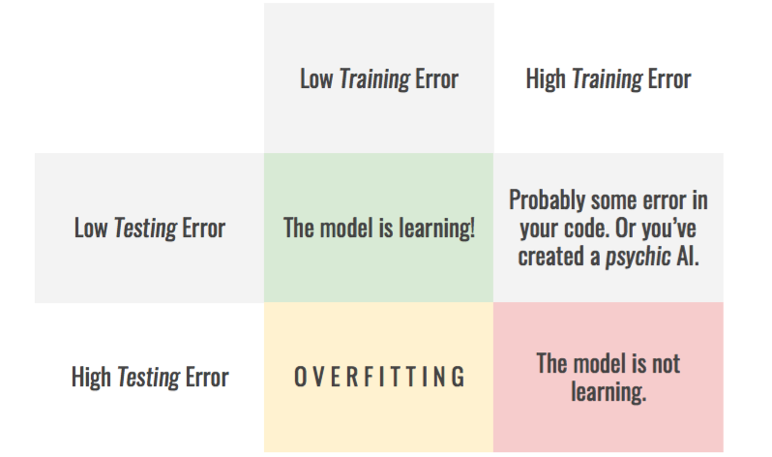
Train-test diagnosis

Slide 8
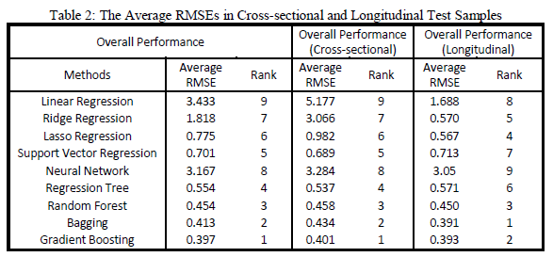
Performance comparison
Notes:
http://www.sr-sv.com/the-predictive-superiority-of-ensemble-methods-for-cds-spreads/

Slide 9

Pooling Test
https://www.nature.com/articles/d41586-020-02053-6
https://members.loria.fr/ADeleforge/the-maths-of-pool-testing-mixing-samples-to-speed-up-covid-19-detection/

