Slide 1
應用機器學習
Brian Chan 陳醒凡

Slide 2
課程目標
了解基本的數據分析
了解基本的機器學習(Machine Learning)方法
掌握Python的基本操作和一些有用的package
處理及從網上下載數據
在Python上應用機器學習

Slide 3
今天課堂概要
Model Evaluation
Pipeline & Validation (Holdout & k-fold)
Over- and underfitting addressed with validation curves
Evaluation matrix
Class imbalance

Slide 4
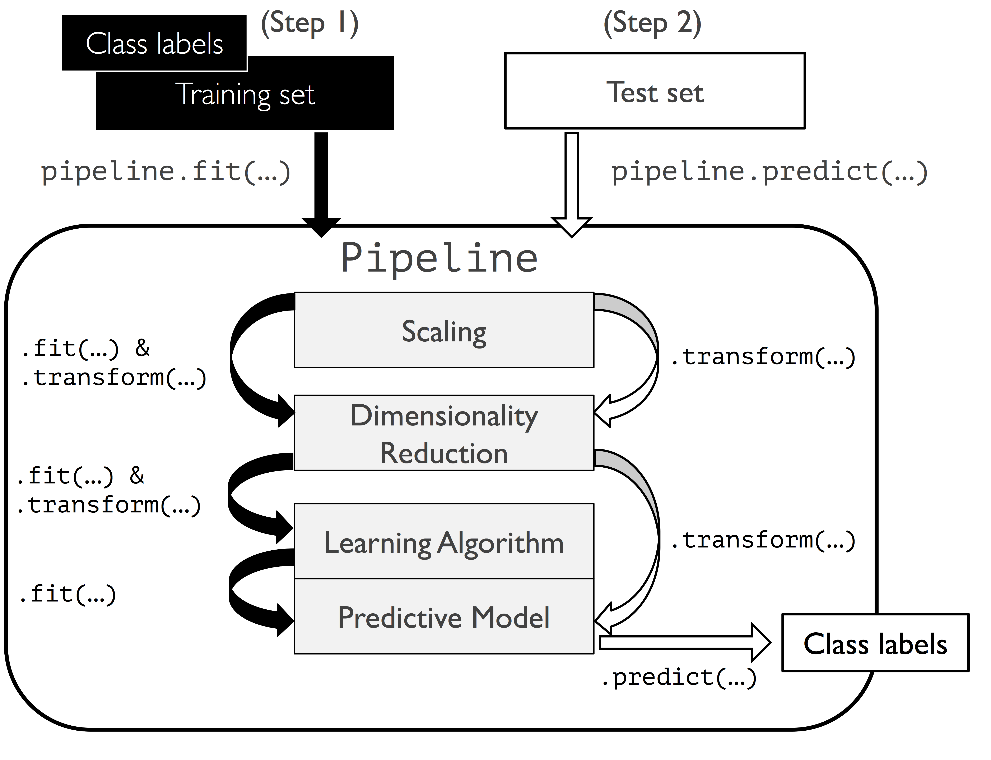
Pipeline

Slide 5
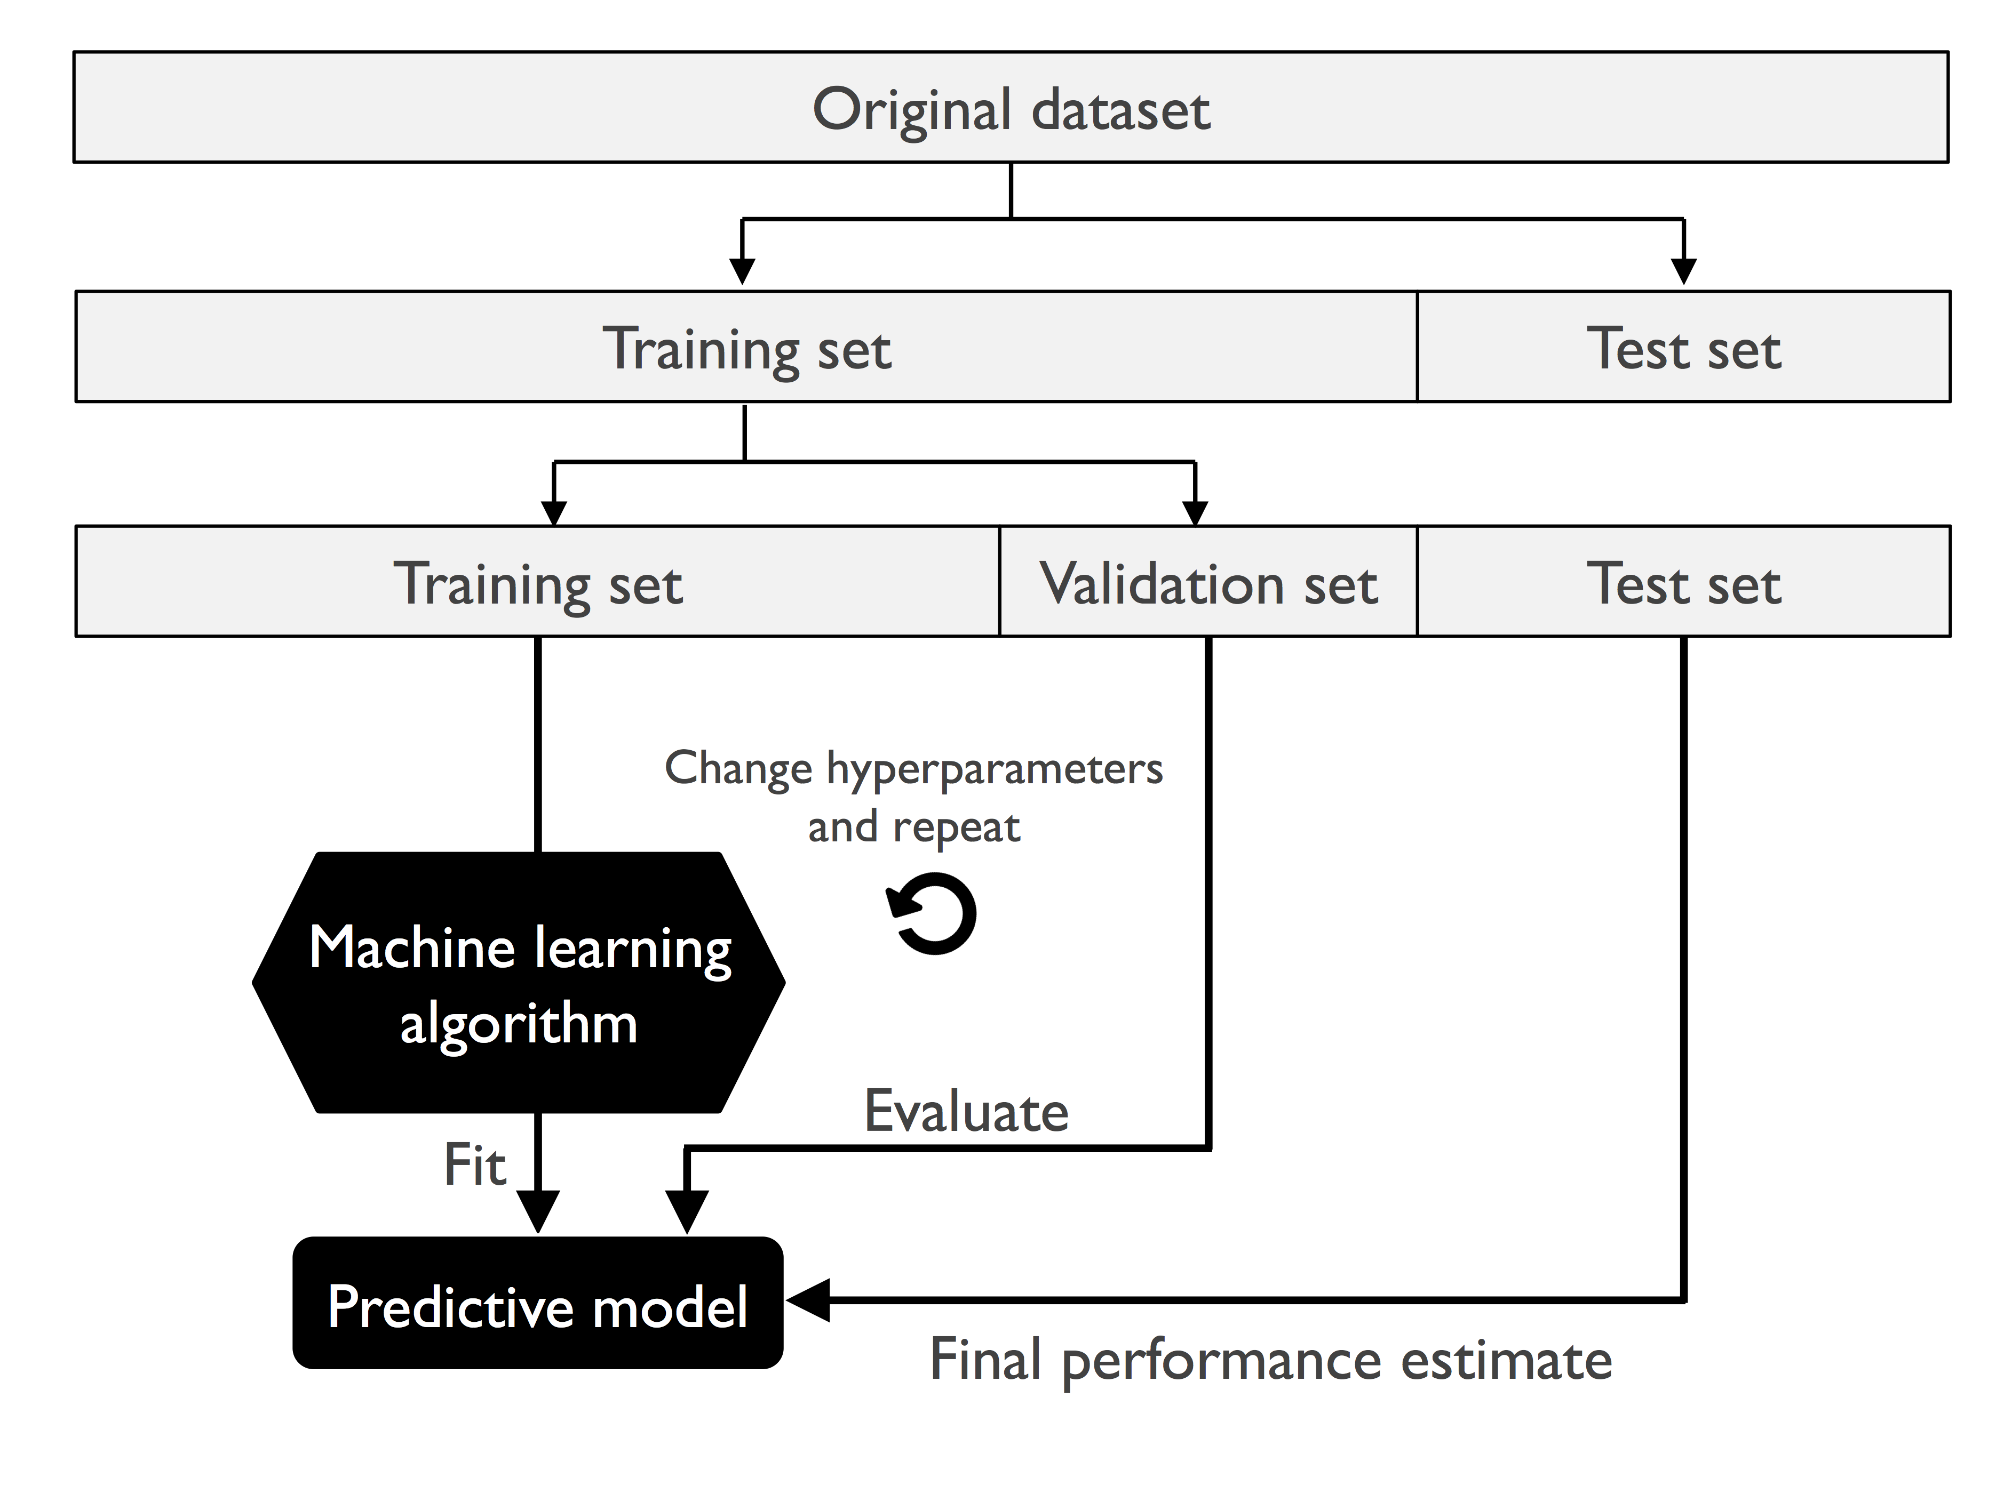
Holdout Validation

Slide 6
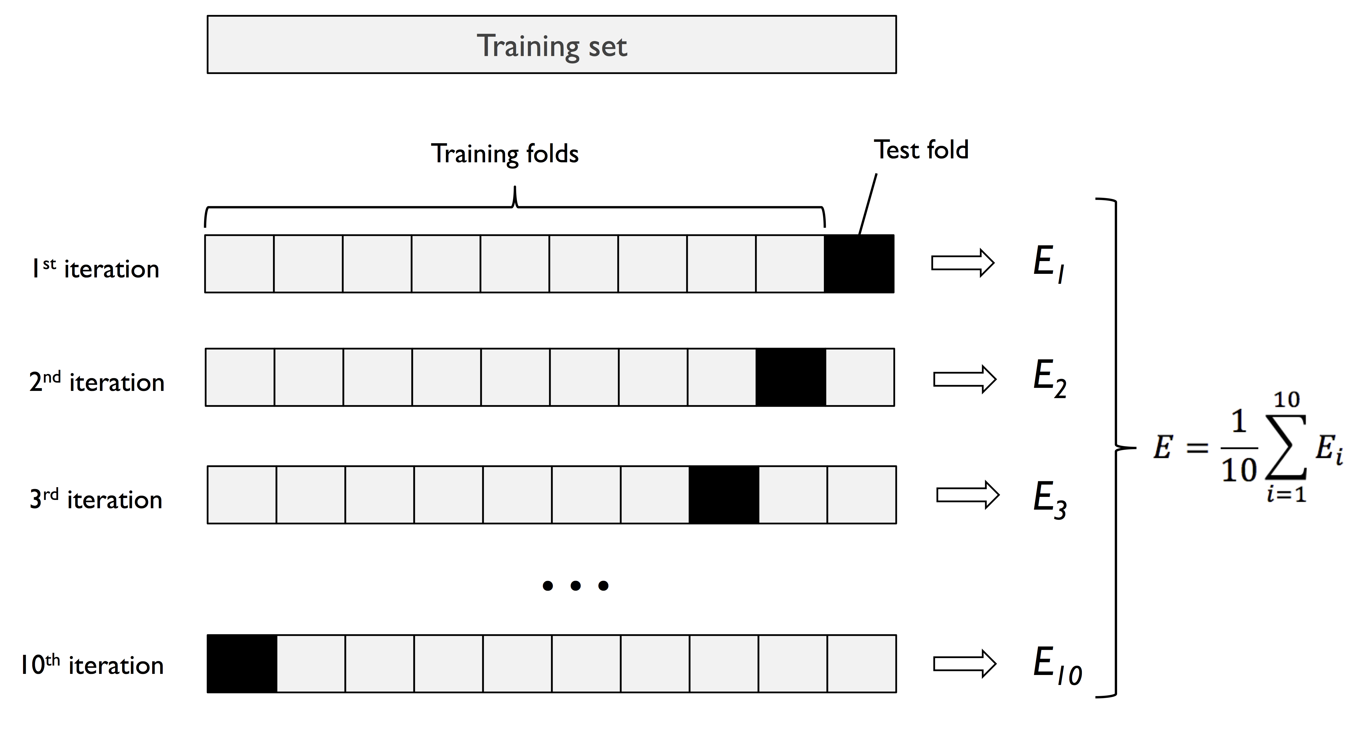
k-fold Validation
Intend to avoid the possible bias introduced by relying on any one particular division into test and train components, to partition the original set in several different ways and to compute an average score over the different partitions.

Slide 7
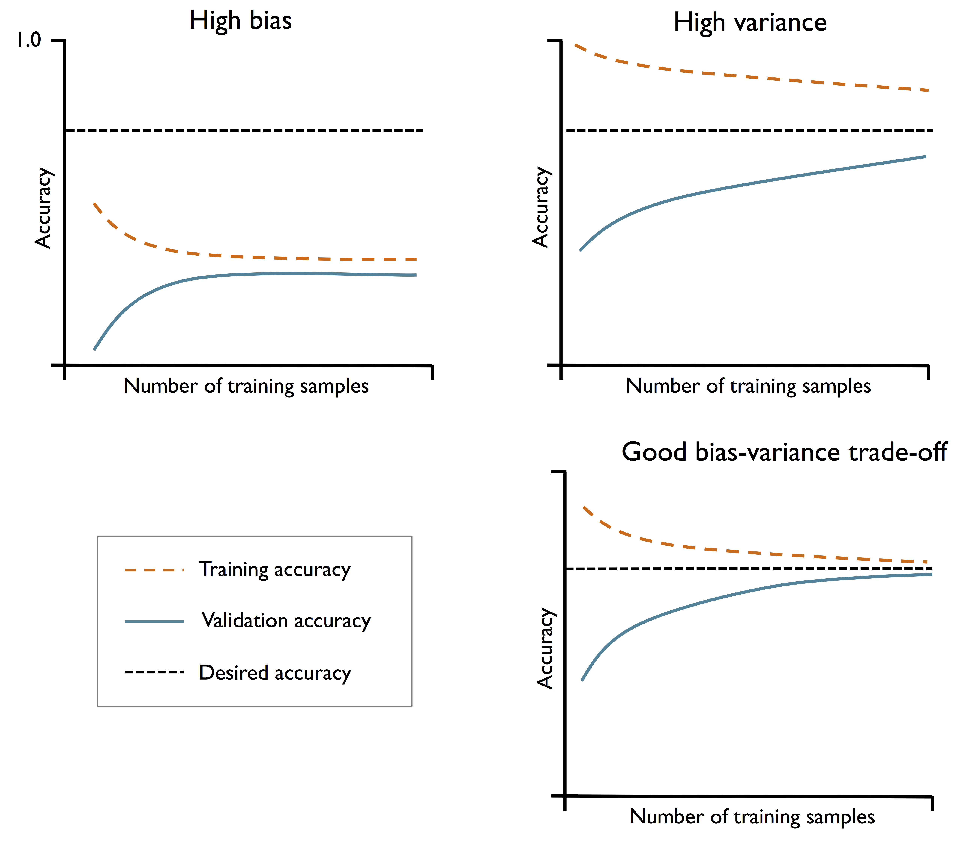
Diagnosing bias and variance
High bias – Too restricted model
High variance – Too complicated model

Slide 8
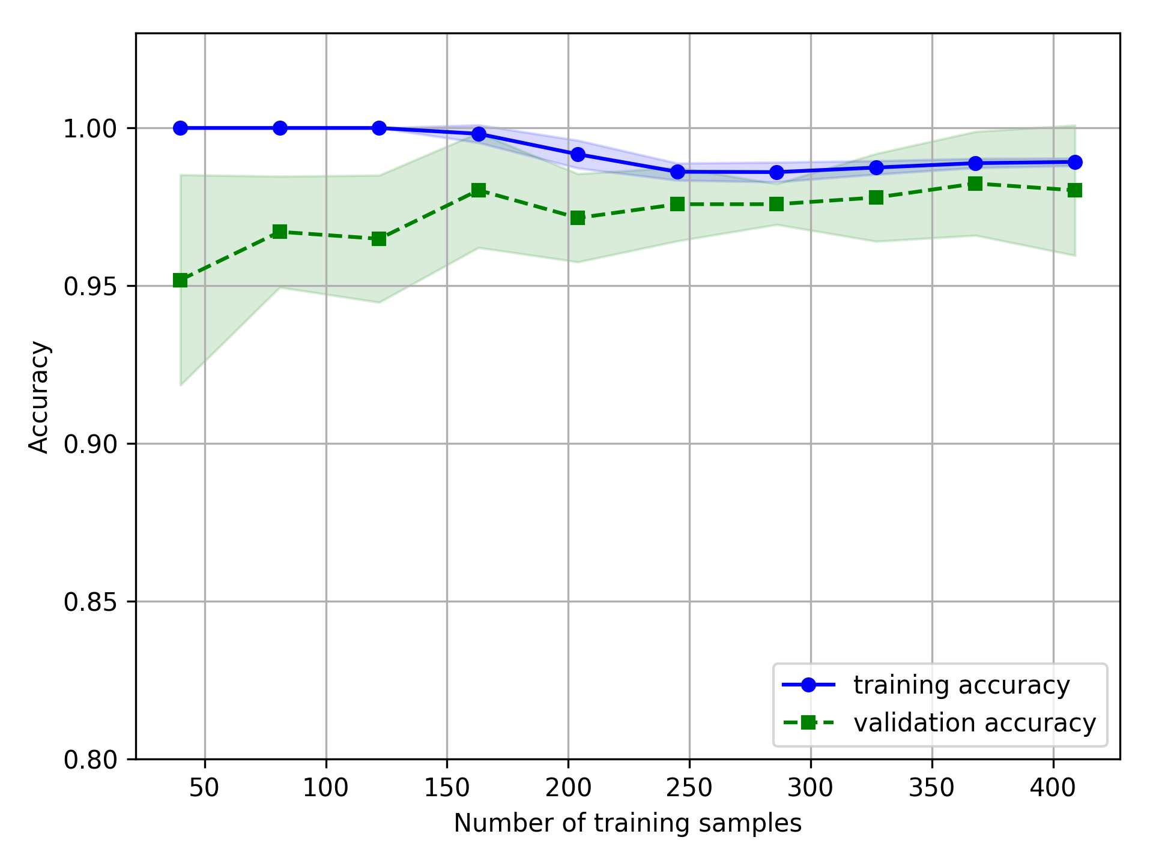
Diagnosing bias and variance

Slide 9
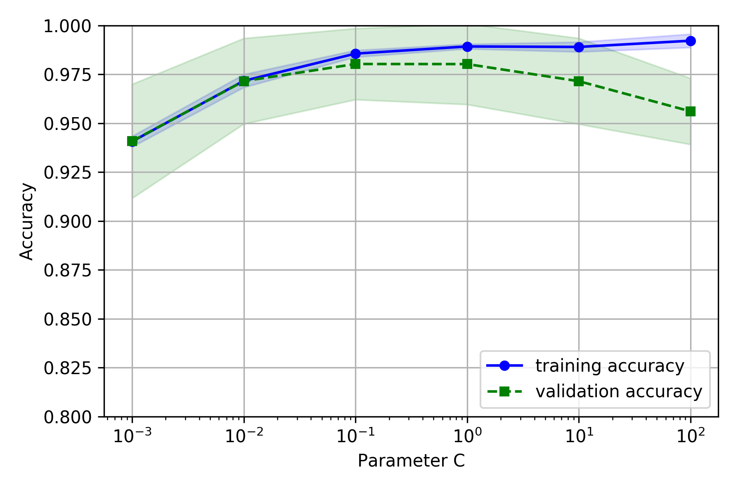
Over- and underfitting addressed with validation curves

Slide 10
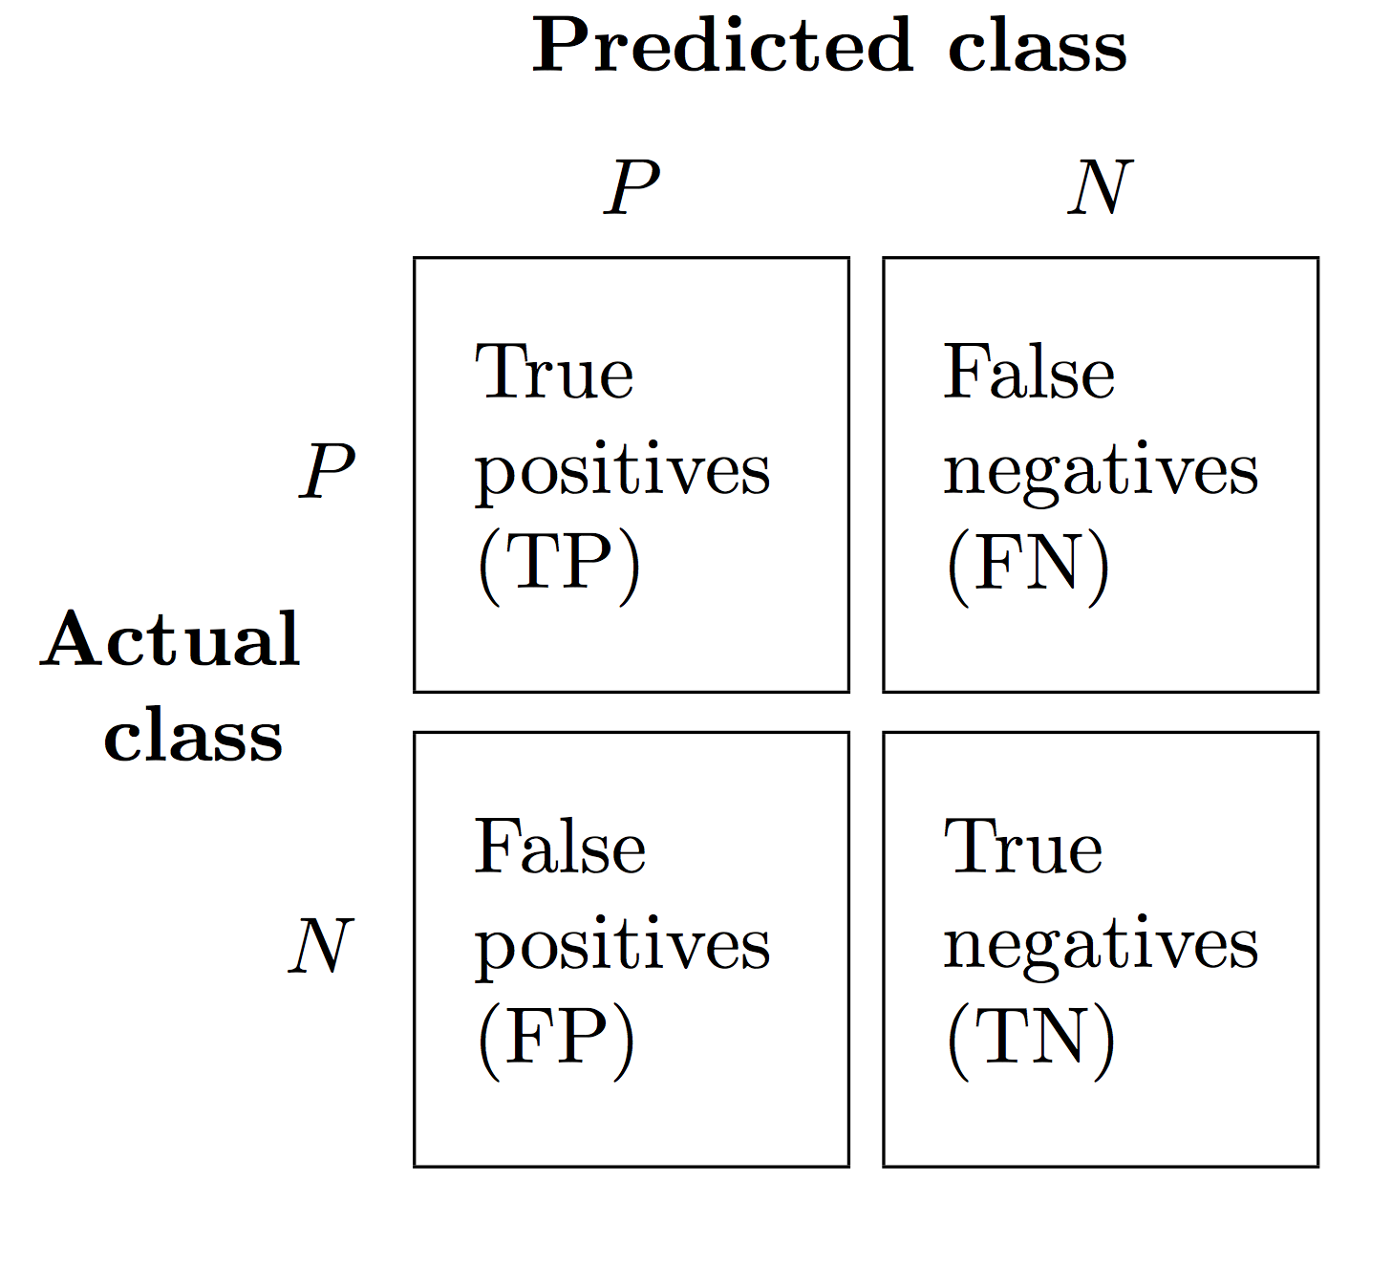

Evaluation matrix
Accuracy = $\frac{TP+TN}{TP+FN+FP+TN}$
Precision = $\frac{TP}{TP+FP}$
Recall = $\frac{TP}{FN+TP}$
F1 =$2×\frac{PRE×RECALL}{PRE+RECALL}=2×\frac{1}{\frac{1}{Pre}+\frac{1}{Recall}}$

Slide 11
“Misleading” accuracy
Suppose that there is a data set which has 1,000 data points (970 with false label and 30 with true label).
 | Predict true | Predict false
Actual true | 20 | 10
Actual false | 70 | 900
Accuracy = (20+900)/(20+70+10+900) = 0.92
 | Predict true | Predict false
Actual true | 1 | 29
Actual false | 0 | 939
Accuracy = 940/970= 0.96

Slide 12
Evaluation measures
Case 1:
Precision = 20/(20+70)=0.222
Recall = 20/(20+10)=0.667
F1 = 0.333
Case 2:
Precision = 0/(30)
Recall = 1/(1+30)=0.032
F1 = 0

Slide 13
imbalanced class
Re-sampling
Class weighting
SMOTE

Slide 14
今天課堂概要
Model Evaluation
Pipeline & Validation (Holdout & k-fold)
Over- and underfitting addressed with validation curves
Evaluation matrix
Class imbalance

Slide 15
下一課…
Summarize the topics covered
Introduction of deep learning and demonstration of selected application (e.g. Text summarization or computer vision)

