Slide 1
應用機器學習
Brian Chan 陳醒凡

Slide 2
課程目標
了解基本的數據分析
了解基本的機器學習(Machine Learning)方法
掌握Python的基本操作和一些有用的package
處理及從網上下載數據
在Python上應用機器學習

Slide 3
今天課堂概要
Introduction to deep learning
Neural network design
Training approach
Regularization
Example of deep learning

Slide 4
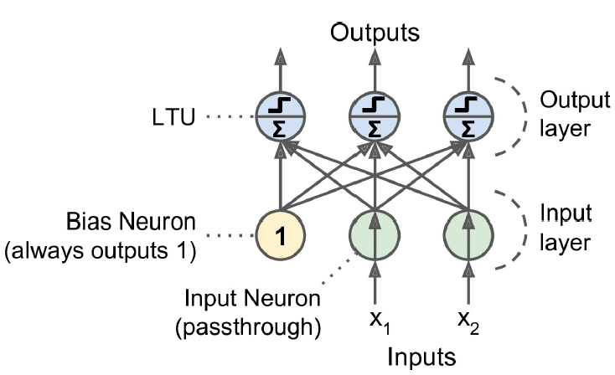
Neural network design

Slide 5
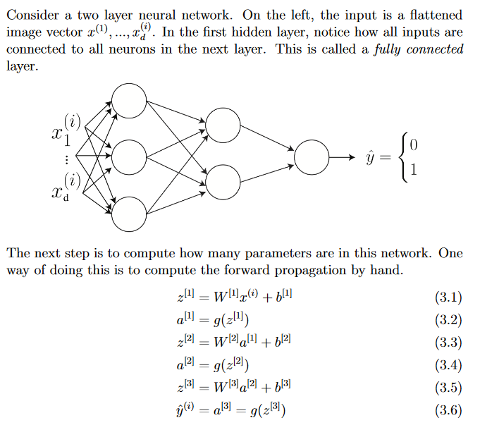

Slide 6
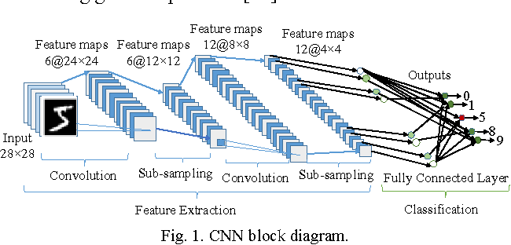
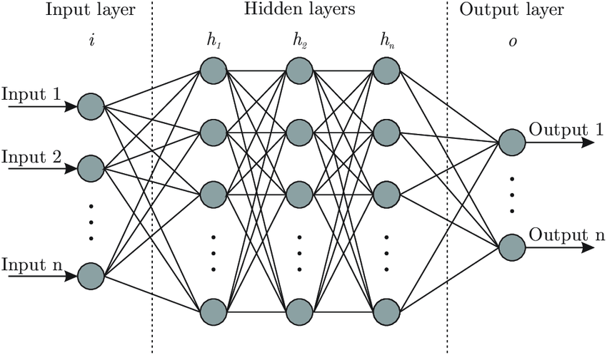
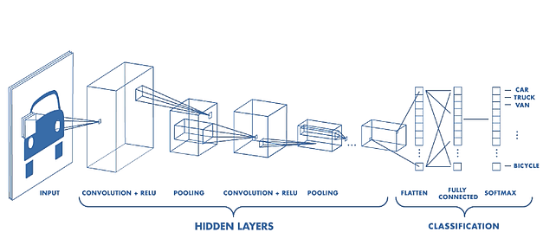

Slide 7

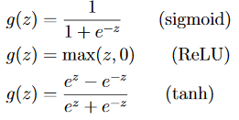
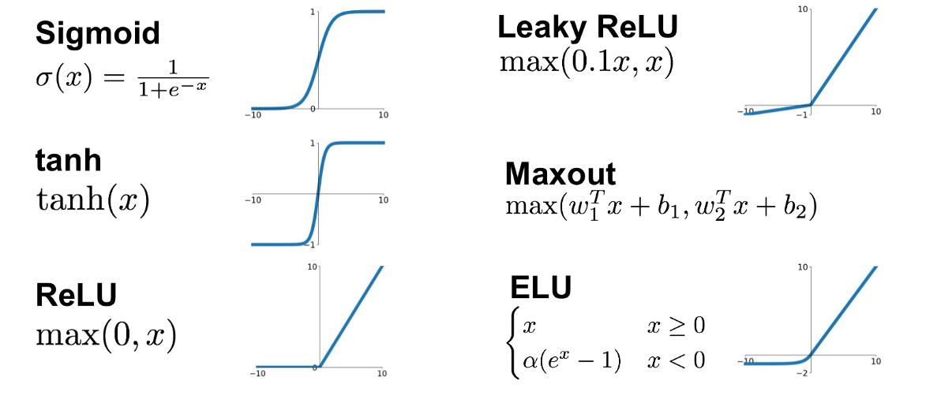
Activation function

Slide 8
Convolution

Slide 9
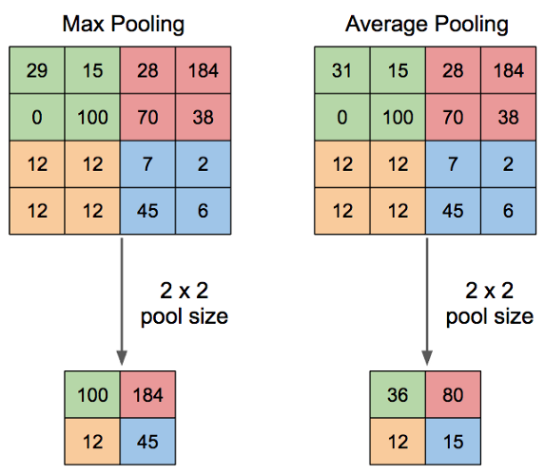
Pooling

Slide 10
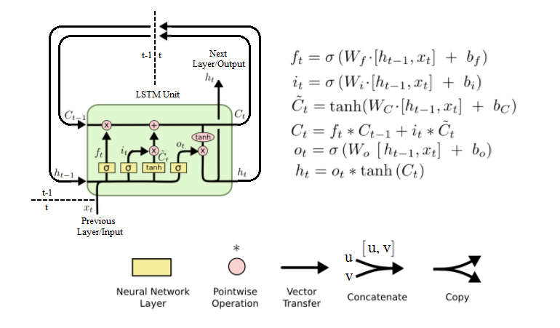
LSTM Cell

Slide 11
Initializing neural networks
https://www.deeplearning.ai/ai-notes/initialization/

Slide 12
Trainnnig Algo: Mini-batch gradient descent
Mini-batch gradient descent is a variation of the gradient descent algorithm that splits the training dataset into small batches that are used to calculate model error and update model coefficients.
Upsides
The model update frequency is higher than batch gradient descent which allows for a more robust convergence, avoiding local minima.
The batched updates provide a computationally more efficient process than stochastic gradient descent.
The batching allows both the efficiency of not having all training data in memory and algorithm implementations.
Downsides
Mini-batch requires the configuration of an additional “mini-batch size” hyperparameter for the learning algorithm.
Error information must be accumulated across mini-batches of training examples like batch gradient descent.

Slide 13
Epoch - Batch Size - Iterations
Epoch: One Epoch is when an ENTIRE dataset is passed forward and backward through the neural network only ONCE.
Batch Size: Total number of training examples present in a single batch.
Iterations: The number of batches needed to complete one epoch.
We can divide the dataset of 2000 examples into batches of 500 then it will take 4 iterations to complete 1 epoch.
Where Batch Size is 500 and Iterations is 4, for 1 complete epoch.
Notes:
https://towardsdatascience.com/gradient-descent-algorithm-and-its-variants-10f652806a3

Slide 14
Regularization
Regularization with penalization of L1 & L2
Dropout (Srivastava 2014)

Slide 15
Dropout
The term “dropout” refers to dropping out units (both hidden and visible) in a neural network.
Simply put, dropout refers to ignoring units (i.e. neurons) during the training phase of certain set of neurons which is chosen at random. By “ignoring”, I mean these units are not considered during a particular forward or backward pass.
Some Observations:
Dropout forces a neural network to learn more robust features that are useful in conjunction with many different random subsets of the other neurons.
Dropout roughly doubles the number of iterations required to converge. However, training time for each epoch is less.
Notes:
Some Observations:
Dropout forces a neural network to learn more robust features that are useful in conjunction with many different random subsets of the other neurons.
Dropout roughly doubles the number of iterations required to converge. However, training time for each epoch is less.
With H hidden units, each of which can be dropped, we have 2^H possible models. In testing phase, the entire network is considered and each activation is reduced by a factor p.

Slide 16
Mnist dataset
http://yann.lecun.com/exdb/mnist/

Slide 17
Install keras
Run code on anaconda prompt: pip install keras
https://www.tensorflow.org/install/gpu

Slide 18
今天課堂概要
Introduction to deep learning
Neural network design
Training approach
Regularization
Example of deep learning

Slide 19
下一課…
Medium
Reference books

Slide 20



Suggested books
Deep Learning with Python
by Francois Chollet
Hands-On Machine Learning with Scikit-Learn and TensorFlow
by Aurelien Geron
Python Machine Learning
by Sebastian Raschka

Slide 21

Python
Python：網路爬蟲與資料視覺化應用實務
高效率資料分析：使用Python
Python 資料運算與分析實戰
https://www.books.com.tw/products/0010778000?sloc=main

