Slide 1
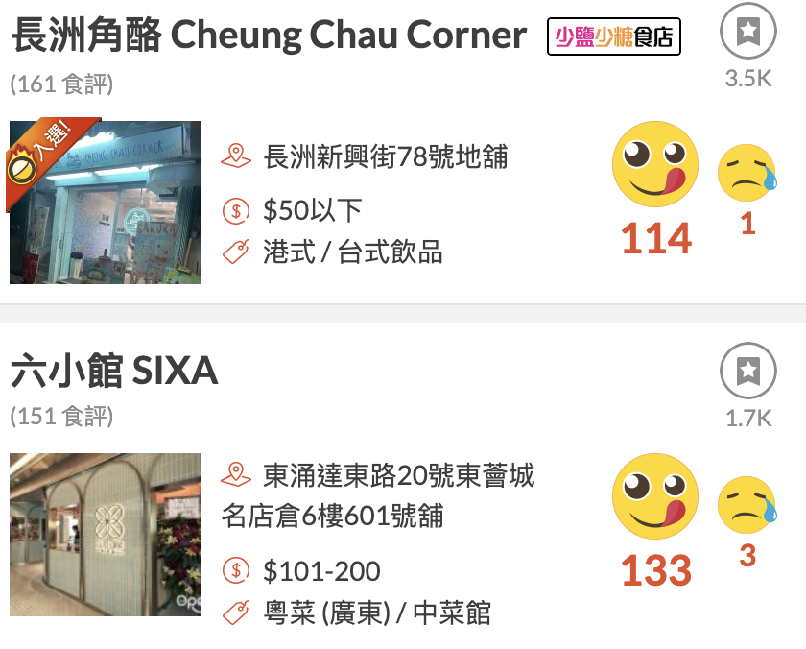
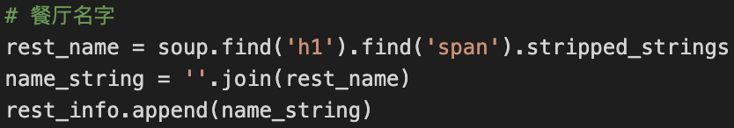
Data Scraping
We use Python to scrap data from Openrice Website.
https://www.openrice.com/zh/hongkong/restaurants/district/%E9%9B%A2%E5%B3%B6
Take above two steps for example. We inspect the website source page and find the
attribute we require such as restaurant name, address, region, price and score and so on.
After scraping, we save it to a csv file.

Slide 2
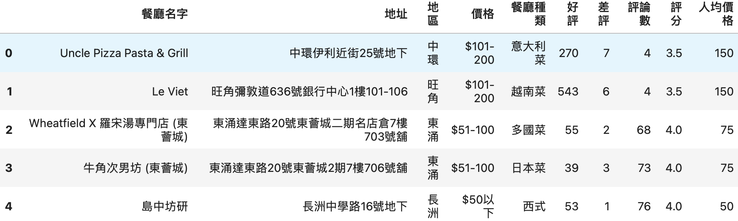
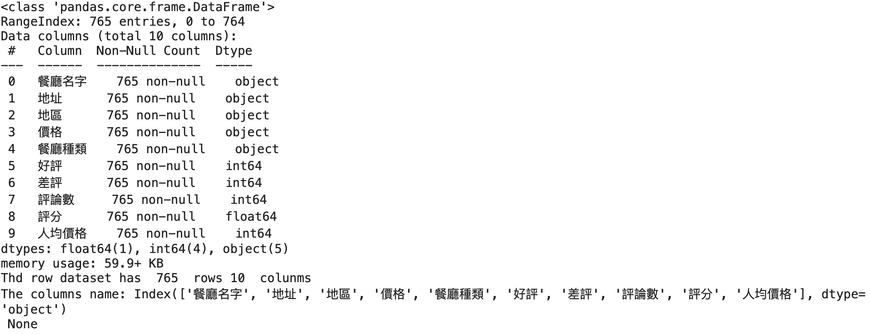
Dataset processing and describing
The row dataset we collected:
From the dataset, there are 765 rows and 10 colums which means there are 765 restaurants we collected from Openrice and their 10 attributes such as name, detailed address, region, price, good or bad reputation counts and so on.

Slide 3
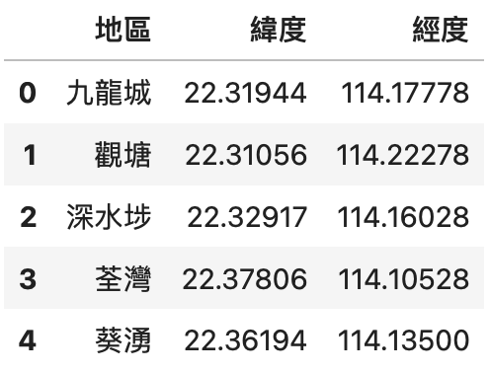
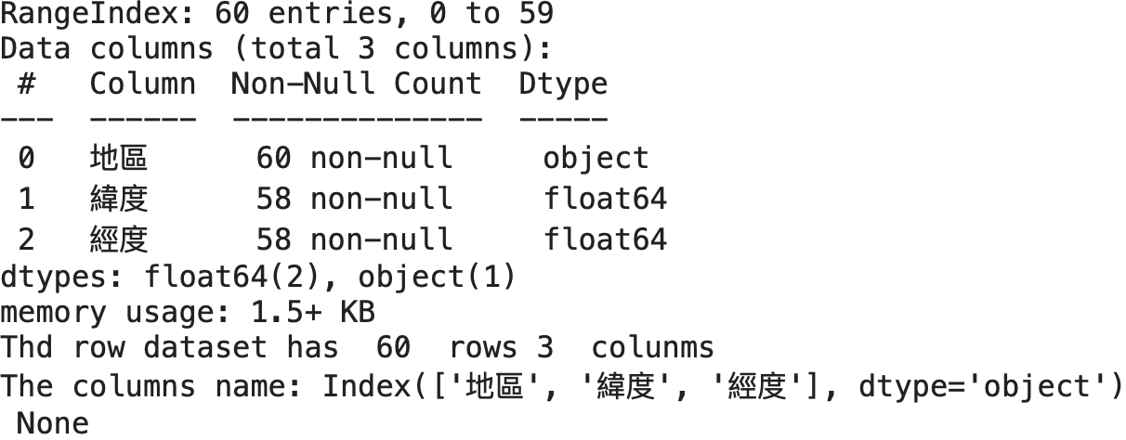
Dataset processing and describing
In order to show the map information of all of there restaurants in Tableau, we collect
their longitude and latitude of different region such as Kowloon City, To Kwa Wan in
Hong Kong. Then merge it into our raw dataset.
There are 60 rows and 3 columns of longitude and latitude dataset.

Slide 4
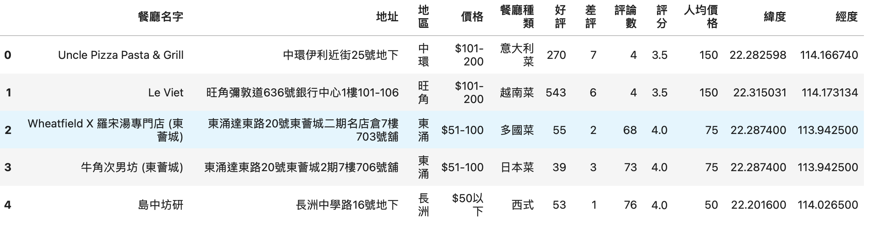
Dataset processing and describing
After merge the longitude and latitude with the row dataset, we get a final dataset like below.
From the final dataset, there almost no difference with the raw dataset except two
additional columns.

