Slide 1



PROJECT 3
CLASSIFICATION OF SUBREDDIT POSTS
Aw Boon Jun

Slide 2
PROBLEM STATEMENT
To classify whether a post is an uplifting news for reddit to boost positivity within the community.

Slide 3


DATA
r/UpliftingNews
r/worldnews
A place to read and share positive and uplifting, feel good news stories.
A place for major news from around the world, excluding US-internal news.

Slide 4
DATA
Baseline Accuracy: 0.62
r/UpliftingNews
r/worldnews
Y=0
410 Posts
410 Titles
0 Selftext
Y=1
672 Posts
672 Titles
0 Selftext

Slide 5





WORKFLOW
Web Scraping With Json API
Data Cleaning
EDA
Model Validation: Logistic Regression & Multinomial Classification
Model Fitting & Prediction

Slide 6
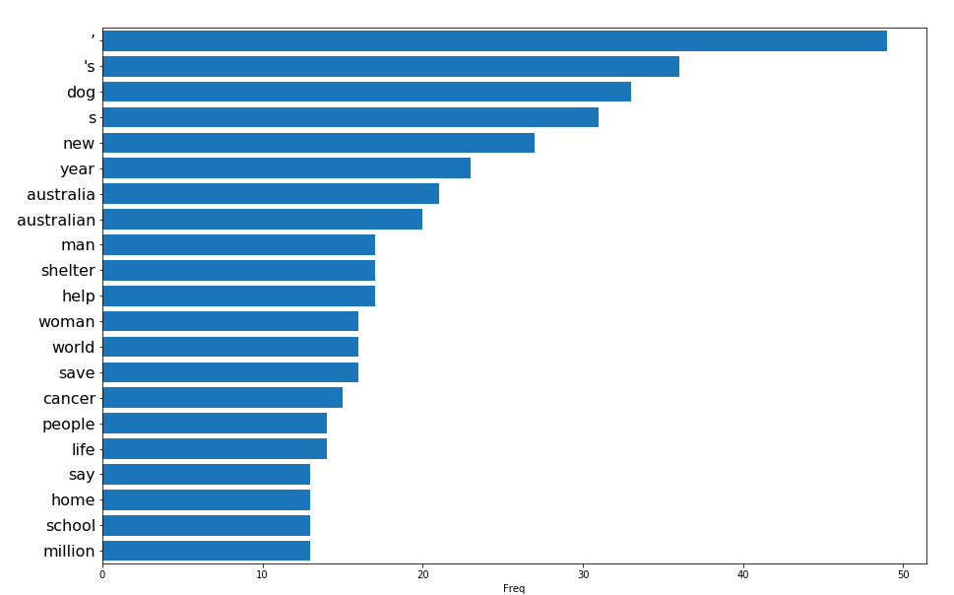
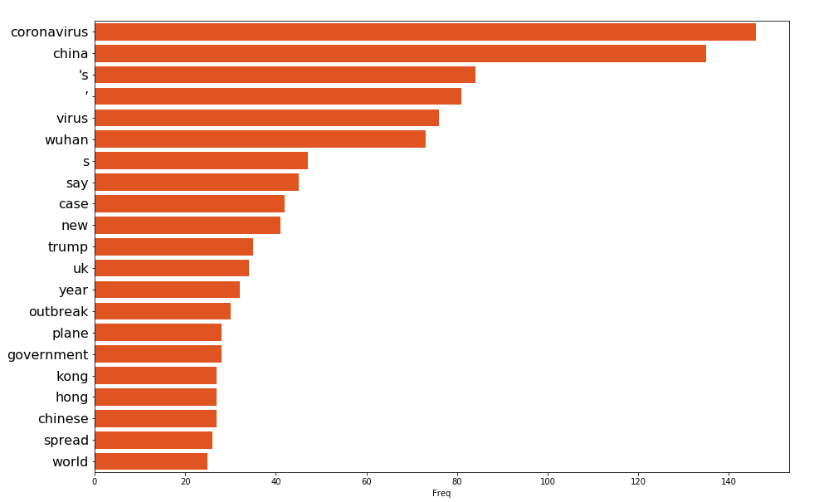
WORKFLOW - EDA
Uplifting News
World News
Words related to current events, which make sense.
A few ‘dirty’ words remain after count vectorizing: ‘s, ‘, & s

Slide 7


WORKFLOW – MODEL VALIDATION
VS
Logistic Regression
Multinomial
Vectorizing Method | Score
Count Vectorizer | 0.89
TFIDF | 0.83
Vectorizing Method | Score
Count Vectorizer | 0.88
TFIDF | 0.87

Slide 8
WORKFLOW – MODEL FITTING
Logistic Regression
Cvec params | Max features = 400 Max_df = 0.5 Min_df = 2 Ngram_range = (1,2)
Penalty | l1
Training Score | 0.89
Testing Score | 0.82

Slide 9
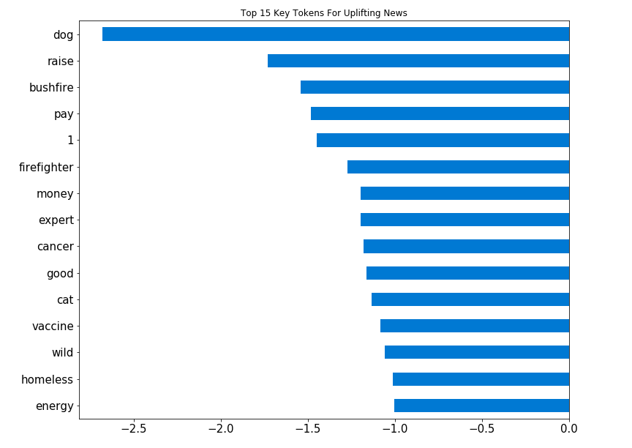
WORKFLOW – MODEL EVALUATION
Logistic Regression
Key Tokens make senses.
Dogs are men’s best friend
Cats are the king of internet
Australian bushfire is getting better

Slide 10
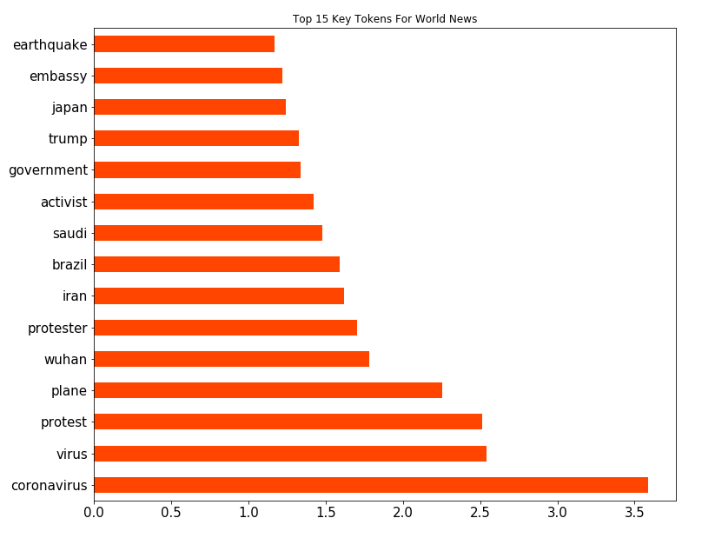
WORKFLOW – MODEL EVALUATION
Logistic Regression
Key Tokens make senses.
Correspond to recent current event

Slide 11
WORKFLOW – MODEL EVALUATION
Model perform as expected in classifying the 2 subreddit posts
Limitation
Classifying news related subreddit is very time specific
Tokens such as Corona Virus are not relevant for news last year
Logistic Regression
Confusion Matrix
True Negatives | 92
False Positives | 11
False Negatives | 40
True Positives | 128
Accuracy Comparison
Baseline | 0.62
Model | 0.81

Slide 12
RECOMMENDATIONS
Only can be trained on the most recent 500-700 posts due to API limitation
Would be more accurate and less time-dependent if more historic data of the posts can be used to train the LR model

Slide 13
THANK YOU

