Slide 1

PROJECT 1 : SAT & ACT ANALYSIS
Alan
Le-Anne
Boon Jun

Slide 2
OBJECTIVE
How can we increase participation rate for states with a low participation rate?

Slide 3
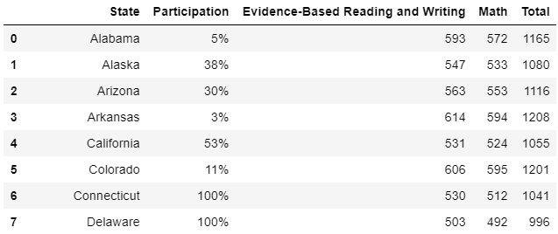
DATA OVERVIEW
Data Set Used
{
Participation Rates by State
Mean Test Scores
Mean Subject Scores
SAT & ACT
2017 & 2018

Slide 4
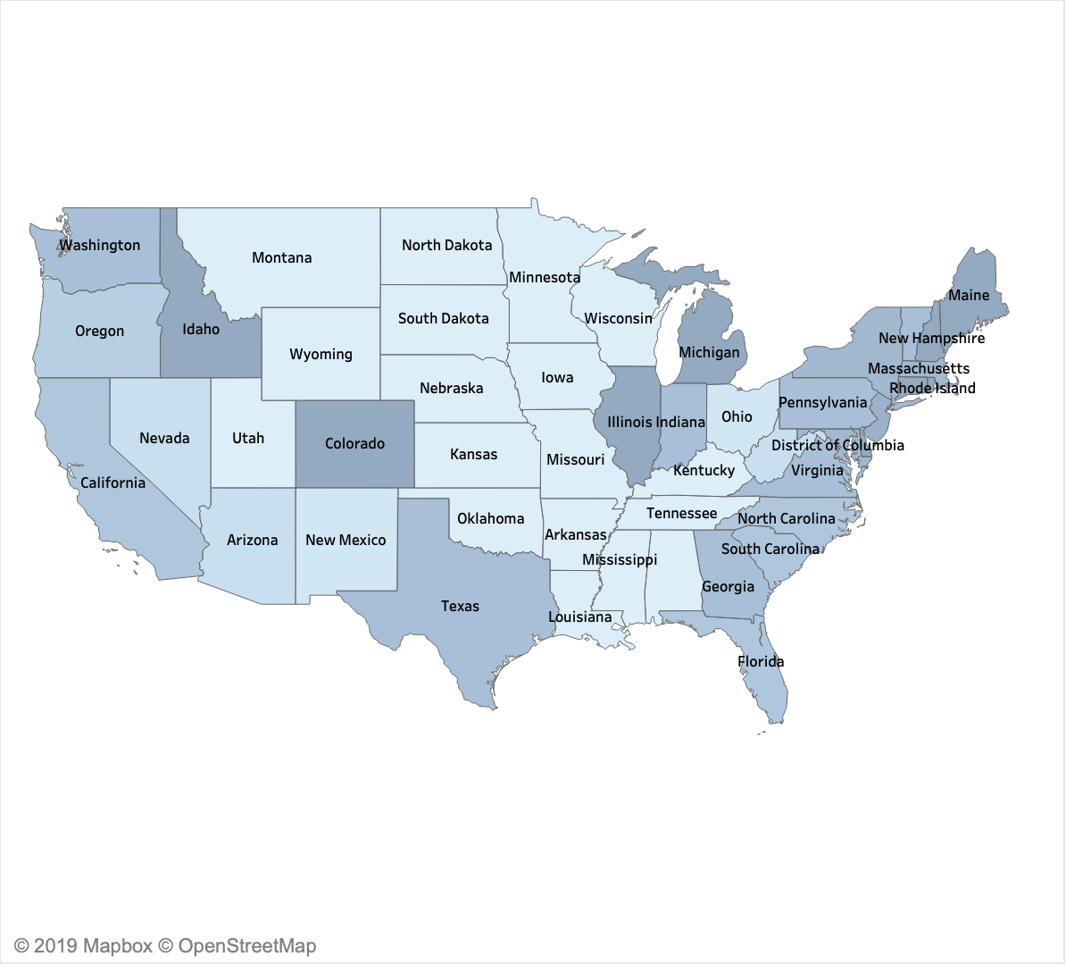
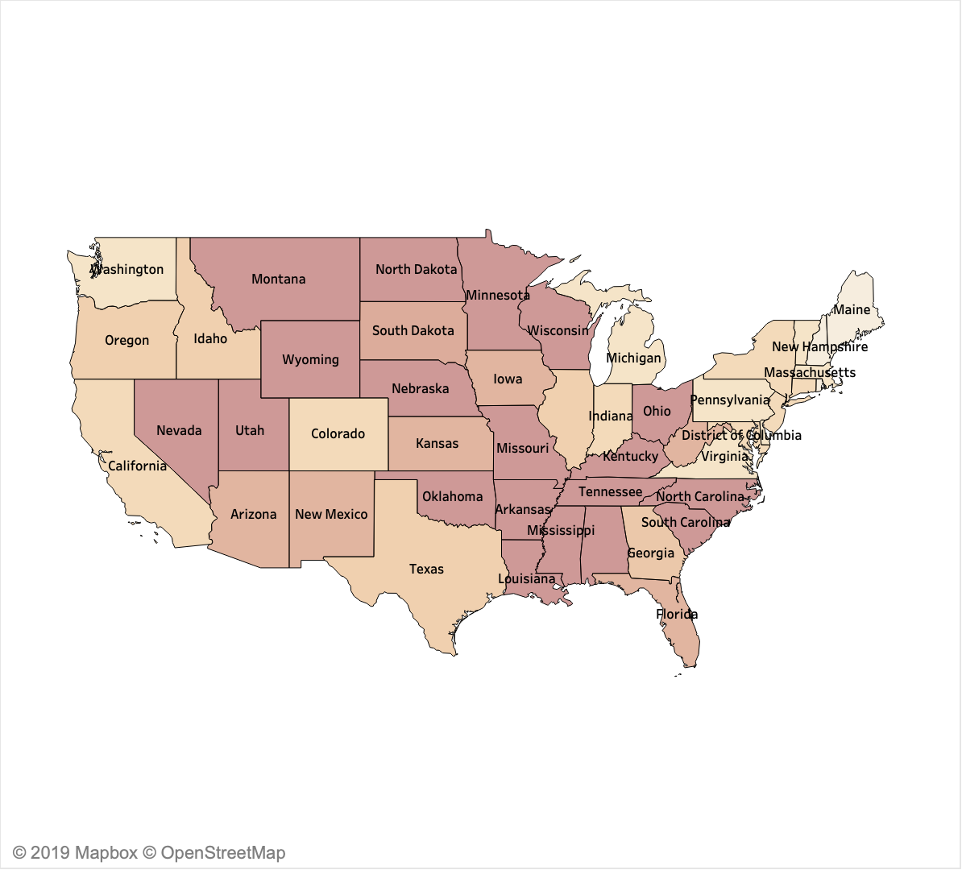
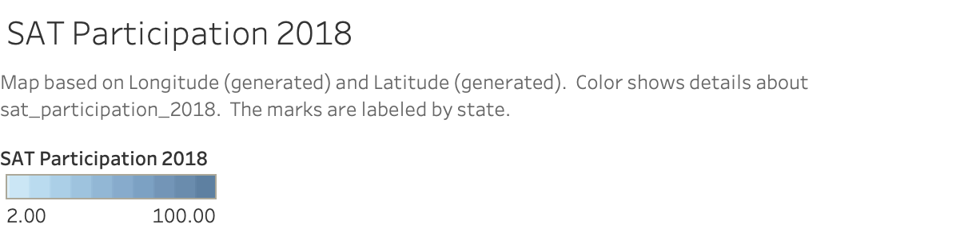
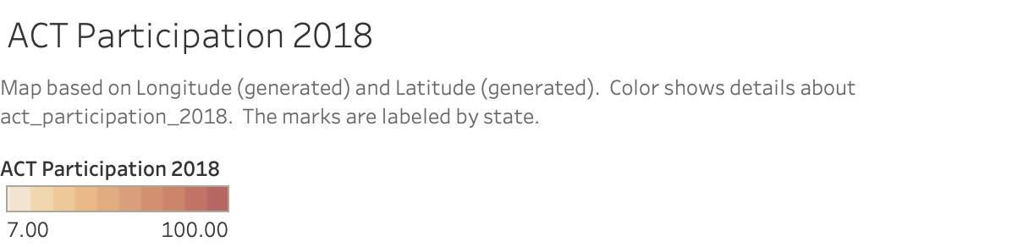
DATA OVERVIEW
SAT Participation Vs ACT Participation in 2018

Slide 5
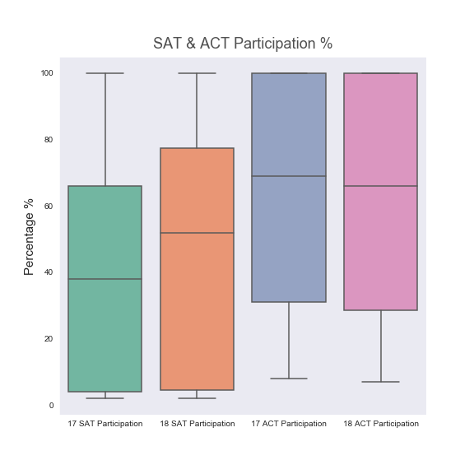
DATA OVERVIEW
Median of Participation Rate
Median of SAT Participation rate is lower than that of ACT

Slide 6
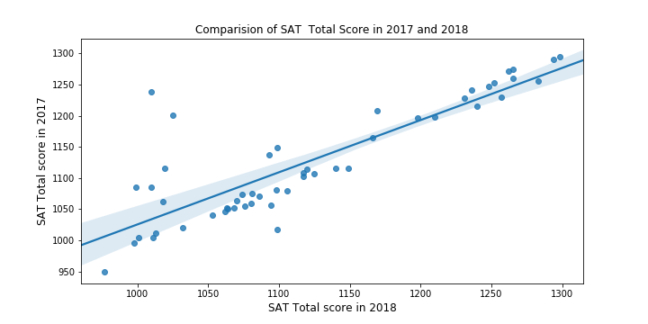
DATA OVERVIEW
Comparing of SAT Total Score
Positive Correlation

Slide 7
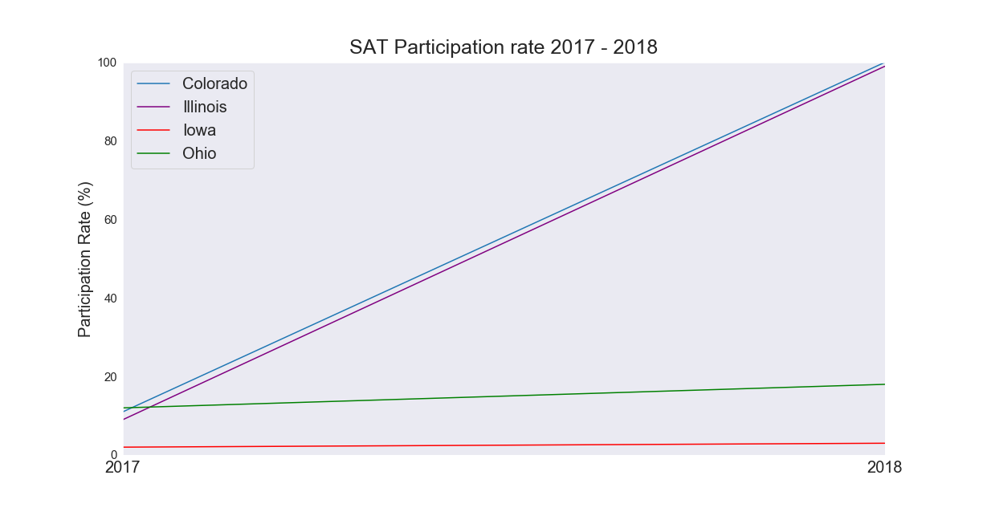
DATA OVERVIEW
Other Observations
Zooming into 4 states with various rate of change in participation rate between years

Slide 8
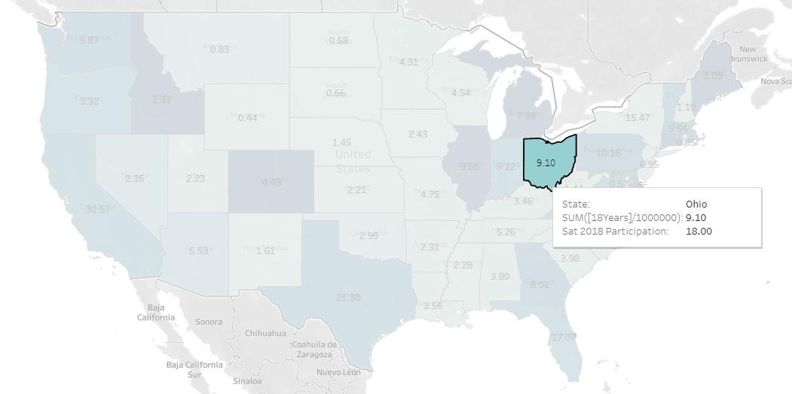
DATA OVERVIEW
Other Observations
Considering participation rate with population size (>18 years) of state

Slide 9


RECOMMENDATIONS
State to target
IOWA
OHIO
No mandatory test yet
Low SAT participation rate in both 2017 & 2018 with potential for growth

Slide 10
RECOMMENDATIONS
Widen the wavier eligibility of students to more lower income group
Reach out to minority group and provide equal opportunity for all students
Create awareness about SAT's inclusive program to State Government and Universities
Showcase success stories unique to each state of interests

Slide 11
CONCLUSION
ACT has been faring better than SAT in terms of participation rate
Iowa and Ohio has potential to increase SAT participation rate
Actively engage state of department for effectively result

Slide 12
THANK YOU

