Slide 1

Project 1 : SAT & ACT Analysis
Presented by:
Aw Boon Jun

Slide 2
PROBLEM
STATEMENT
There are still potential for SAT participation rate to increase across all states.
Given the data set of SAT and ACT in 2017 and 2018, we hope to identify insightful trend to suggest effective measures to implement and increase participation rate; especially in states with low SAT participation rate.

Slide 3
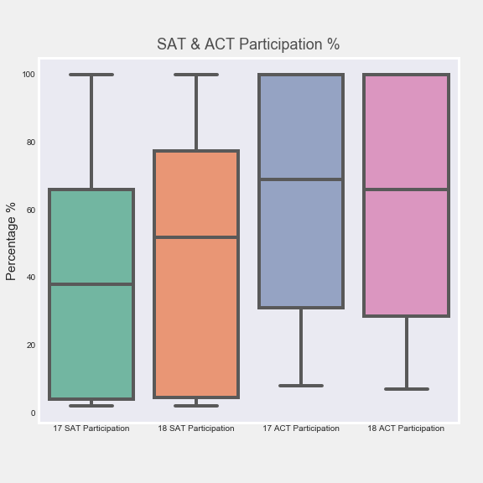
DATA OVERVIEW
Analysis of SAT, ACT data from 2017 and 2018
Average participation rate of SAT is lower than ACT
Wider spread of participation rate in 2018 for SAT
Though Q1 is still relatively low compared to ACT

Slide 4
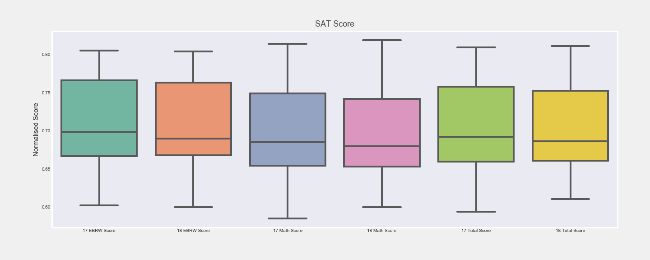
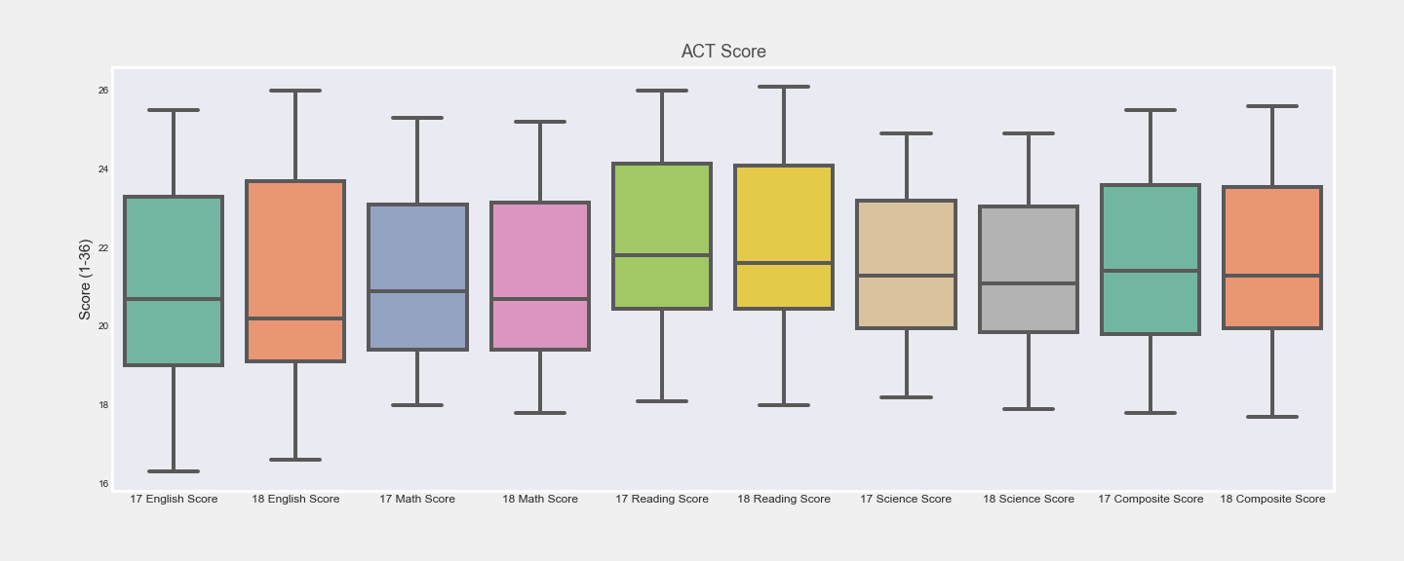
DATA OVERVIEW
Analysis of SAT, ACT data from 2017 and 2018
The English/Reading/Writing subjects for both SAT & ACT has higher Q3 than that of Math & Science

Slide 5
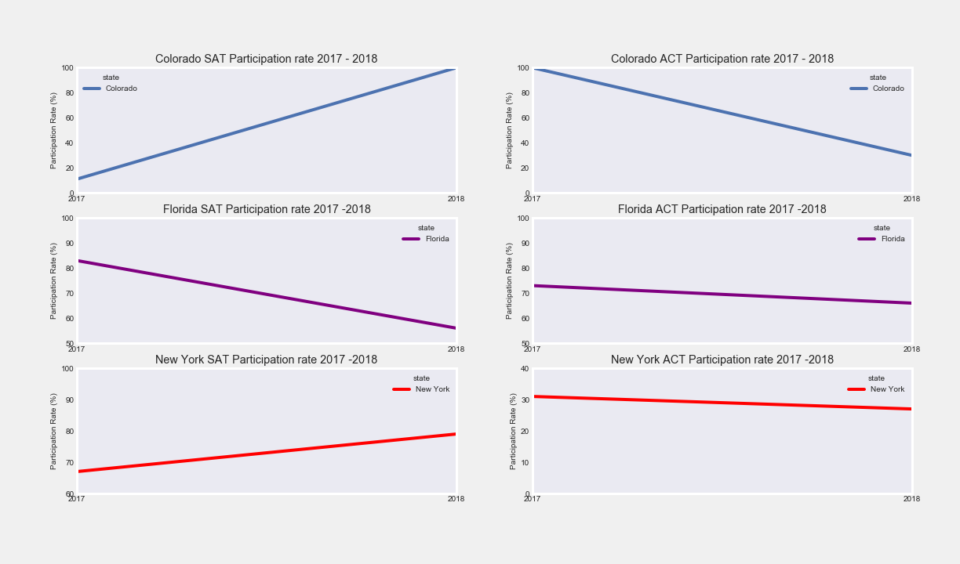
CASE
STUDIES
Review of 3 states’
Participation rate:
Colorado
Florida
New York
SAT’s wavier and school day program effectively helped to increase participation rate of Florida (updated as of 2019) and New York.
For Colorado, SAT was chosen because of it’s higher accuracy to indication a student’s chance to enter University.

Slide 6

CONCLUSION &
RECOMMENDATIONS
State to target:
No mandatory test yet
Low SAT participation rate in both 2017 (2%) & 2018 (3%)
IOWA
Recommendation
Widen the wavier eligibility of students to more lower income group
Provide more support to help student improve Math & Science score
Reach out to minority group such and provide equity opportunity to the groups to take SAT
Create awareness about SAT's inclusive program to State Government and Universities in Iowa

Slide 7
THANK YOU

